Slide 1
The Art of Writing up Your Science:
How to Make Your Results Accessible to an Extension Audience
Annette Wszelaki¹, Javier Fernandez-Salvador² & Alice Formiga³
¹Department of Plant Sciences, University of Tennessee, annettew@utk.edu
²Department of Crop and Soil Science, Oregon State University, javier.f-s@oregonstate.edu
³Department of Horticulture, Oregon State University, Alice.Formiga@oregonstate.edu

Slide 2
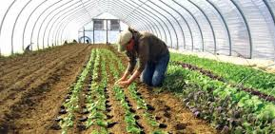
Keep it simple!

Slide 3
The Seven C’s of Writing
Created by Don Ranly, professor at the University of Missouri-Columbia School of Journalism
A guideline for checking the effectiveness of your writing

Slide 4
Be correct
Get it right!- Make sure everything you write is accurate.
Your credibility is at stake.
Check everything, including names, dates, phone numbers, URLs- especially URLs!, email addresses, references, etc.
Adapted from Don Ranly and Purdue Agriculture Communications and Marketing.

Slide 5
Be consistent
Make sure everything looks and reads like they belong together.
Pay particular attention to the way you use:
Numbers and figures (ten or 10?).
Titles (Dr., Professor, Ph.D.).
Names, both authors and organization names.
Abbreviations.
Units.
Headlines and other headings.
Fonts.
Taglines.
Logos and graphics.
Adapted from Don Ranly and Purdue Agriculture Communications and Marketing.

Slide 6
Be clear
Make everything easy to understand and find.
Define your technical terms or jargon!
Don't assume readers know what you know. This is when knowing who your readers are is essential.
Use simple language.
Answer your readers' "So what?" question. Just because the importance of your information is clear to you, does not mean it is clear to your readers.
Adapted from Don Ranly and Purdue Agriculture Communications and Marketing.

Slide 9
Be concise
Avoid excessive background.
Use active voice instead of passive voice.
Use short sentences.
Place the most important information near the top of the page or story.
Don't "save the best for last.”
Avoid slow-loading graphics in electronic media.
Adapted from Don Ranly and Purdue Agriculture Communications and Marketing.

Slide 10
Be coherent
If there's anything you think your readers might not understand that is not pertinent to your message, it's time to edit.
Use easy-to-understand language, not flowery words.
Use simple comparisons to help readers visualize the unfamiliar.
Adapted from Don Ranly and Purdue Agriculture Communications and Marketing.

Slide 11
Be complete
Include all necessary information.
Provide specific examples to illustrate your points.
Pay attention to the Five W's & H
Who? - Tell readers who did it and who it affects.
What? - Make the event, information, or news clear.
When? - Include times and dates.
Where? - Provide locations, especially of future events.
Why? - Inform readers of the purpose behind the event or information.
How? - Give readers a sense of process behind the story.
Adapted from Don Ranly and Purdue Agriculture Communications and Marketing.

Slide 12
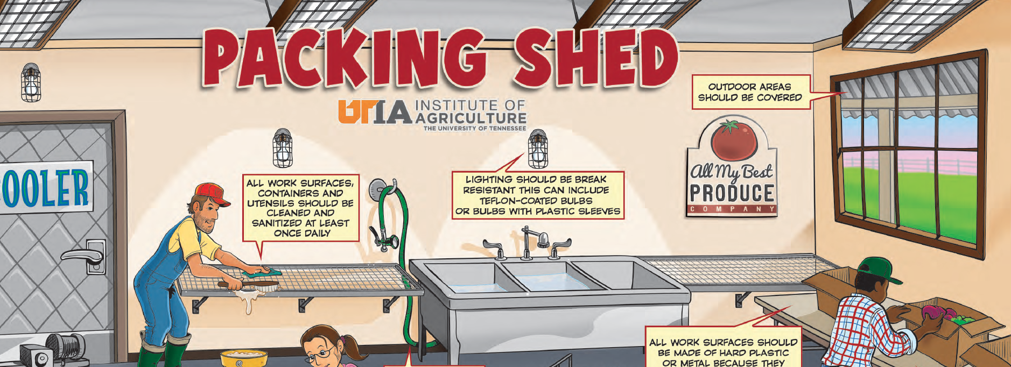
Be creative
Make your writing interesting, but focus on content first.
Look for new information to present.
Look for new ways to present information.
Adapted from Don Ranly and Purdue Agriculture Communications and Marketing.

Slide 13
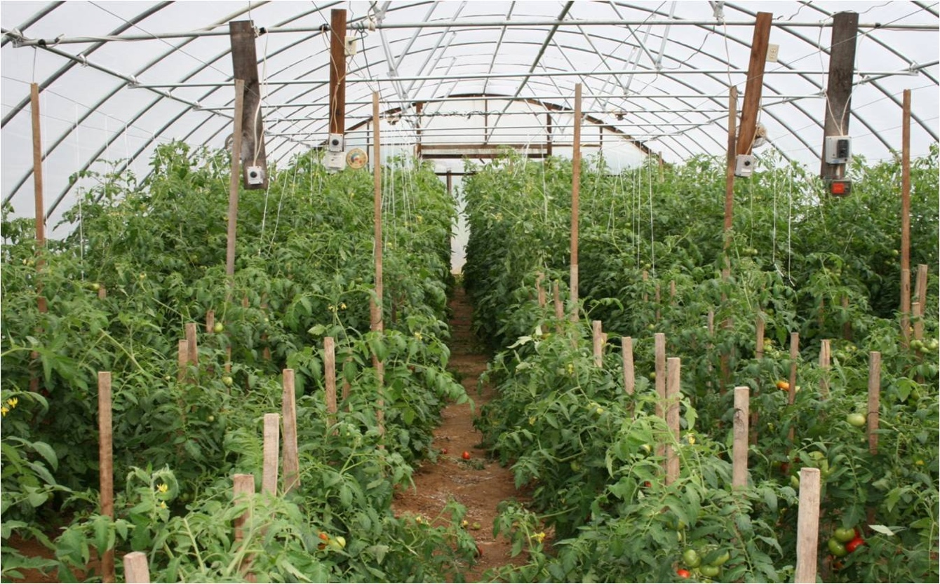
A picture (or table or figure) is worth a thousand words…
50-80 lbs sodium per acre
700 lbs sodium per acre
Grower in Henderson or McLean County, photo courtesy of Dr. Tim Coolong, UGA.

Slide 14
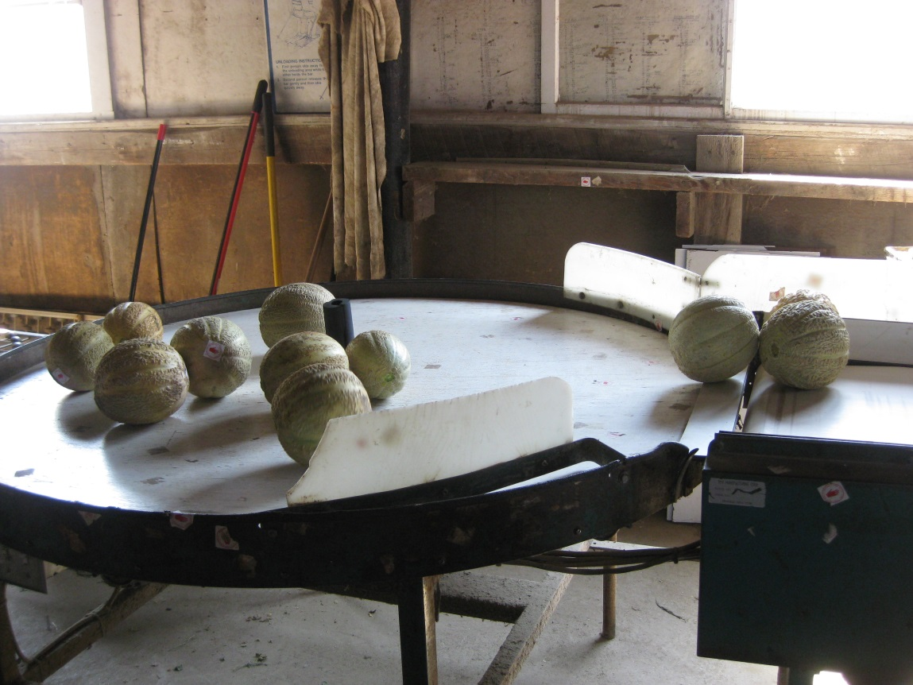
Help prioritize cleaning and sanitation efforts by designating areas or ‘zones’ within the packing area.
Zone 1
(direct food contact surface)
Zone 4
(outside)
Zone 3
(floor)
Zone 2
(outside surface of washer)
From PSA Grower Training Curriculum.

Slide 15
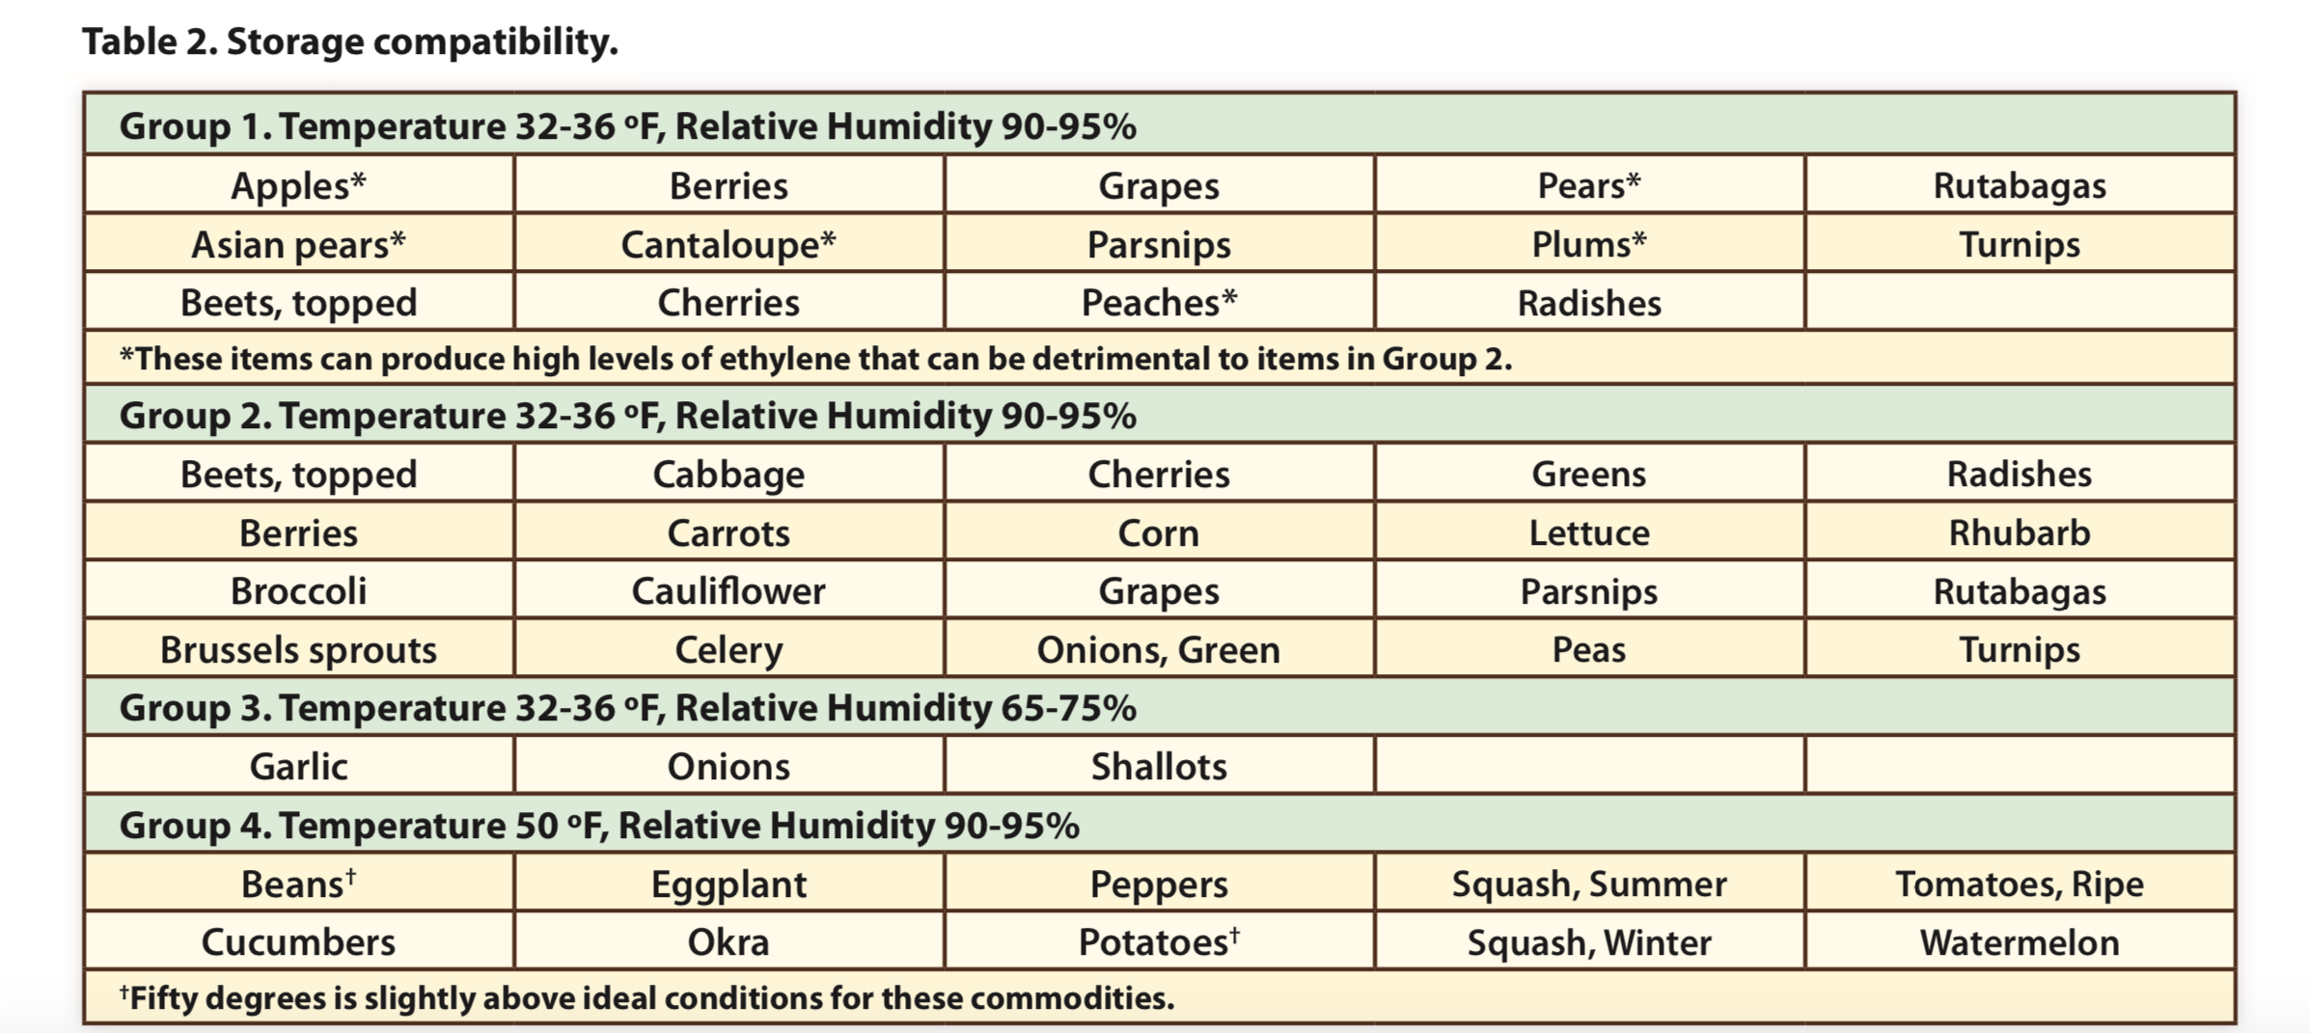
Harrison, Critzer and Wszelaki, 2015.

Slide 16
Reasons to proofread twice:
to check what you have written and
to check how you have written it.
From Purdue Agriculture Communication and Marketing
”Write unto others as you would have them write unto you.”
-Don Ranly

Slide 17
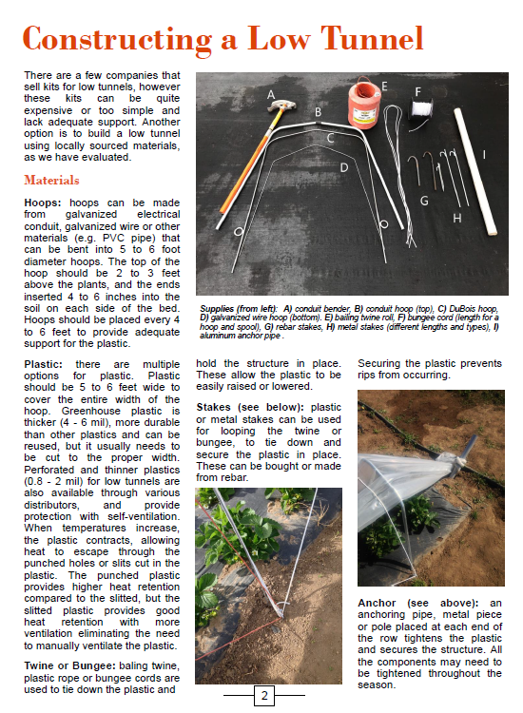
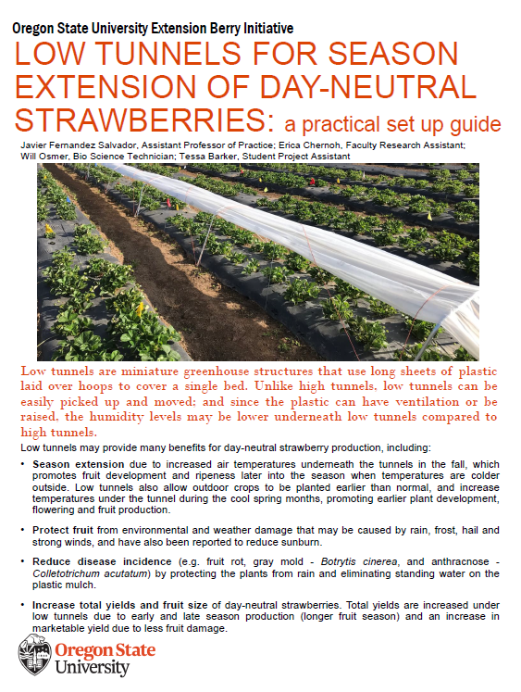
How?
Who?
What?
Where?
When?
Why?

Slide 18
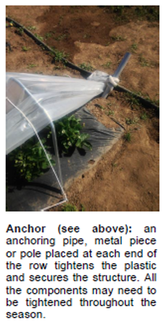
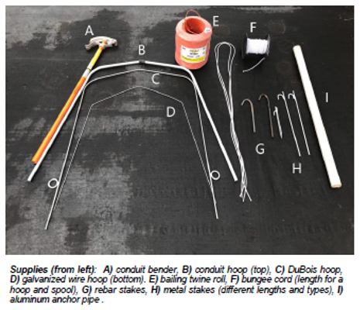

Slide 19
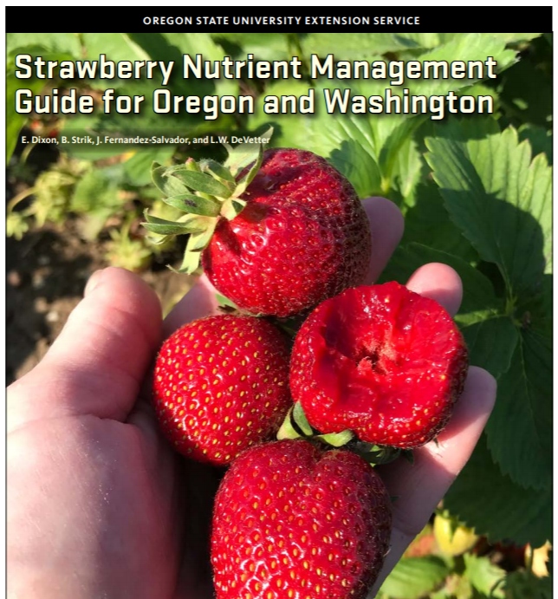
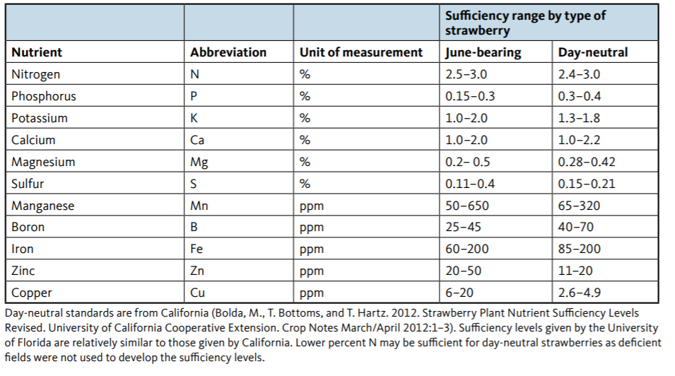
Critical levels for leaf tissue
during the growing season
Proof read and
reviewers
Clear for all audiences.
Define terms – don’t assume
Credit and
other info

Slide 20
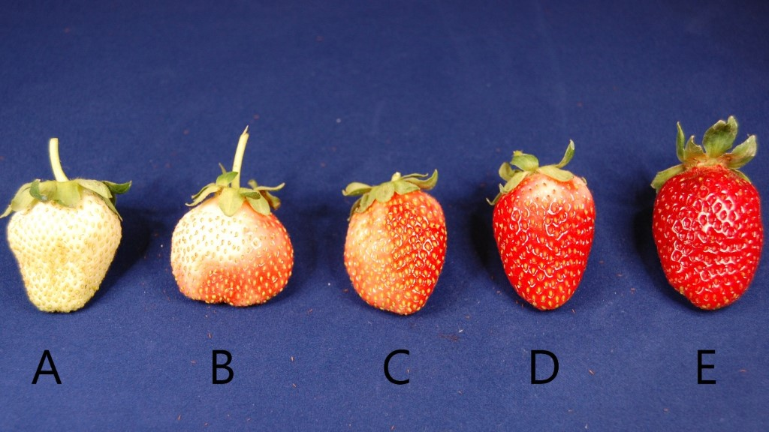
Strawberry Fruit Quality
Be inclusive
of all audiences
Stages of Ripeness Based on Color
0%
25%
50%
75%
100%

Slide 21
Presenting Survey Data
This is particularly important for extension publications as it may give a reason to conduct your research.
From in-person interviews, online, focus groups, etc.
As with other types of studies, base your questions (and results to present) on your project objectives!
DO NOT describe the results that you are already presenting on a figure or table (redundant).
Use an adequate figure for the specific type of data presented.

Slide 23
Olive Cultivars Grown in Oregon
Arbequina
Frantoio
Leccino
Pendolino

Slide 24
Incorrect:
25% of growers lost 75-100% of trees (see Figure 1).
Correct:
Most growers lost trees to cold injury, including a quarter of them having to possibly replace most of their orchard after devastating freeze events (Fig. 1).

Slide 25
Thank you! Questions? Email us: annettew@utk.edu javier.f-s@oregonstate.edu Alice.Formiga@oregonstate.edu

