Slide 1
How to write an eOrganic article class session 4:
Reviewing your article
Alice Formiga Alex Stone, and Javier Fernandez-Salvador, Oregon State University
Annette Wszelaki, University of Tennessee Knoxville
Notes:
eOrganic, information for organic and sustainable agriculture. eOrganic is funded by USDA NIFA and eXtension, with core services managed out of Oregon State University, University of Vermont and University of Illinois.

Slide 2
2 eOrganic Article Competitions
The conferences will take place at the following dates and times:
ASHS, Orlando FL Aug 9-13 2020
Tri-Societies ASA/CSSA/SSSA, Phoenix AZ, Nov 8-11 2020
The call for papers is going out the week of November 18, 2019.
The tentative Deadline is: February 15, 2020.
Entries will be judged by eOrganic staff and members of the organic interest groups of the respective societies.
5 winners for each conference will have their articles published on eOrganic, travel to the conference and present their articles at an oral session.
Winners will be reimbursed for US domestic travel, registration, abstract fees and meals up to $1500 after the conference.
Funding will be provided by a NIFA OREI grant
Even if you are not a winner, your article can be published if it meets our requirements!

Slide 3
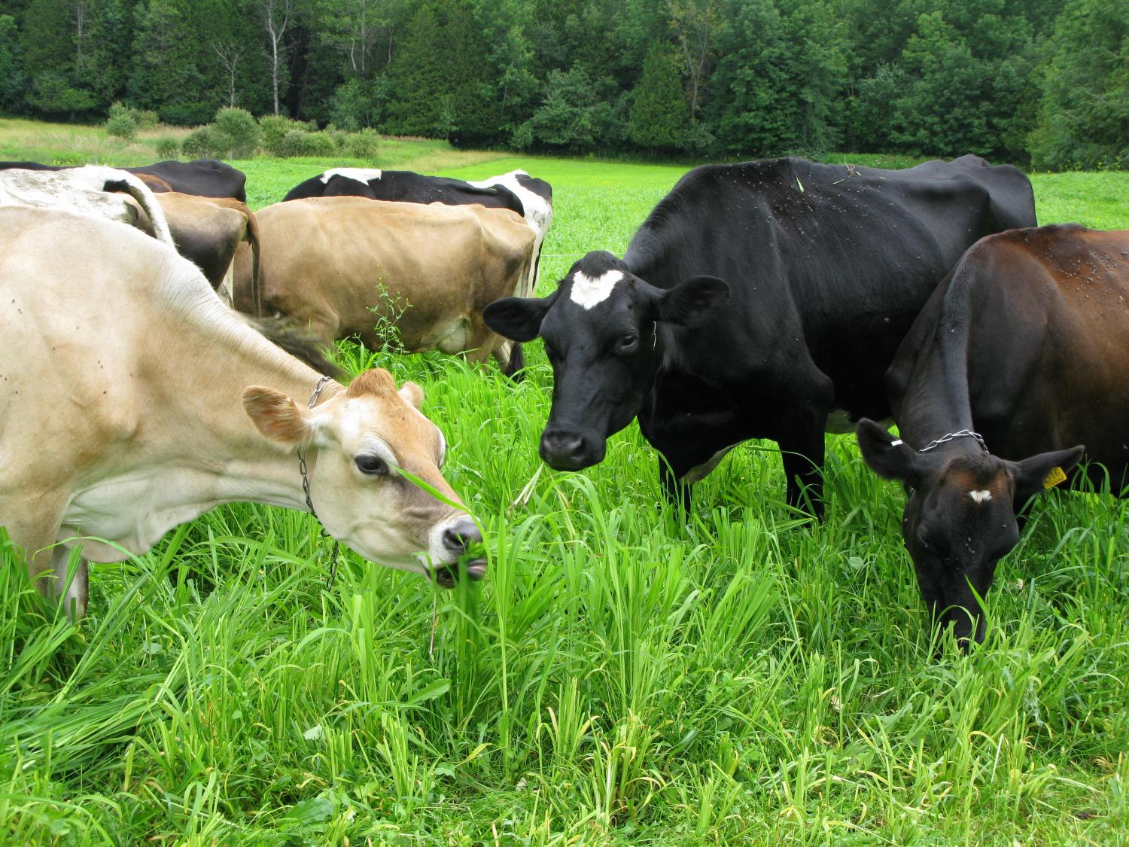
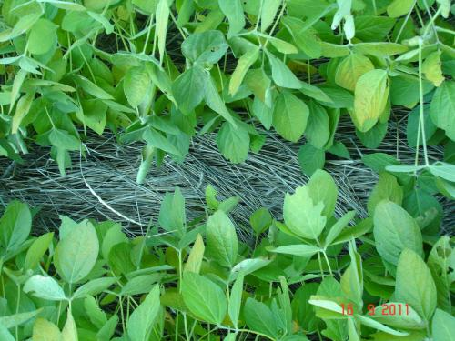
Articles will be judged by the following criteria
Must be written according to the eOrganic Instructions for Authors. Please read them carefully before preparing your article, check eOrganic for other articles on the subject, and look at examples.
Must be written at a technical level appropriate for a general audience of producers, extension agents, agricultural professionals, organic inspectors and certifiers.
Must be accurate and current, and different from other published articles on eOrganic
Any products recommended in the article must be in compliance with NOP regulations.
Must be appropriate for the scope of the respective conference.

Slide 4
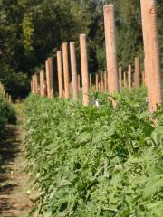
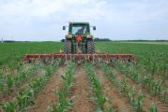
Instructions for Authors
https://eorganic.info/node/5199
eOrganic content is derived from:
Research conducted in organic systems
Information from farmers/ag professionals/other practitioners that demonstrate best practices on organic farms.
Research conducted in conventional ag systems relevant to organic systems
Regulation based information.

Slide 5
Articles must be well written with correct spelling and grammar!

Slide 6
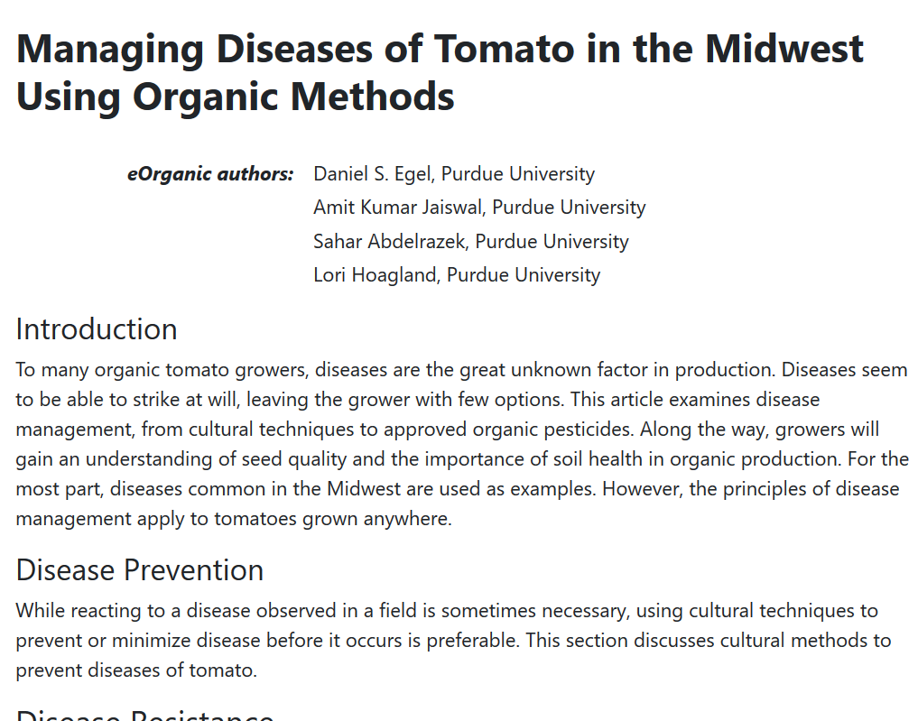
Titles
Introduction and Conclusion
Headings
Paragraphs

Slide 7
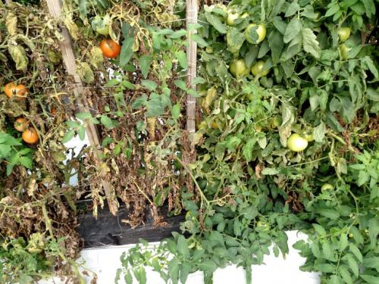
Lists
Tables
Table of Contents with Links
Figures
Captions
Links
References and Citations
Additional Resources
Citation Format
Figure 1. The tomato variety on the left is susceptible to leaf mold, while the variety on the right is resistant. Host resistance offers an opportunity to avoid some tomato diseases. Photo credit: Dan Egel, Purdue University.

Slide 8
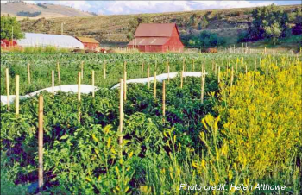
Articles are peer refereed and checked for certification compliance and copy edited before the conference.
They will be published at http://eOrganic.org after the conference.

Slide 9
Review form
Clarity: Will the intended audience be able to clearly understand the text?
Length: Is the length of the text about right for the intended message?
Accurate and current: Is the subject matter accurate and current?
Tables and figures: If tables and figures are used, are they easy to read and understand?
Recommendation: (Please select one)
__Recommend NOT to publish
__Recommend to publish with minor revisions
__Recommend to publish with major revisions
__Recommend to publish
Recommendation Reasons:

Slide 10
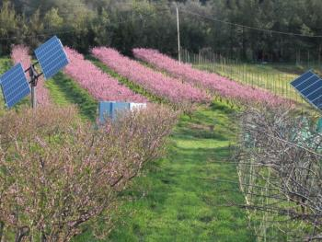
Submit your article draft for feedback this week if you have not already done so!

Slide 11
Find eOrganic articles and other public resources at http://eorganic.org
eOrganic Instructions for Authors http://eorganic.info/node/5199
Join eOrganic at: http://eorganic.info
Contact Information
alice.formiga@oregonstate.edu
Alex.Stone@oregonstate.edu
awszelak@utk.edu
fernandj@oregonstate.edu

Slide 12
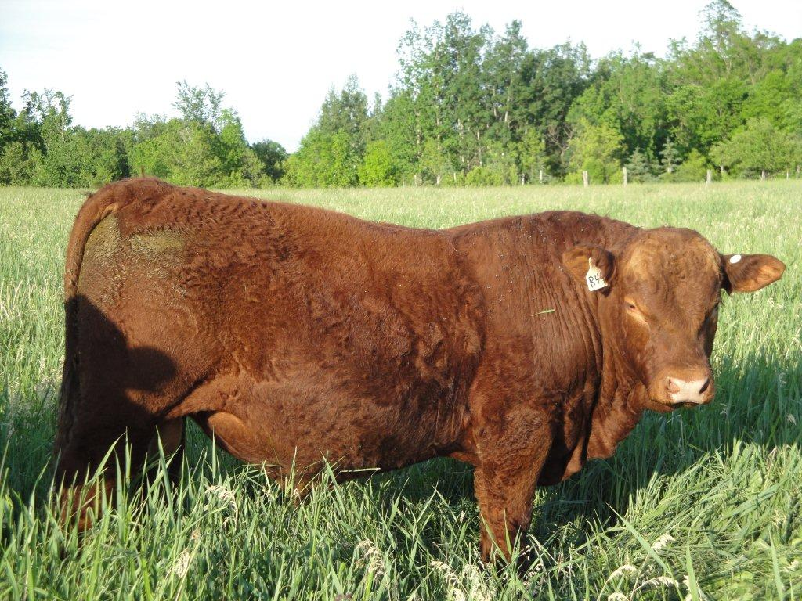
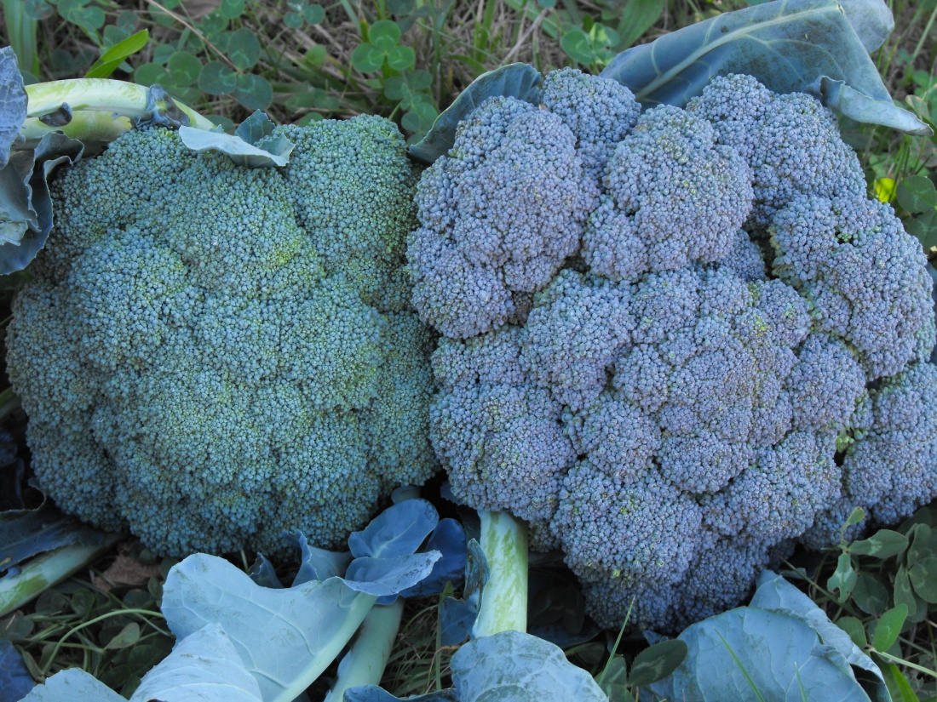
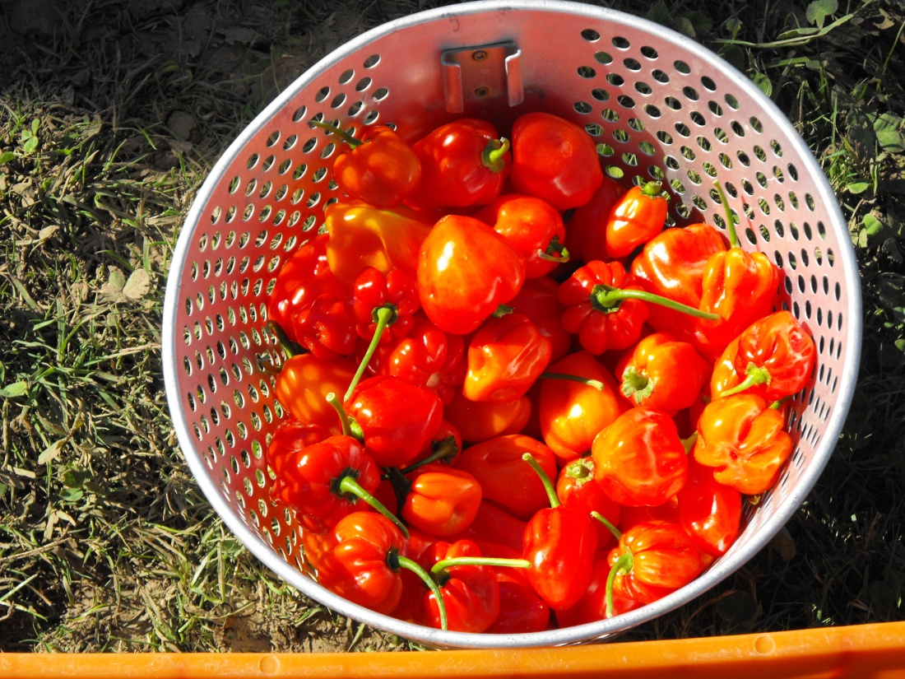
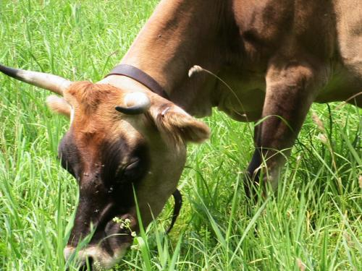
Questions?

