Slide 1
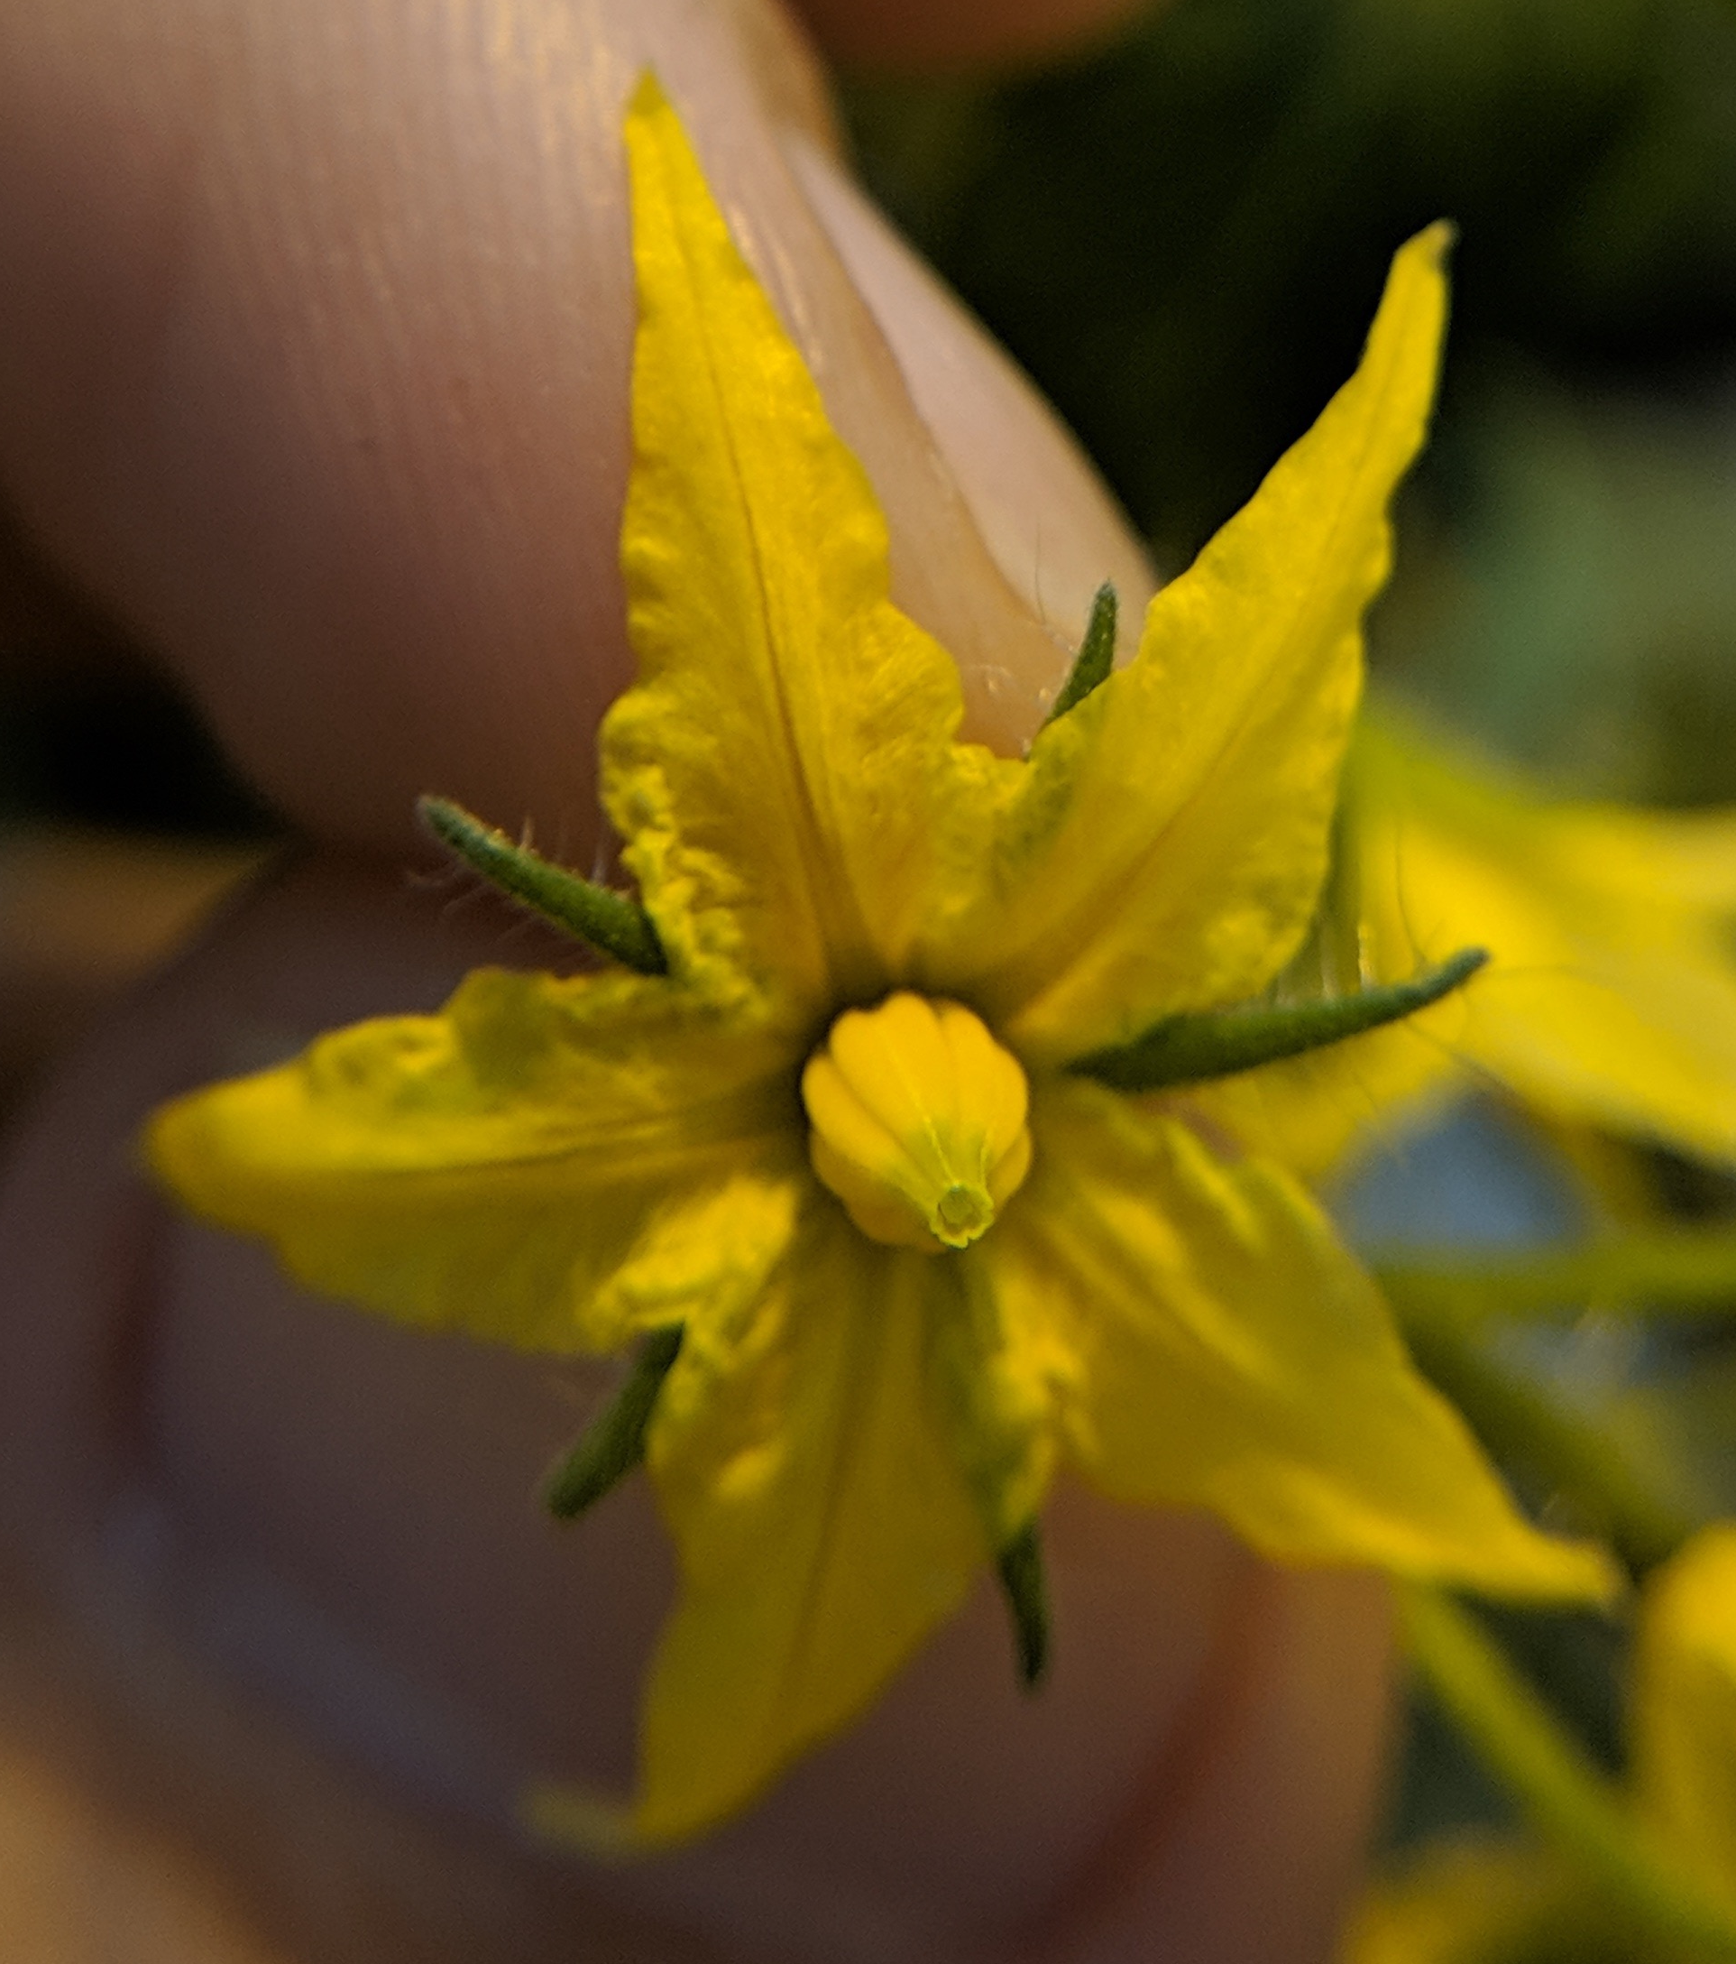
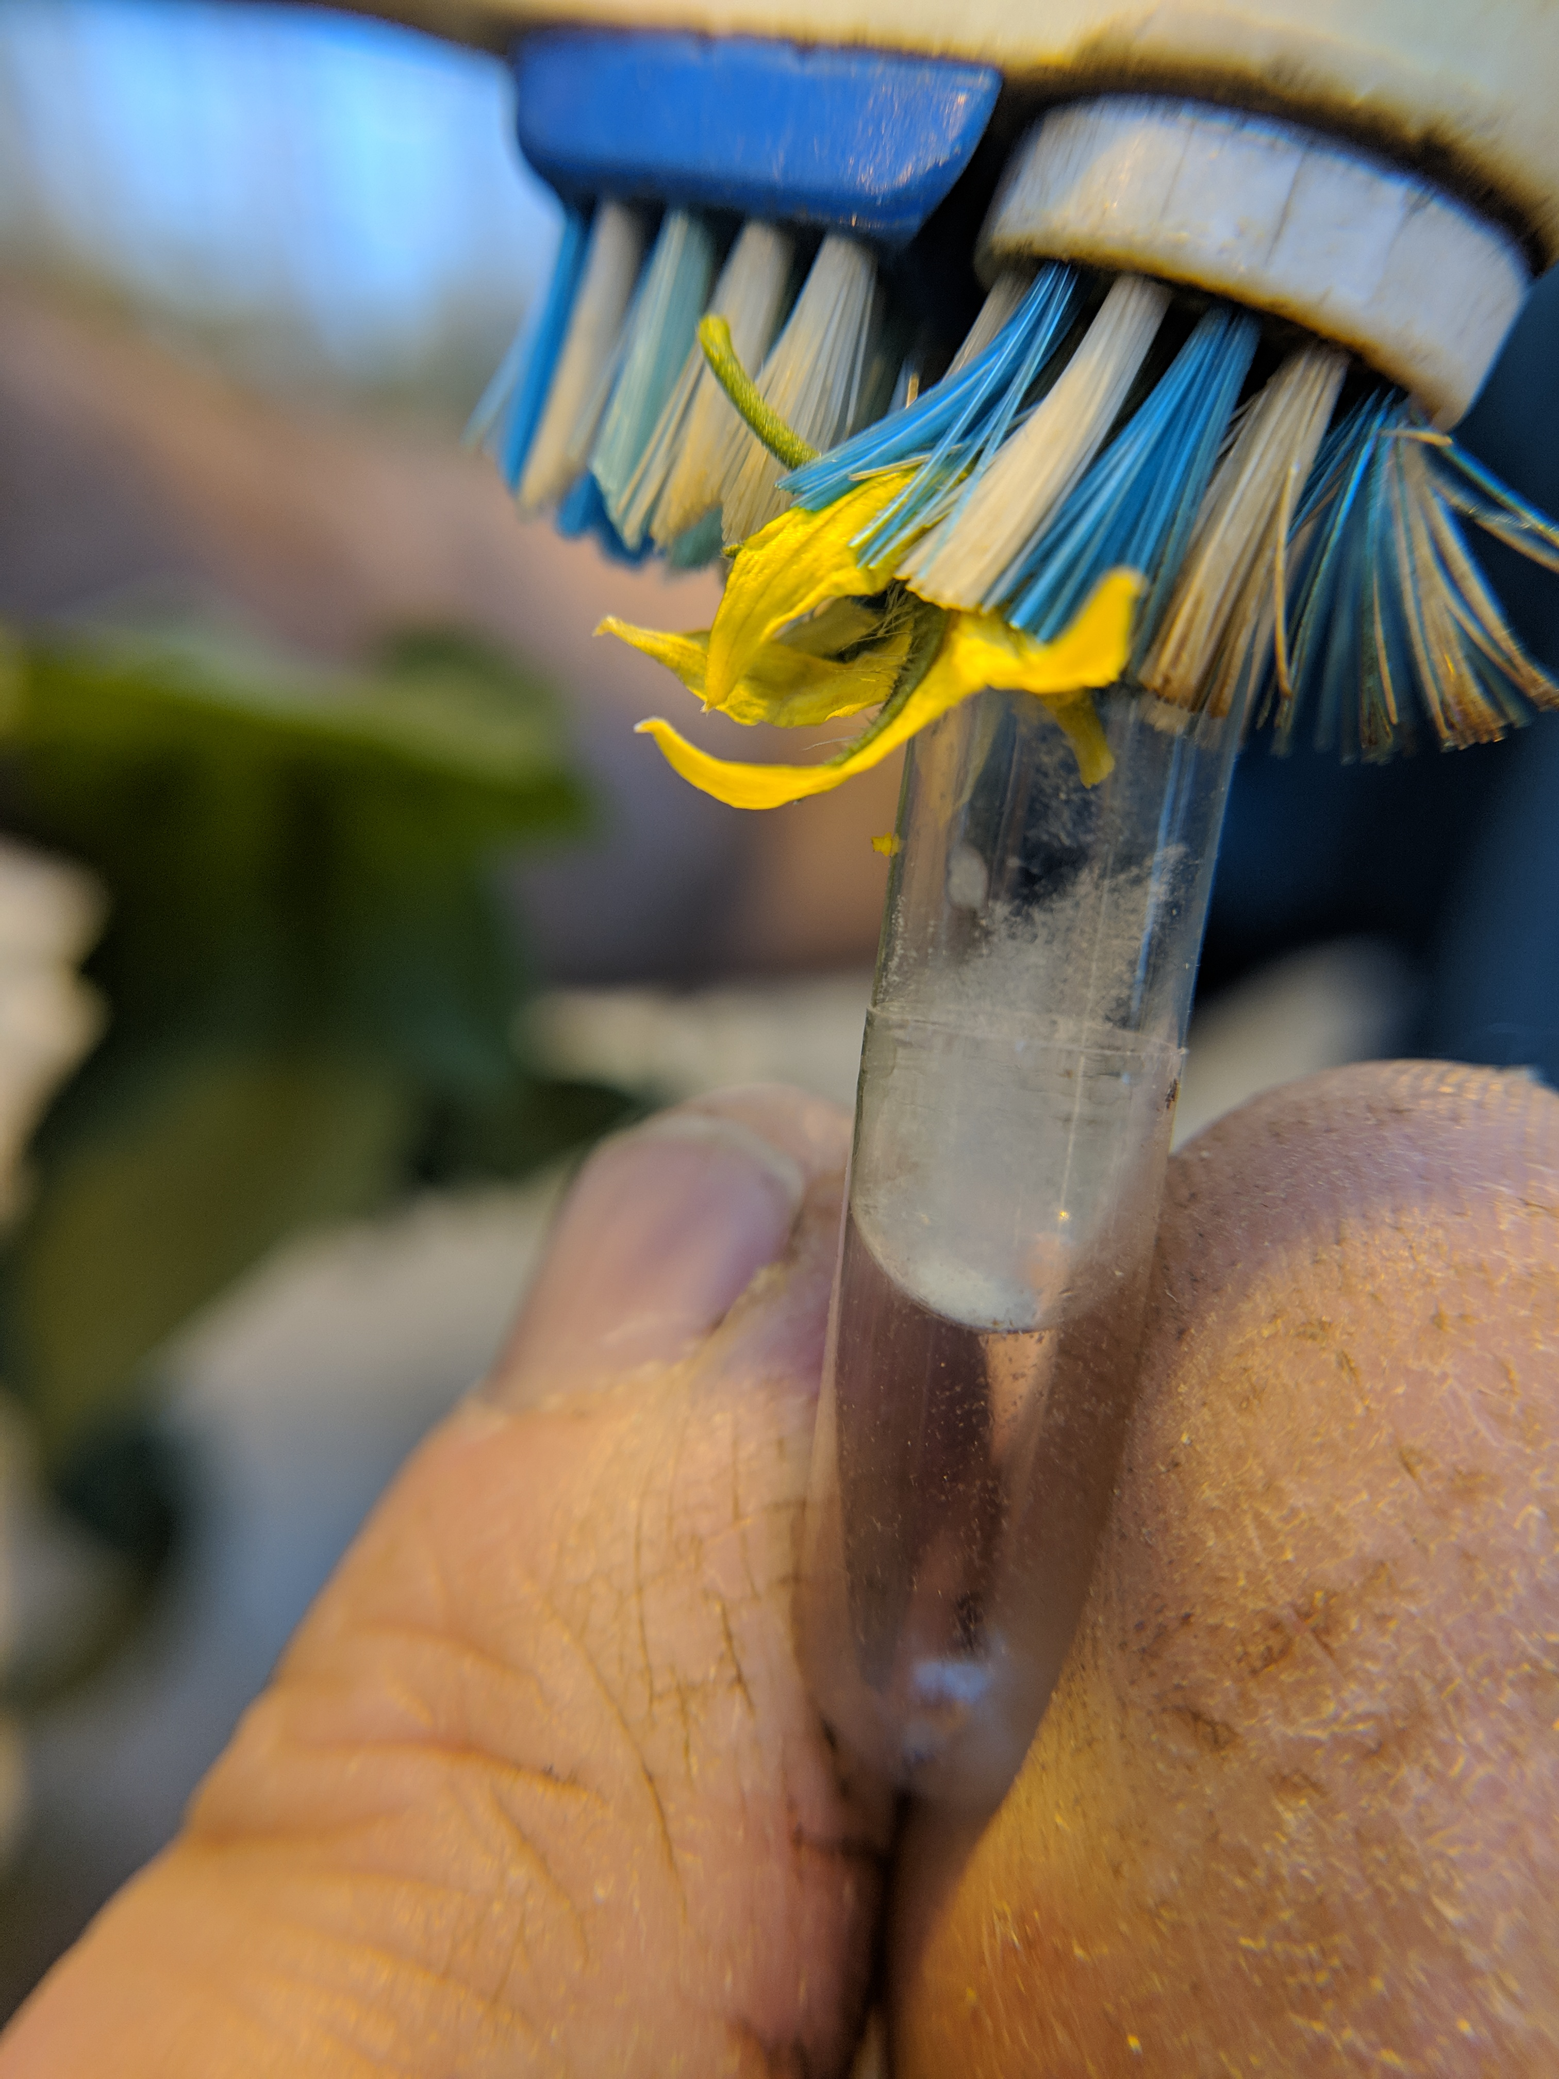
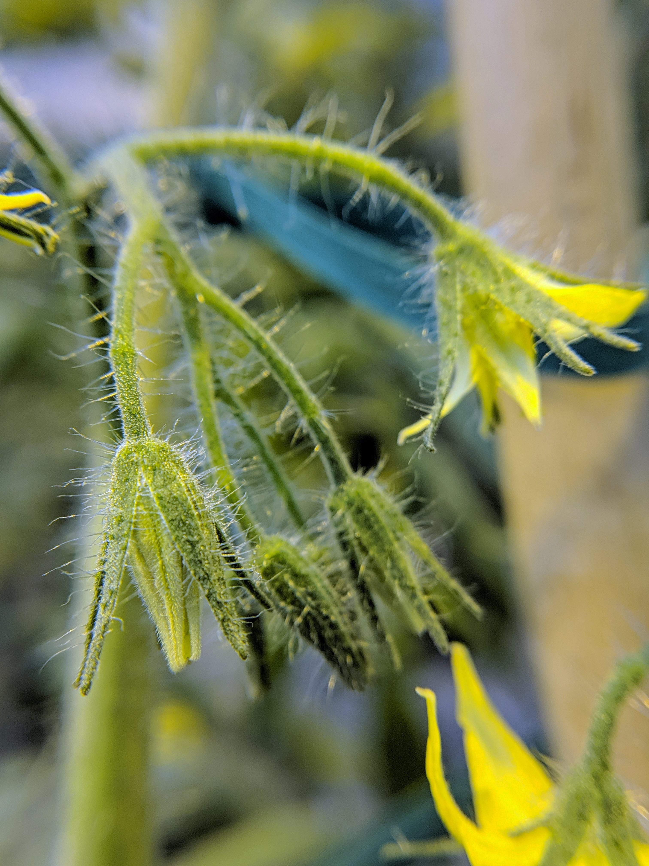
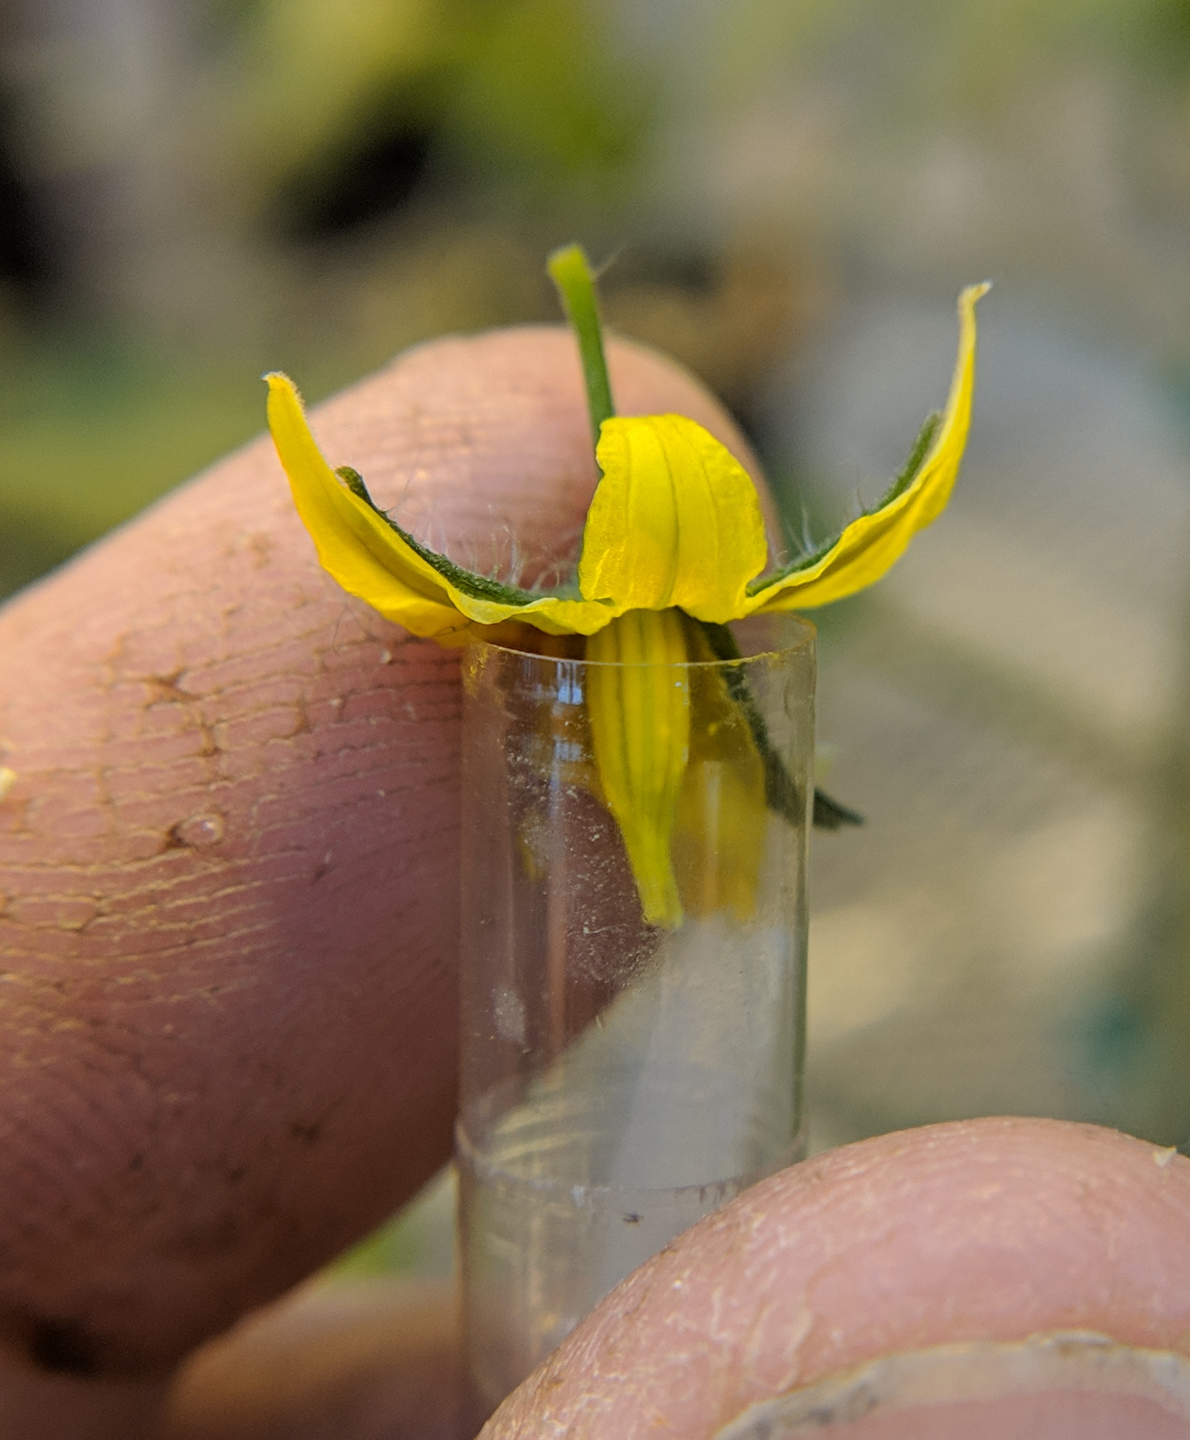
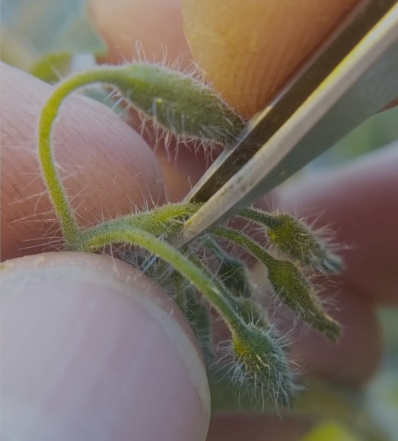
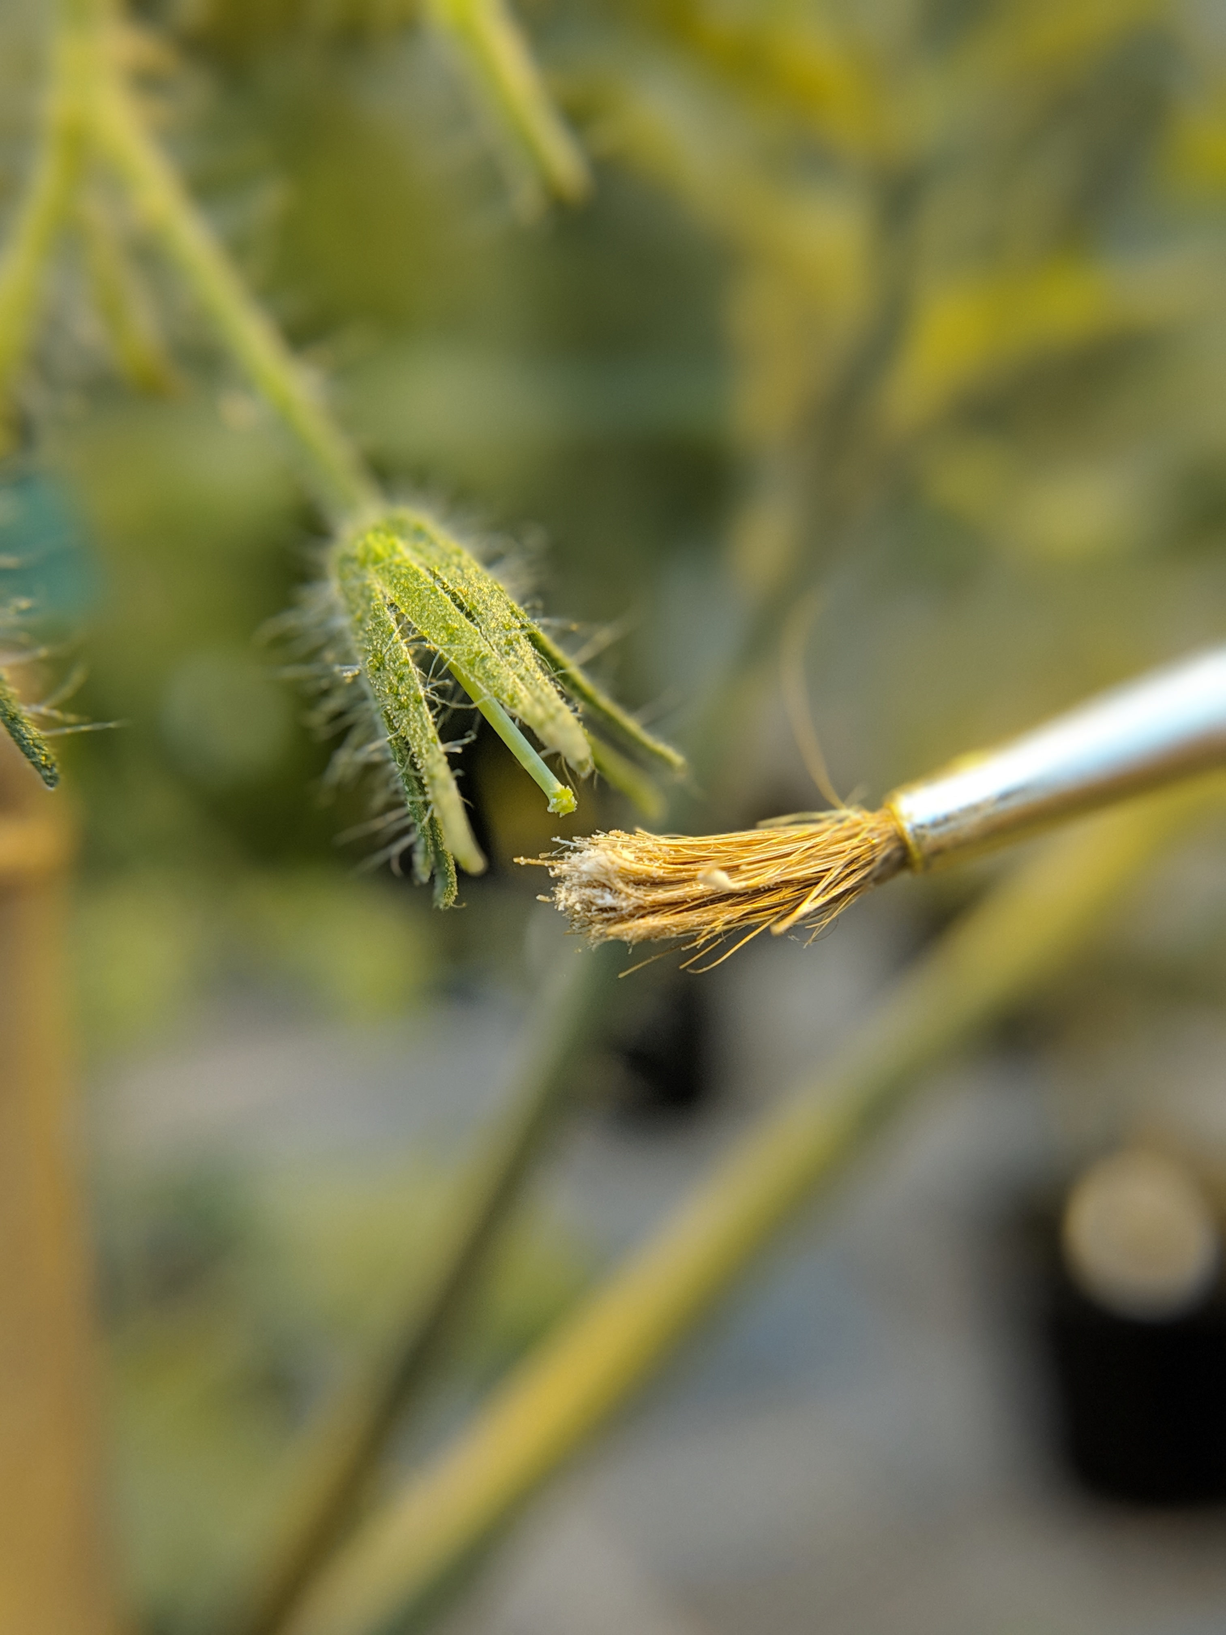
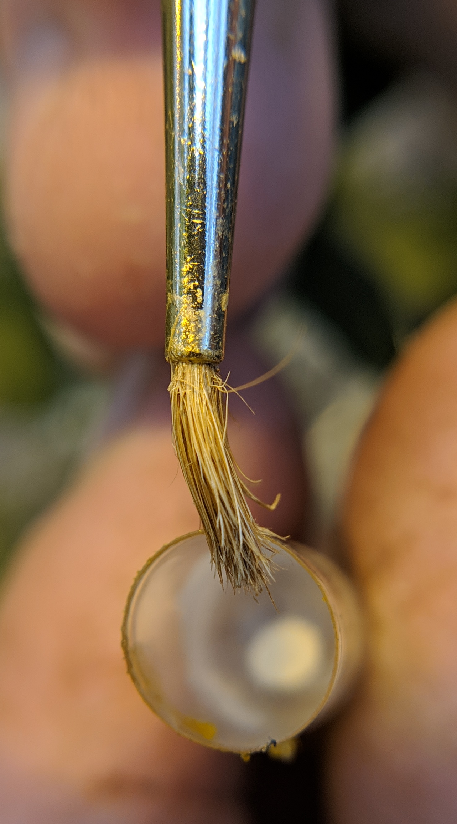
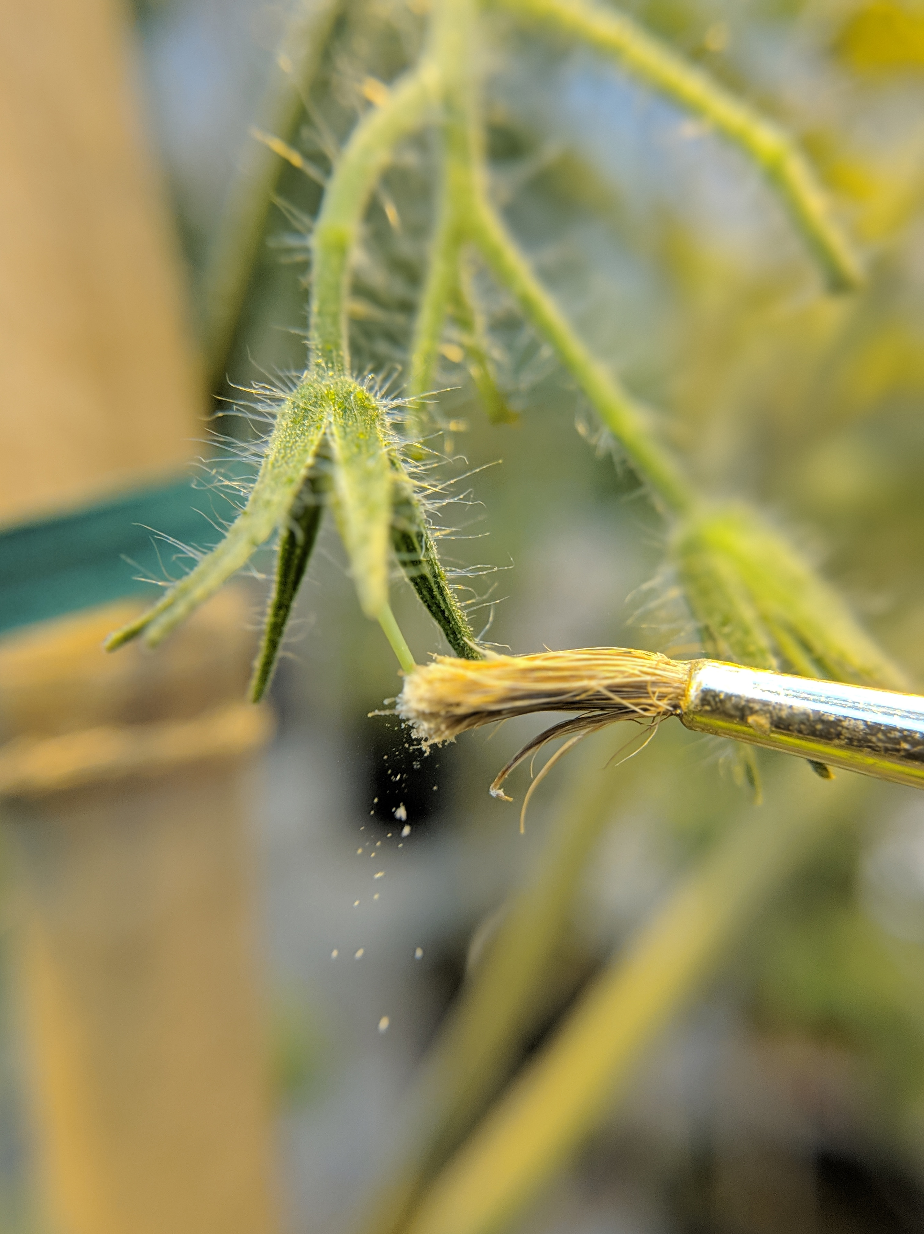
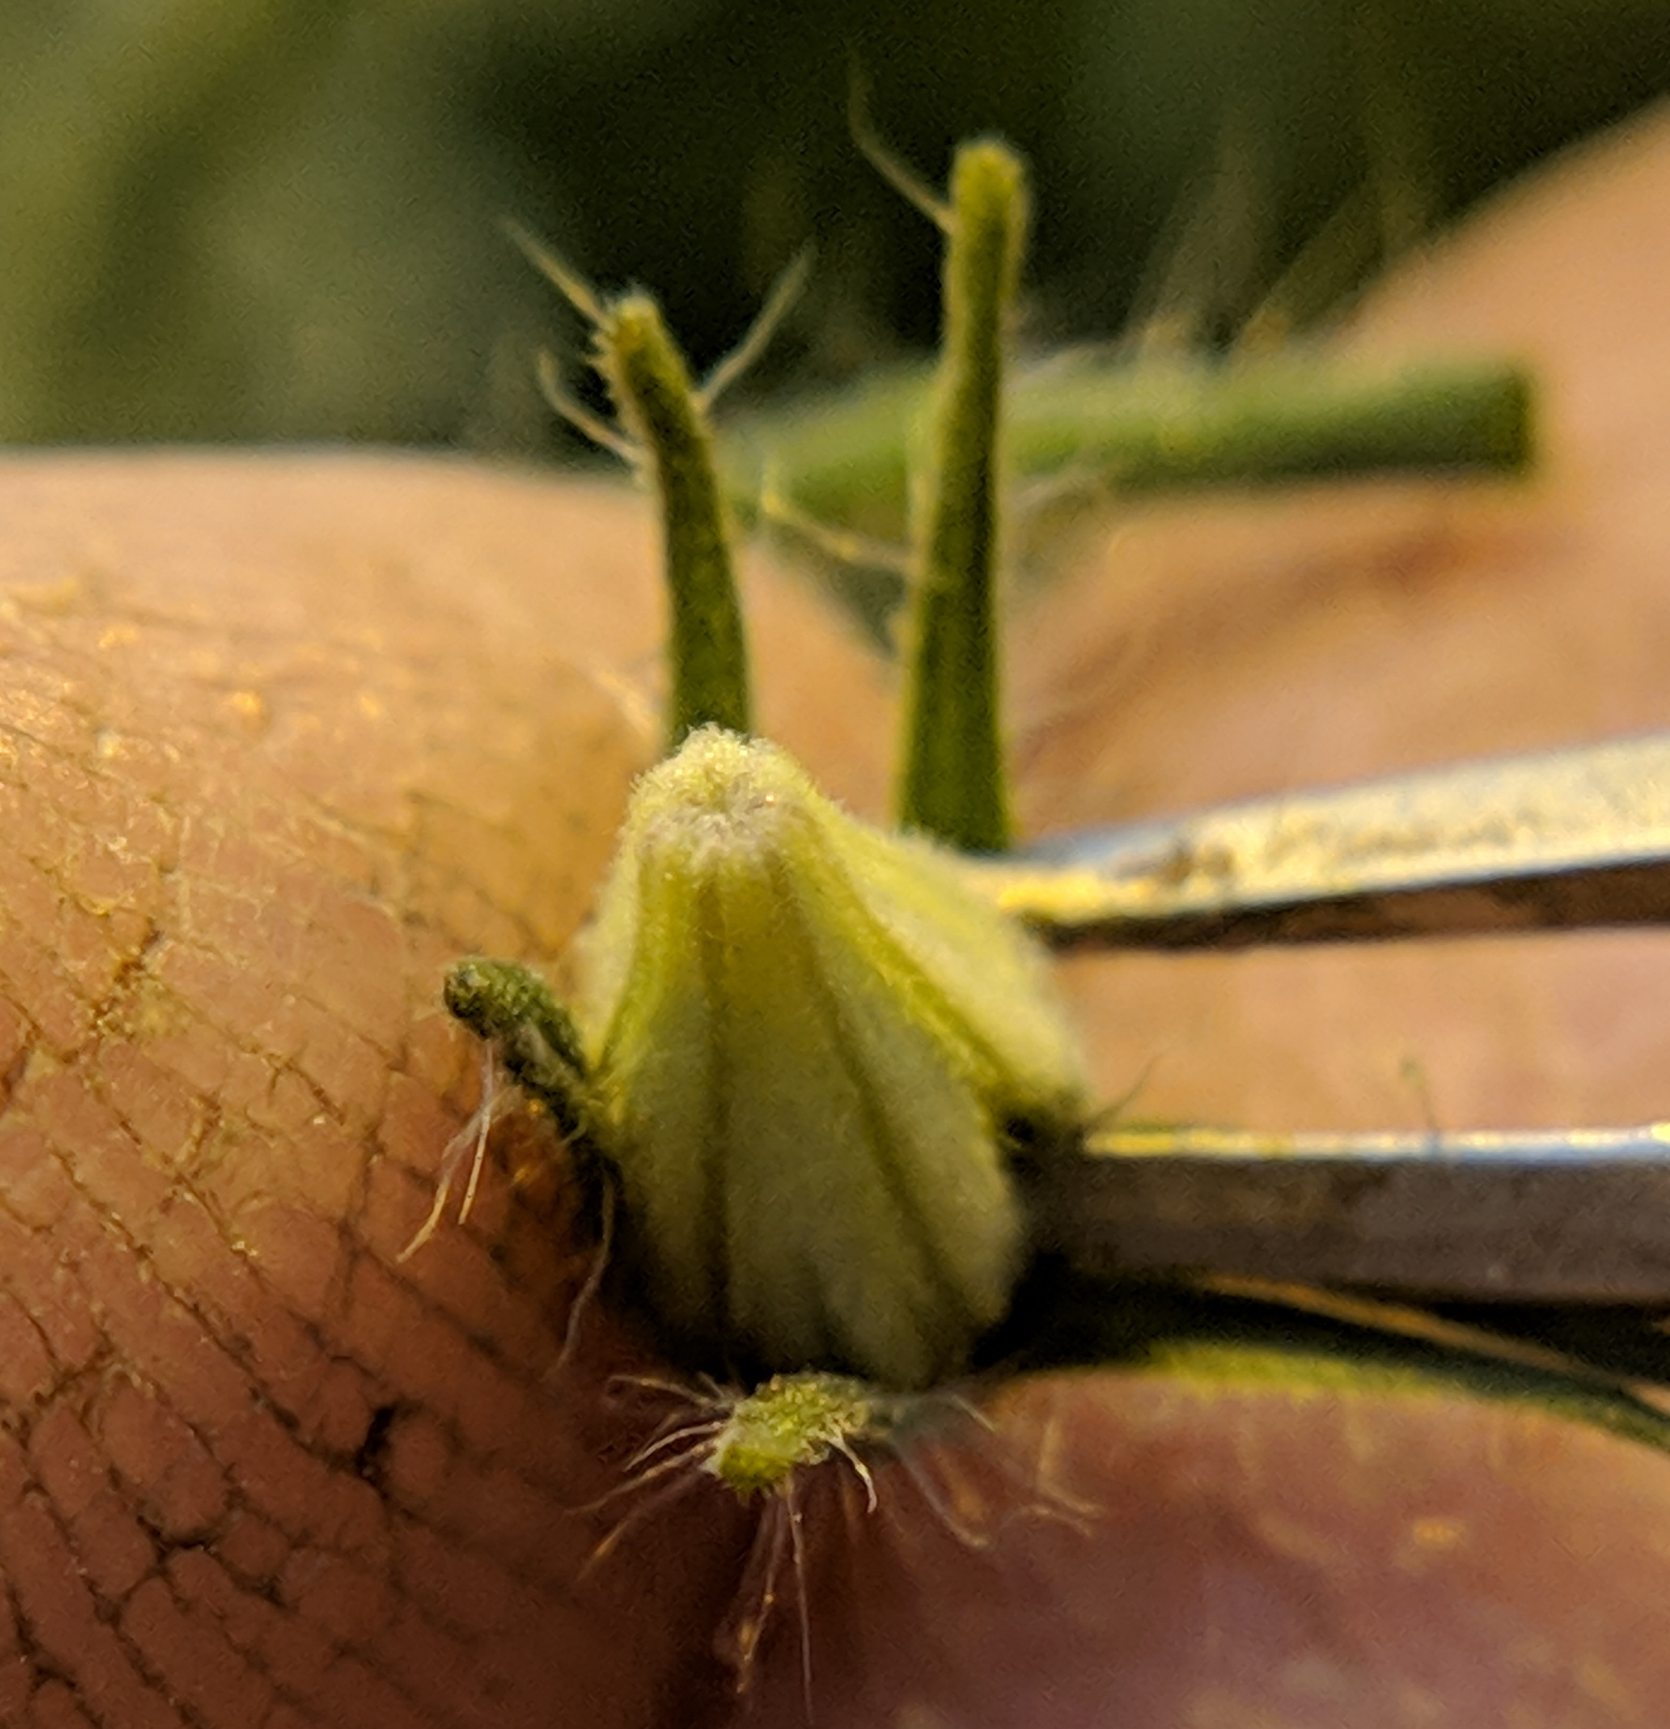
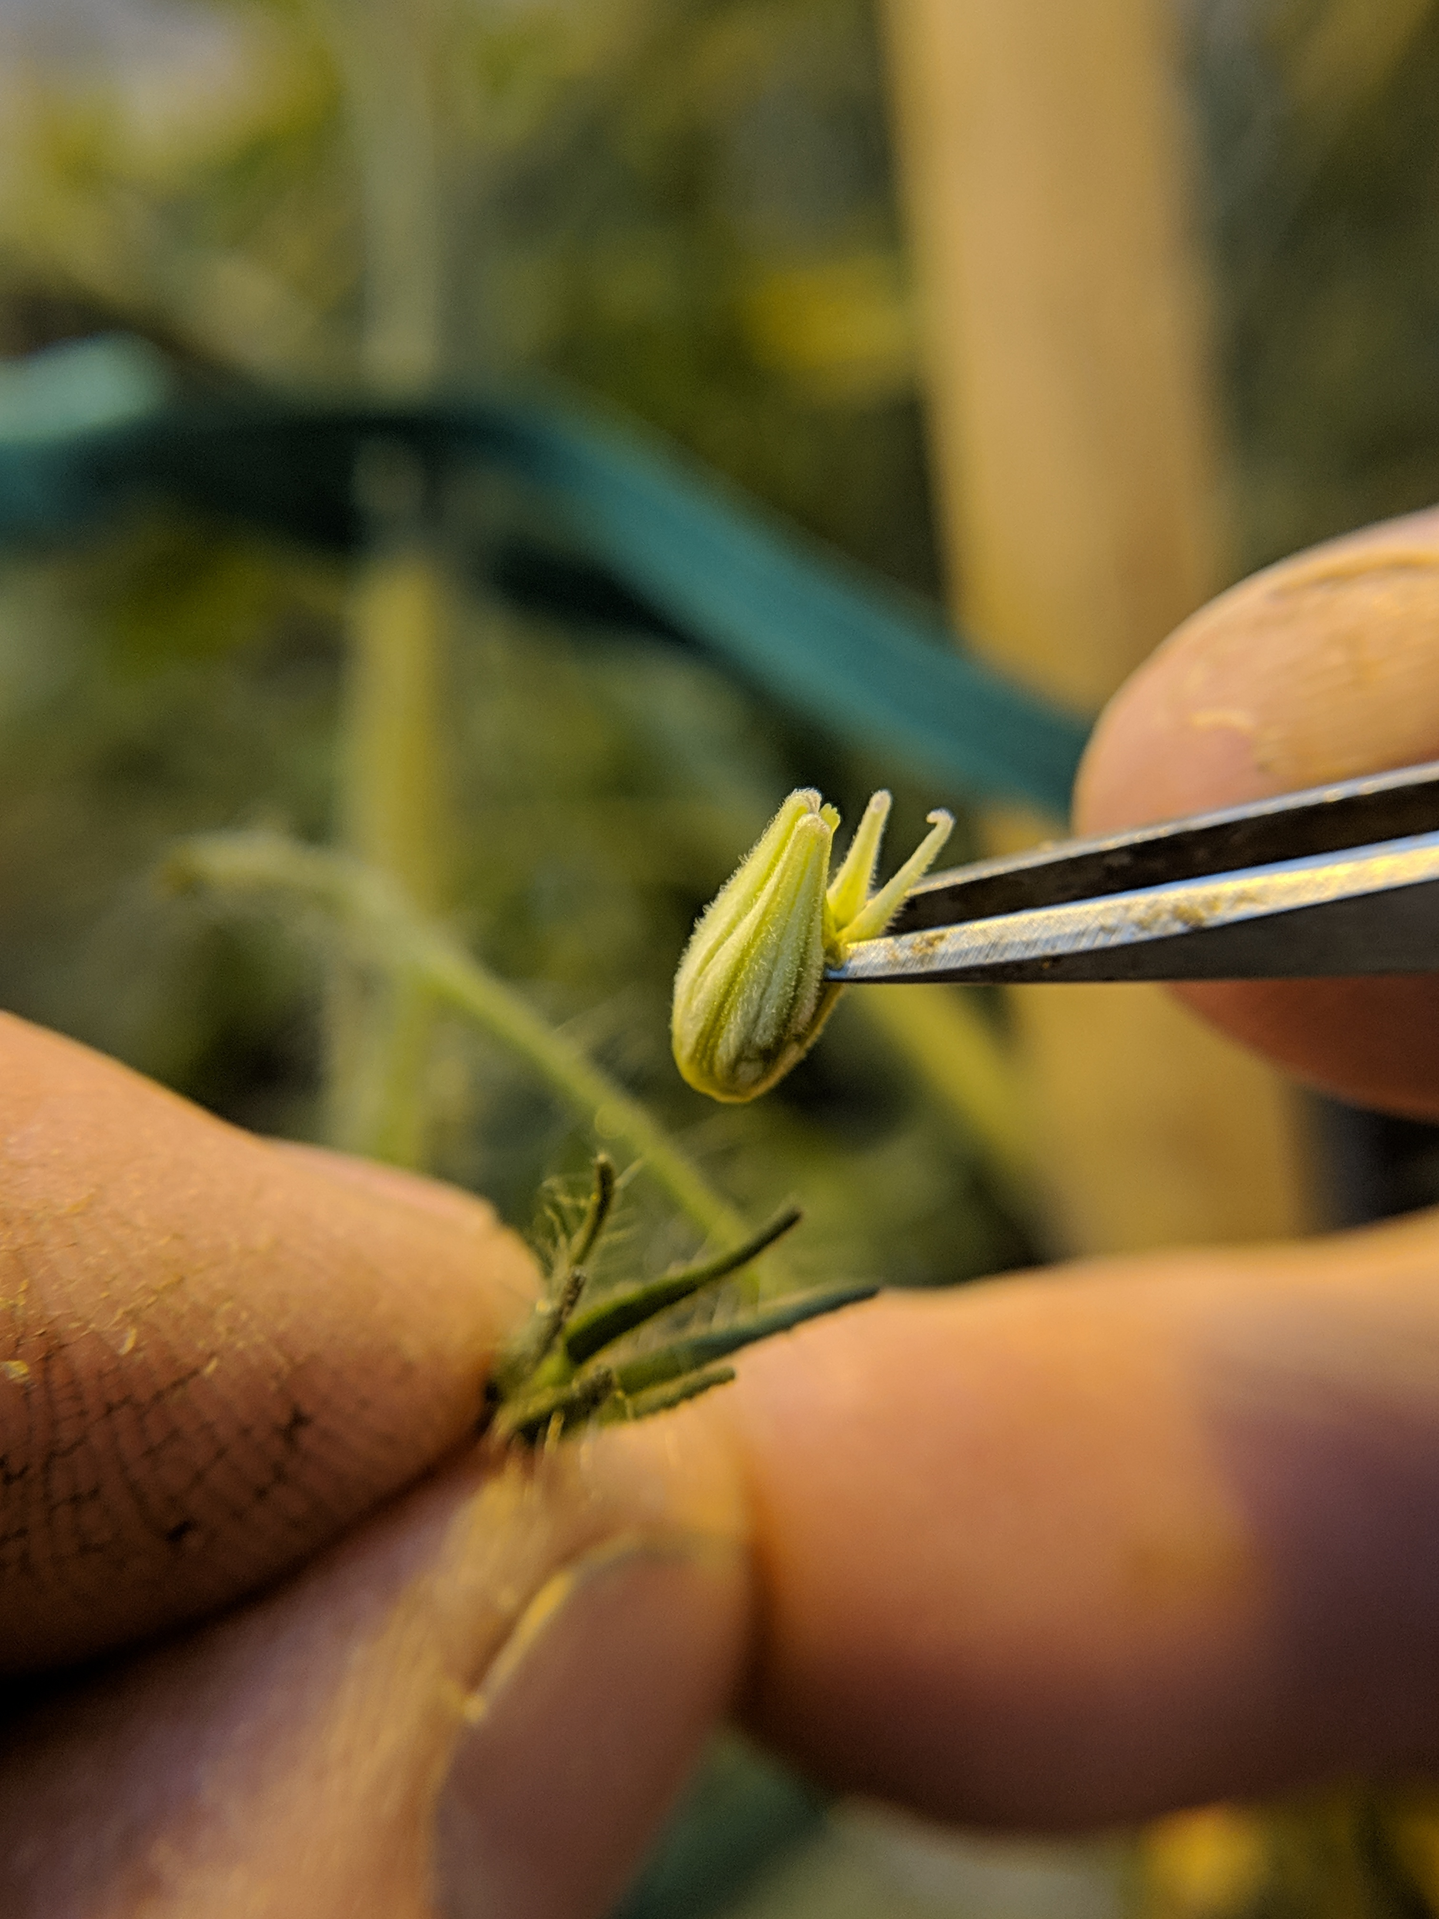
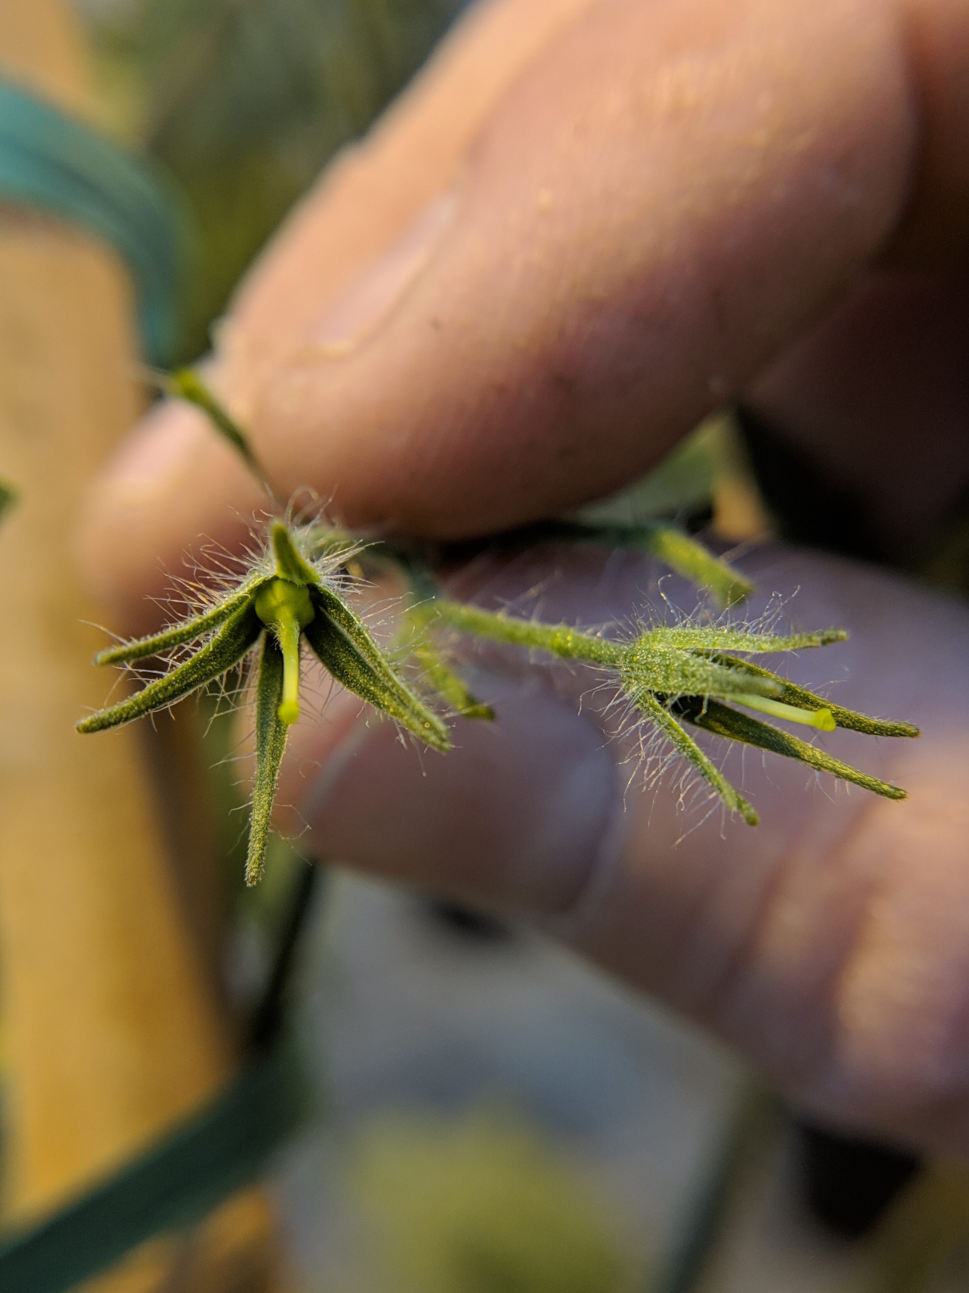
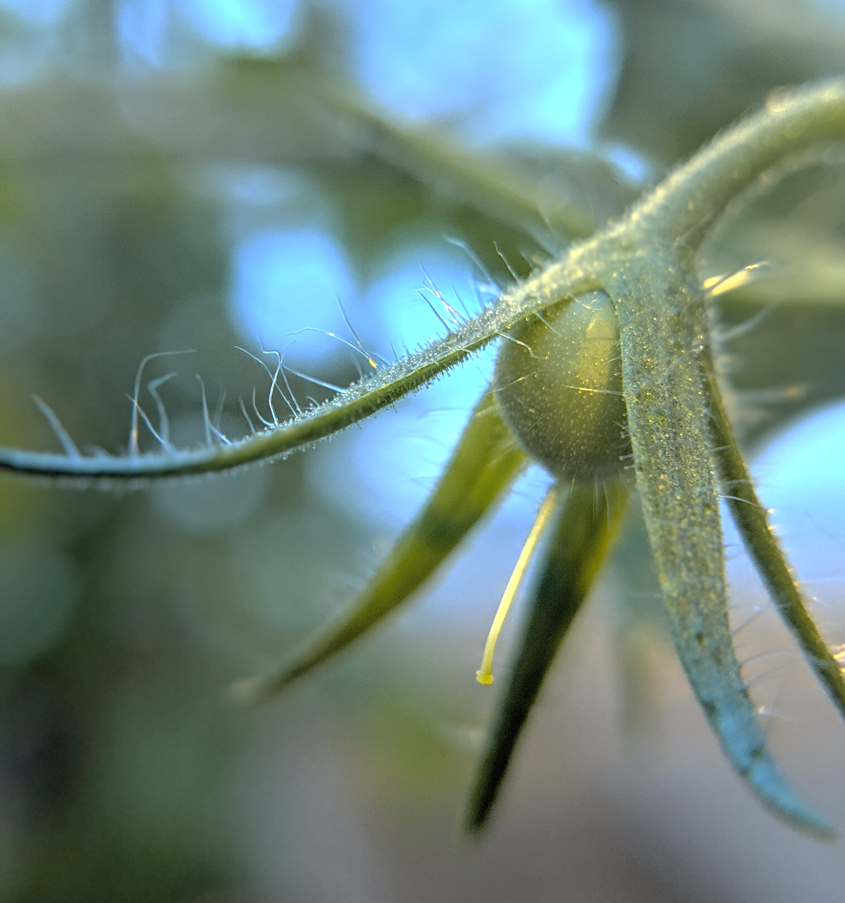
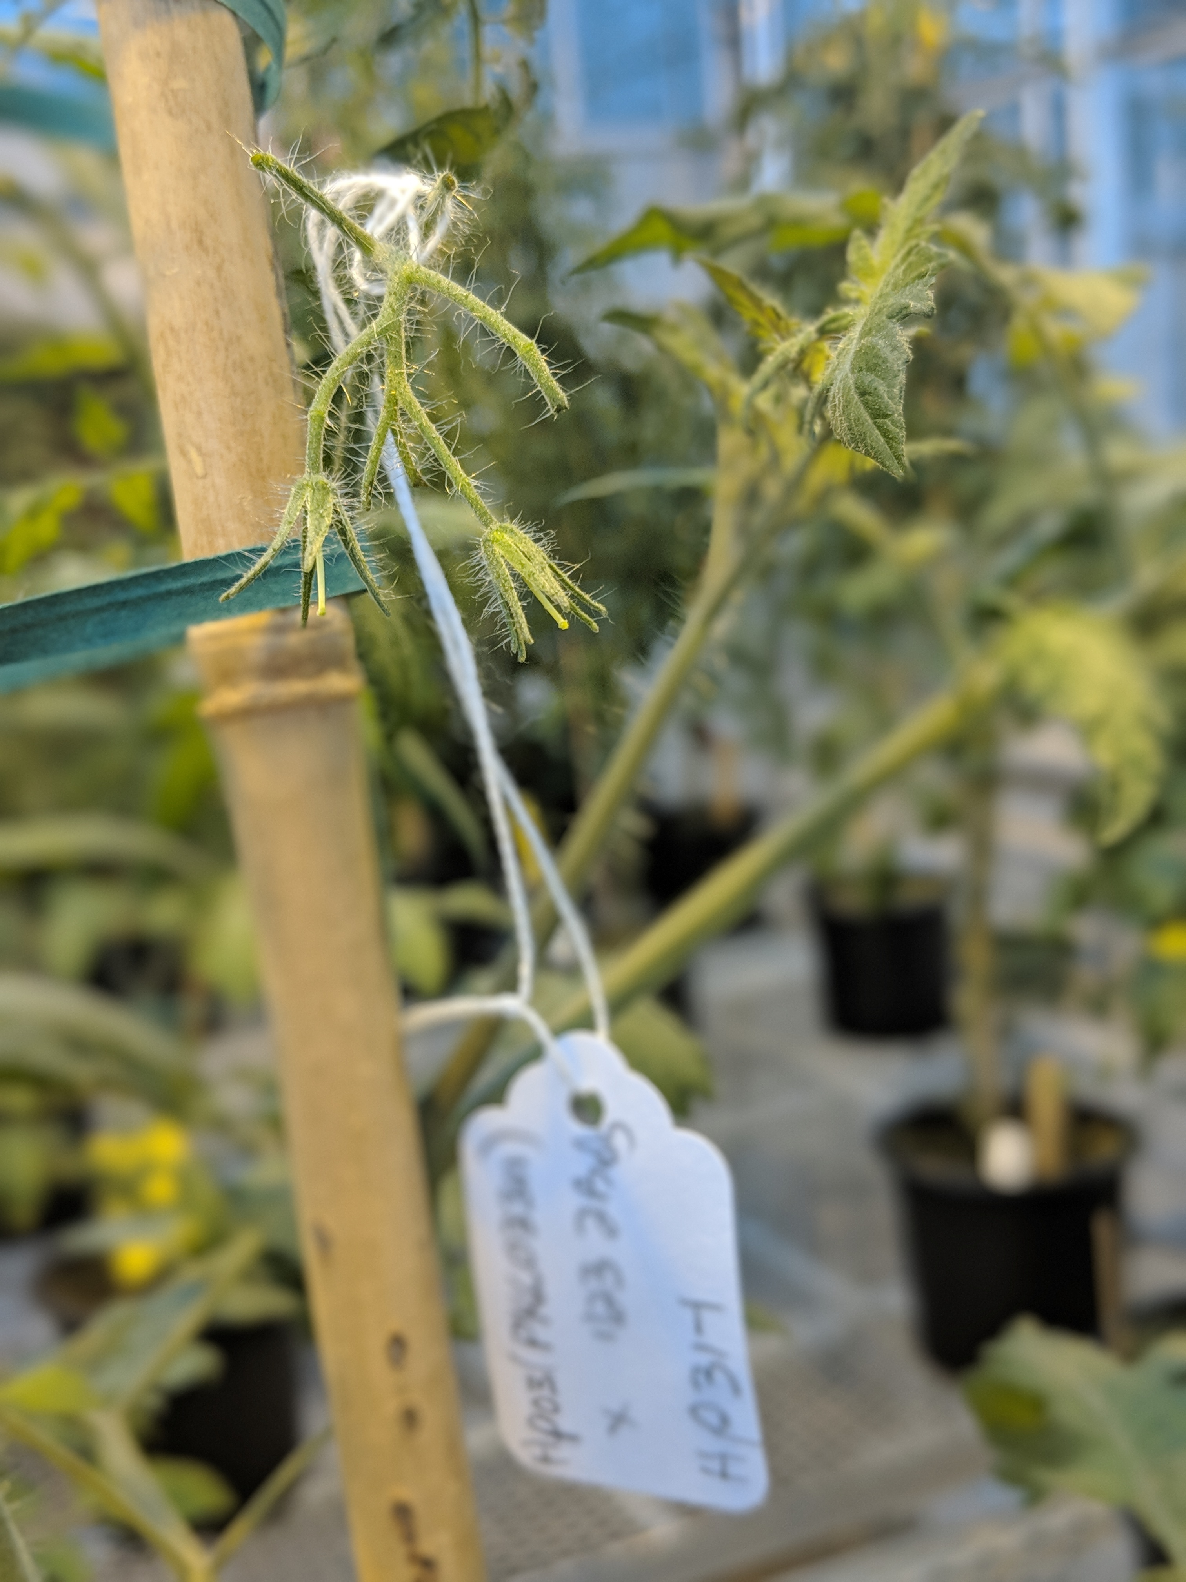
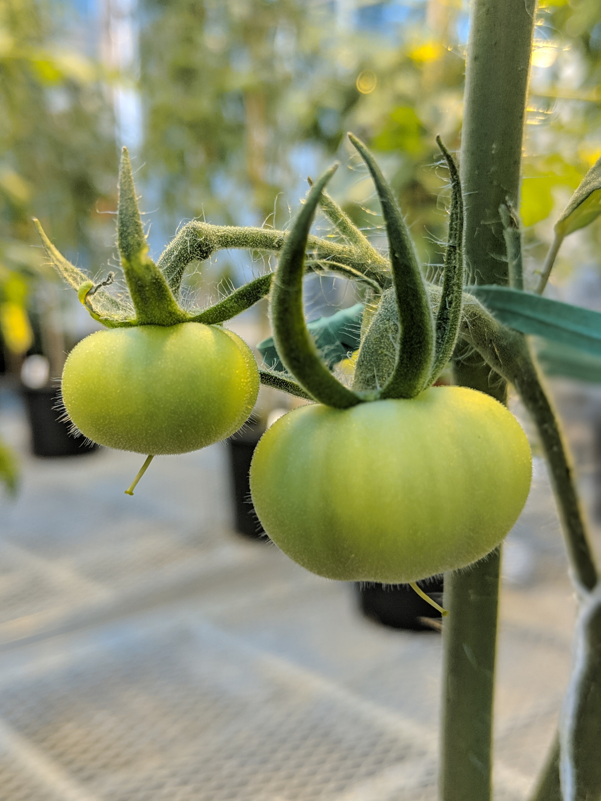

TOMATO POLLINATION GUIDE
Solanum lycopersicum
Tomatoes have a perfect flowers with both male and female structures. These plants are self-pollinating, meaning saved seeds will be true-to-type unless a controlled pollination is made prior to pollen maturation.
PETAL
SEPAL
STIGMA
STAMEN
Step ONE: Collect viable donor pollen
Step TWO: Identify immature flowers
Four to eight tomato flowers will typically appear on an inflorescence. Look for fully opened flowers that are dark yellow approximately 7-8 weeks after seeding. Place a mature flower over the rim of a plastic capsule to catch mature pollen. Use an electric toothbrush or finger tap to shake pollen from the flower.
Identify immature flowers that are approximately one day prior to anthesis (i.e. mature pollen formation) or flower opening.
Remove flowers that have already started to open or are too small to contain a viable female stigma.
Step THREE: Remove petals to expose stigma
Step FOUR: Transfer donor pollen to stigma
Carefully insert a tweezers in between the flower petals and tug straight up to remove the petals/stamen in one swift motion. A singular stigma will remain connect to the calyx.
Using a sanitized paintbrush or cotton swab, gently cover the stigmatic surface with collected donor pollen.
Step FIVE: Properly label cross
Step SIX: Monitor and harvest mature fruit
If performing a cross indoors without pollinators present, covering the flower/inflorescence is not strictly necessary. Label a small crossing-tag with female x male designators and the date of the cross. More than one immature flower per inflorescence may be pollinated at a time, in which case be sure to place a crossing tag at the base of the inflorescence.
It can take six-to-eight weeks to obtain mature fruit. Seed is physiologically mature when the fruit is ripe, at which time seeds may be saved using wet fermentation methods. Follow good seed stewardship practices, using clean harvesting and storage practices to obtain clean, safe seed.
TIPS FROM THE PROS:
Pollen viability is typically highest in the early morning
Use ethanol to sanitize materials between pollen sources
Aim for cool, dry, and wind-free weather and protect (cover) crosses with cheesecloth, row cover tulle, etc.
THIS PROJECT WAS SUPPORTED BY:
NORTHERN ORGANIC VEGETABLE IMPROVEMENT COOPERATIVE
Photos and design by: H. Swegarden
Demonstration by: M. Wavrick (Griffiths Lab)

