Slide 1
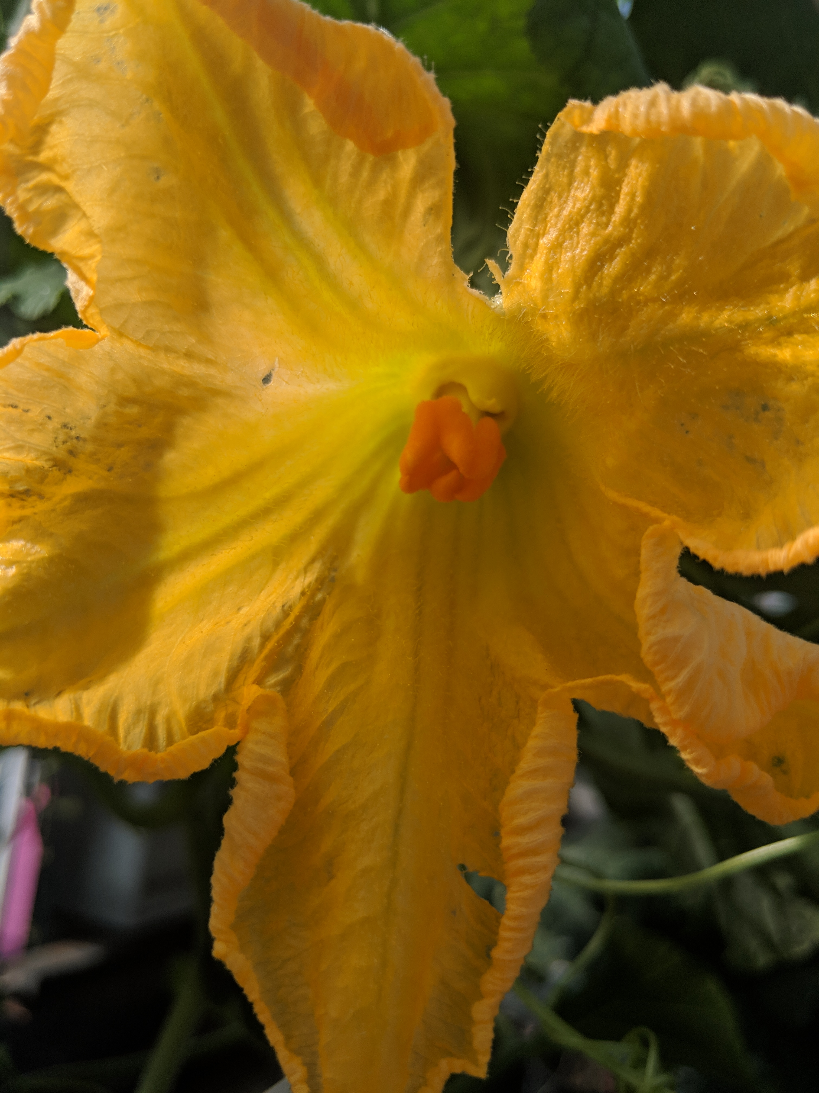
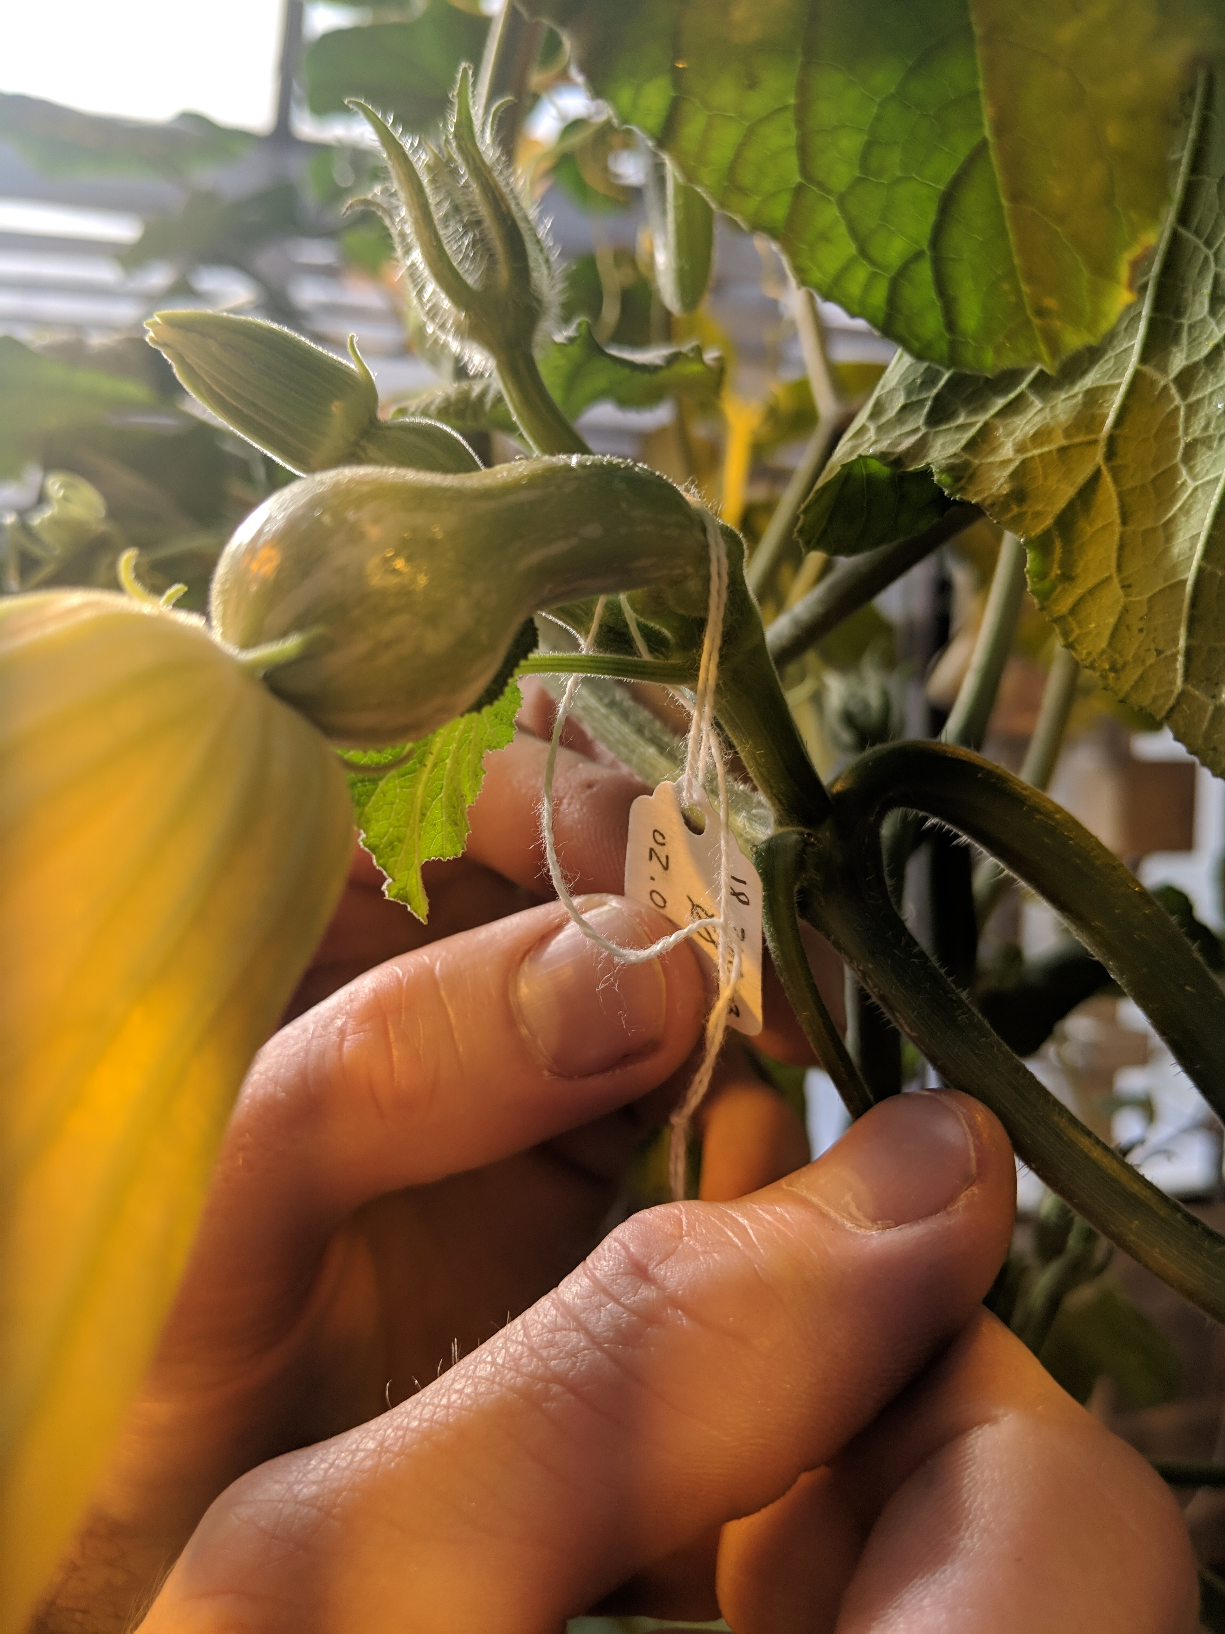
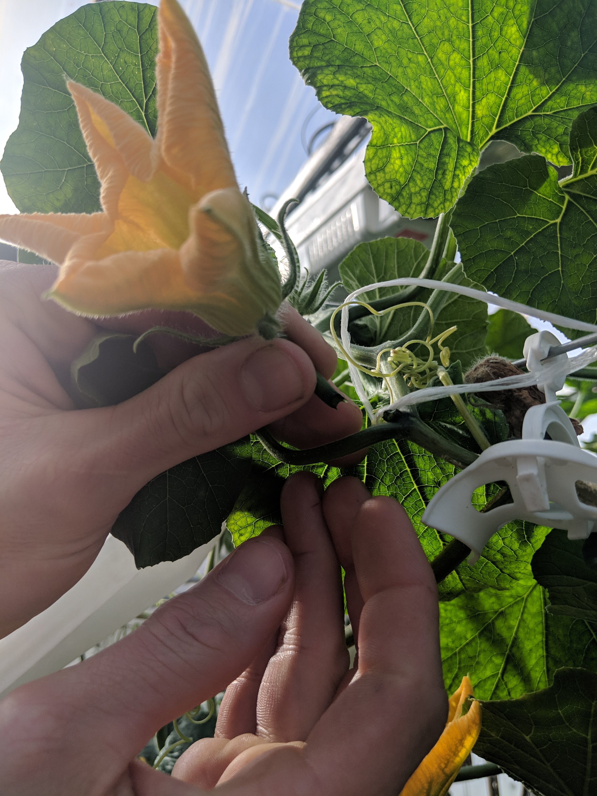
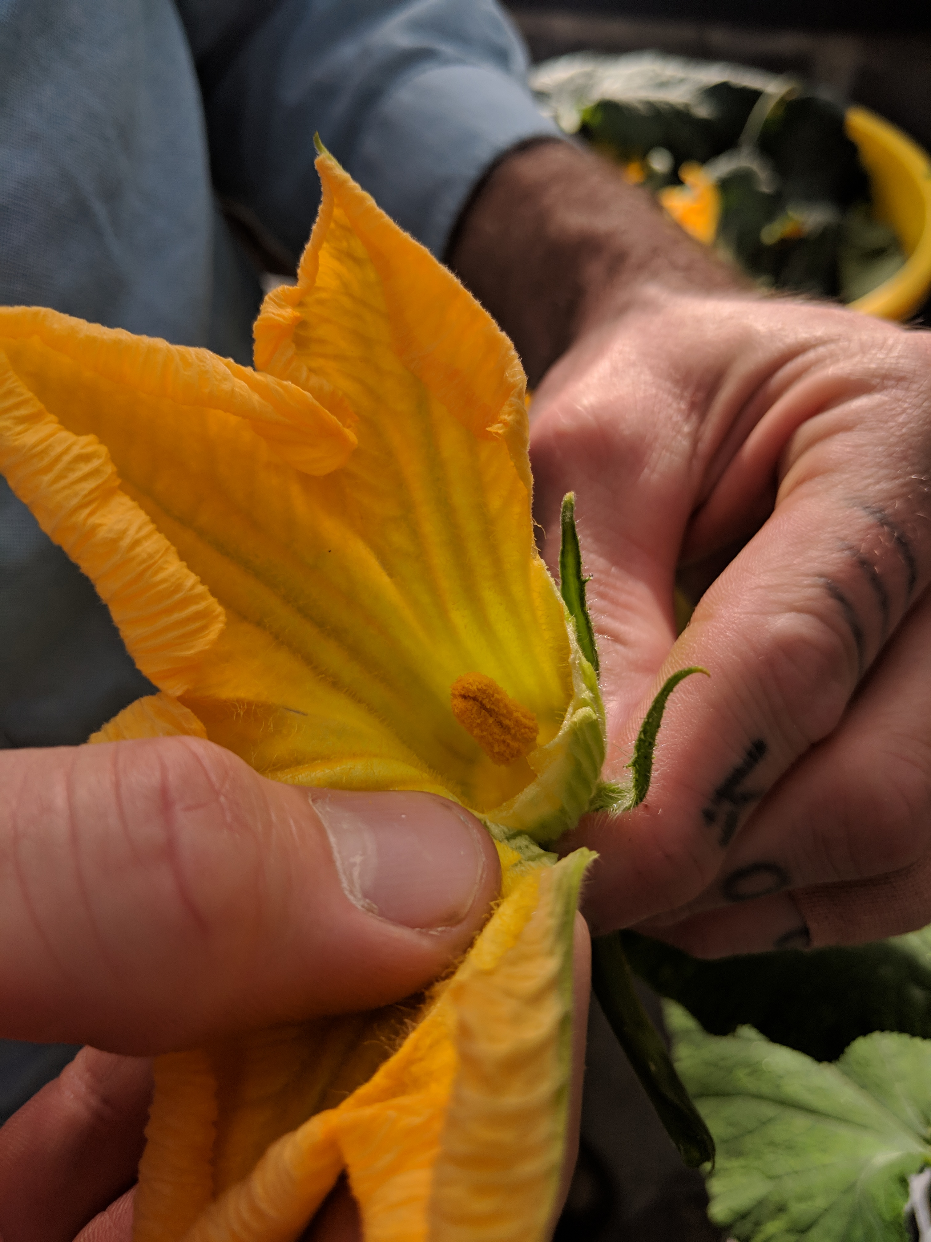
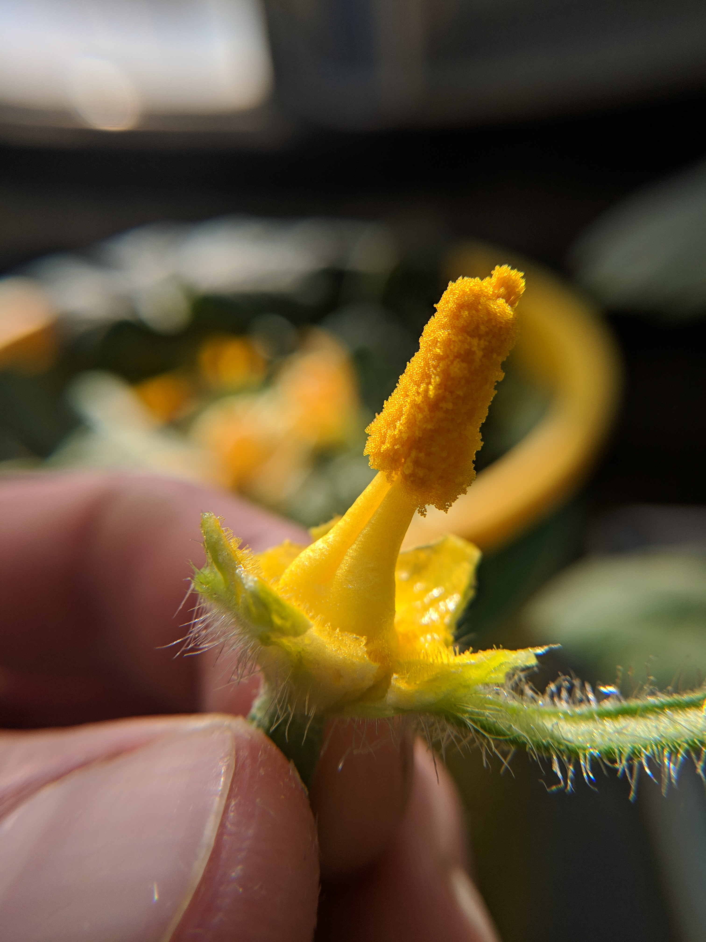
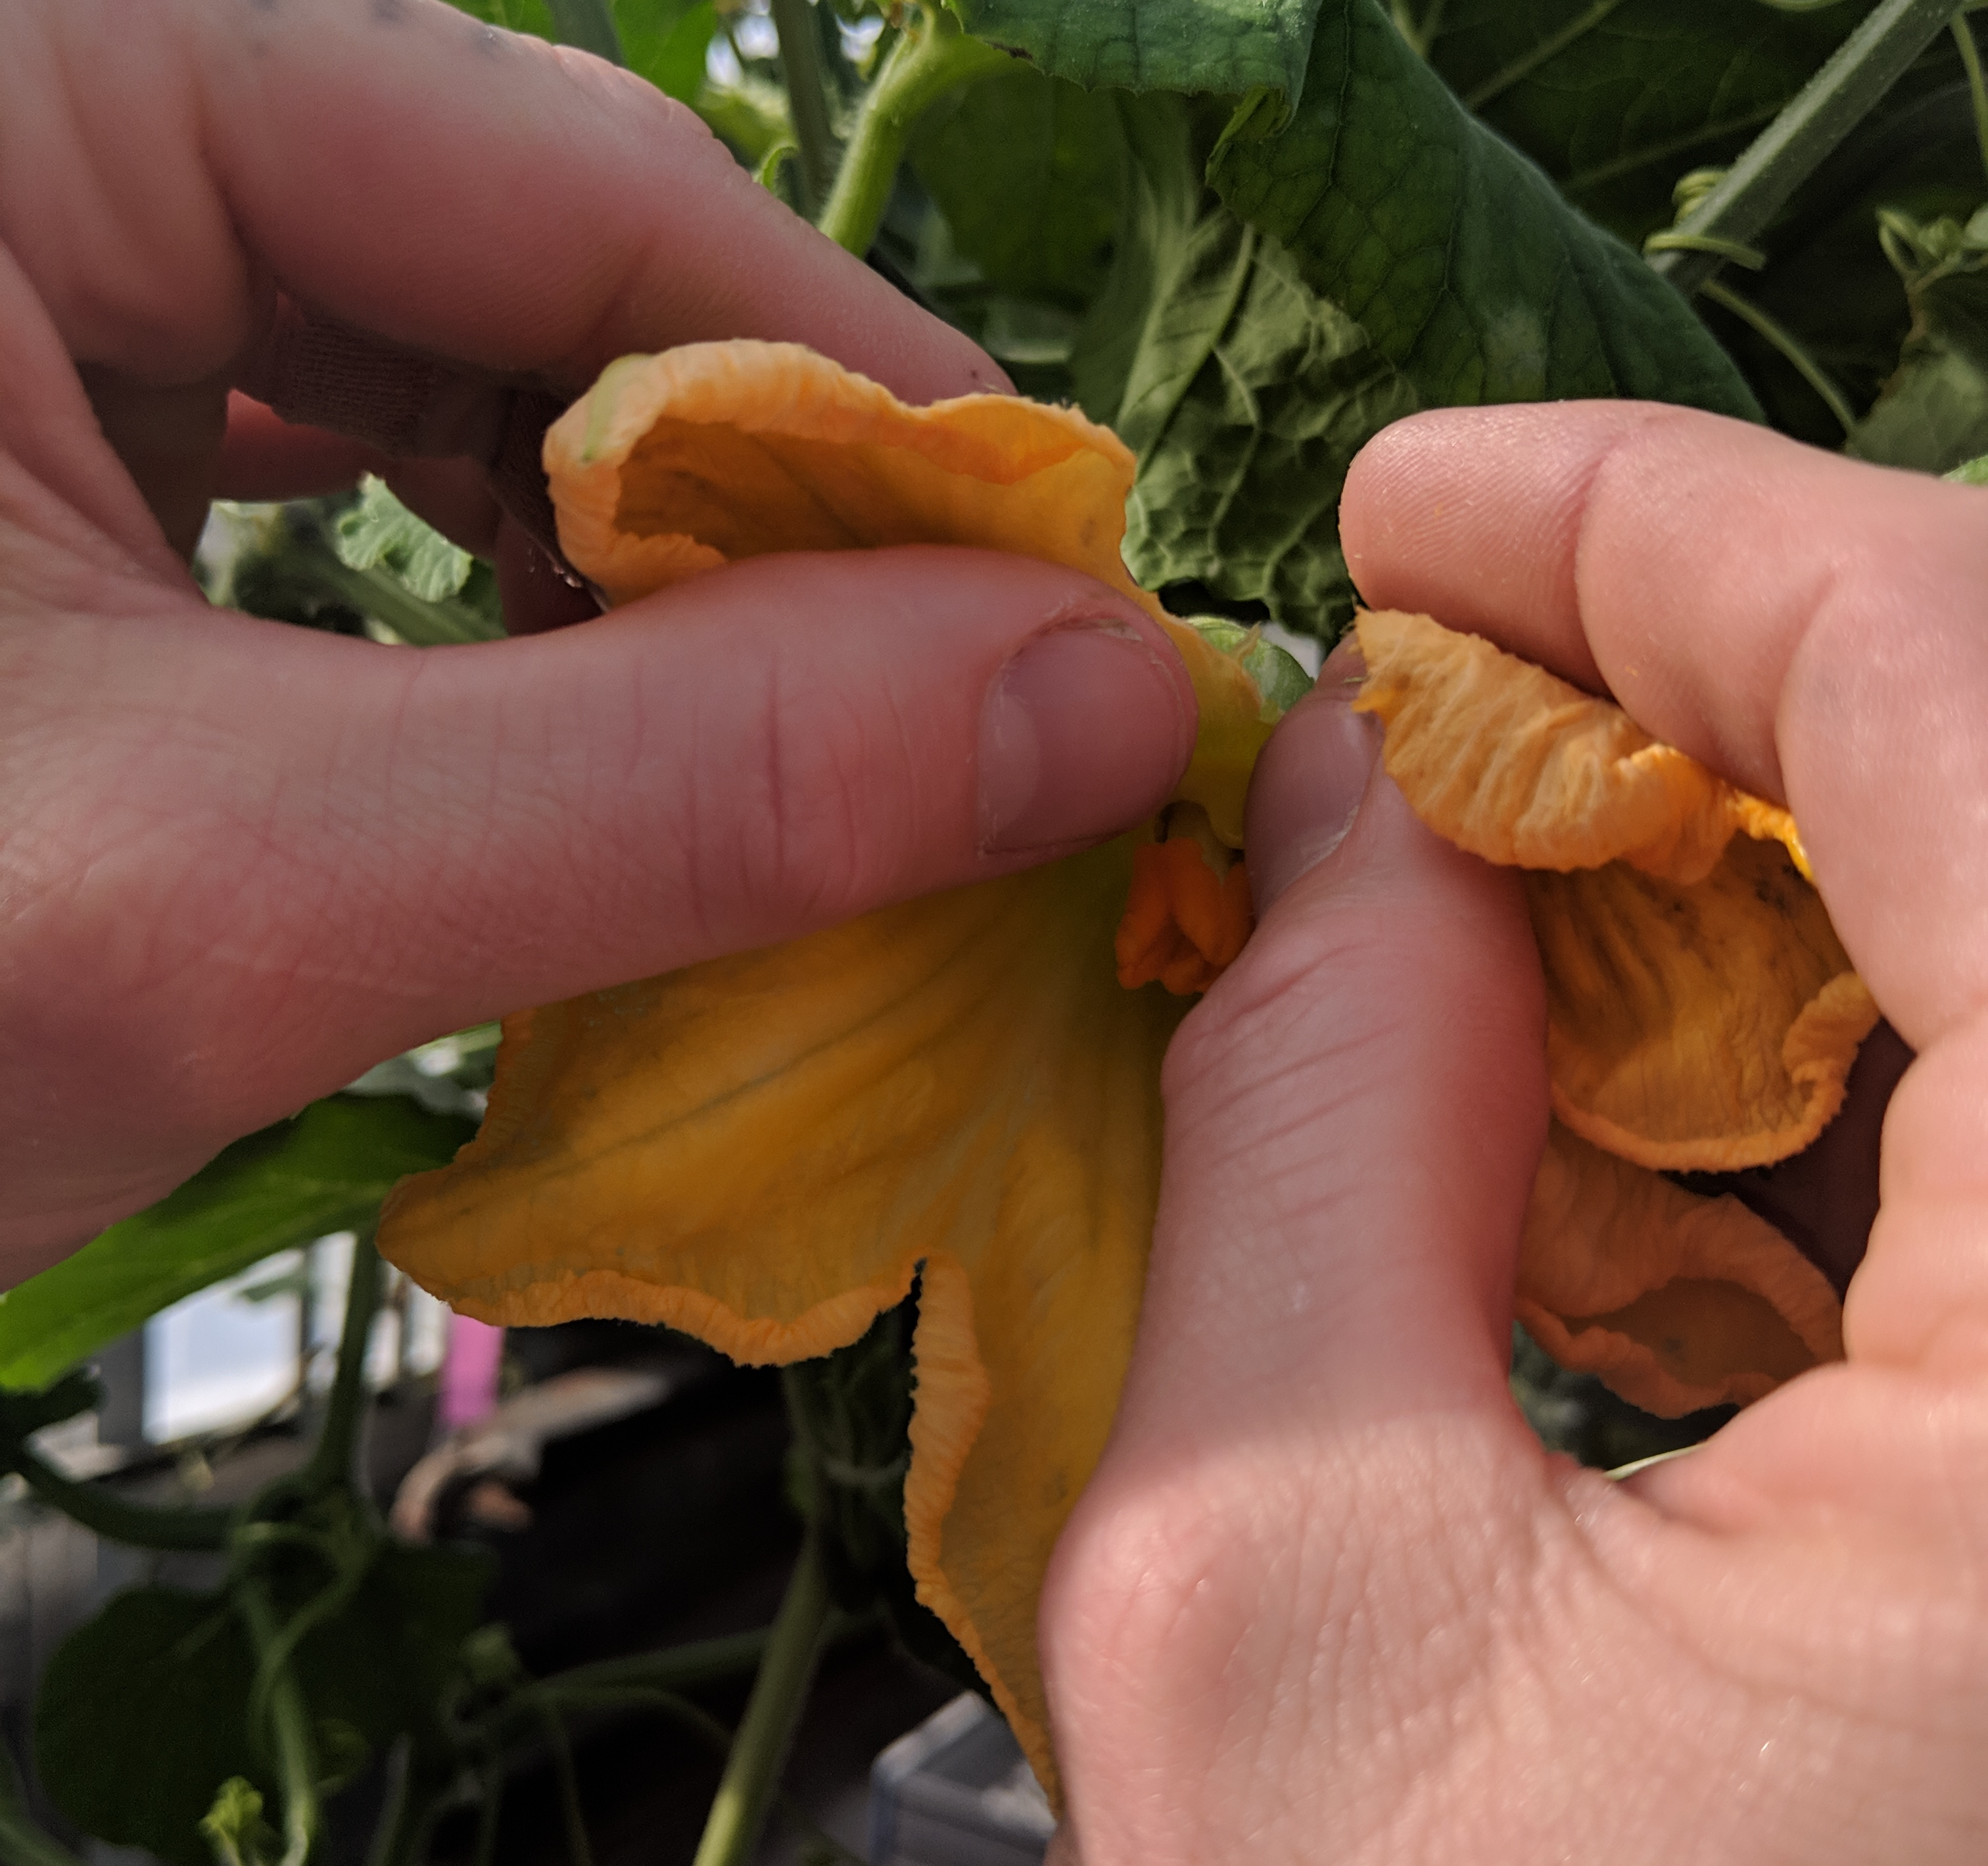
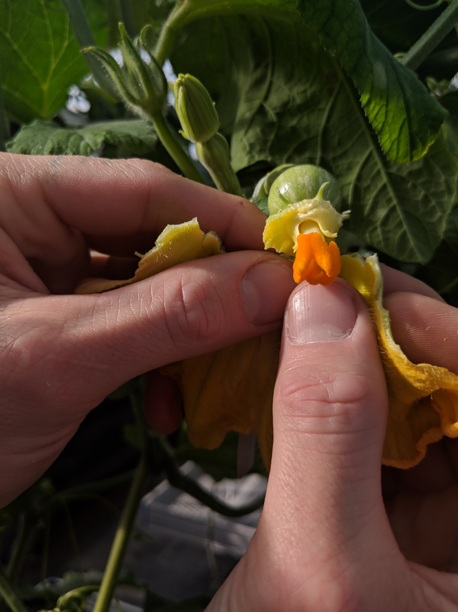
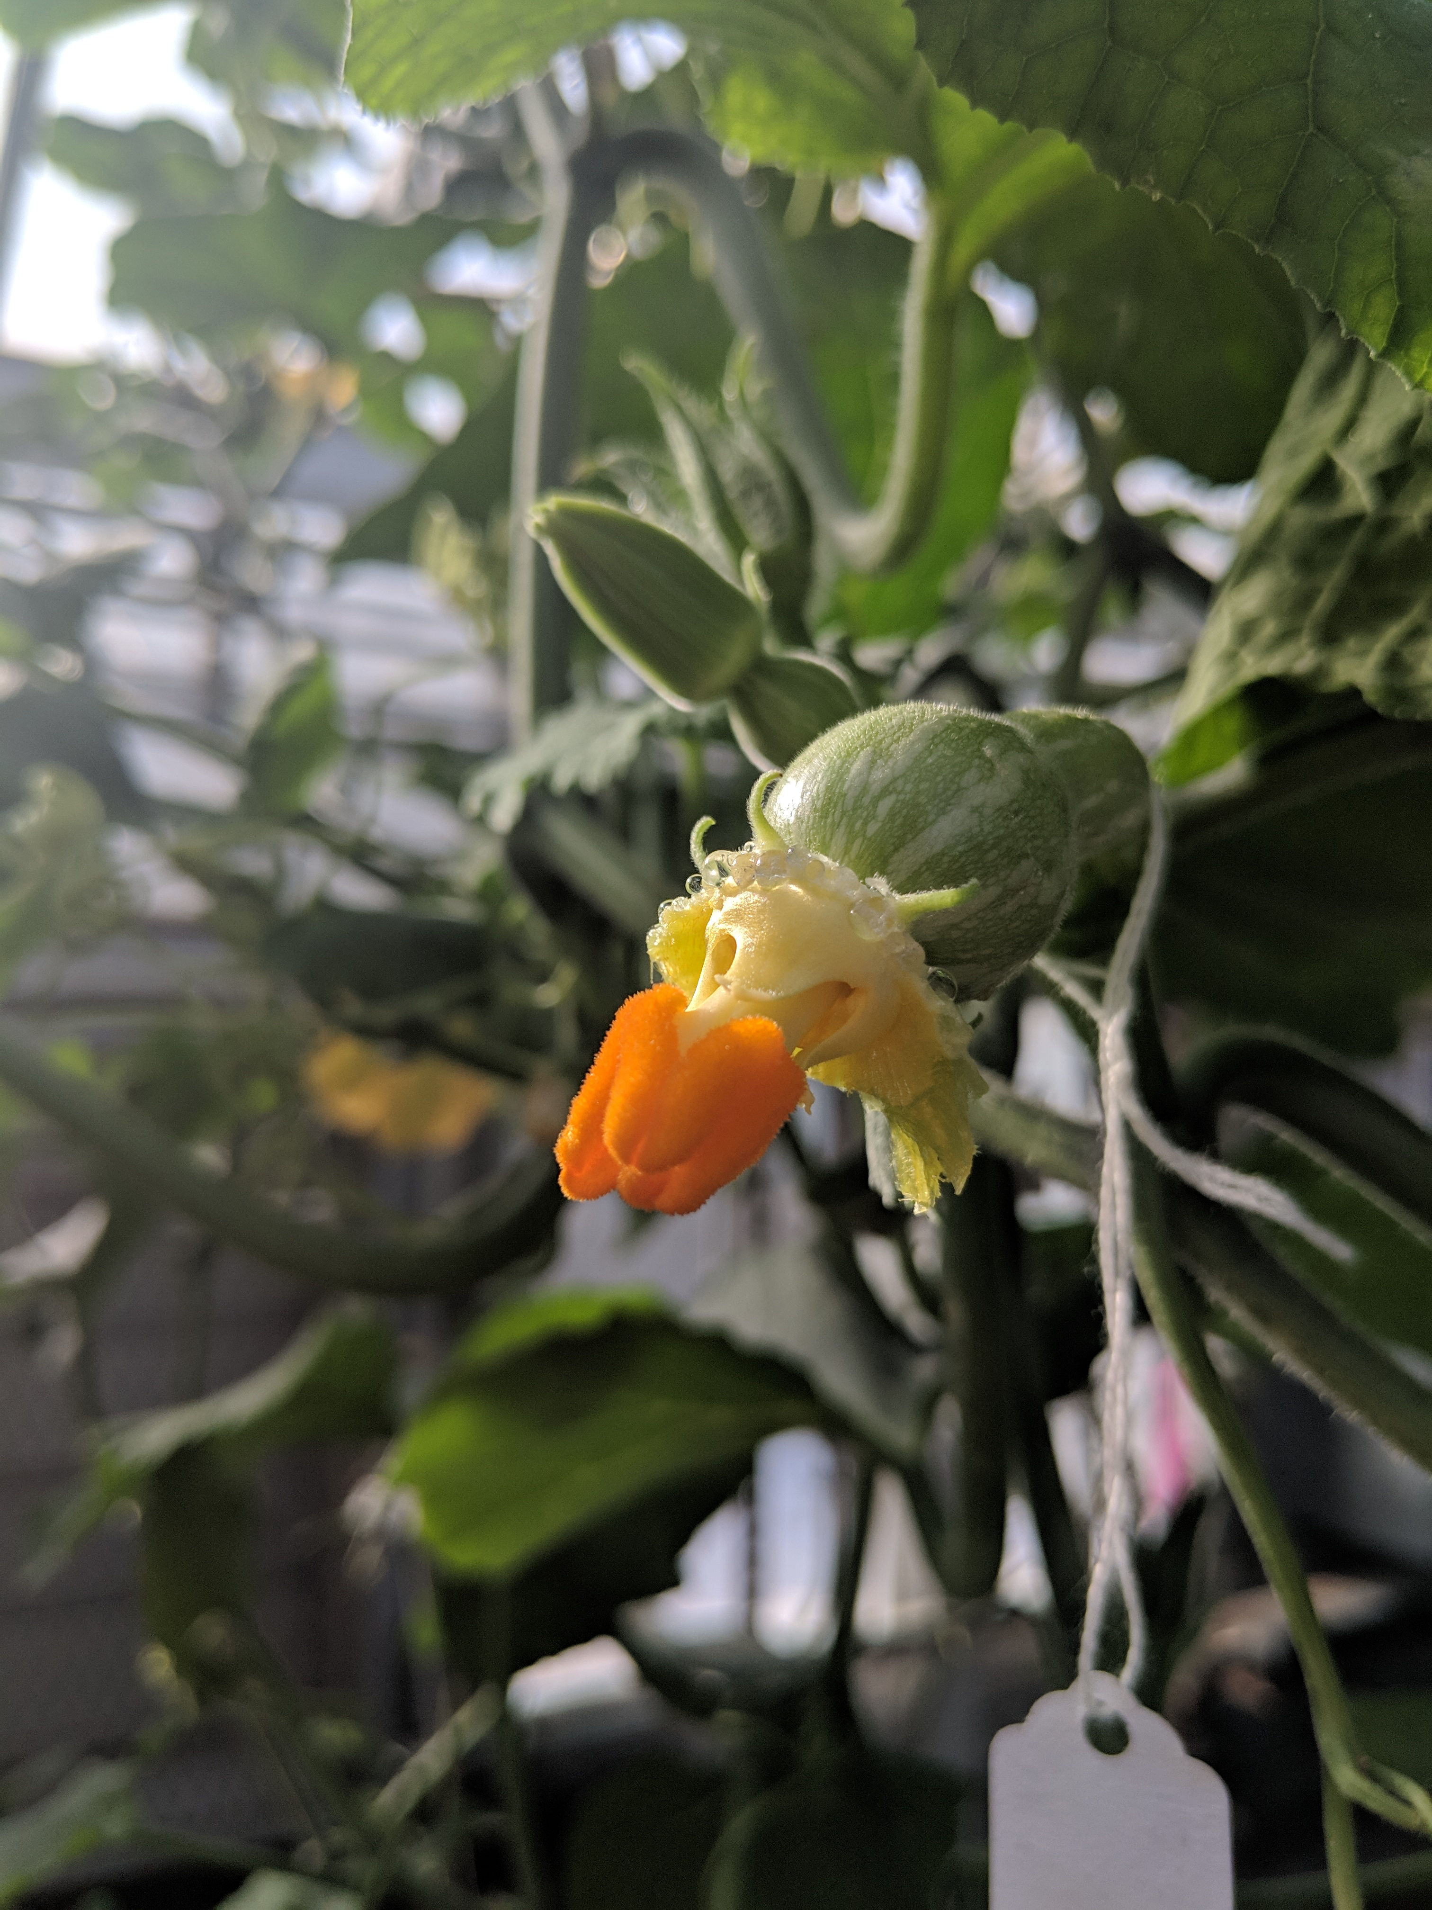
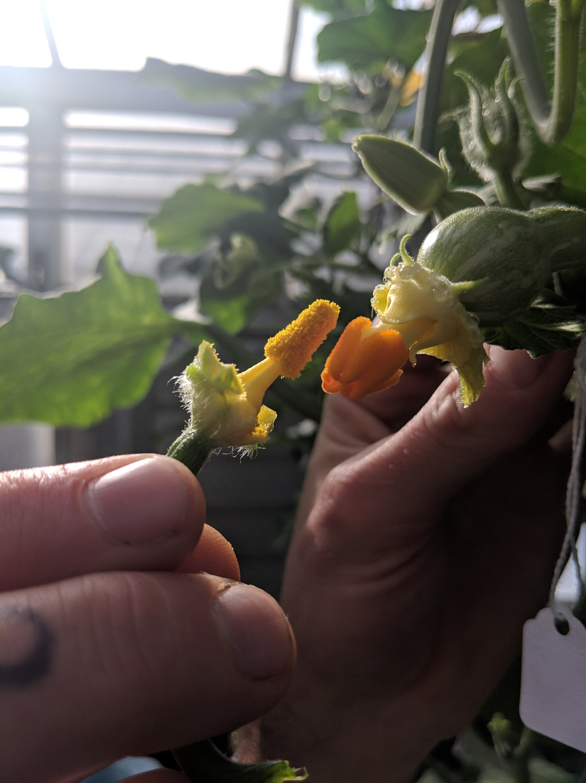
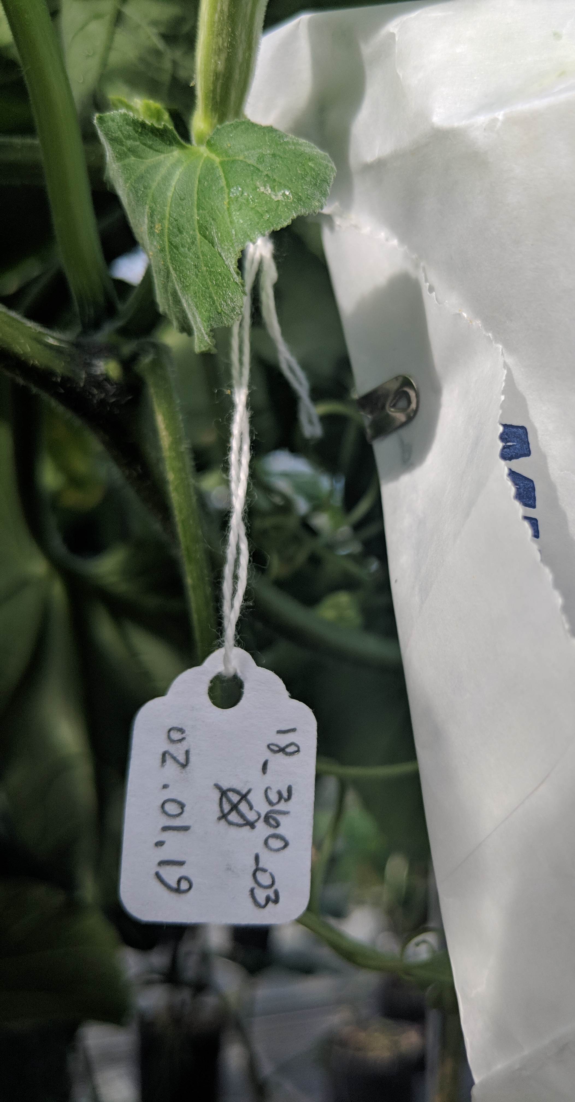
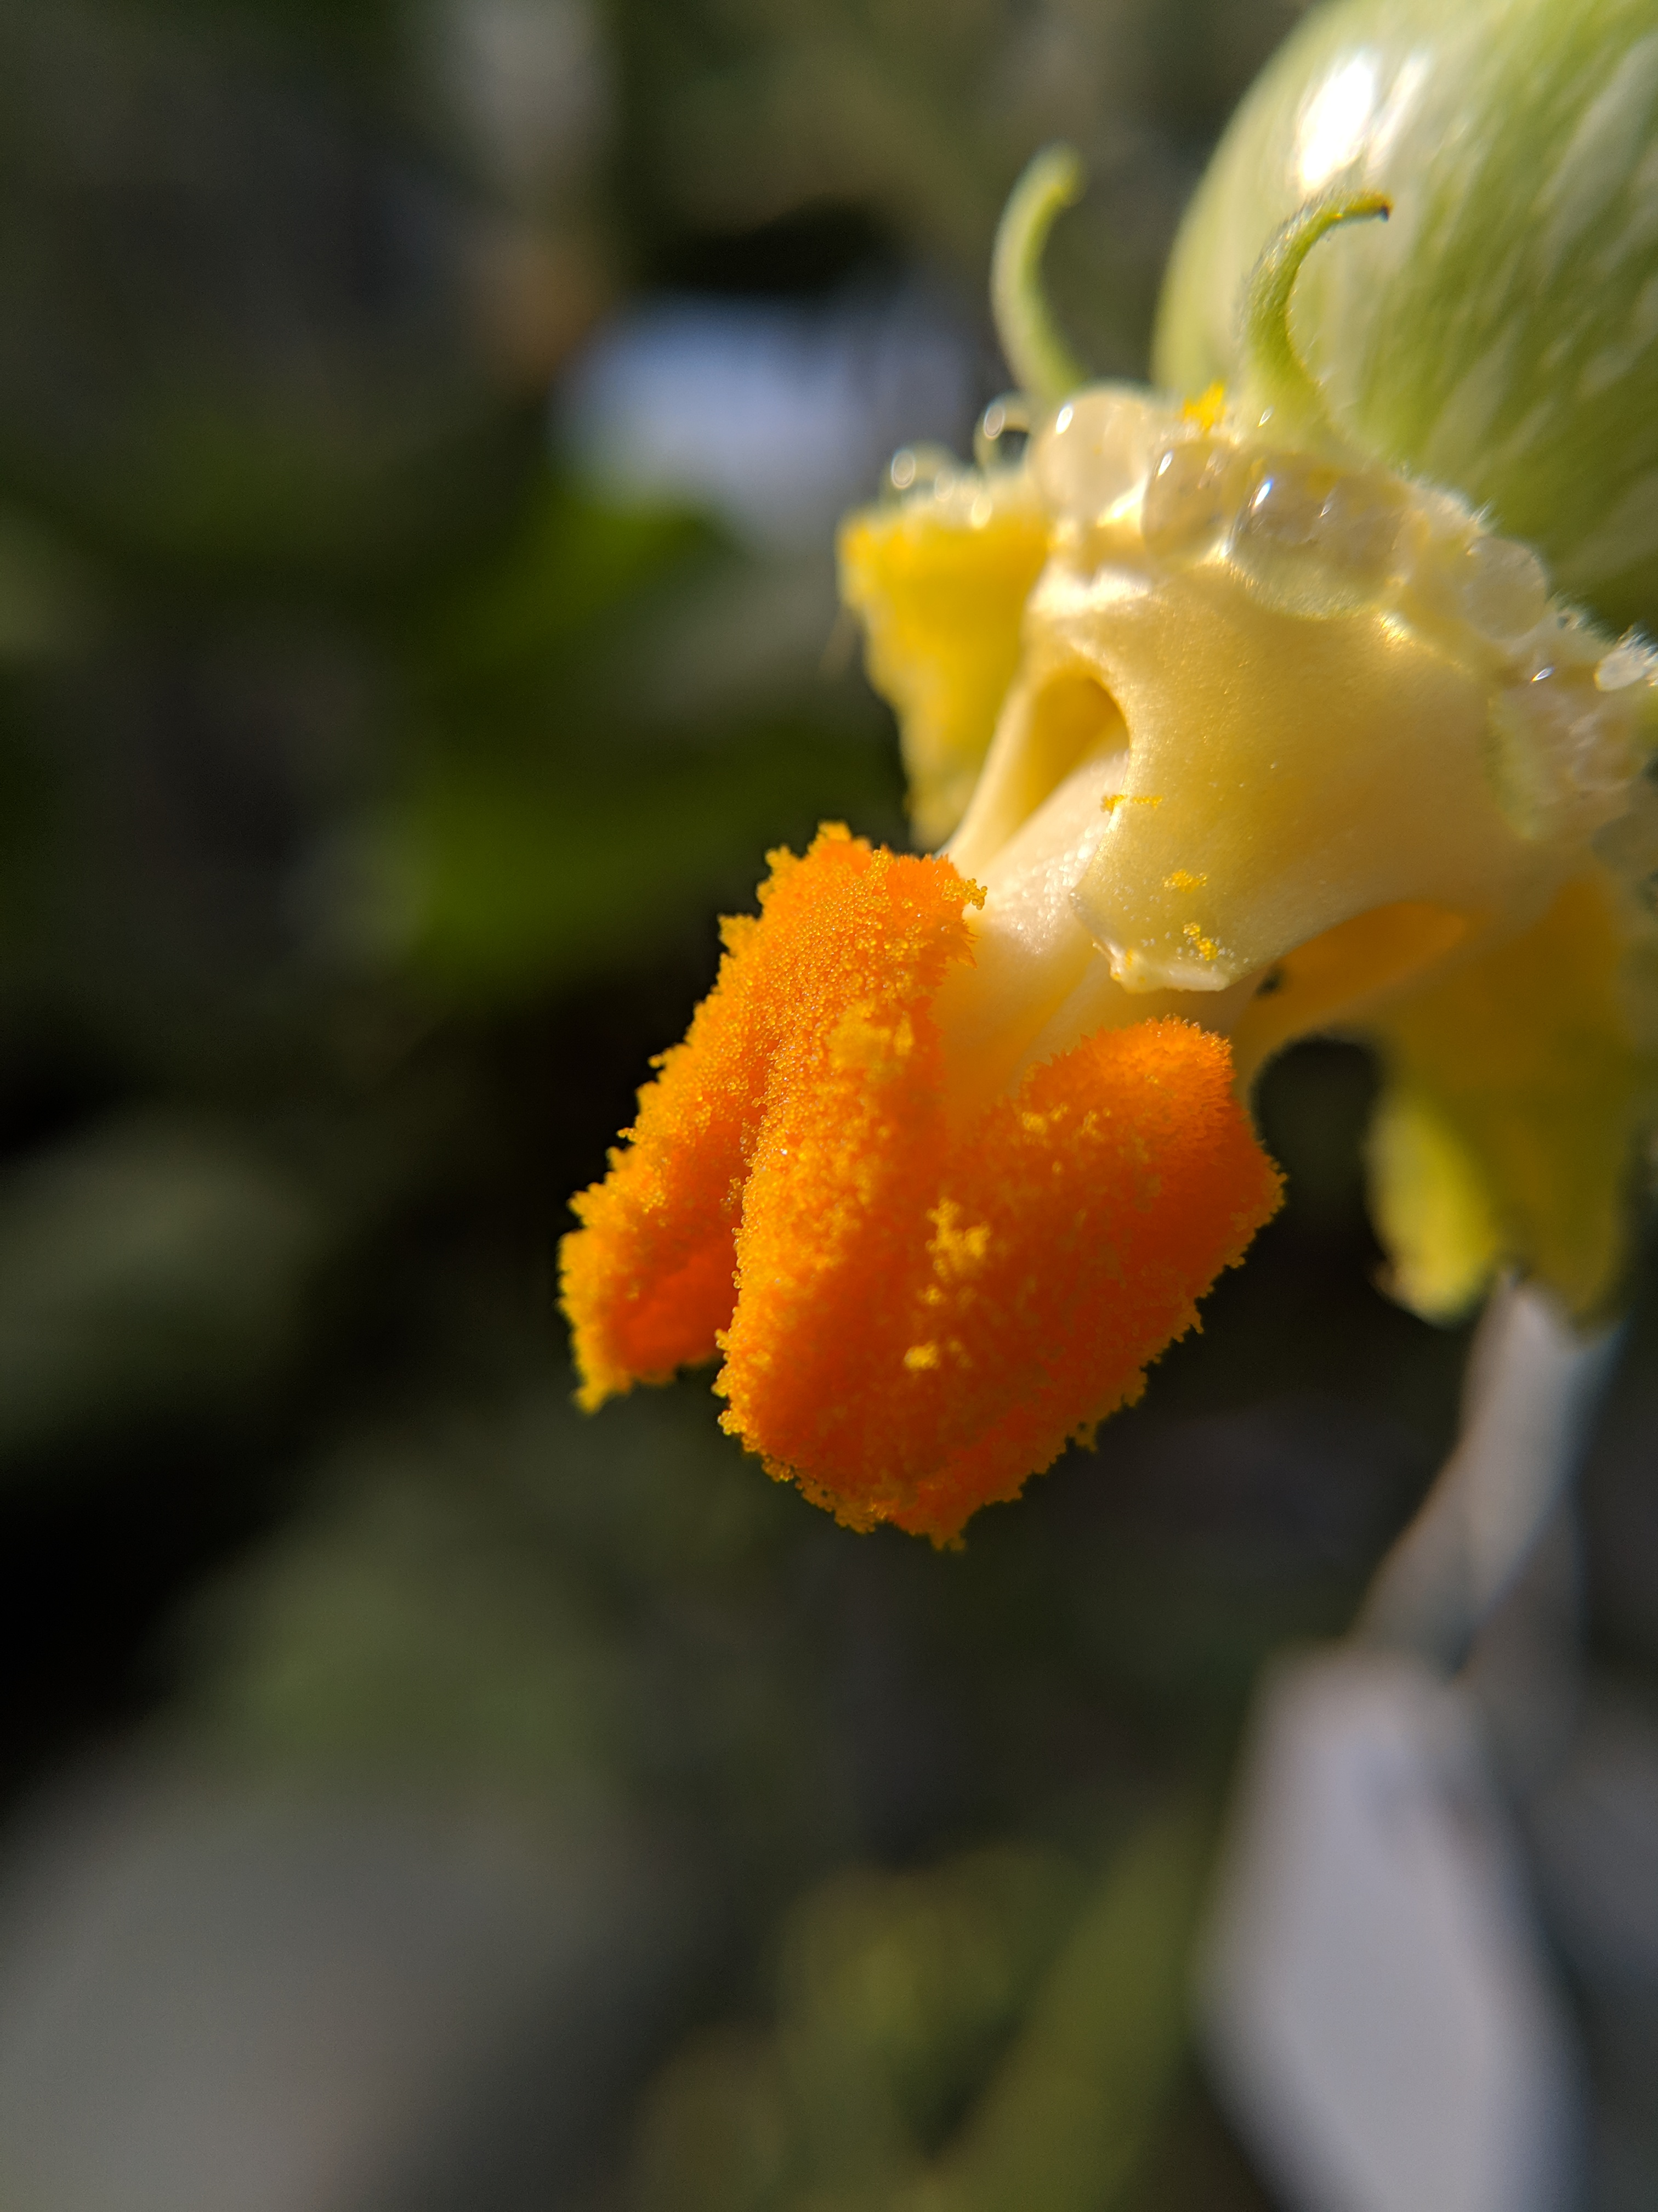
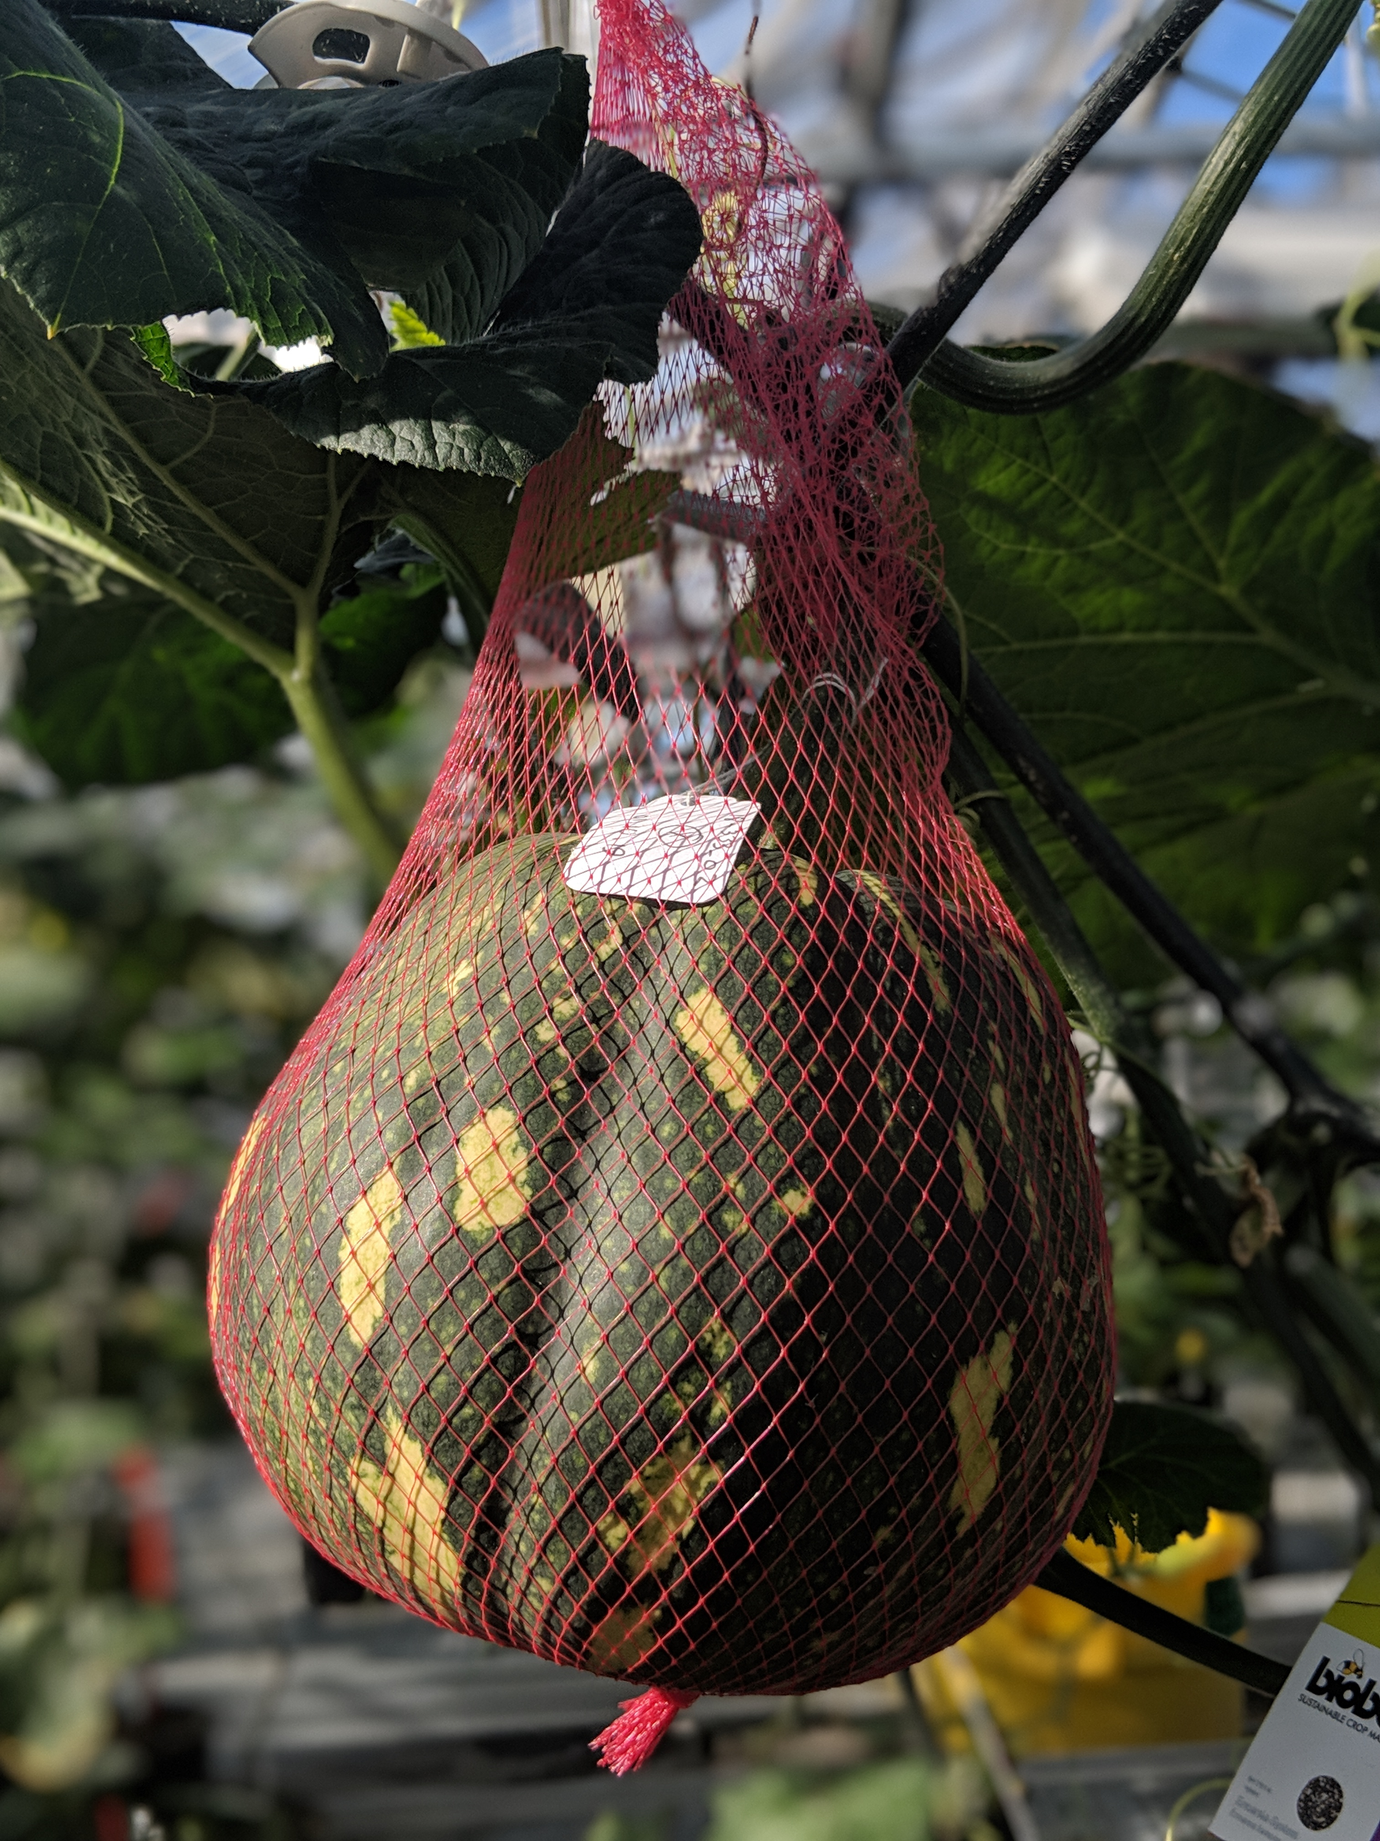
SQUASH POLLINATION GUIDE
Cucurbita moschata
Fruit of Cucurbita moschata are highly variable, but most squash have separate male and female flowers on a plant (monoecious). Squash are primarily out-crossing and depend on pollinators for successful fruit set.
PETAL
STIGMA
Step ONE: Properly label mature female flower
Step TWO: Identify mature male flower
Male flowers will appear first, followed by female flowers. Female flowers are characterized by a slightly swollen pedicel containing the ovary. The female reproductive
Male flowers have a straight, narrow pedicel. Their stamens contain heavy pollen that is only spread by active pollinators.
organ, the stigma, is a stout cluster in the middle of a female flower.
STAMEN
PEDICEL
Avoid dark/shriveled pollen. Male and immature female flowers must be tied and protected from pollinators if crossing outdoors.
OVARY
Step THREE: Remove petals to expose anther
Step FOUR: Remove petals to expose stigma
Carefully cut the male flower from the plant and remove petals to expose the anther. Check the pollen quality before proceeding.
Without damaging the ovary, remove the petals on the female flower to access the reproductive organ (stigma).
Step FIVE: Transfer donor pollen to stigma
Step SIX: Protect and monitor development
Carefully rub/roll pollen onto the stigmatic surface. Pollen grains on the stigma should be visible.
Using a paper bag and clip/stapler, cover the female flower and ovary to avoid cross-pollination. Fruits will grow in size and may need
additional support. Follow good seed stewardship practices, using clean harvesting and storage practices to obtain clean, safe seed.
TIPS FROM THE PROS:
Pollen viability is typically highest in the early morning
Viable pollen grains are large and require high humidity
This method also works for C. pepo crosses too!
THIS PROJECT WAS SUPPORTED BY:
NORTHERN ORGANIC VEGETABLE IMPROVEMENT COOPERATIVE
Photos and design by: H. Swegarden
Demonstration by: J. Teague (Mazourek Lab)

