Slide 1
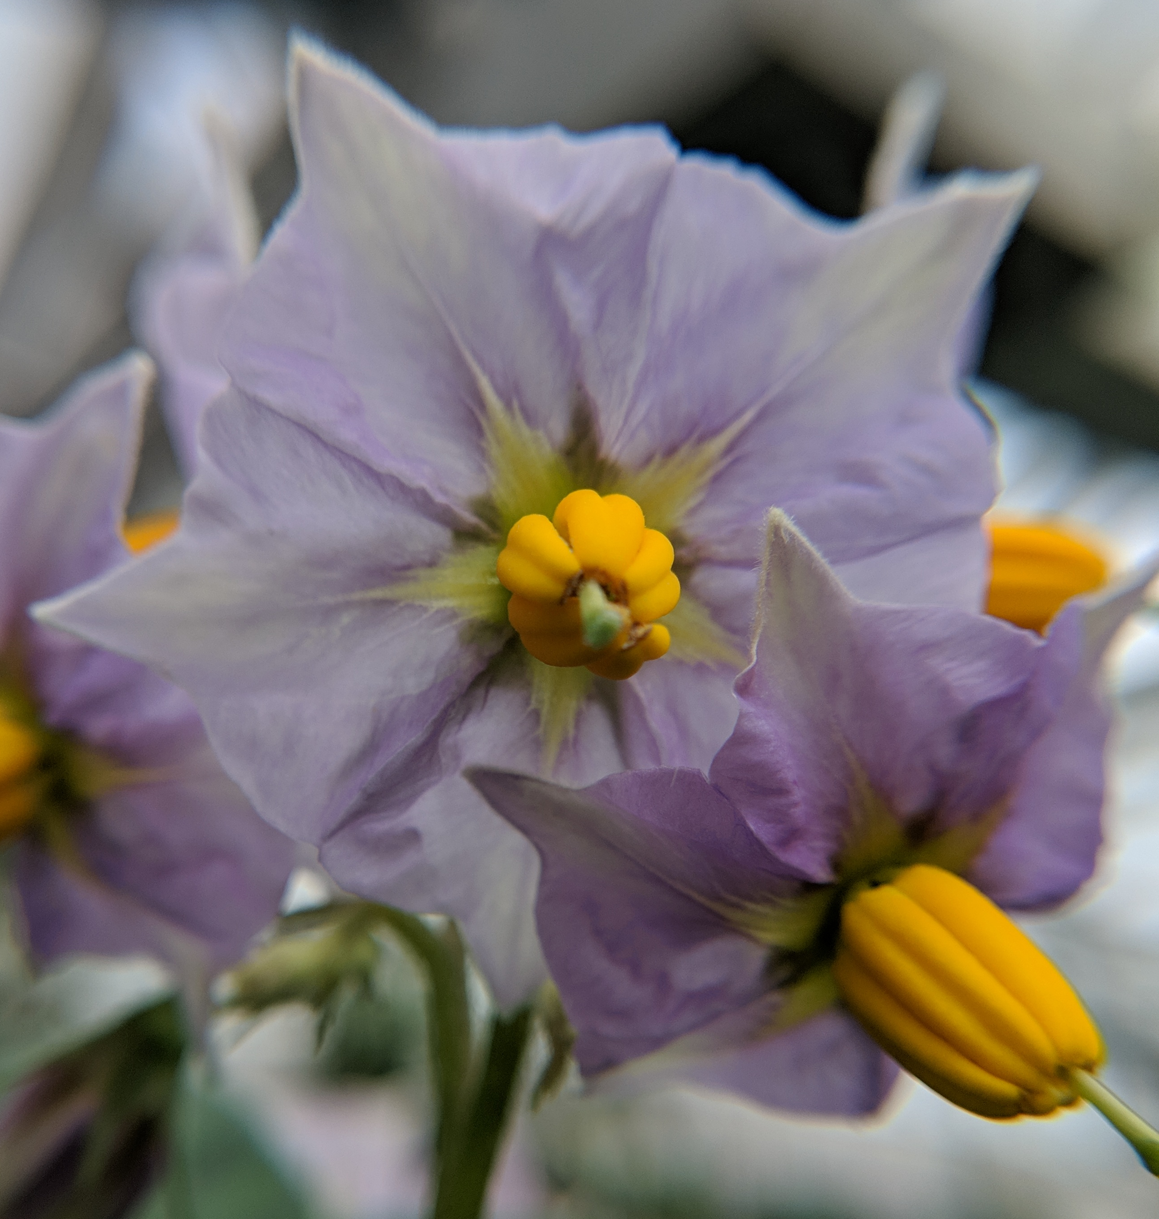
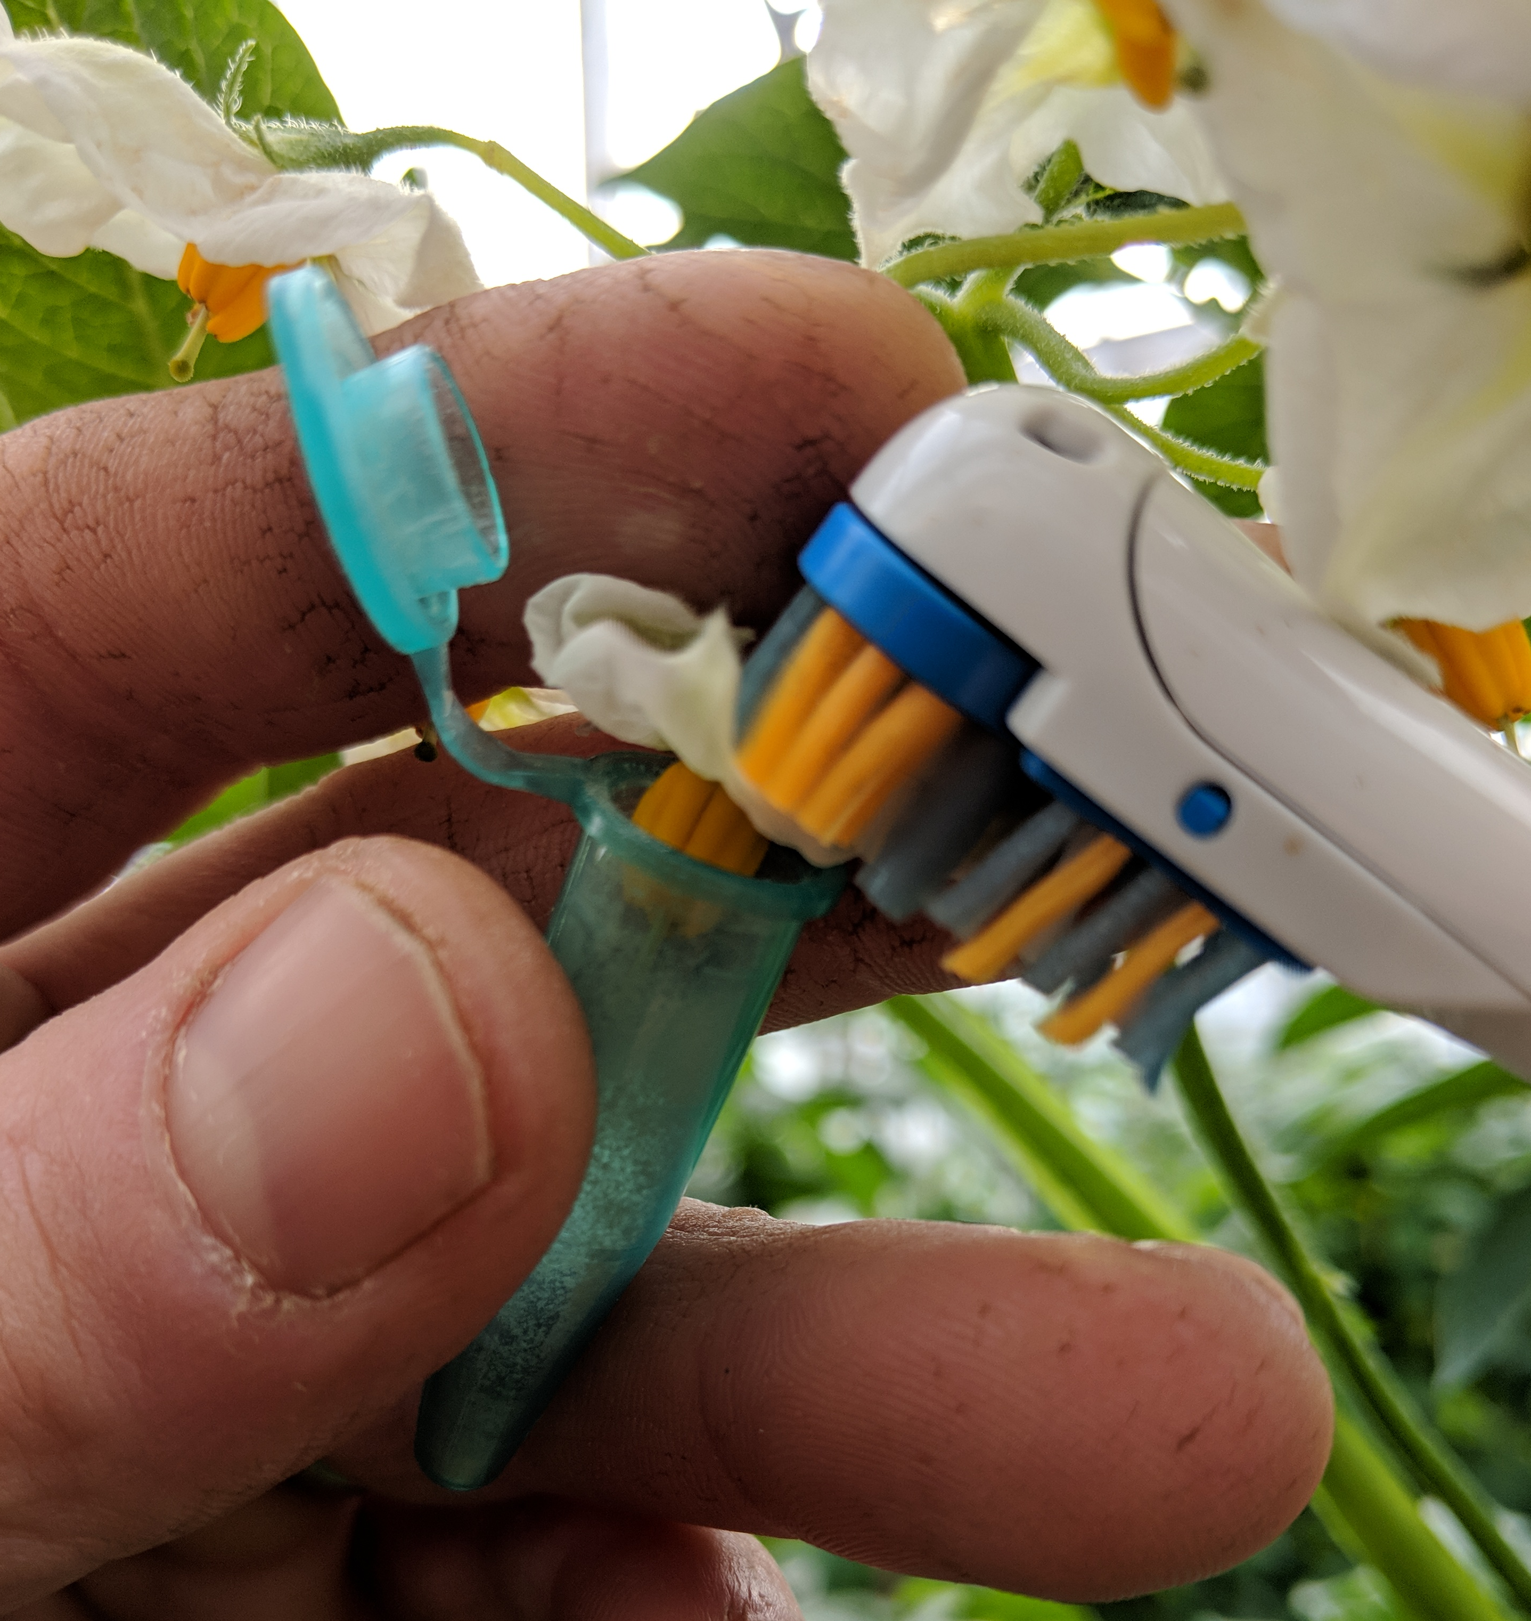
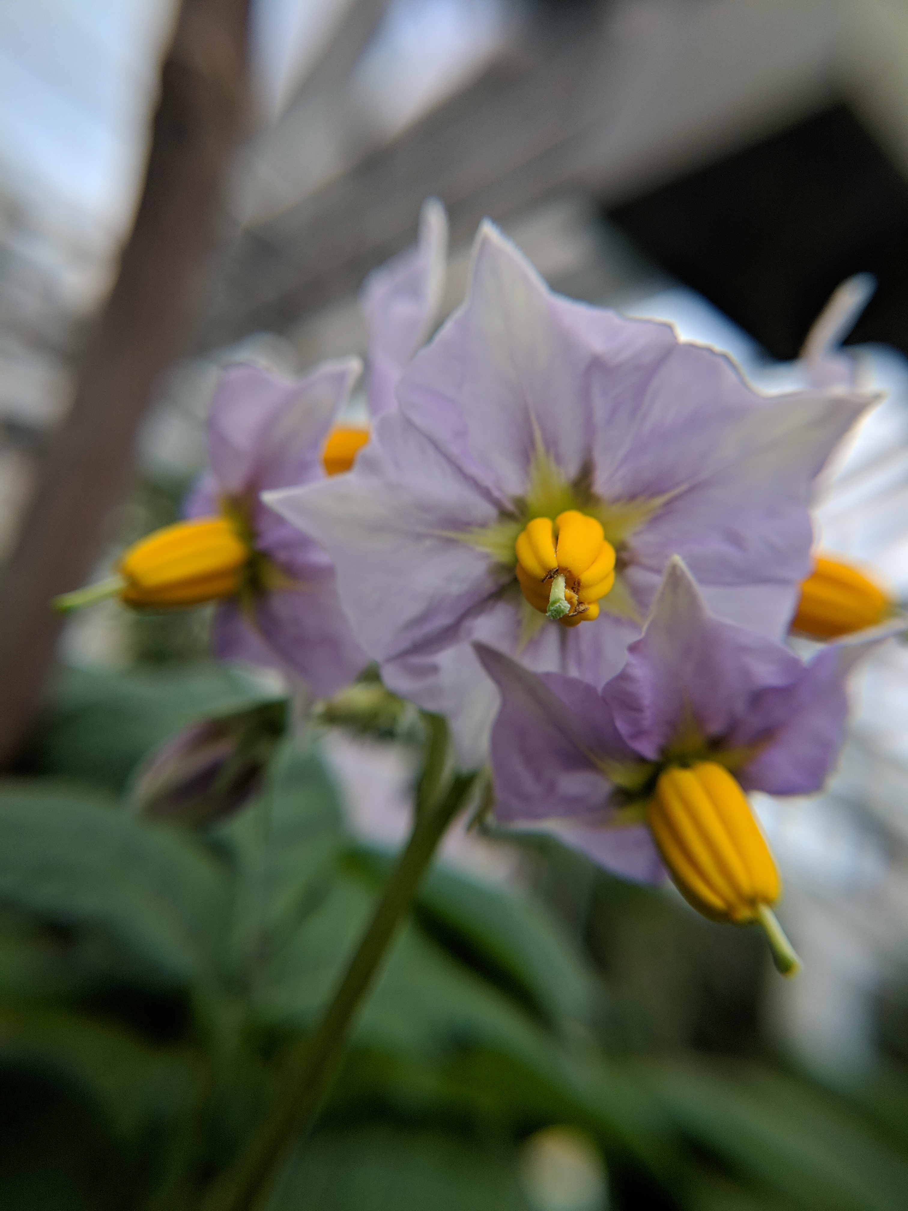
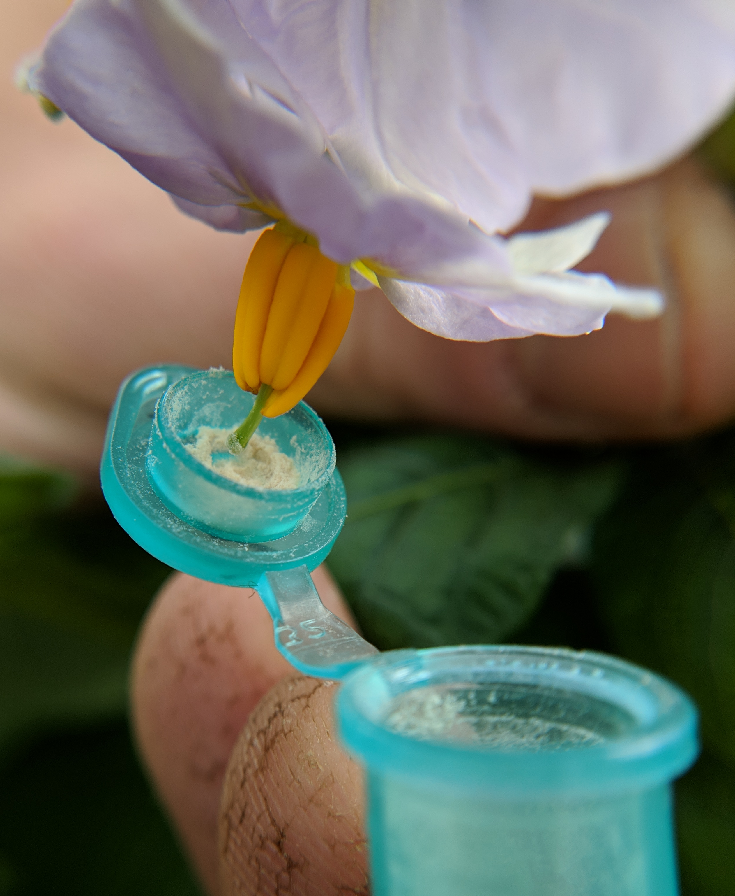
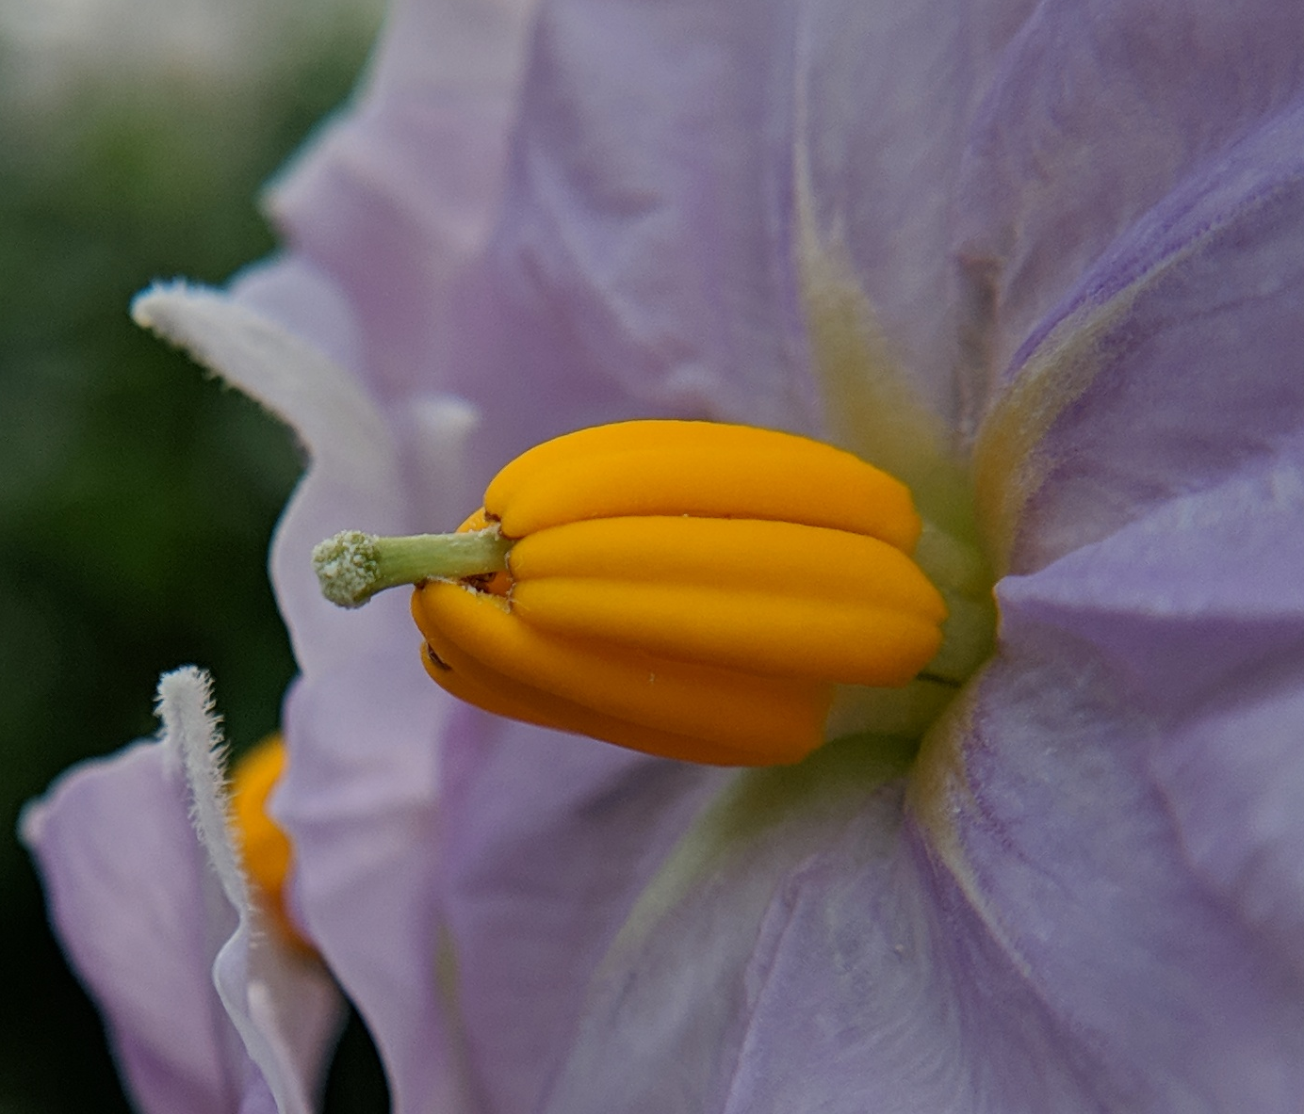
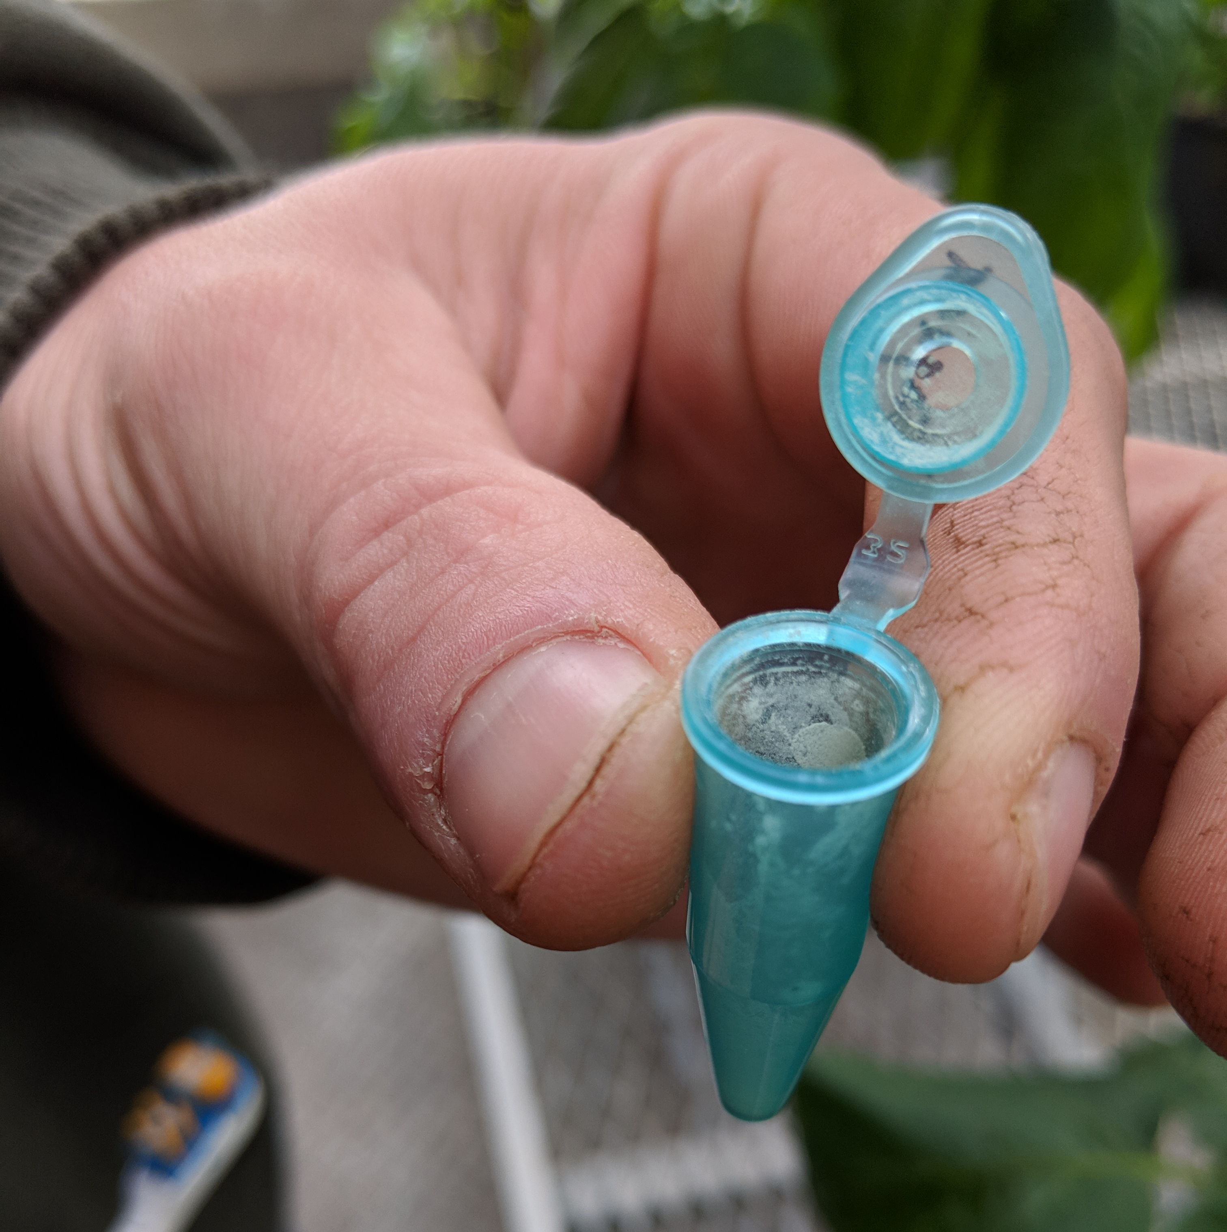
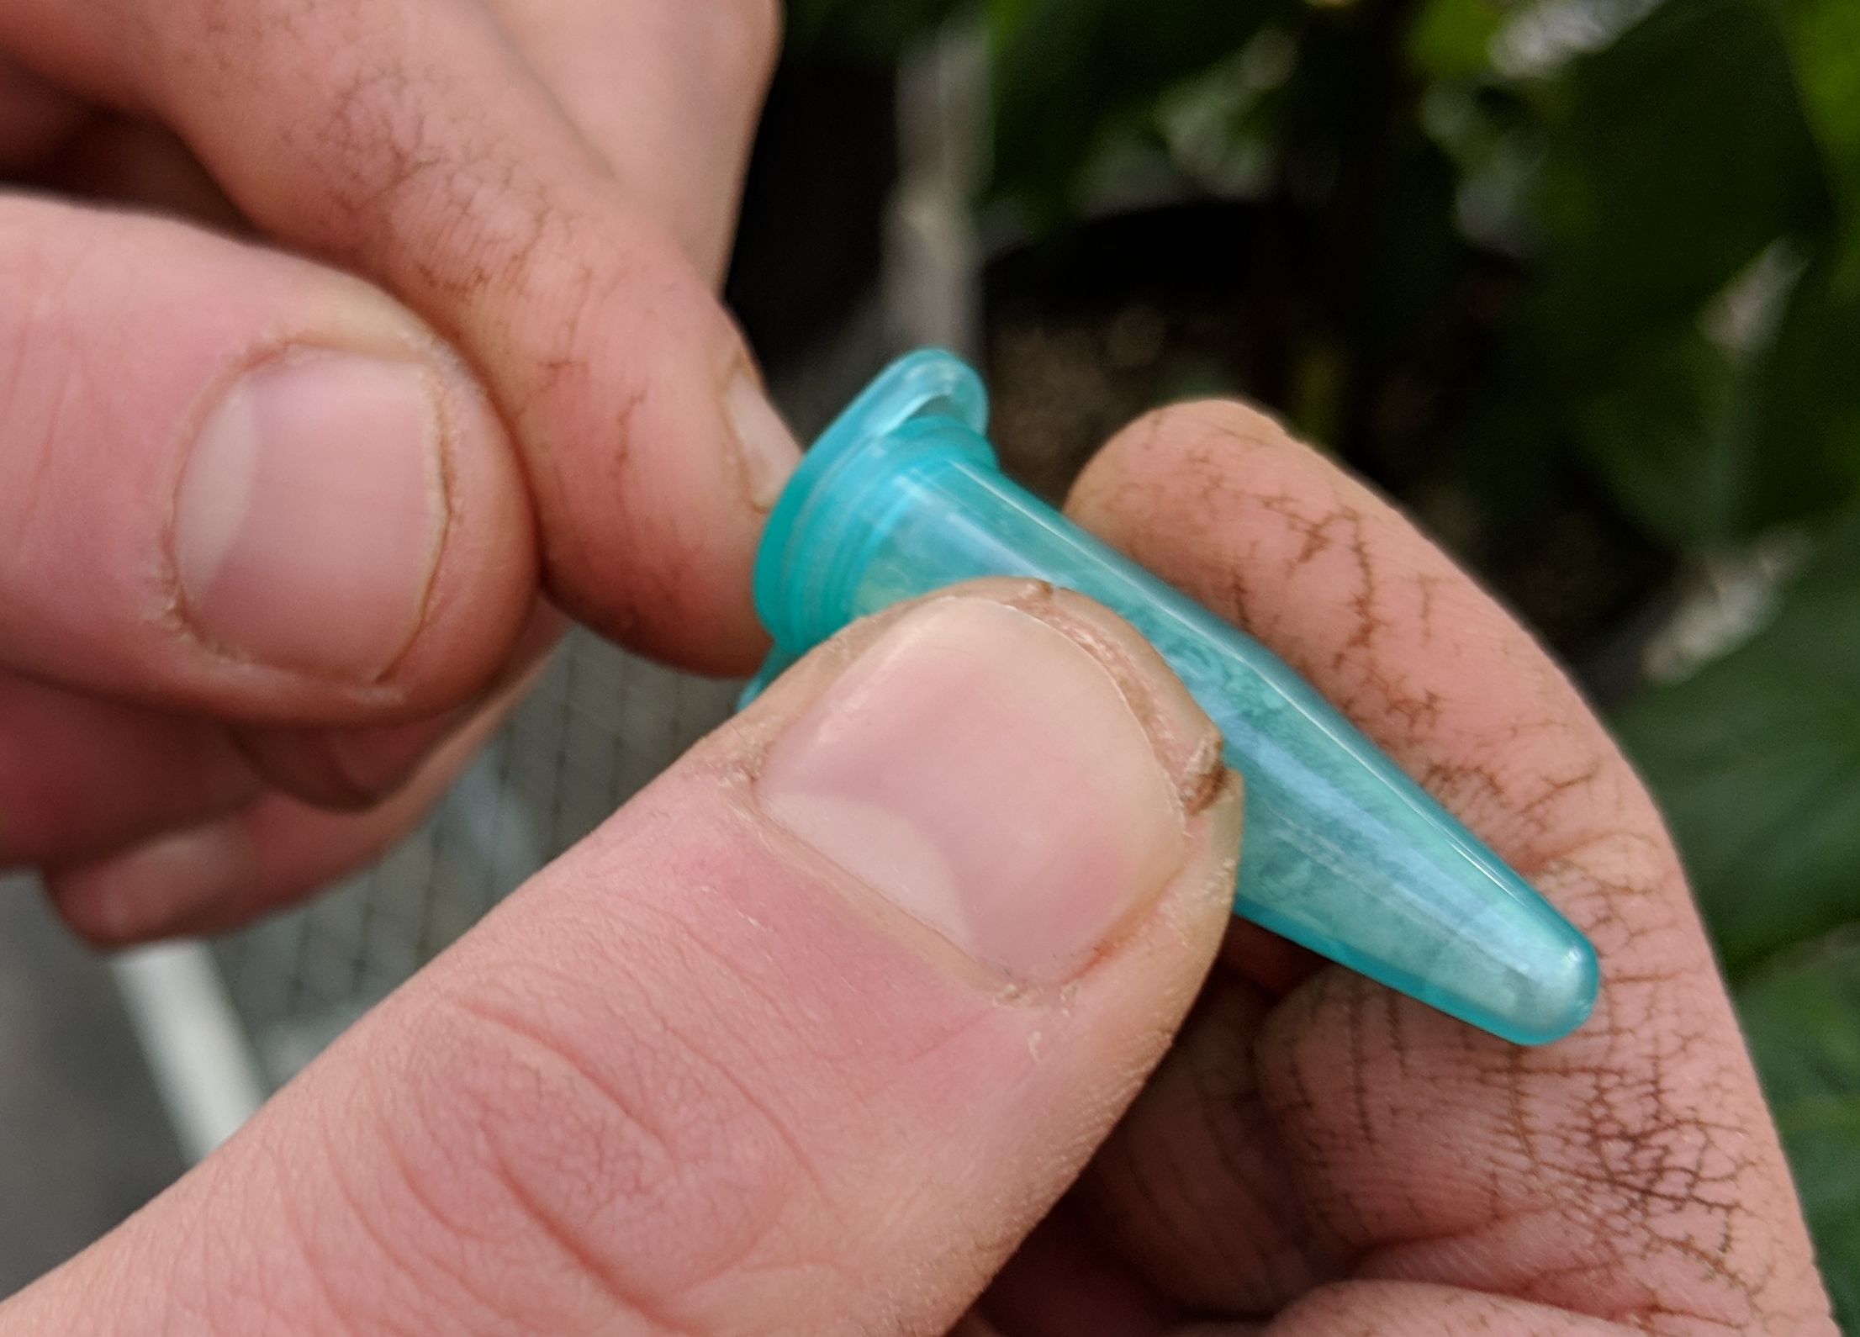
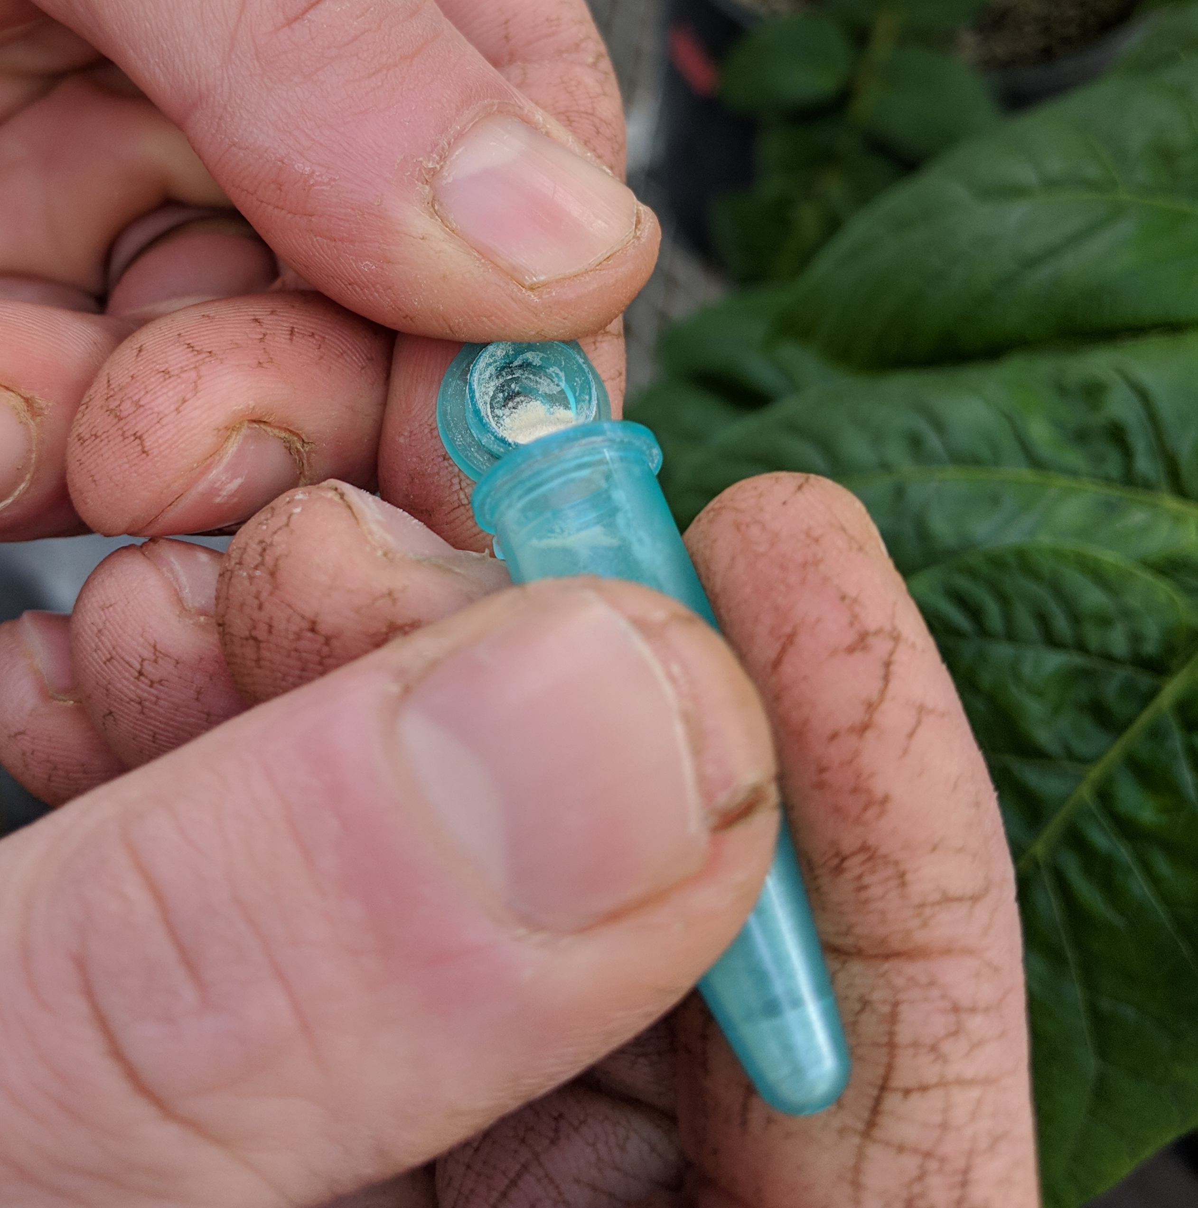
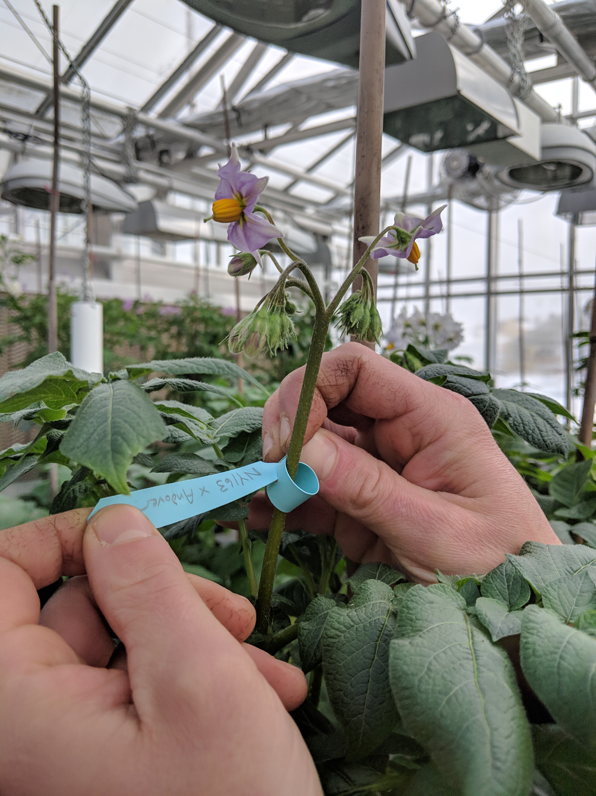
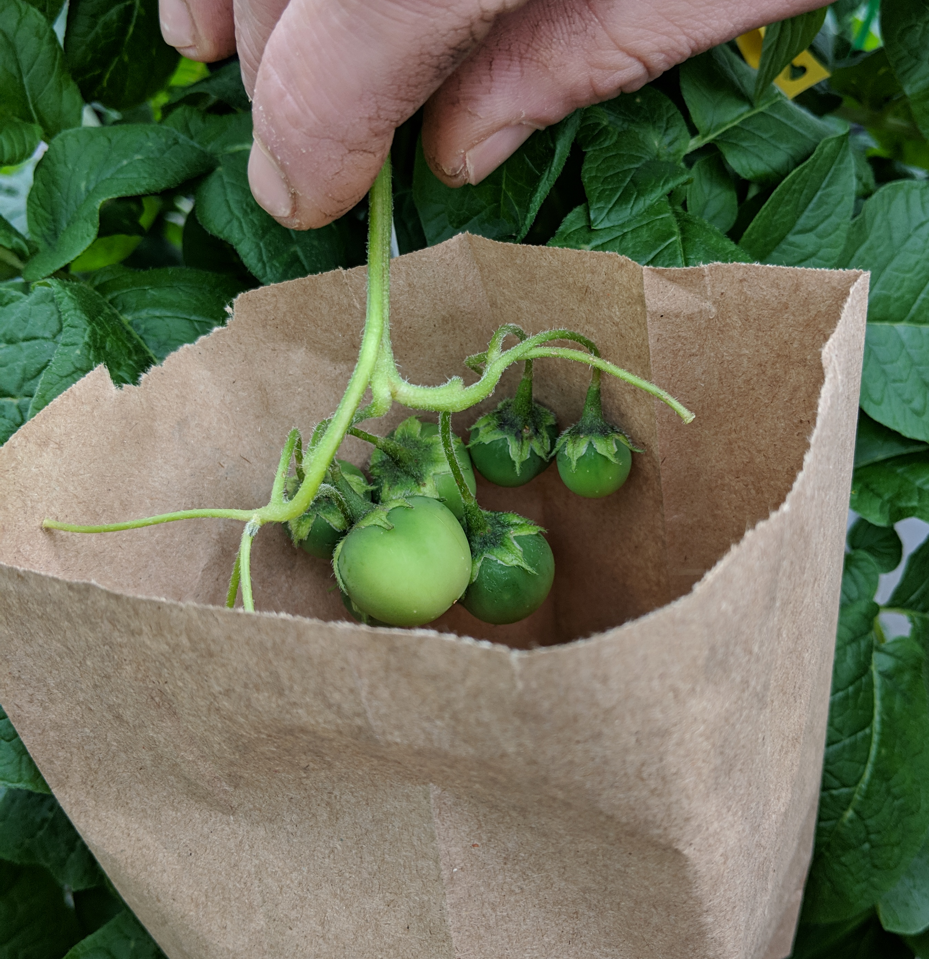
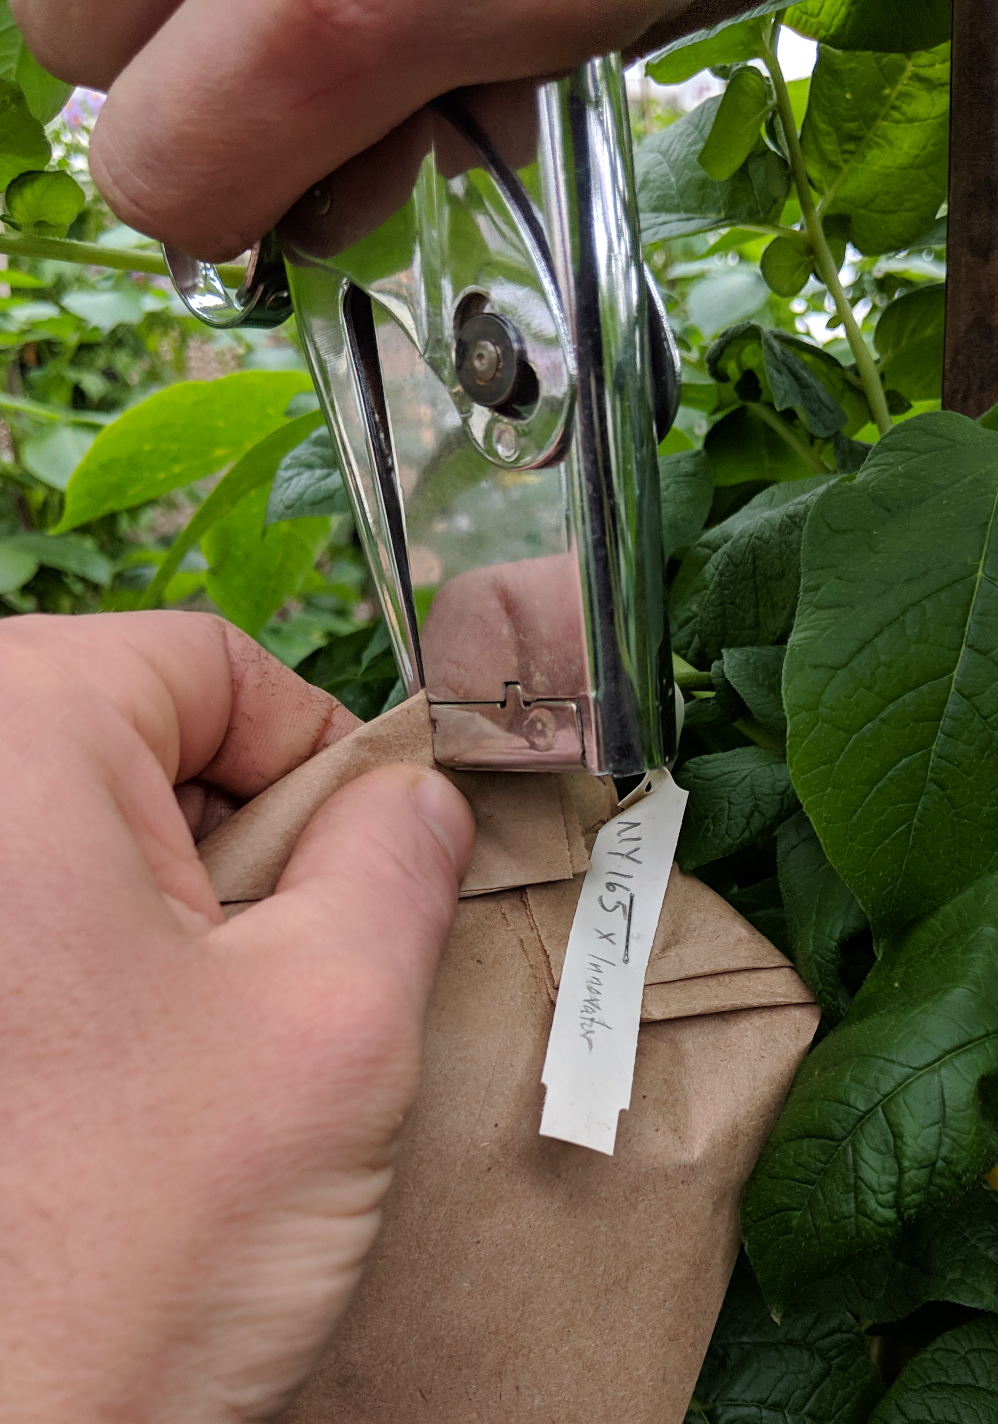
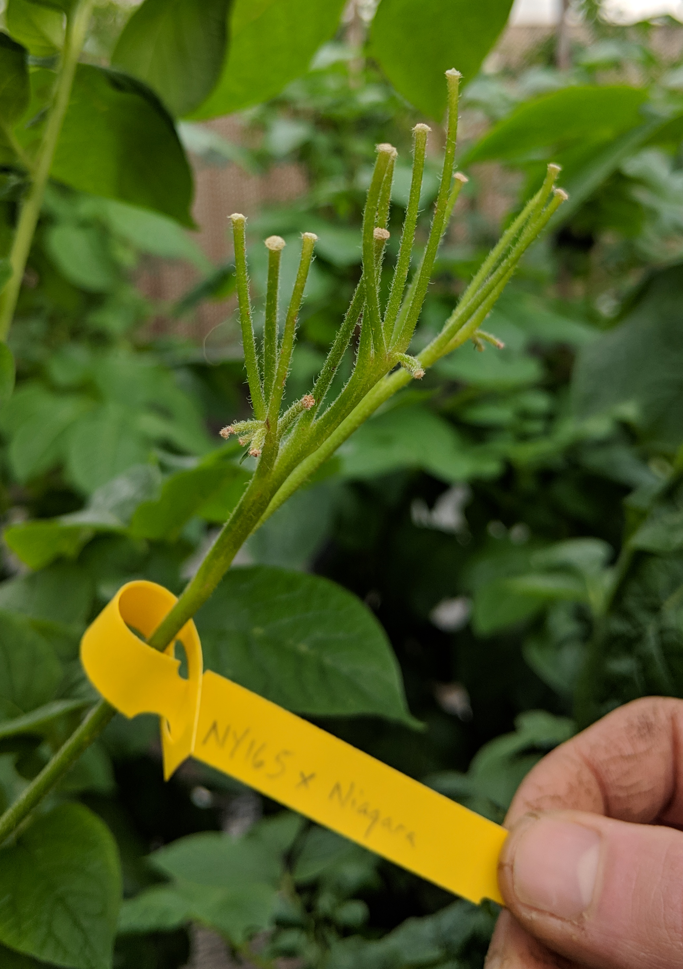

POTATO POLLINATION GUIDE
Solanum tuberosum
Potatoes are typically propagated clonally (via tubers), but their flowers are perfect, containing both male and female parts. Potatoes are sensitive to inbreeding and require outcrossing to form true seed.
PETAL
ANTHERS
STIGMA
Step ONE: Collect viable donor pollen
Step TWO: Identify receptive female flowers
Four to eight potato flowers will typically appear on a cyme (aka inflorescence). Place the anthers of a mature flower over the rim of a plastic capsule to catch mature pollen. Use an electric toothbrush or finger tap to shake pollen from the flower into the capsule.
Flowers on the cymes open two or three at a time, and the female stigma typically remains receptive for two days. Look for a cyme that is in it’s first first flush of flowering. Remove the remaining unopened flower buds or save them to make more of the same cross in the near future. Emasculation is most often not necessary but can be performed if selfed seed is an issue.
Step THREE: Prepare pollen for transfer
Step FOUR: Transfer donor pollen to stigma
Close the top of the plastic capsule and gently tap the capsule to agitate the pollen. Carefully open the top of the capsule, which should contain pollen.
Gently dip the female stigma into the pollen-filled tube, covering the
entire stigmatic surface evenly. Continue to pollinate all fully open flowers on selected inflorescence. Seal and store pollen for later use.
Step FIVE: Properly label cross
Step SIX: Monitor and harvest mature fruit
Using a durable tag, mark the entire inflorescence and cover with a pollen exclusion bag if outdoors. Additional crosses may be made when other
Small berries will develop with successful fertilization, each containing <100 seeds. Place the
entire inflorescence
Young buds on the cyme open. Check back in two weeks to look for young berries.
of berries in a brown paper bag. For good seed stewardship, use clean harvesting and storage practices to obtain high quality, safe seed.
TIPS FROM THE PROS:
Plant clean, quality tubers to produce flowering plants
Many modern cultivars produce little, even sterile, pollen
Potato genetics are very complex - don’t be surprised if something very different appears in the next generation!
THIS PROJECT WAS SUPPORTED BY:
NORTHERN ORGANIC VEGETABLE IMPROVEMENT COOPERATIVE
Photos and design by: H. Swegarden
Demonstration by: M. Falise (De Jong Lab)

