Slide 1
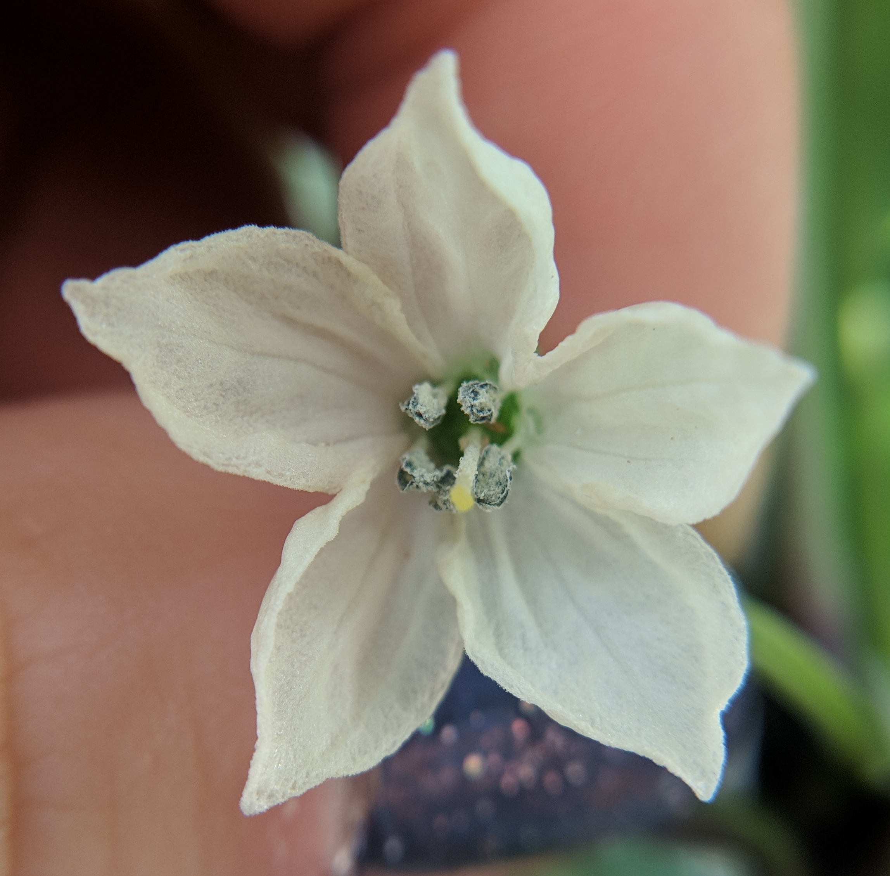
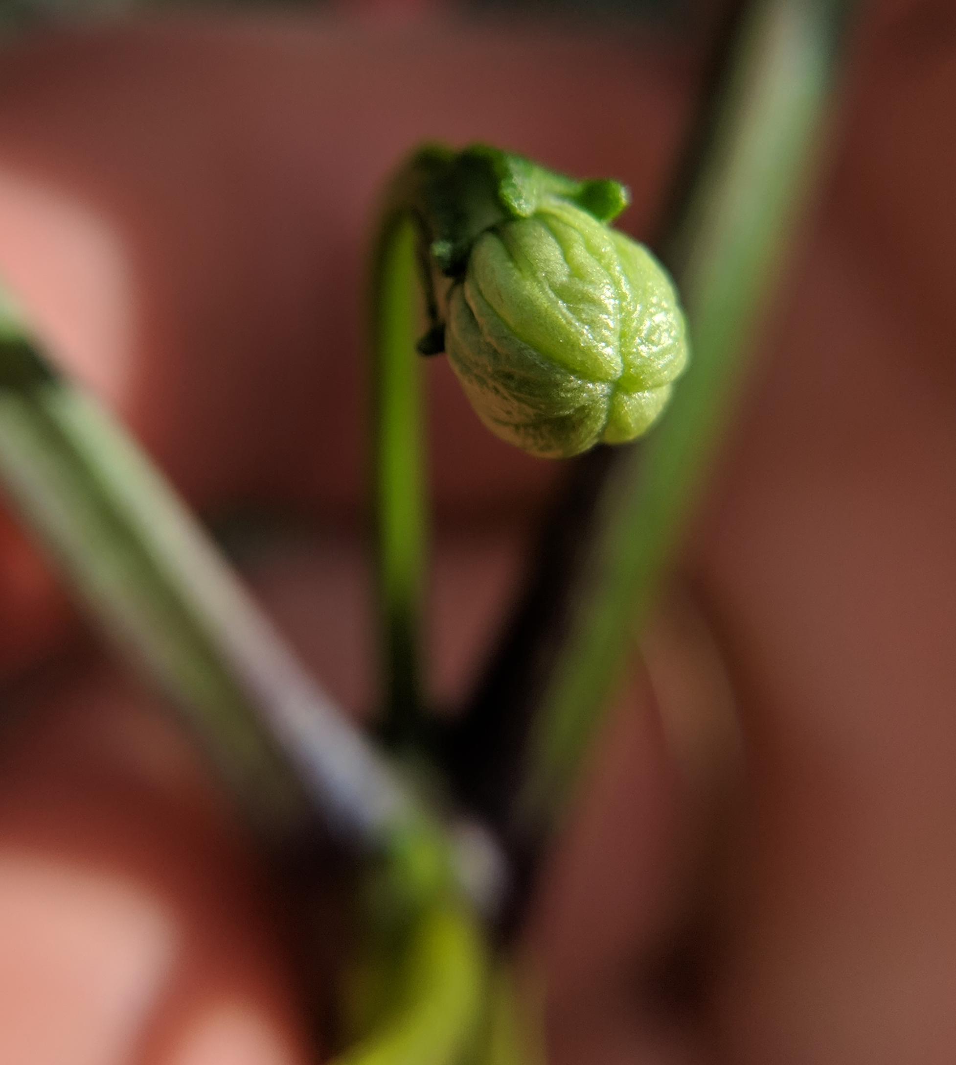
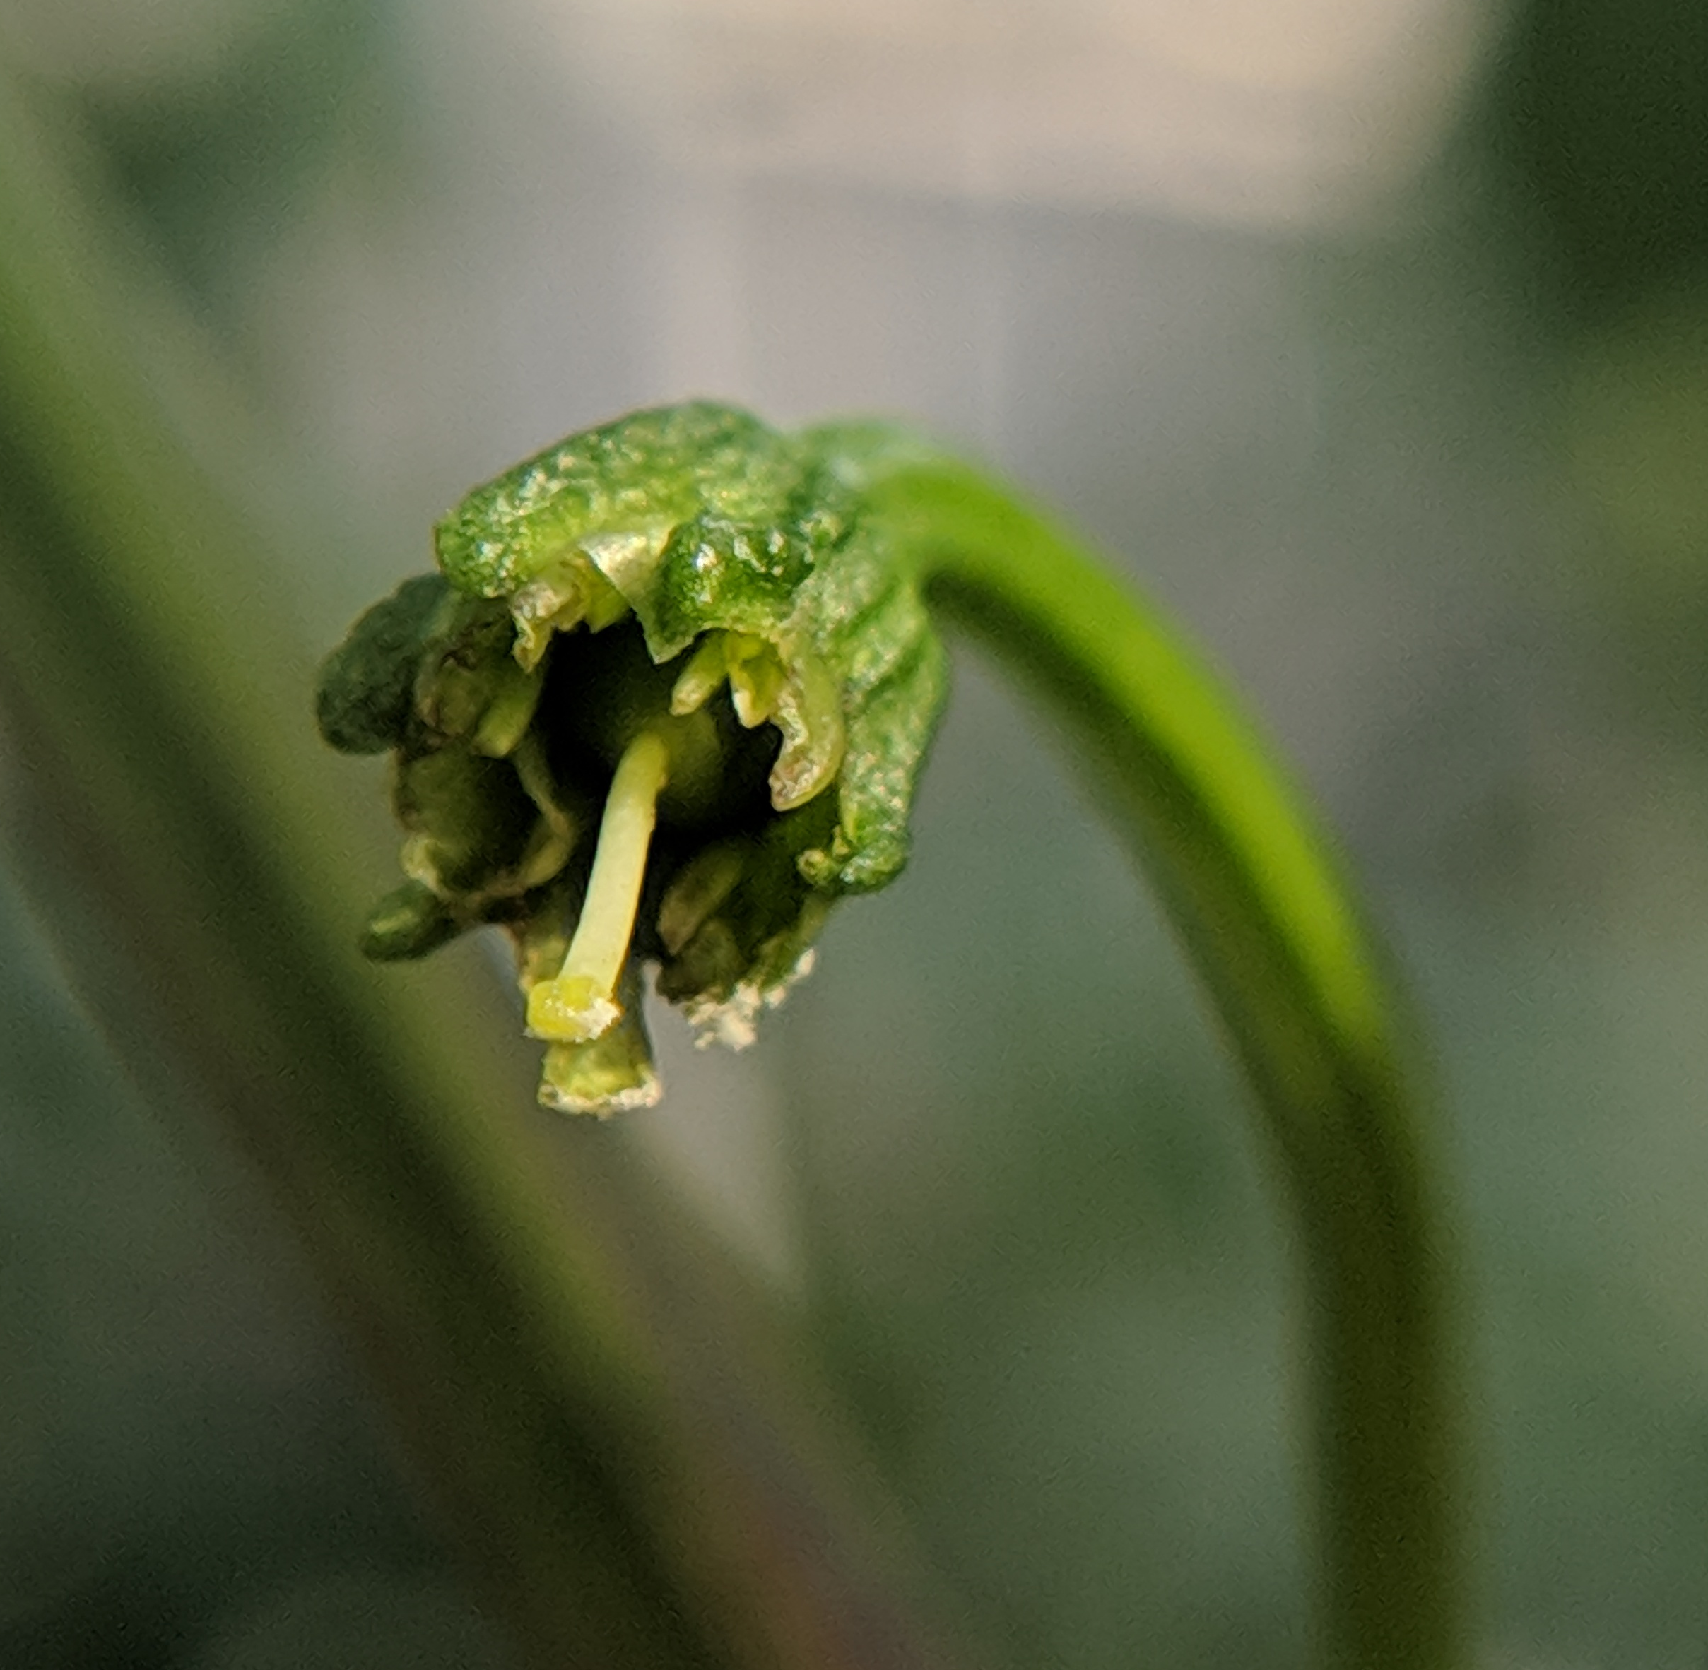
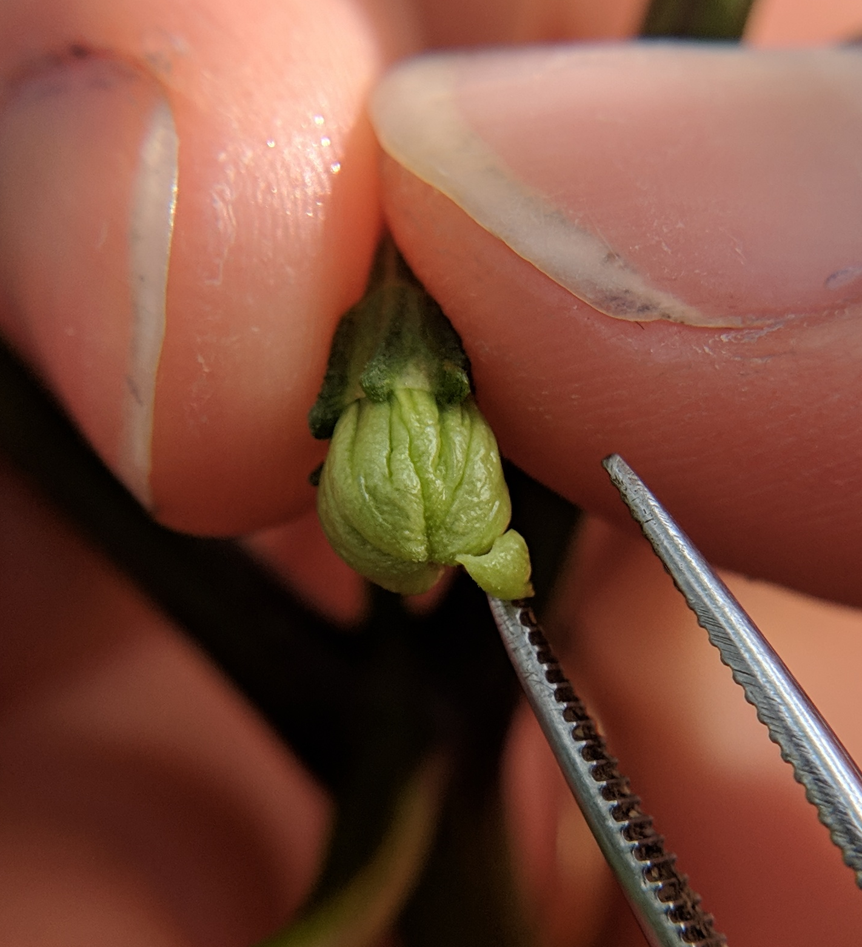
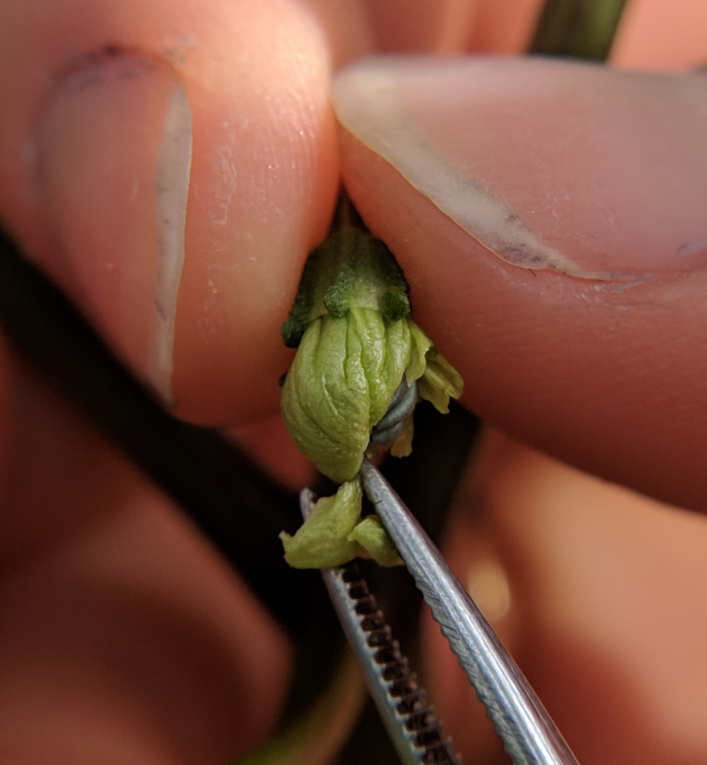
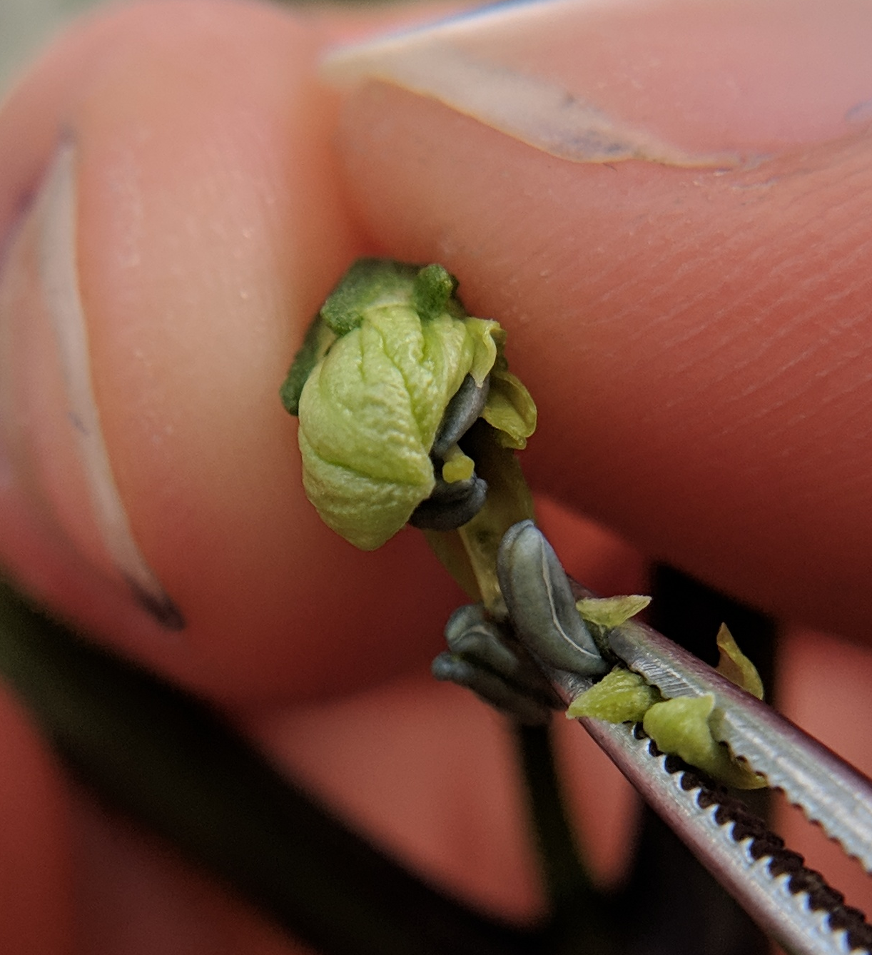
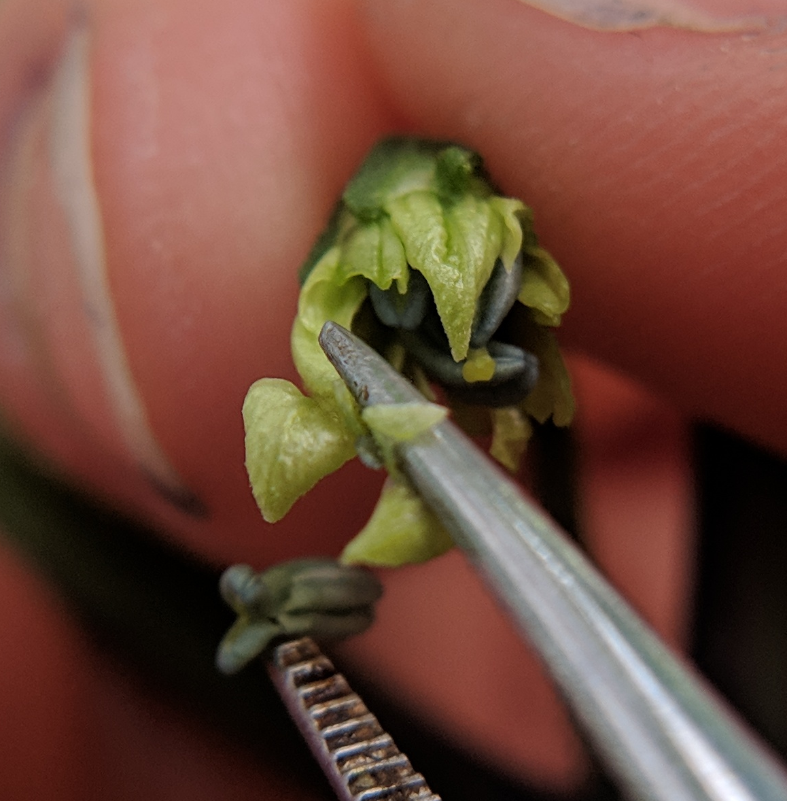
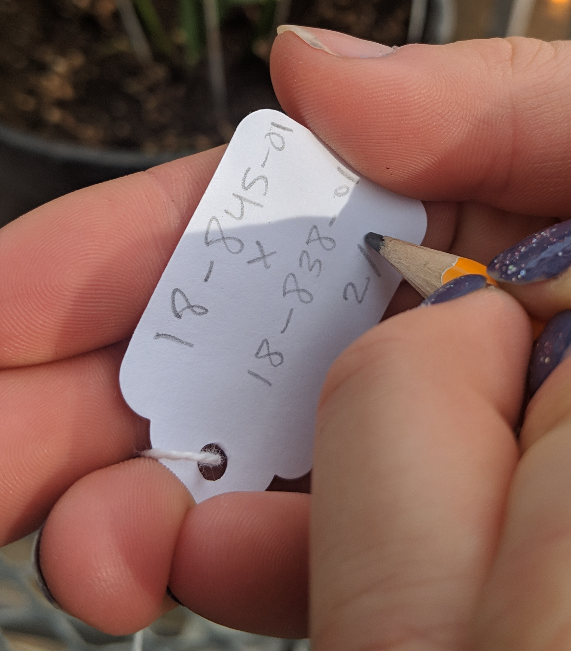
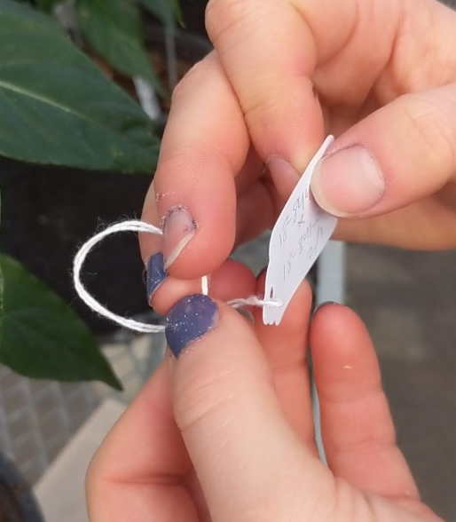
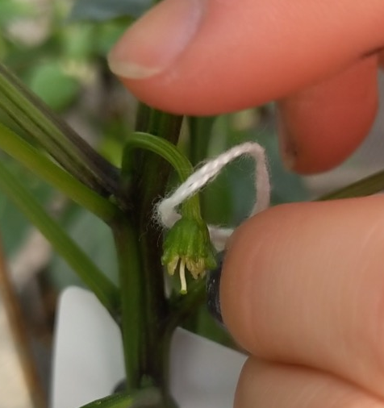
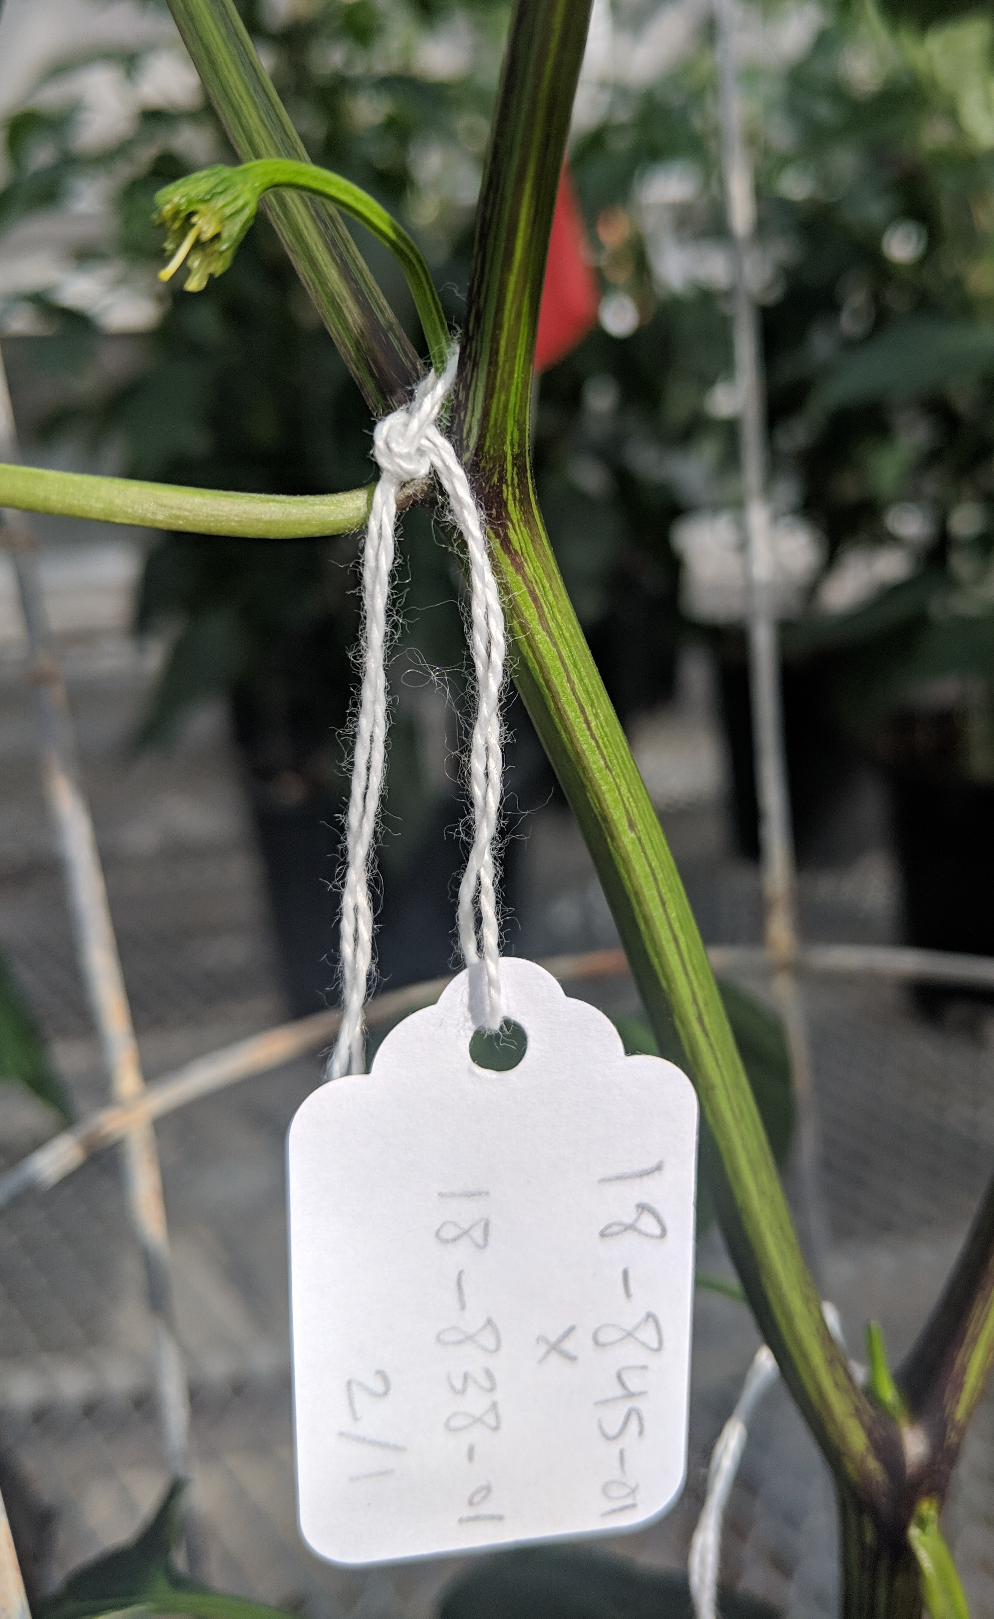
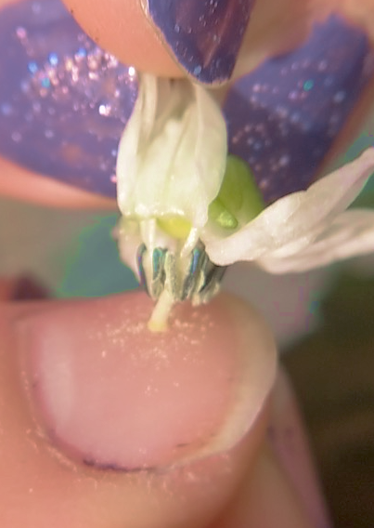
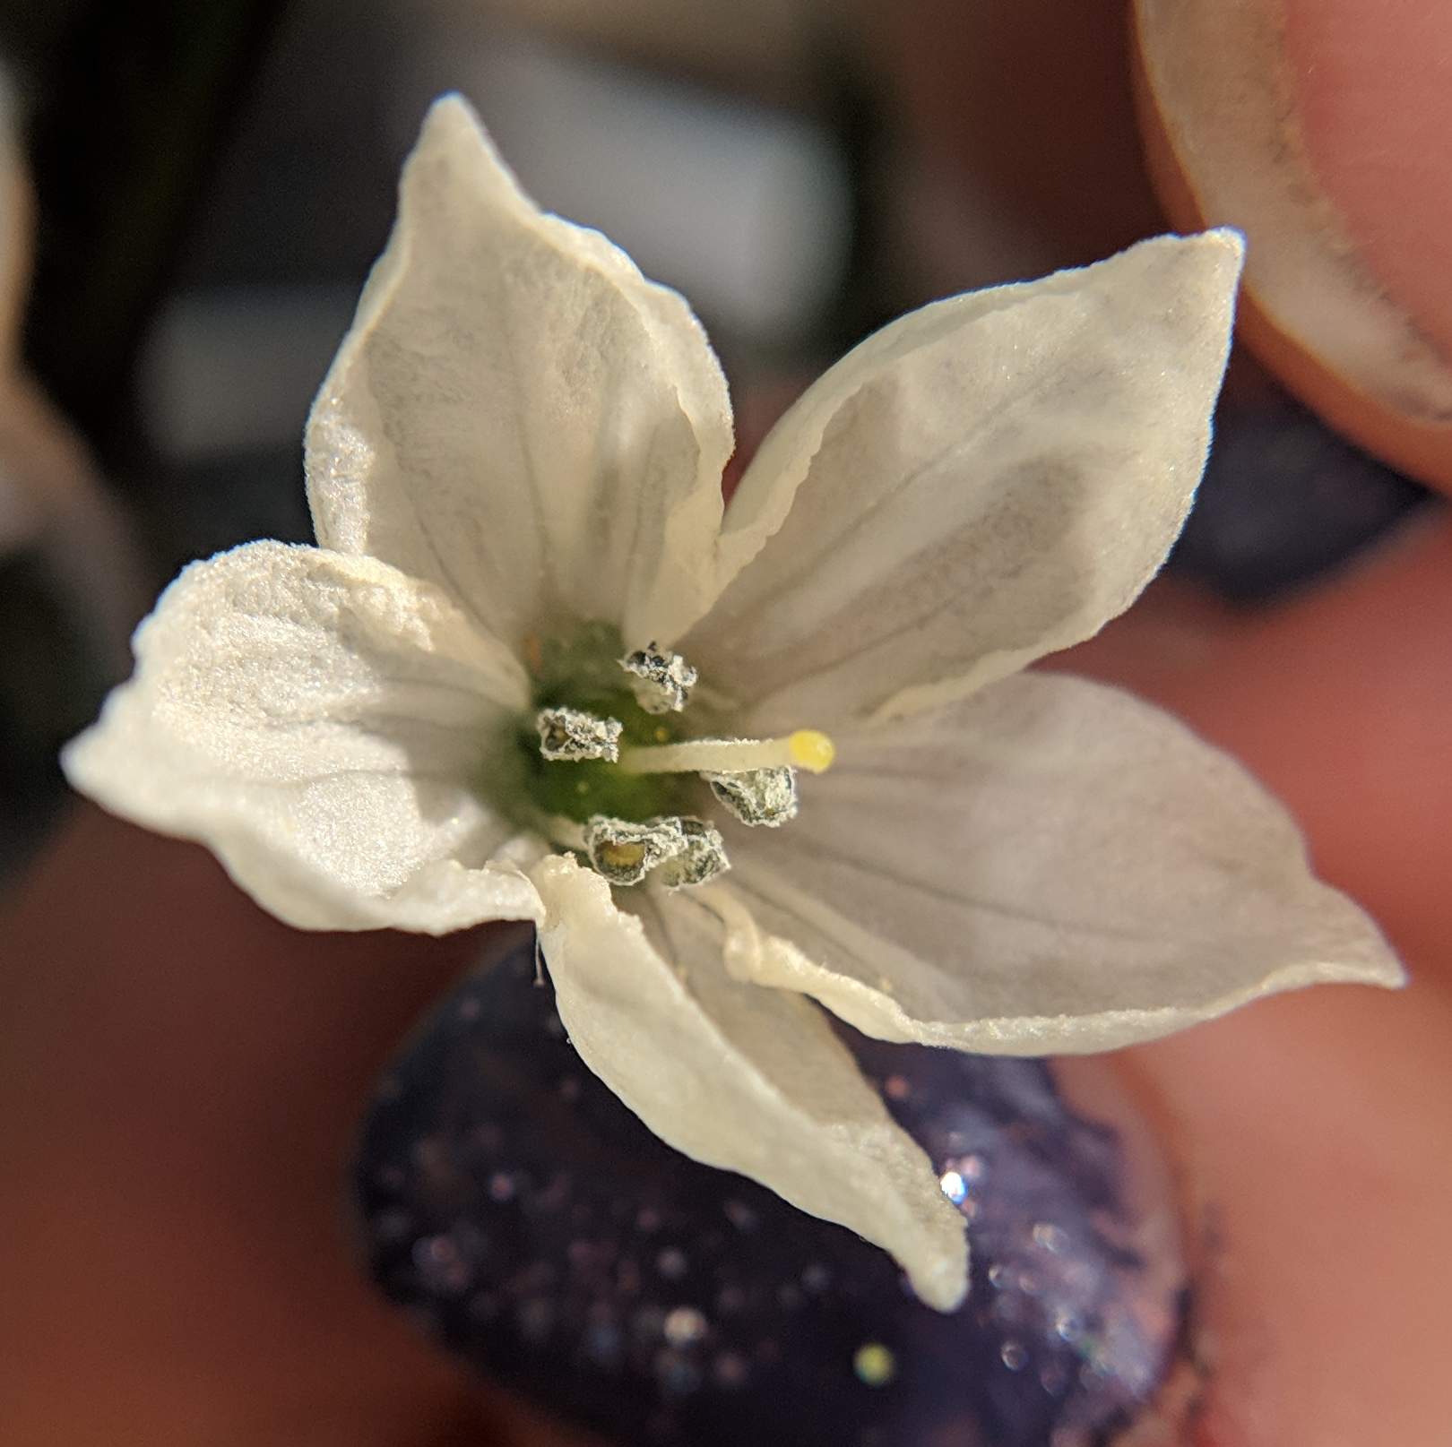
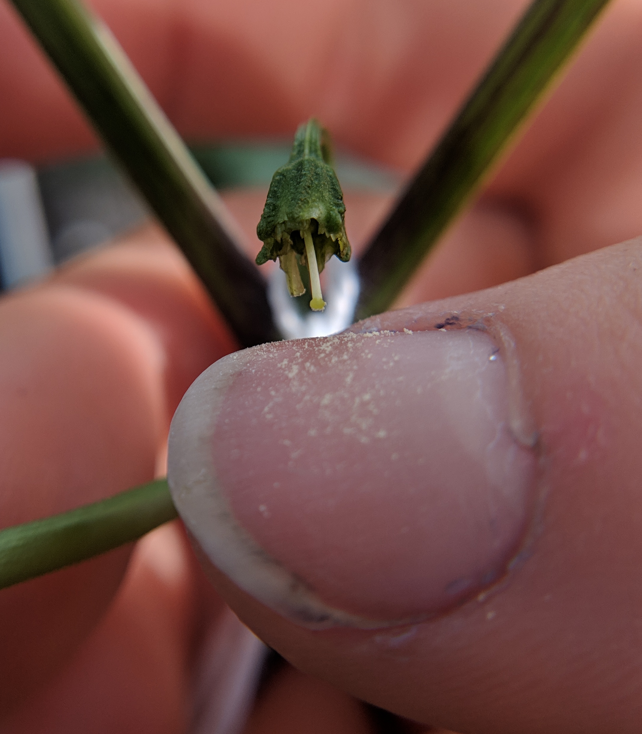
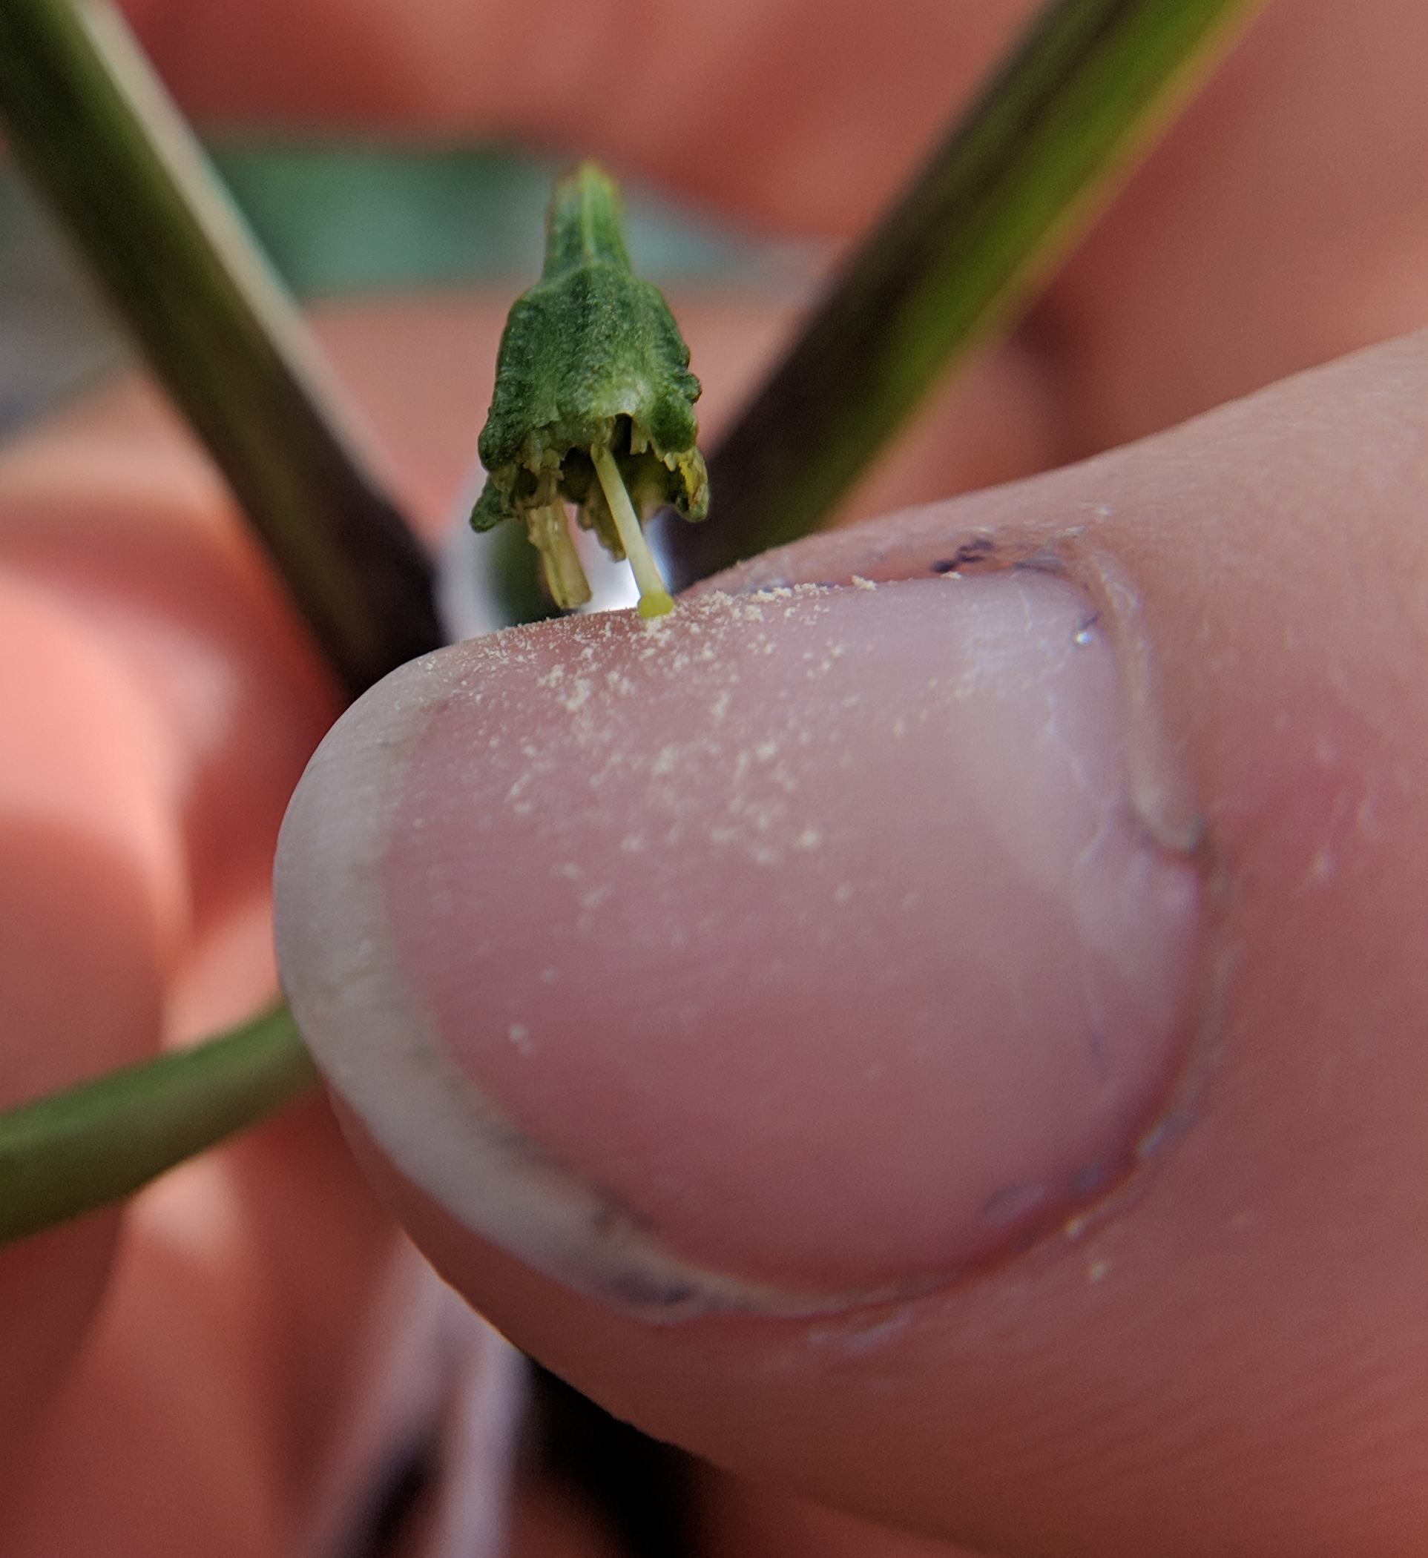
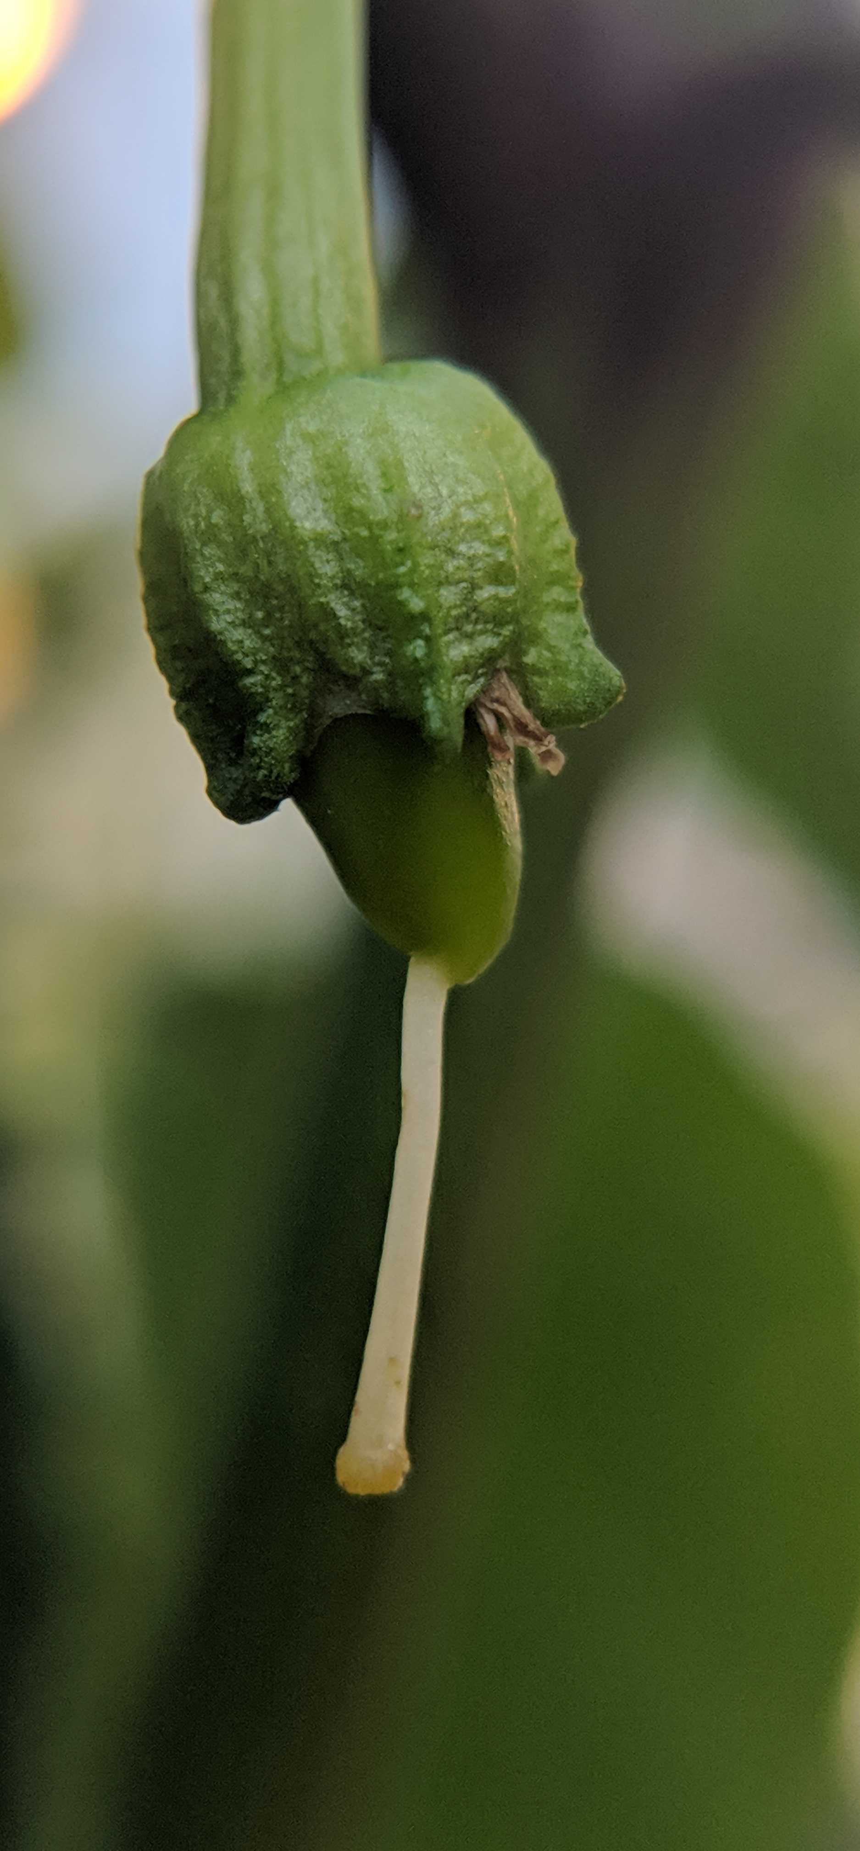
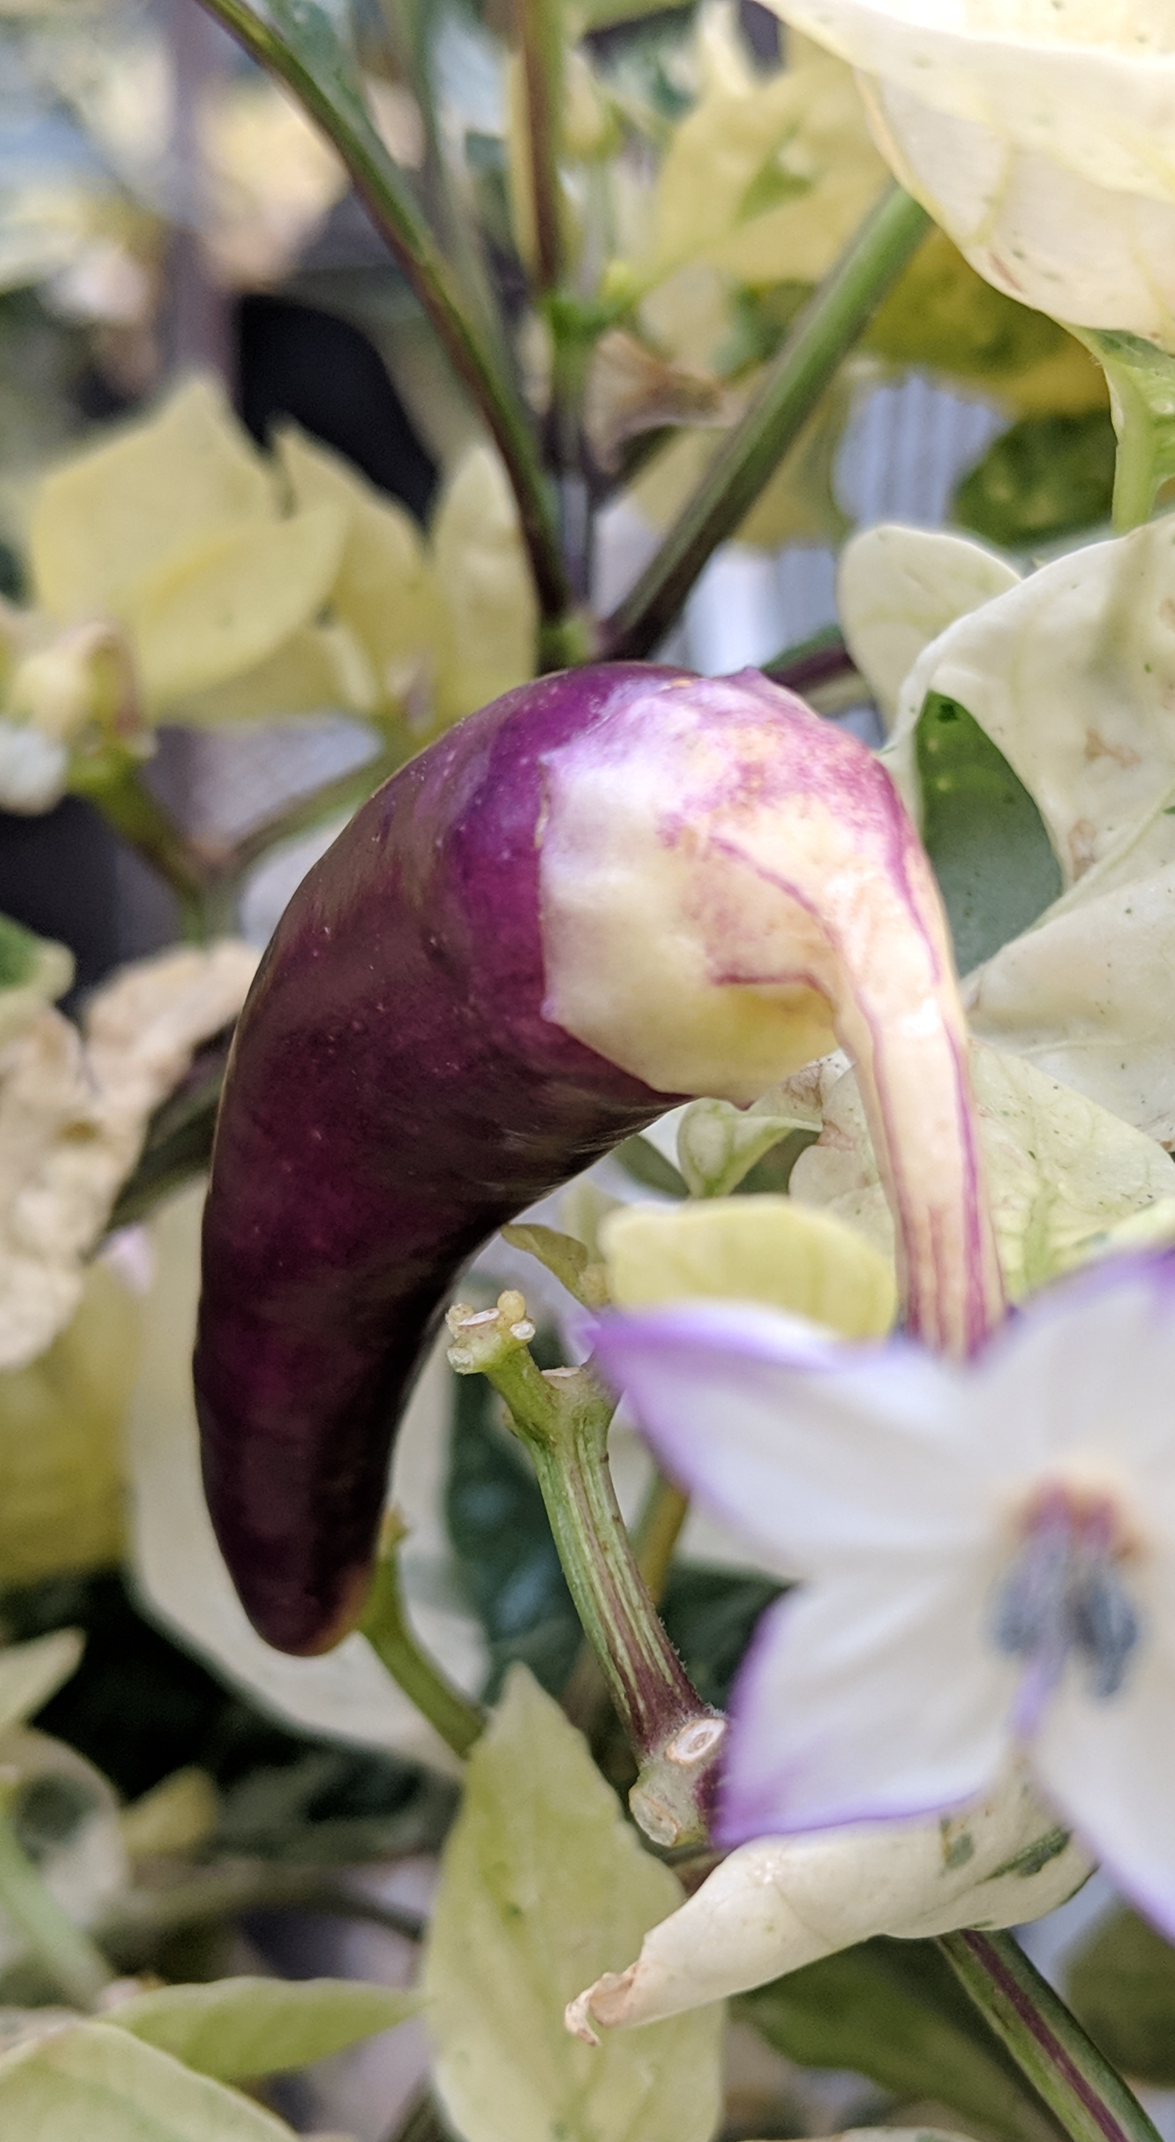

PEPPER POLLINATION GUIDE
Capsicum annuum
Peppers have a perfect flowers with both male and female structures. These plants are primarily self-pollinating, though cross-pollination can occur if pollinators are active in the surrounding environment.
PETAL
ANTHER
STIGMA
Step ONE: Identify immature female buds
Step TWO: Remove stamens on female bud
CAYLX
Stamens consist of pollen-bearing anthers and must be removed ( via emasculation) prior to pollen shed (anthesis). Carefully remove stamens without damaging the receptive female stigma (right). If stamens are shedding pollen, select a new bud.
Immature female buds appear on single pedicels. They are characterized by unopened flower petals, some color development, and a calyx lobe beginning to separate. Look for enlarged buds approximately 4-6mm wide and about one day away from fully opening.
PEDICEL
Step THREE: Properly label cross
Step FOUR: Identify mature male flowers
Select fully opened flowers from a separate donor plant. Anthers should be actively shedding pollen, which can appear yellow-to-white in color. Avoid dark, clumpy pollen, as it is likely past its prime viability. Carefully peel back petals and agitate flower so pollen sheds onto a sanitized thumbnail or forceps. The anther itself may also be used as “paintbrush” to transfer pollen.
Label a small crossing-tag with female x male designators and the date of the cross. Carefully adhere to the single pedicel connecting the flower bud to the main plant stem.
Step FIVE: Transfer donor pollen to stigma
Step SIX: Monitor and harvest mature fruit
Carefully transfer viable pollen to the sigmatic surface, making sure to not break or damage the stigma. Pollen should visibly stick
Mature fruit will begin to develop and expand within a week of pollination. Expect to see mature fruit 3-5 weeks after pollination. Follow good seed stewardship practices, using clean harvesting and storage practices to obtain clean, safe seed.
to the stigmatic surface. Sanitize all tools with ethanol before making additional crosses with different pollen.
QUICK TIPS FROM THE PROS:
Select female buds near the top of the plant and not under any flower opening in the next three days to avoid pollen dropping
Ideal temperatures for pollination vary among pepper species and can even vary within a species – be aware!
THIS PROJECT WAS SUPPORTED BY:
NORTHERN ORGANIC VEGETABLE IMPROVEMENT COOPERATIVE
Photos and design by: H. Swegarden
Demonstration by: A. DeSario (Mazourek Lab)

