Slide 1
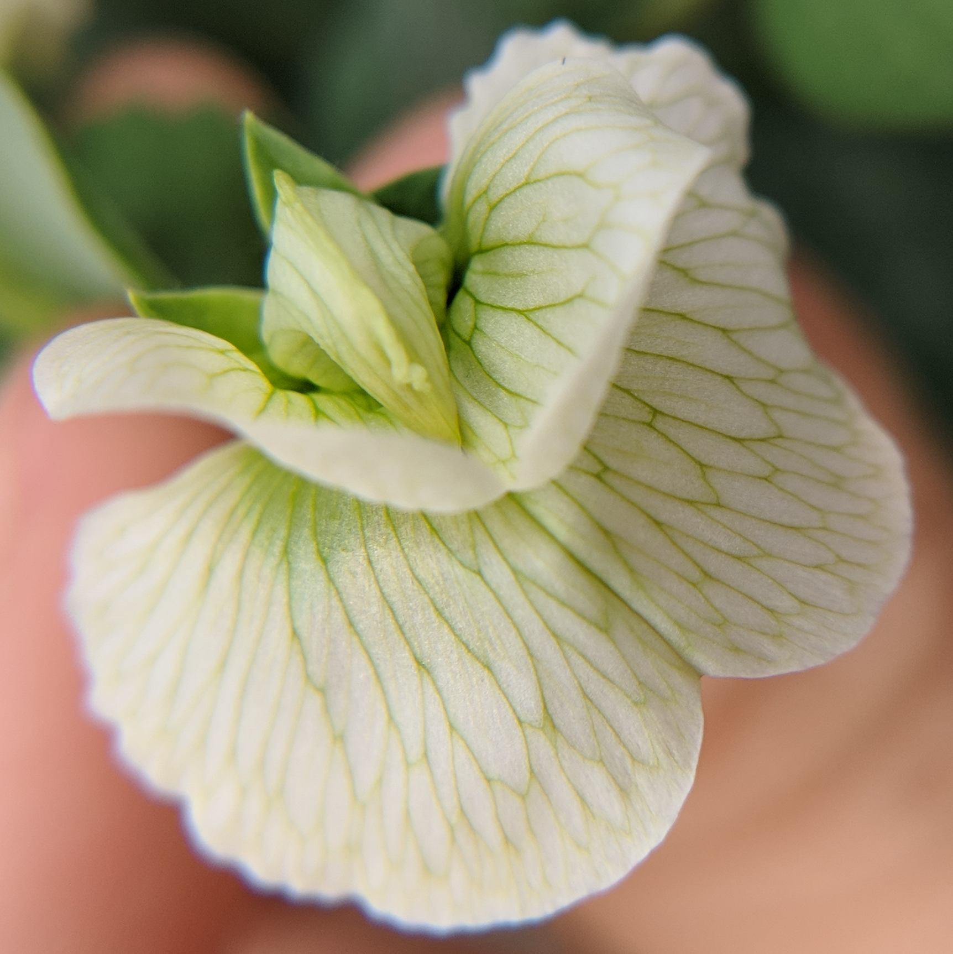
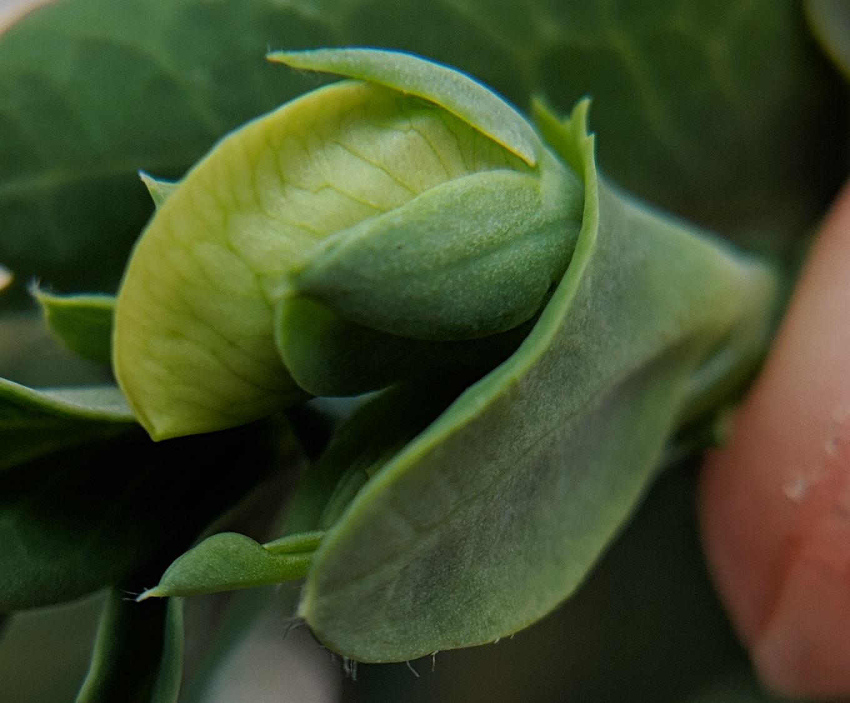
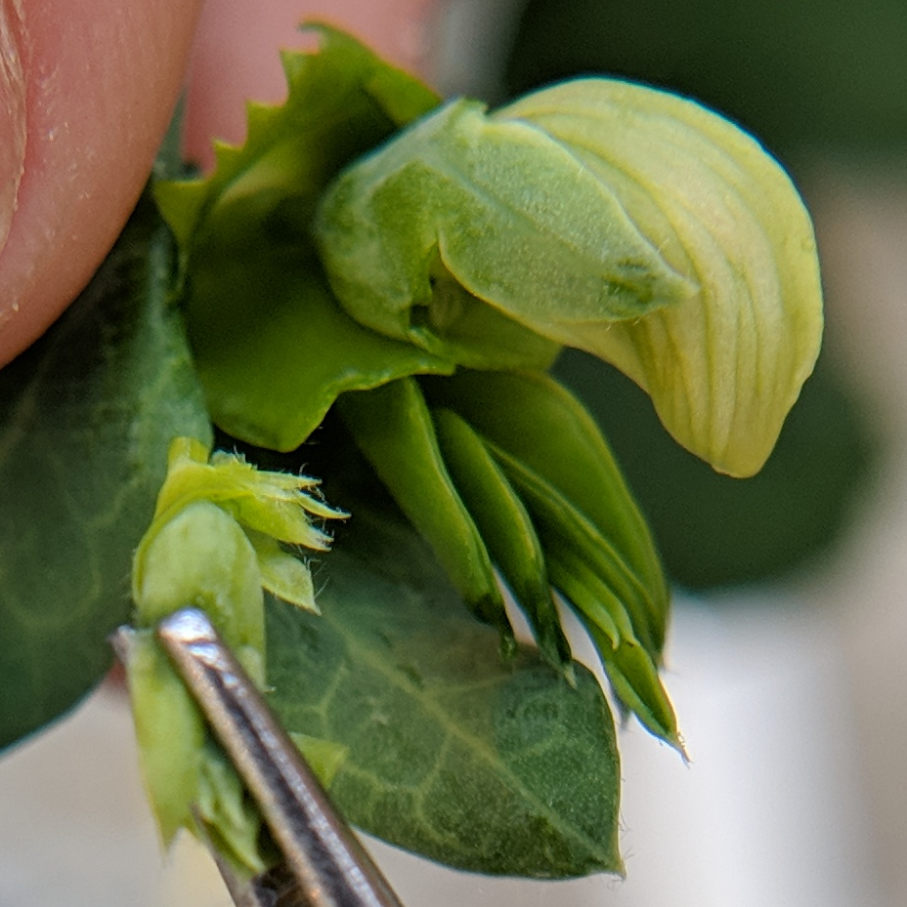
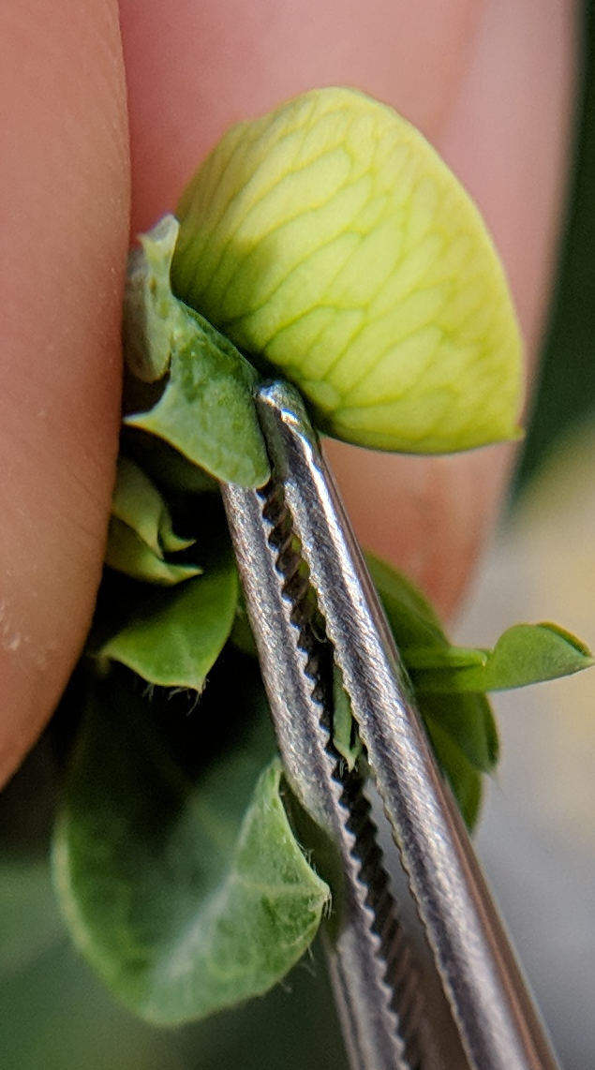
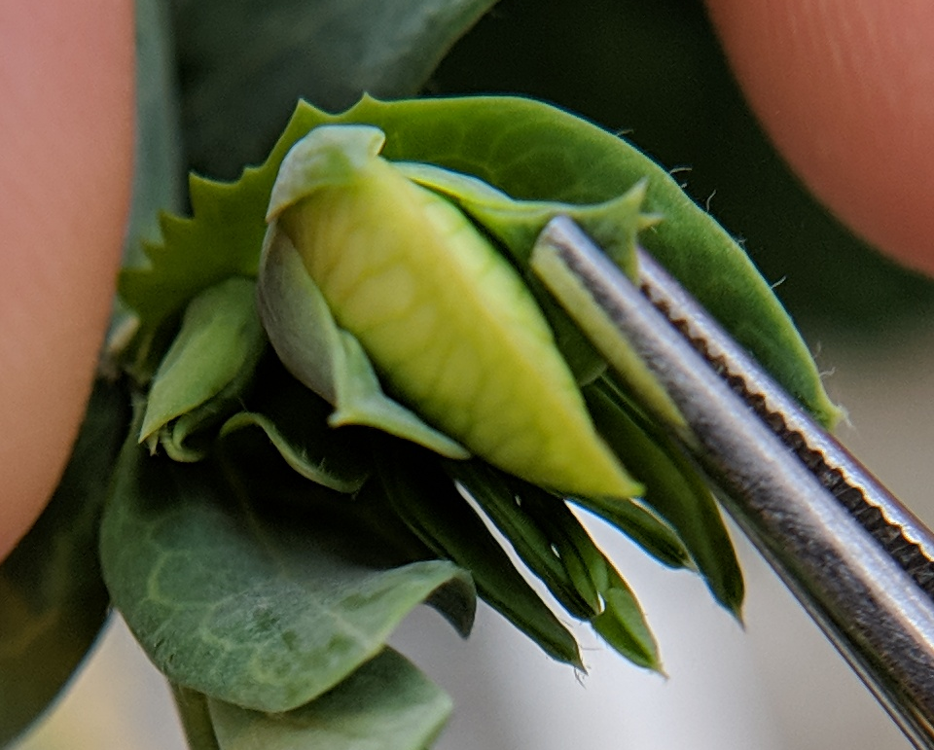
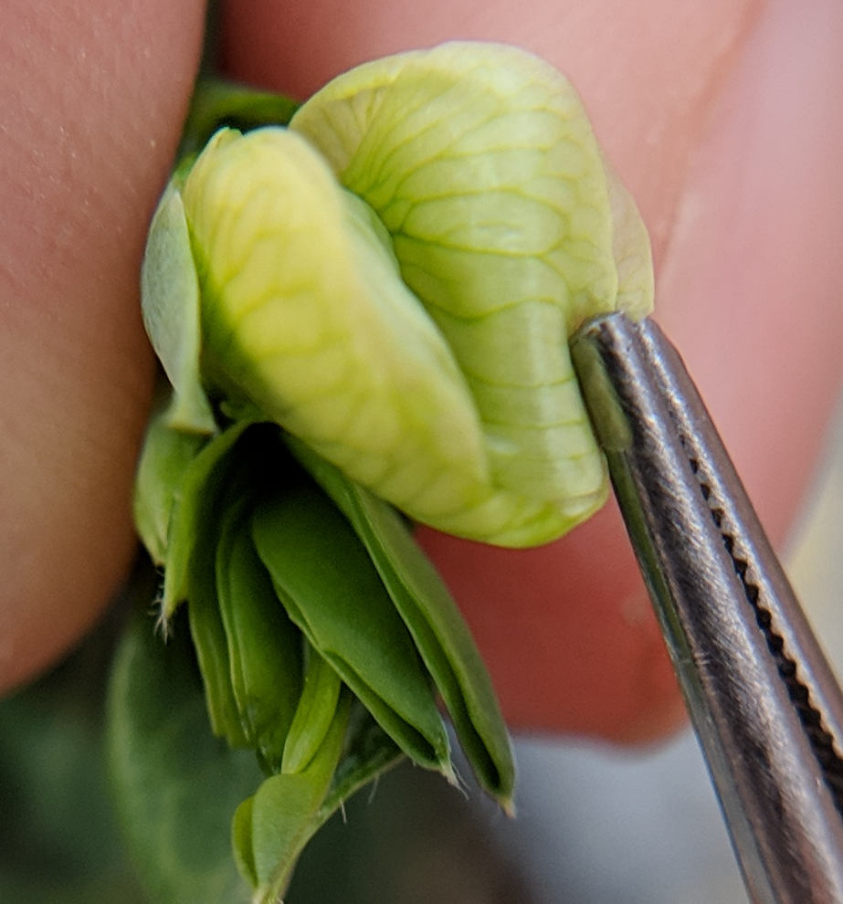
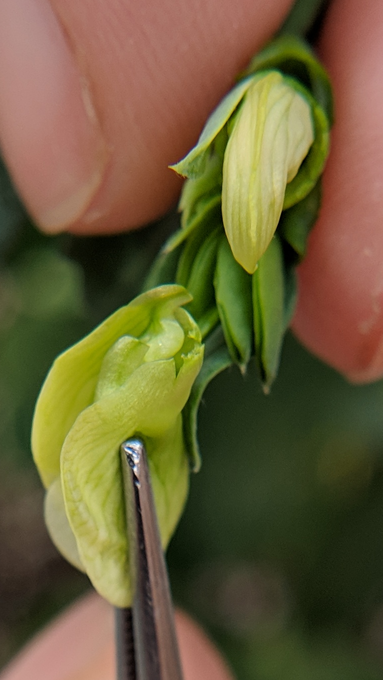
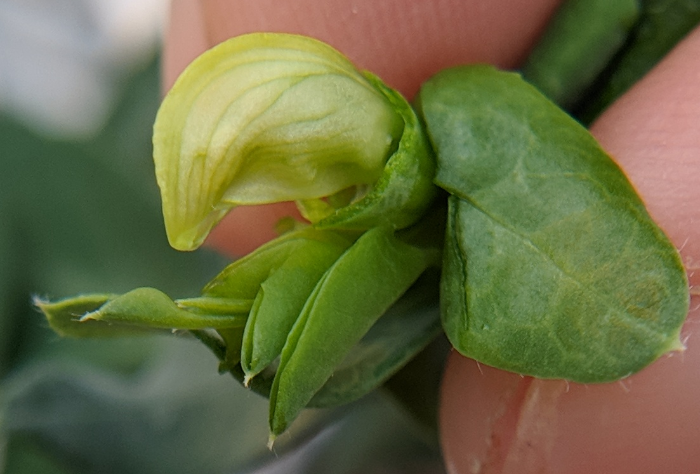
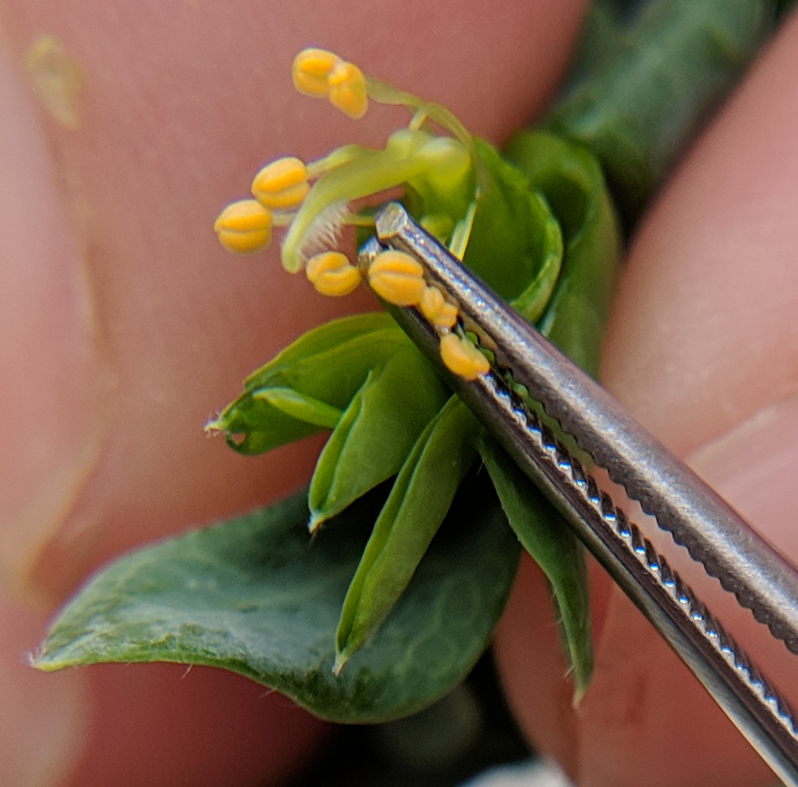
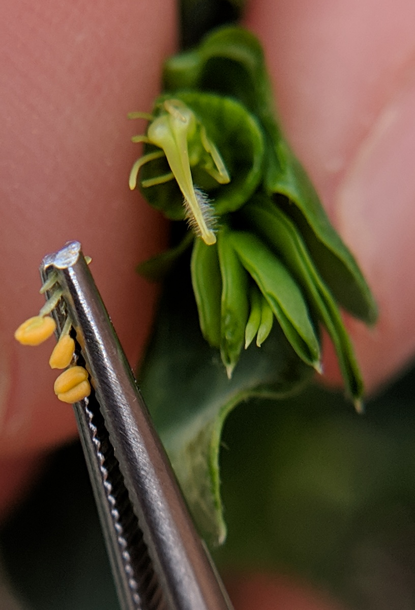
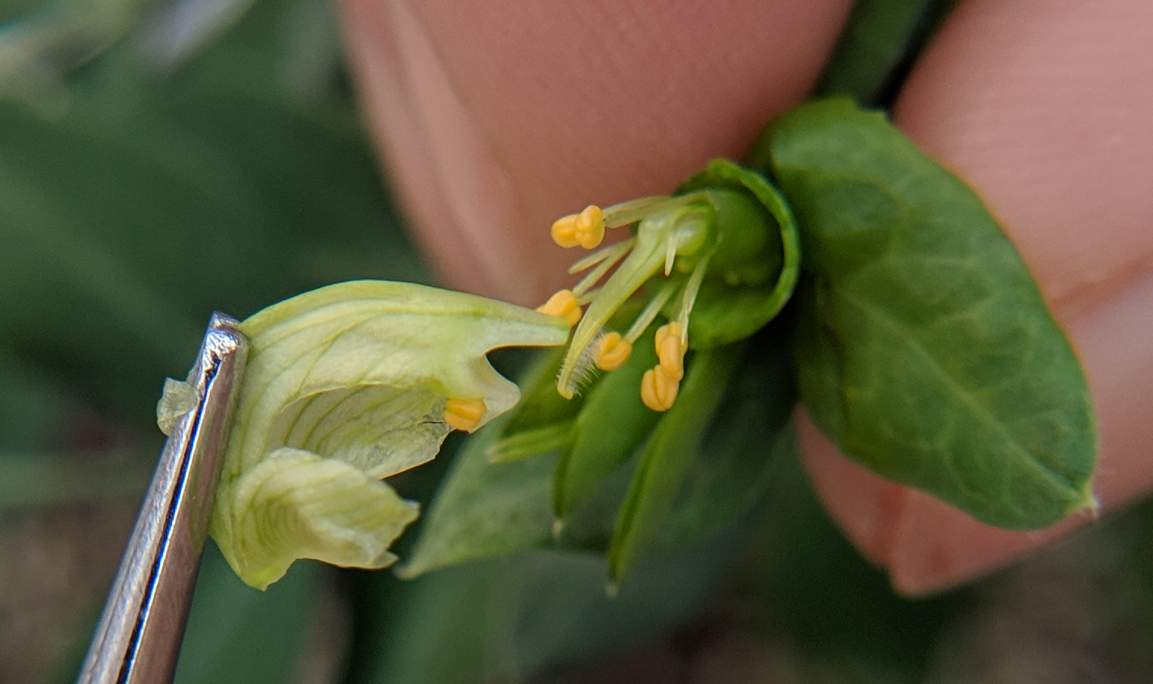
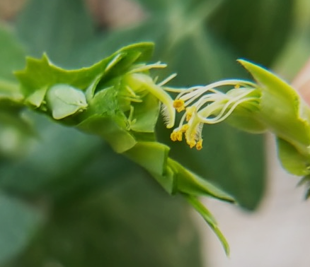
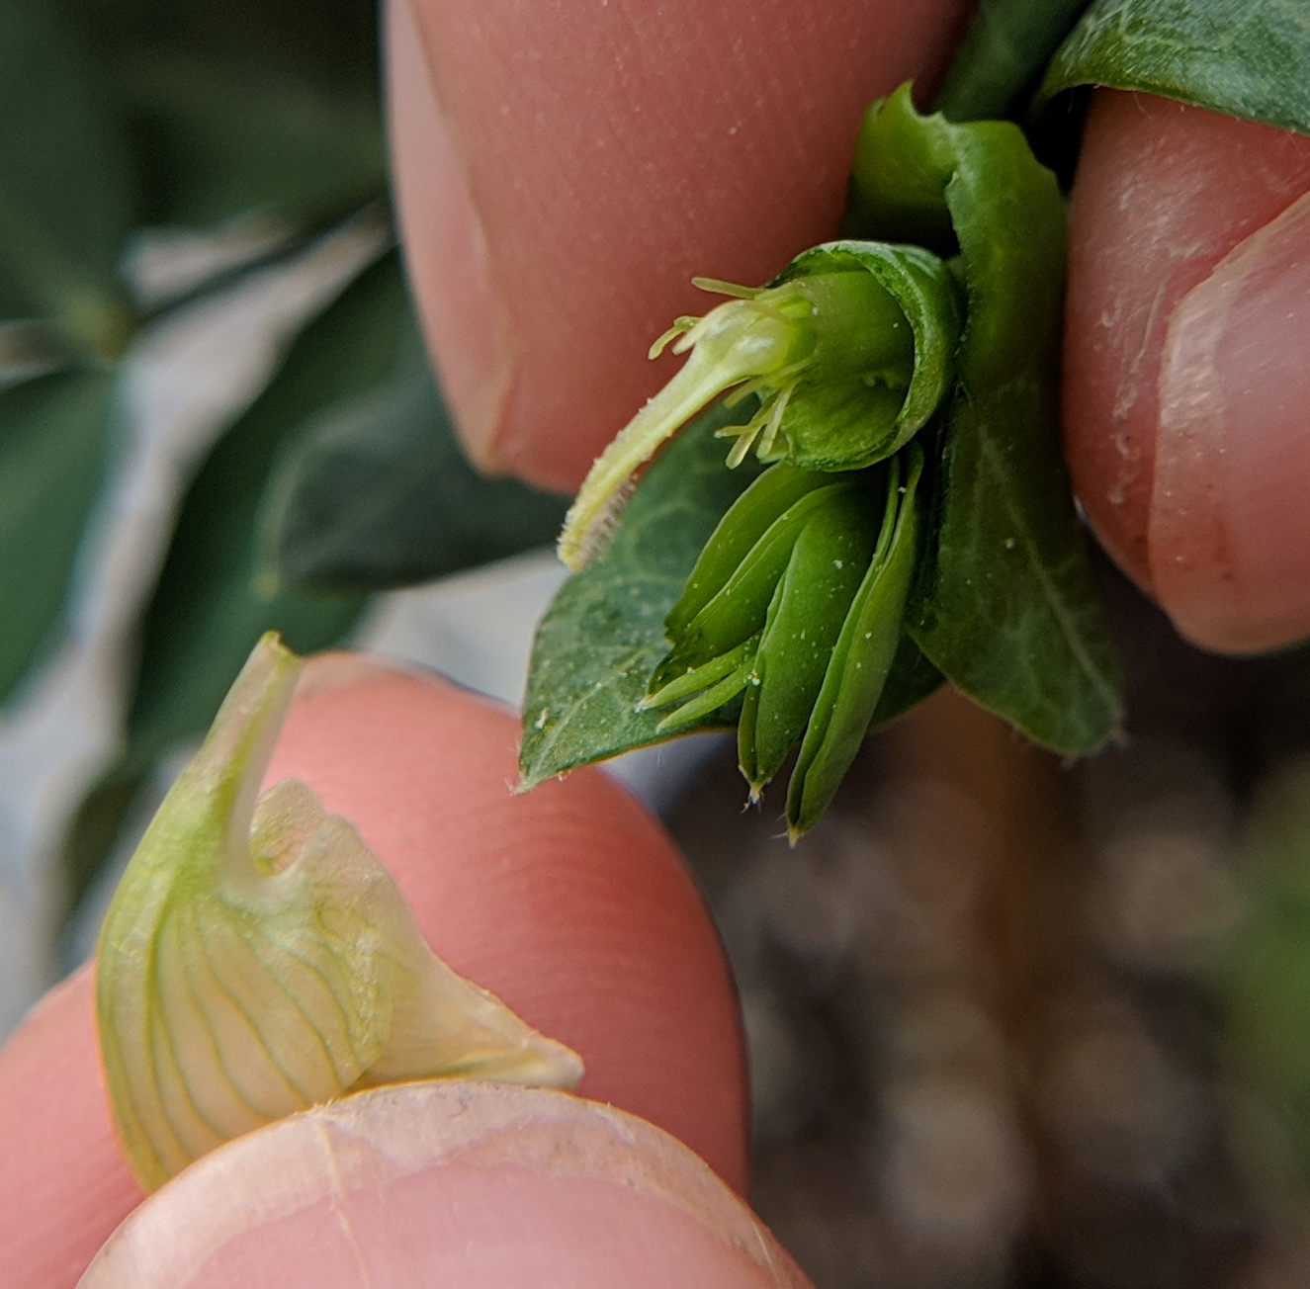
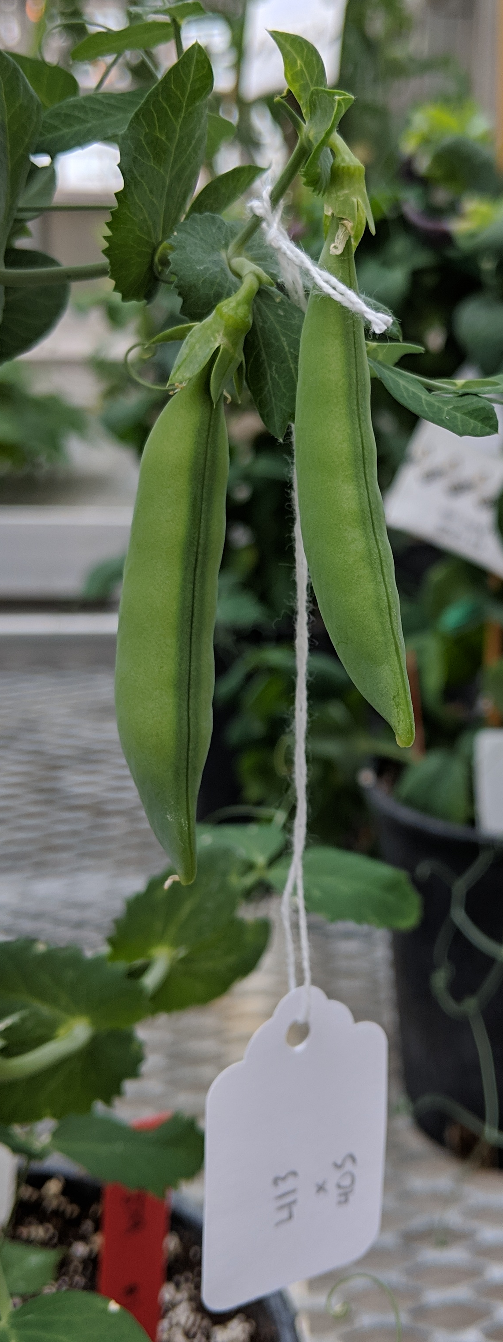
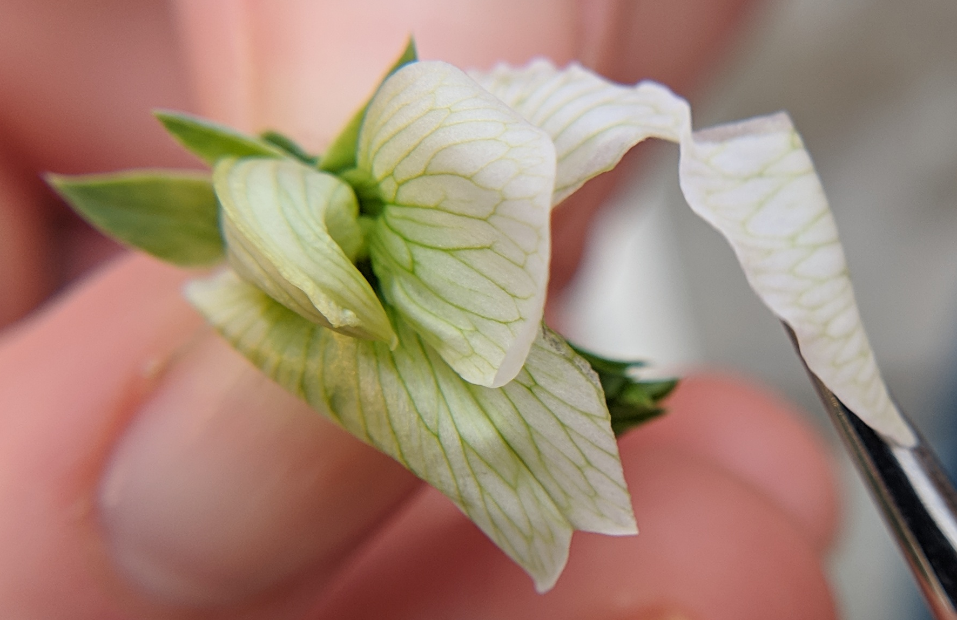

PEA POLLINATION GUIDE
Pisum sativum
SEPALS
Peas have perfect flowers with both male and female reproductive organs. They are highly self-pollinating and require manual manipulation, including emasculation, to make a controlled cross.
STANDARD/ BANNER PETAL
KEEL PETALS
WING PETALS
Step ONE: Identify immature female buds
Step TWO: Remove sepals and standard
Carefully pluck away the sepals around the base of the flower bud. Peel back the standard petal and remove it along with any remaining sepals to expose the keel petals. Disturb the flower as little as possible.
SEPALS
STANDARD
Identify a flower bud with an unopened standard petal approximately 1mm longer than the sepals. Remove all other buds and flowers near the identified female bud.
Step THREE: Remove sepals to expose stigma
Step FOUR: Emasculate the female bud
Push the margins of the keel petals apart, peel the keel petals away from the base of bud, or make a slit in the keel to expose the stigma and anthers.
Without touching or damaging the pistil, gently snip or tug the ten male stamens to remove the yellow anthers.
Alternatively, grip the top portion of the keel petals and pull them in one swift motion from the flower to expose the pistil (the style, stigma, and ovary) and anthers.
This will prevent self pollination and prepare the female bud for the next step. Ideally, emasculate immediately before performing the final cross.
Step FIVE: Transfer donor pollen to stigma
Step SIX: Label, monitor, & harvest mature fruit
Pull apart the standard, wing, and keel petals of an open male flower to expose the pollen-rich anthers. Gently brush the pollen onto the stigmatic surface.
Label a light threaded crossing-tag with female x male designators and the date of the cross. Carefully adhere to the single pedicel connected to the flower bud. Follow good seed
This may be done with multiple male flowers for adequate pollen transfer.
stewardship practices, using clean harvesting and storage practices to obtain high quality, safe seed.
TIPS FROM THE PROS:
Successful pollinations are typically performed with vigorous plants at the onset of flowering
Pollen dehiscence occurs as the flower petals open, so look for fresh male in early-to-late morning
THIS PROJECT WAS SUPPORTED BY:
NORTHERN ORGANIC VEGETABLE IMPROVEMENT COOPERATIVE
Photos and design by: H. Swegarden
Demonstration by: K. Loria (Mazourek Lab)

