Slide 1
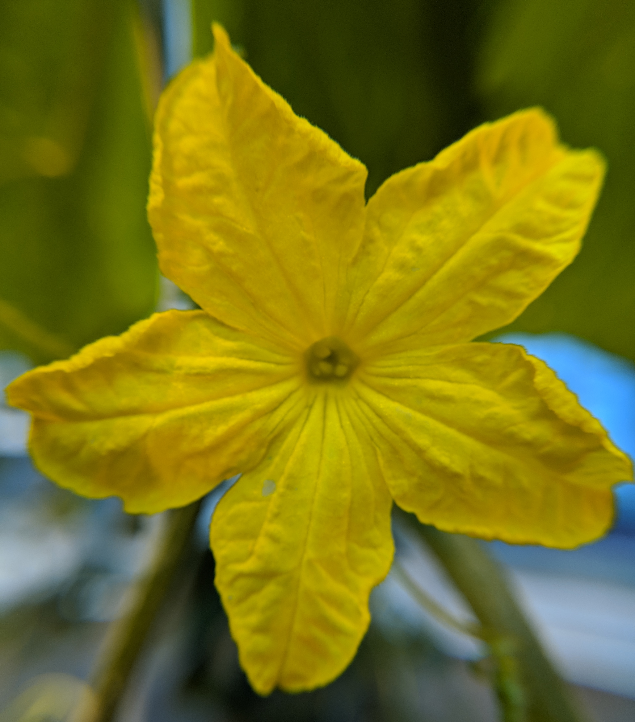
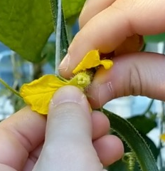
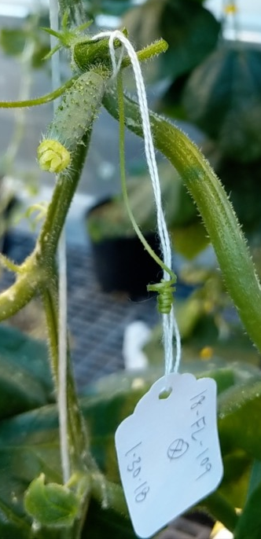
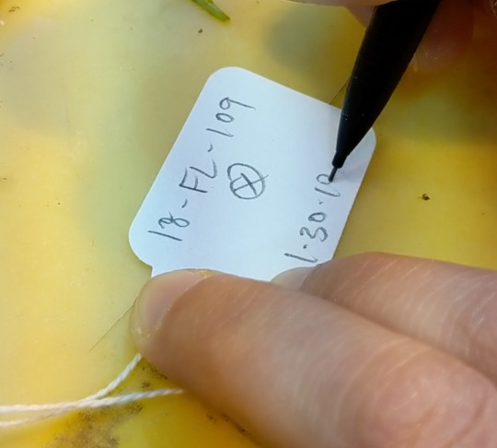
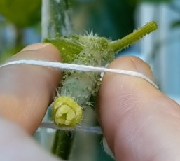
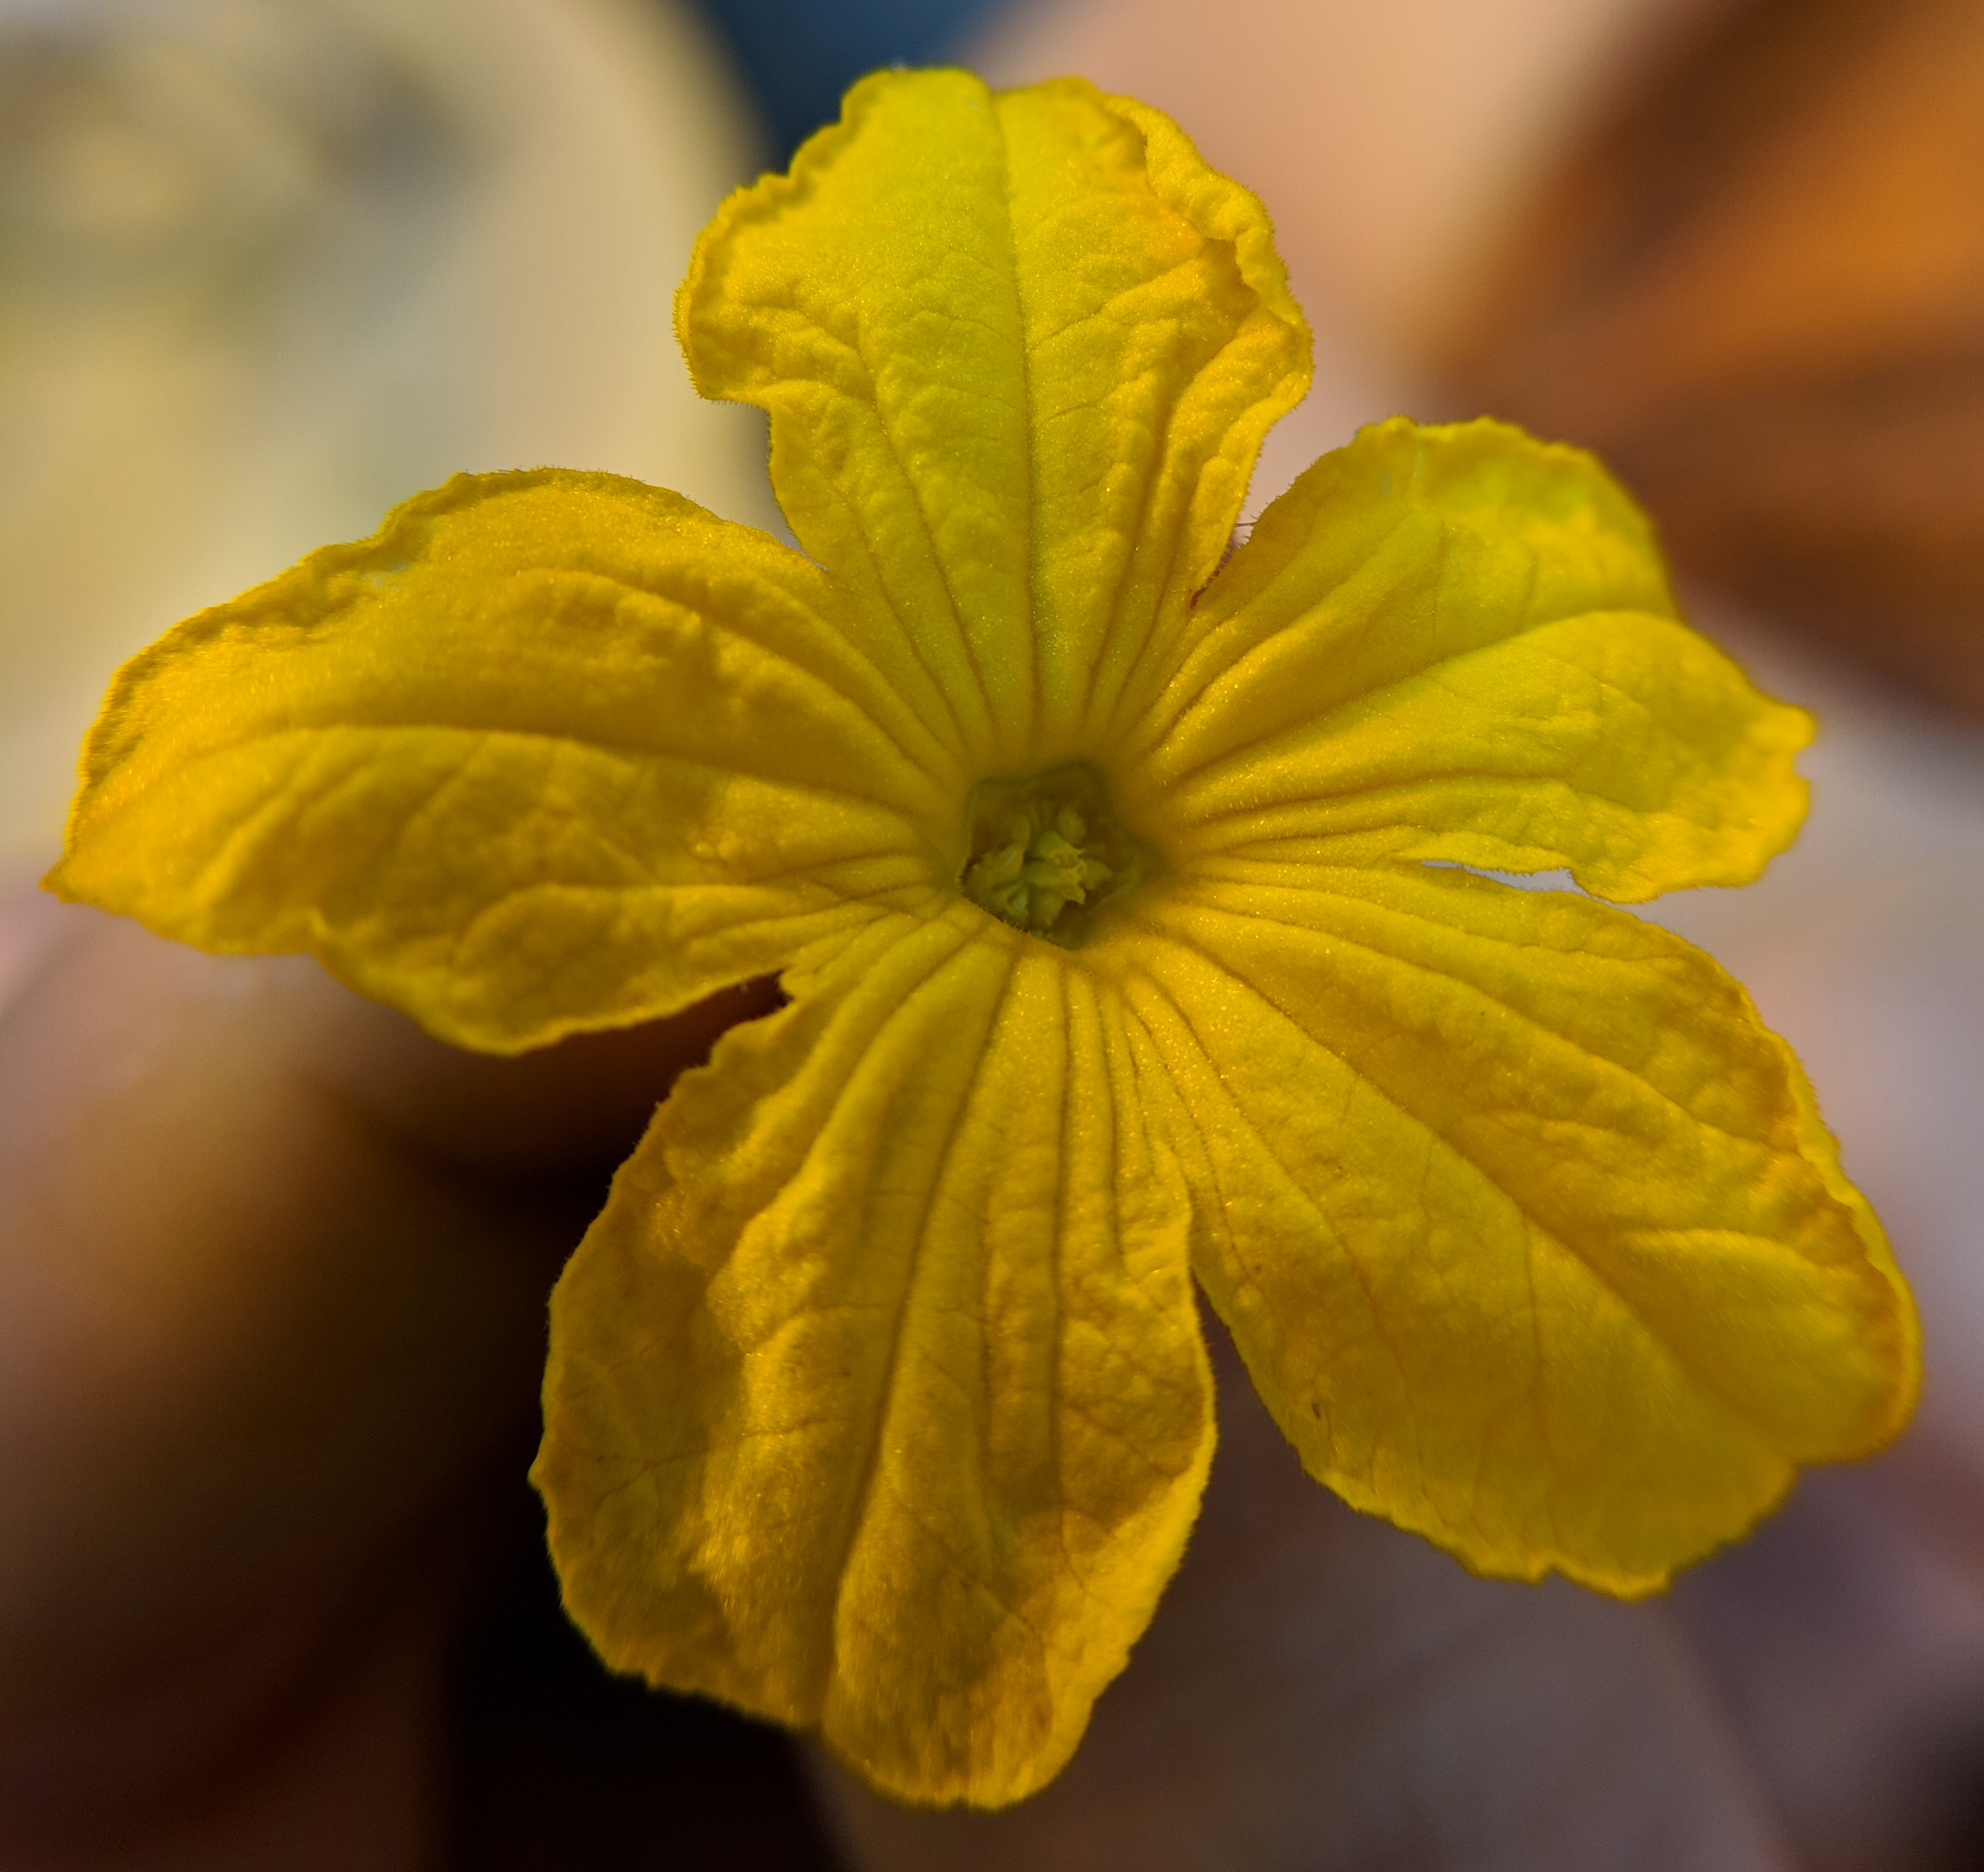
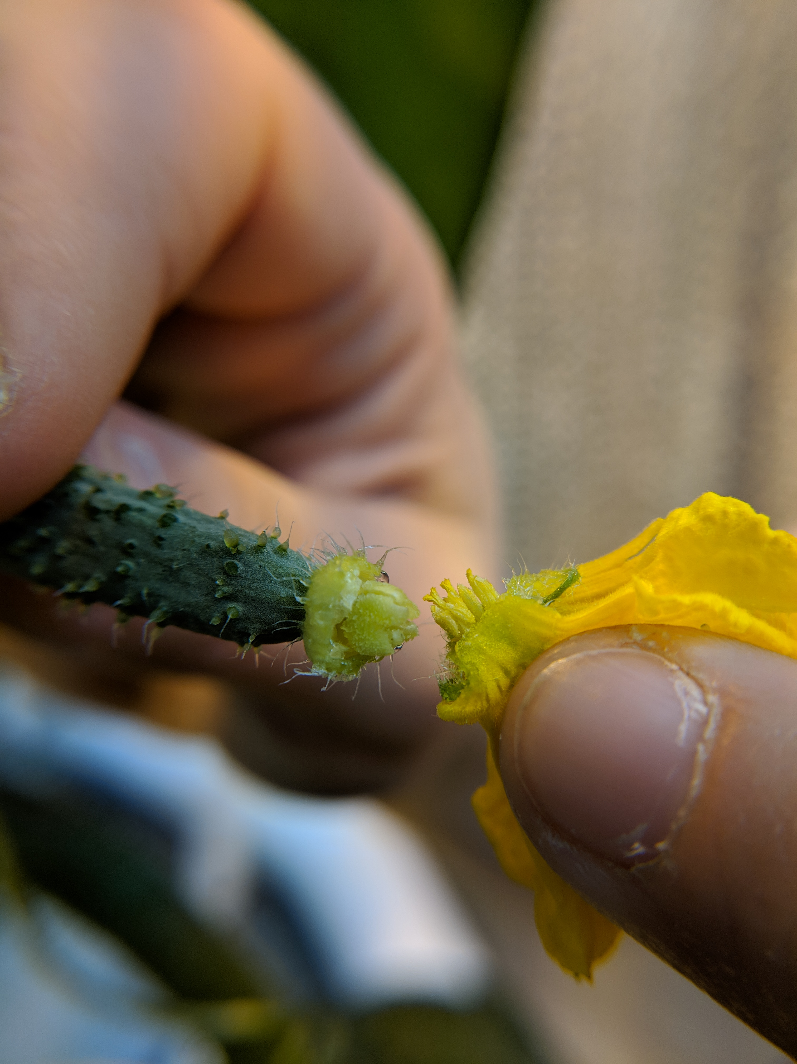
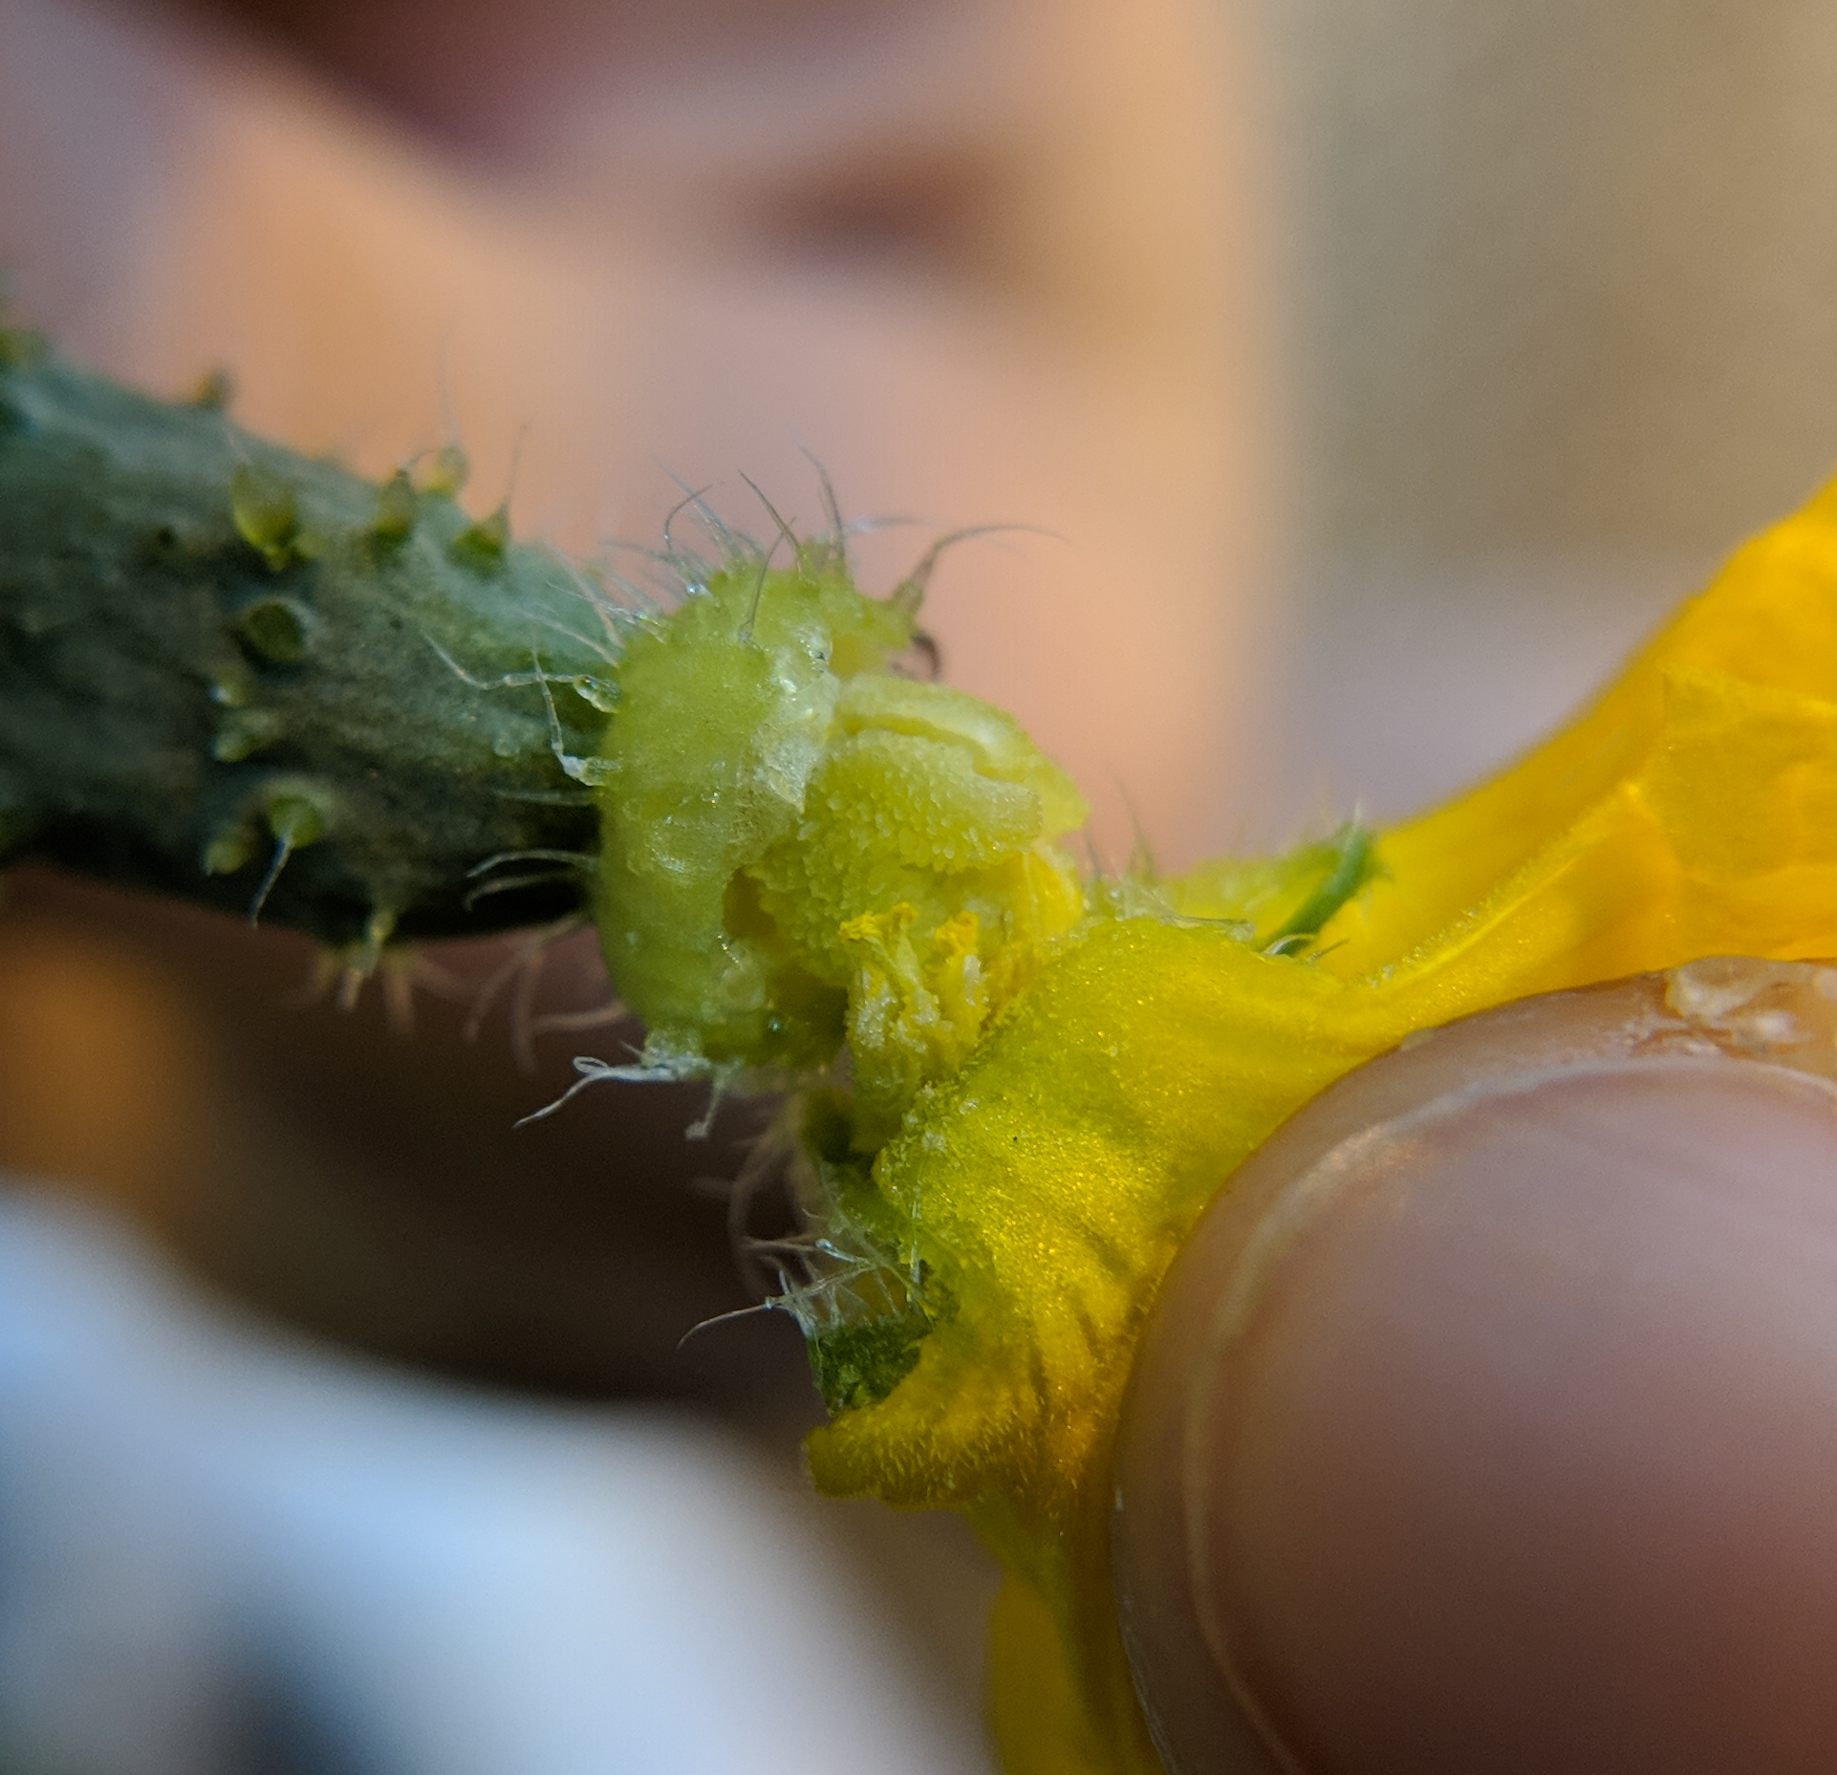
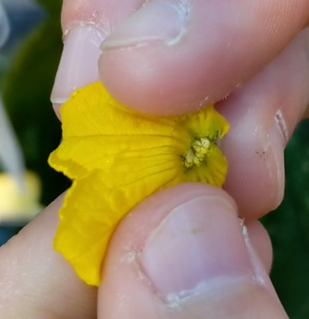
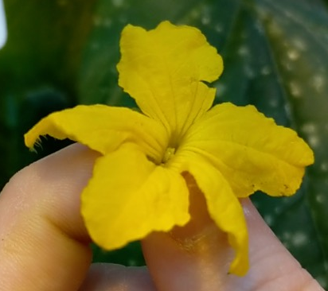
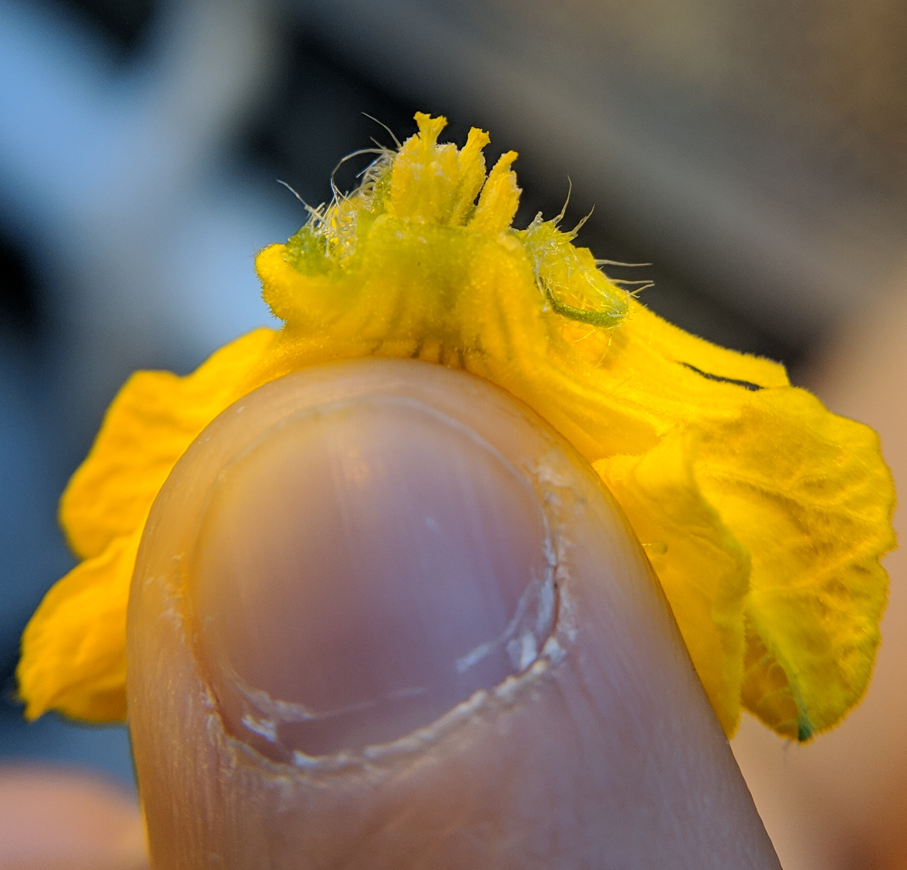
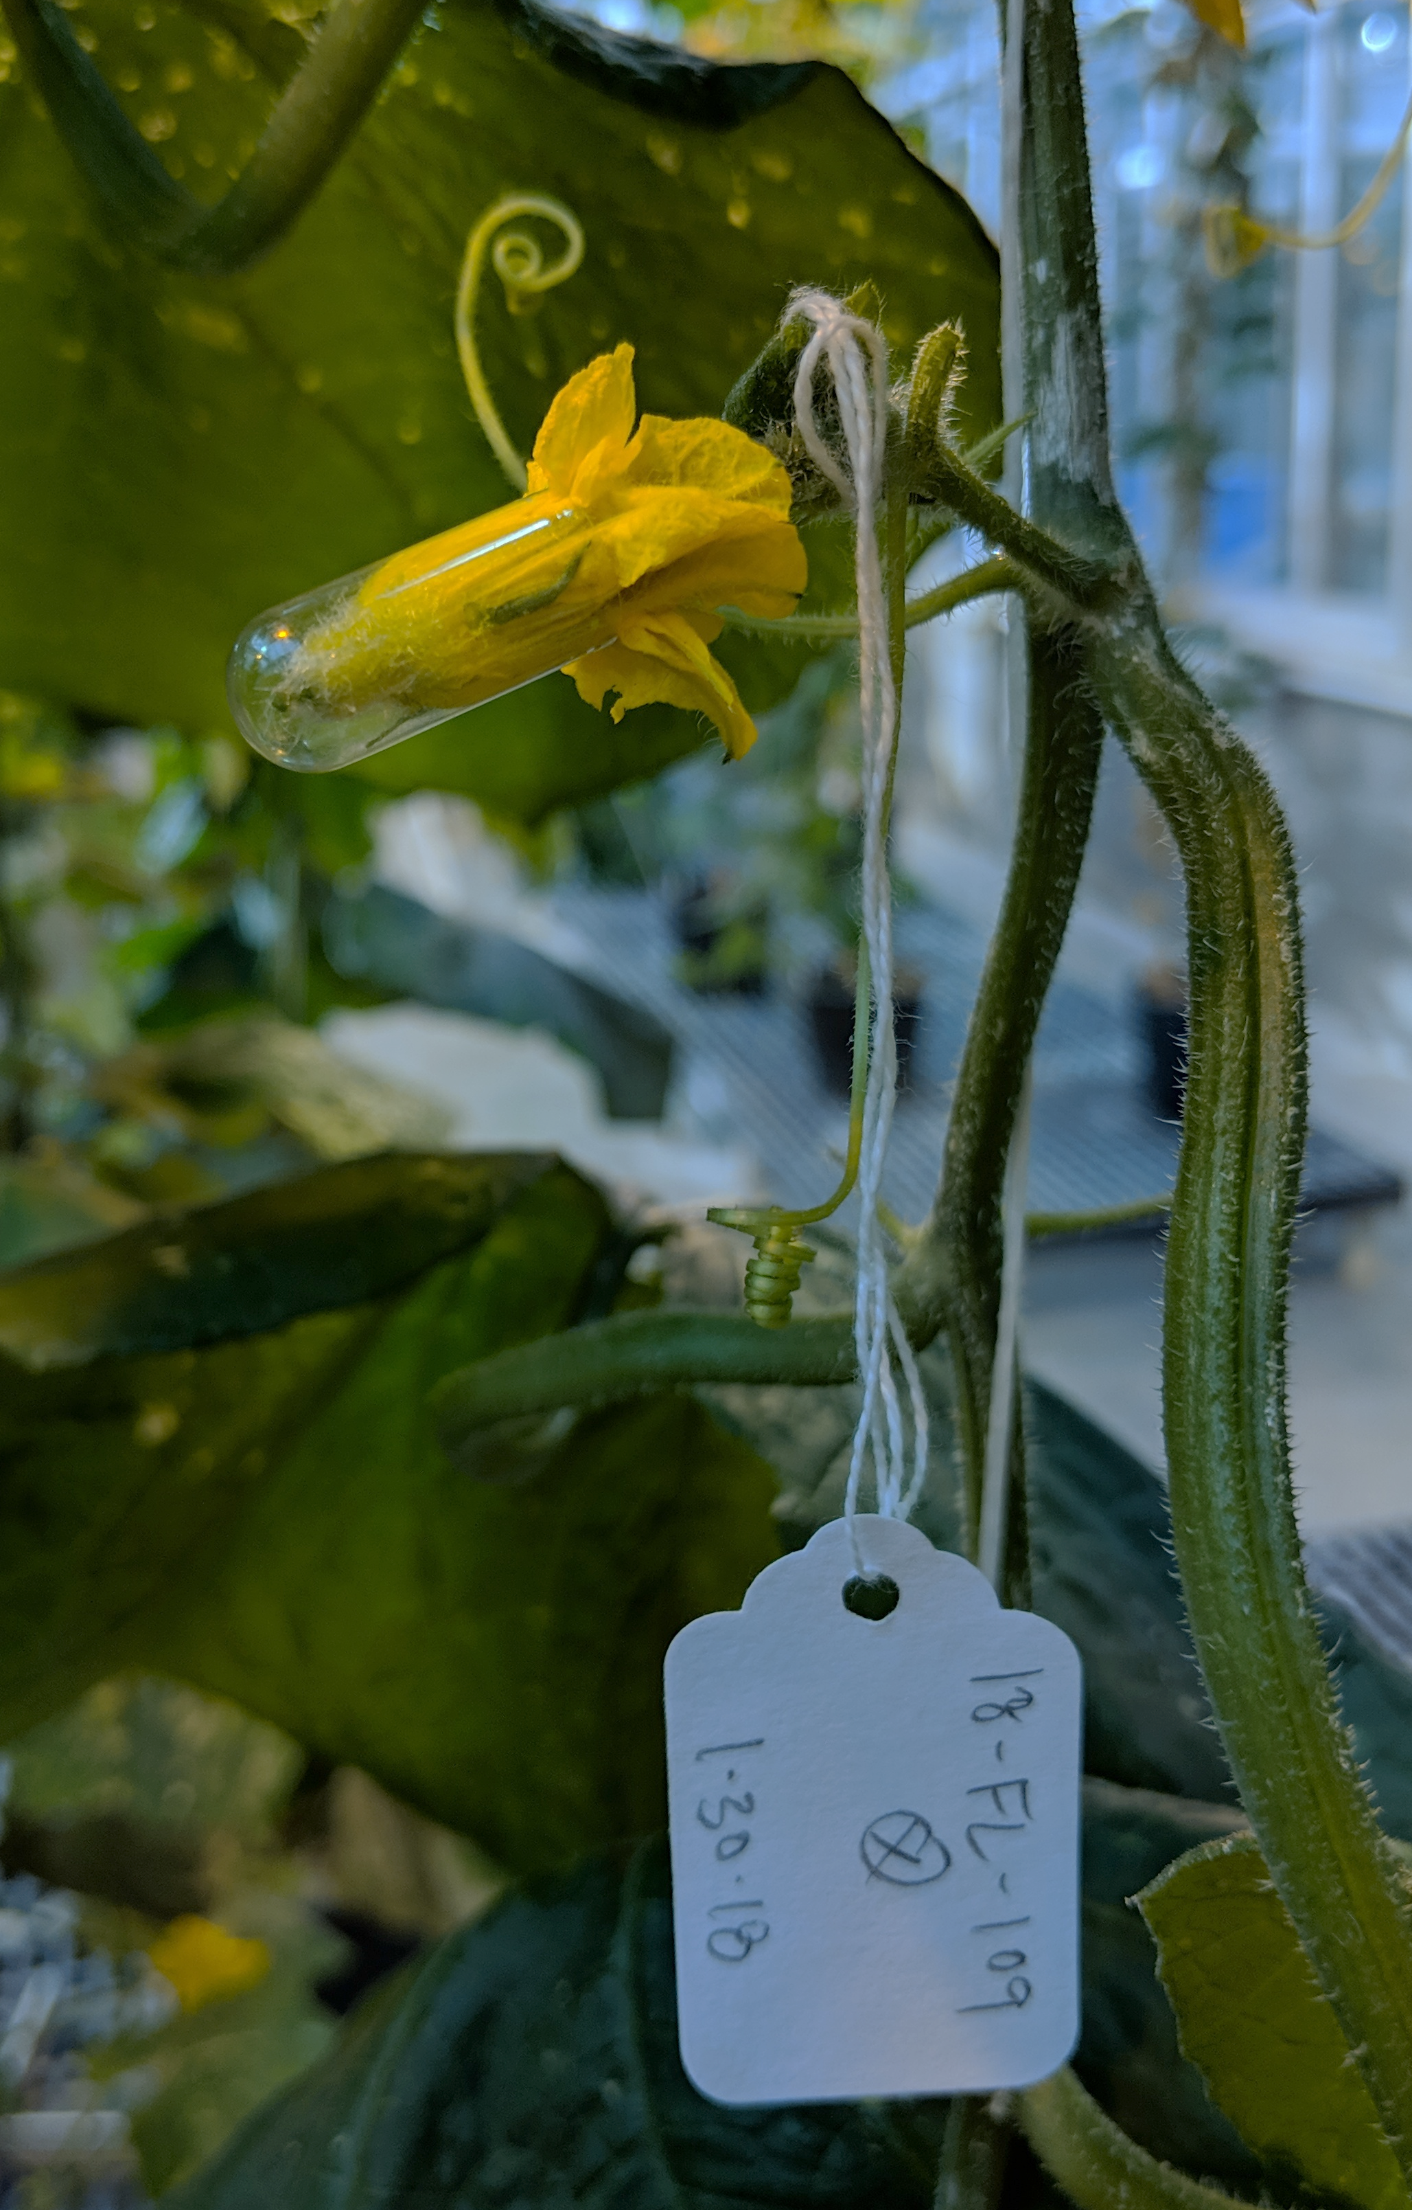
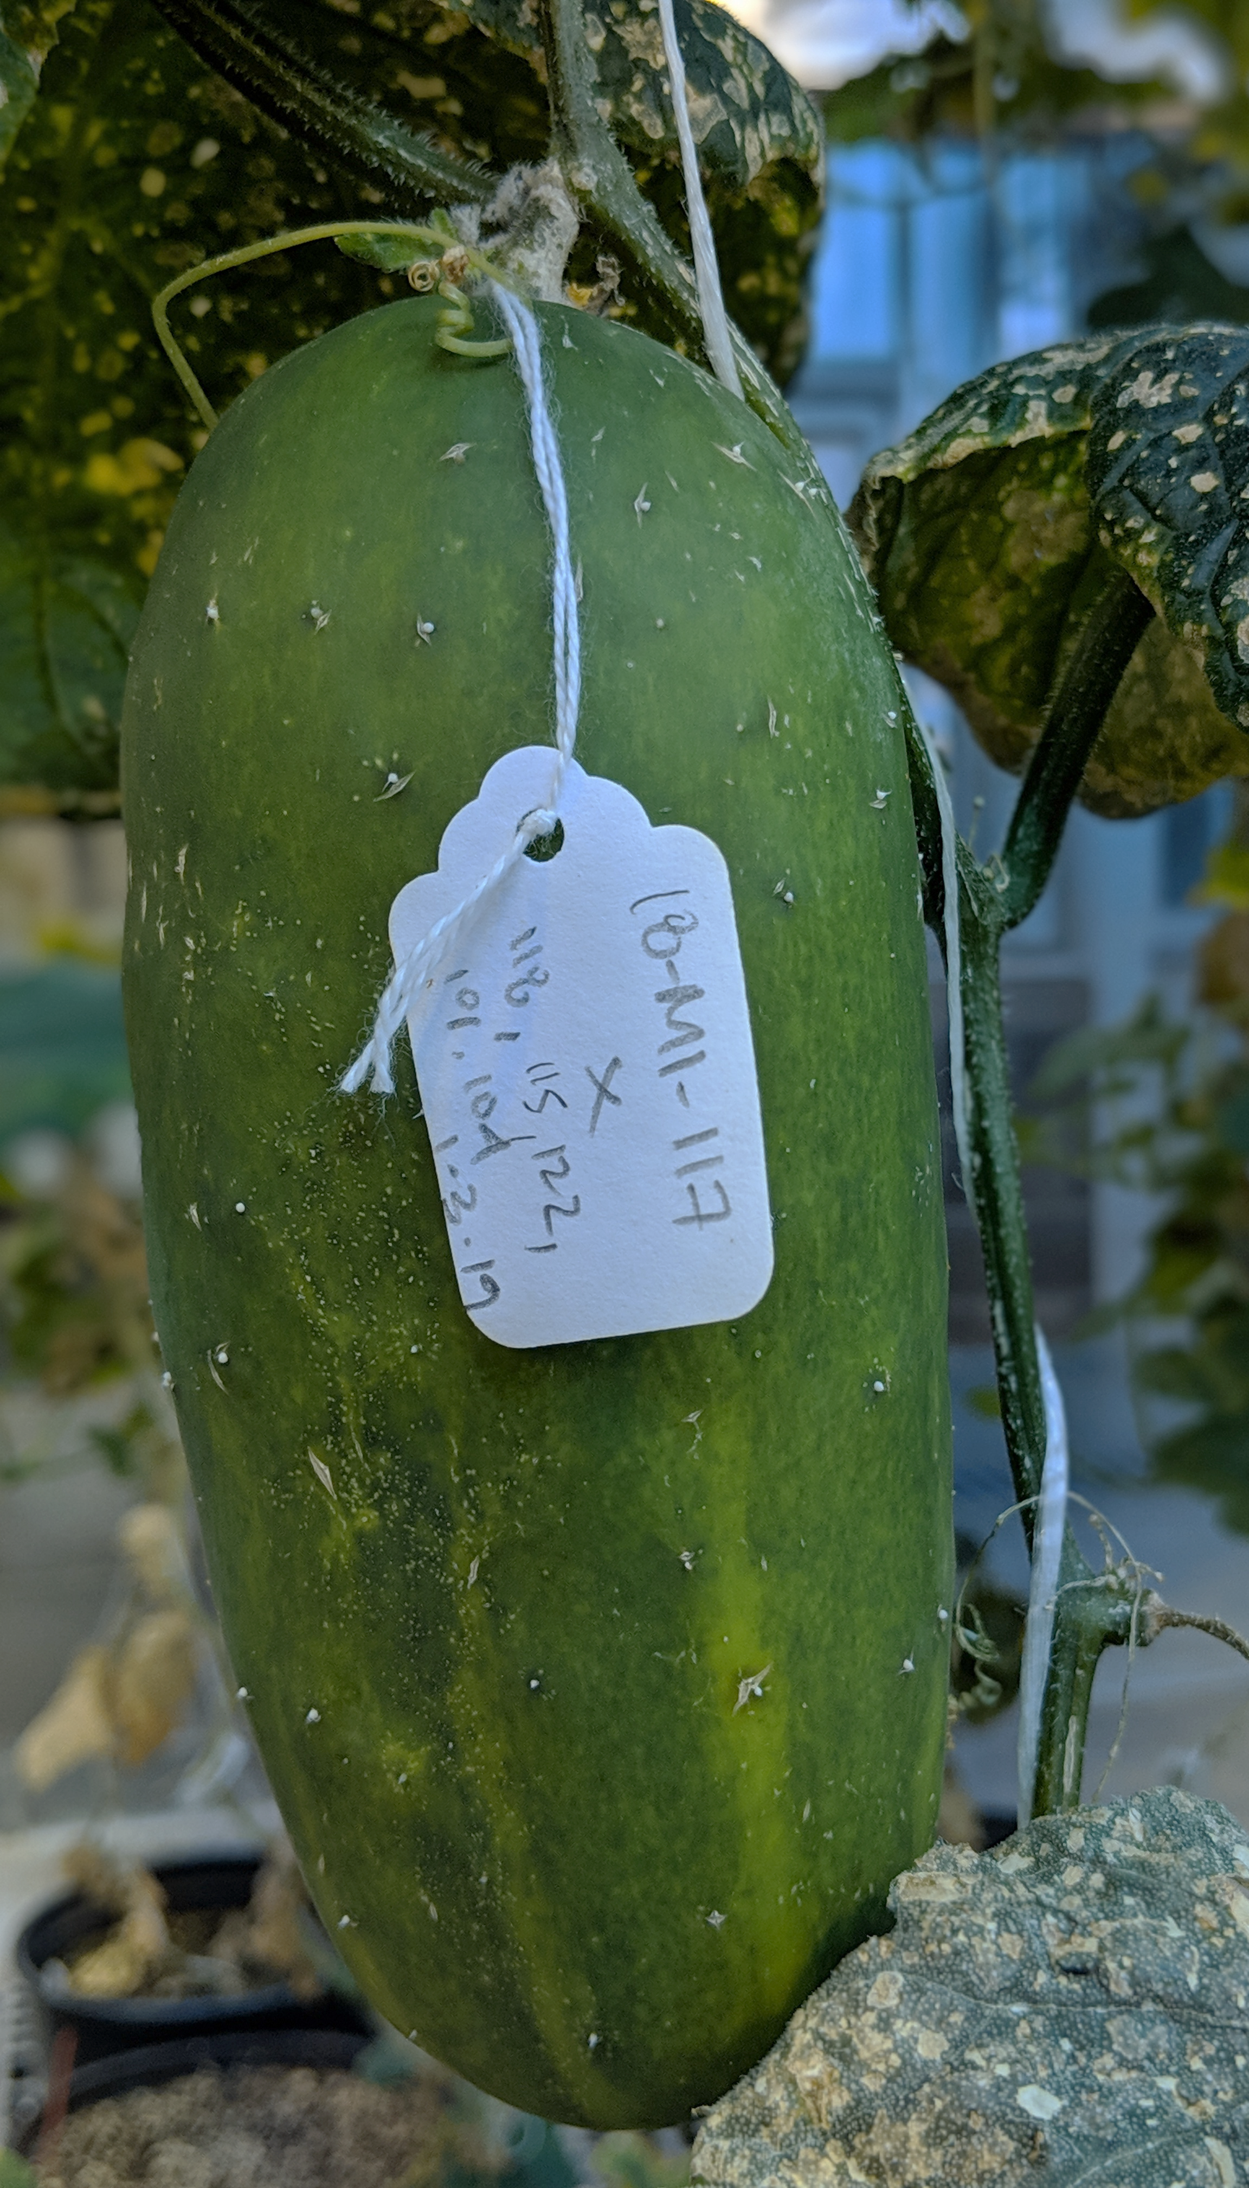
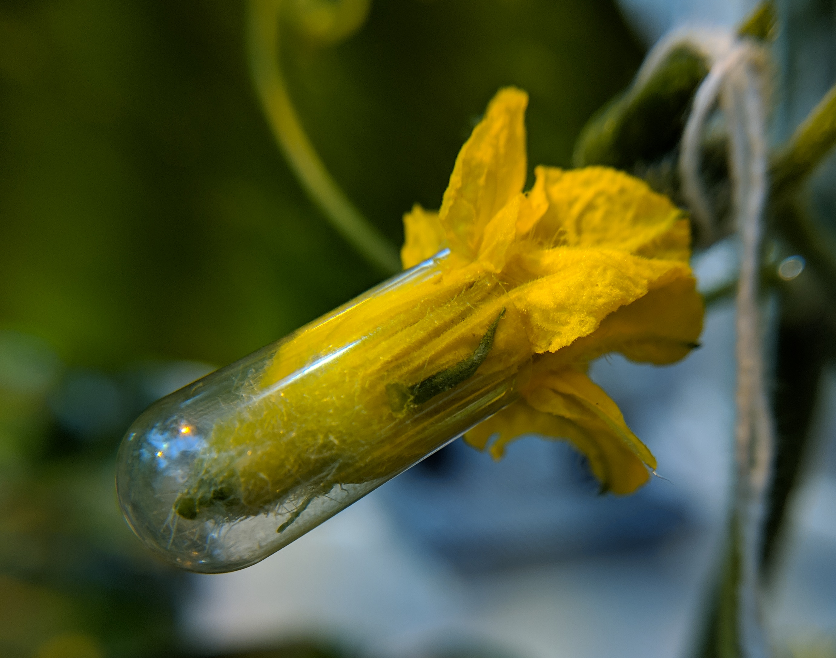
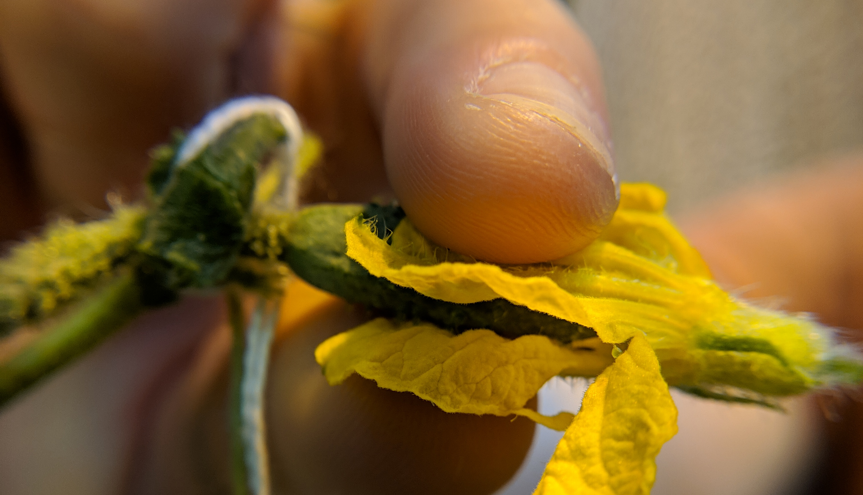
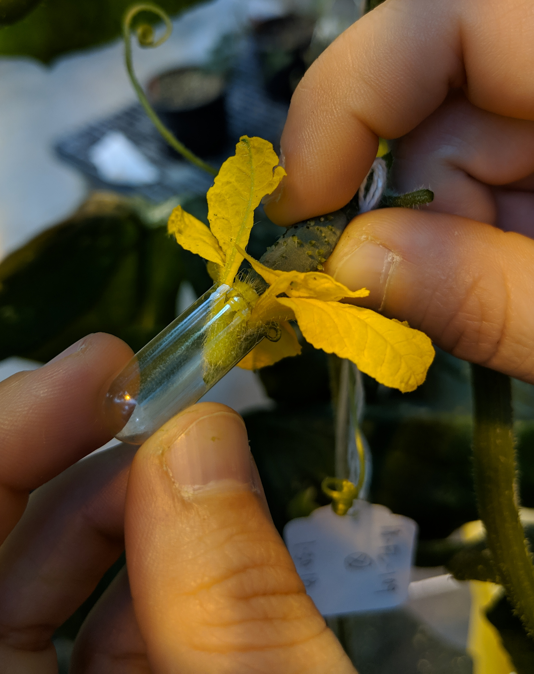

CUCUMBER POLLINATION GUIDE
Cucumis sativus
Cucumbers are often monoecious, having both male and female flowers on the same plant, but flowering can vary depending on the environment, timing, and cultivar. They are out-crossing and depend on pollinators for successful fruit set.
COROLLA
STIGMA
Step ONE: Identify receptive female flower
Step TWO: Properly label female flower
Within a monoecious cultivar, male flowers will often appear first. Female flowers are characterized by a slightly swollen pedicel containing the ovary (a mini cucumber). Look for female flowers that opened the same day as your cross. Remove any previously pollinated female flowers to avoid competition.
Carefully peel away the corolla of the female flower so that the ovary and stigmatic surface are exposed. Label a crossing-tag with female x male designators and the date
of the cross.
Adhere the tag to the pedicel at the base of the ovary.
Step THREE: Identify mature male flower
Step FOUR: Transfer donor pollen to stigma
Identify a newly opened male flower with pollen-bearing anthers and remove it. Gently
Gently transfer the pollen to the exposed stigma of the female flower by
fold back the corolla so that the stamens and anthers are easily accessible.
rotating the male anthers to dislodge the pollen. You may be able to see the pollen adhere to the stigmatic surface. This may be repeated with several male flowers to ensure adequate pollen transfer.
Step FIVE: Cap stigma with male flower
Step SIX: Monitor and harvest mature fruit
Covering the freshly pollinated stigma with a gelatin cap will keep the humidity around the stigma high and aid in pollen growth. Wrap the male flower around the female stigma and ovary. Slide a gelatin cap or bag over
Fruit will mature within 45-60 days, at which point seed may be harvested. Follow good seed stewardship practices, using clean harvesting and storage practices to obtain clean, safe seed.
both the male and female flowers. The cap will fall off as the fruit matures.
TIPS FROM THE PROS:
Understand floral development of your cultivar; cucumbers can be monoecious, gynoecious, and even parthenocarpic!
Avoid hot, dry conditions to increase pollen viability
Pollinate cucumbers early (i.e. 9am – 11 am)
THIS PROJECT WAS SUPPORTED BY:
NORTHERN ORGANIC VEGETABLE IMPROVEMENT COOPERATIVE
Photos and design by: H. Swegarden
Demonstration by: P. Reeves (Mazourek Lab)

