Slide 1
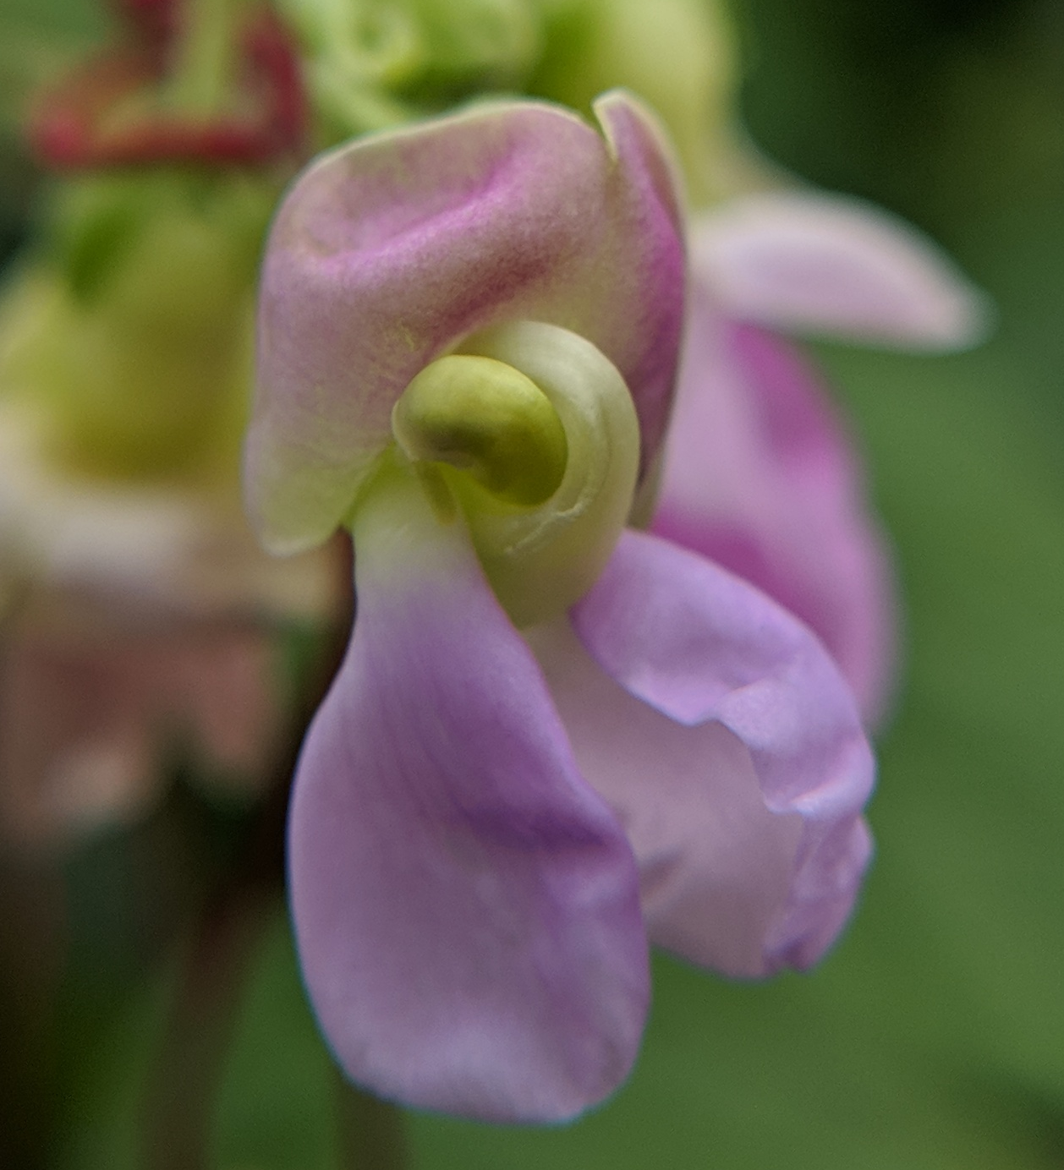
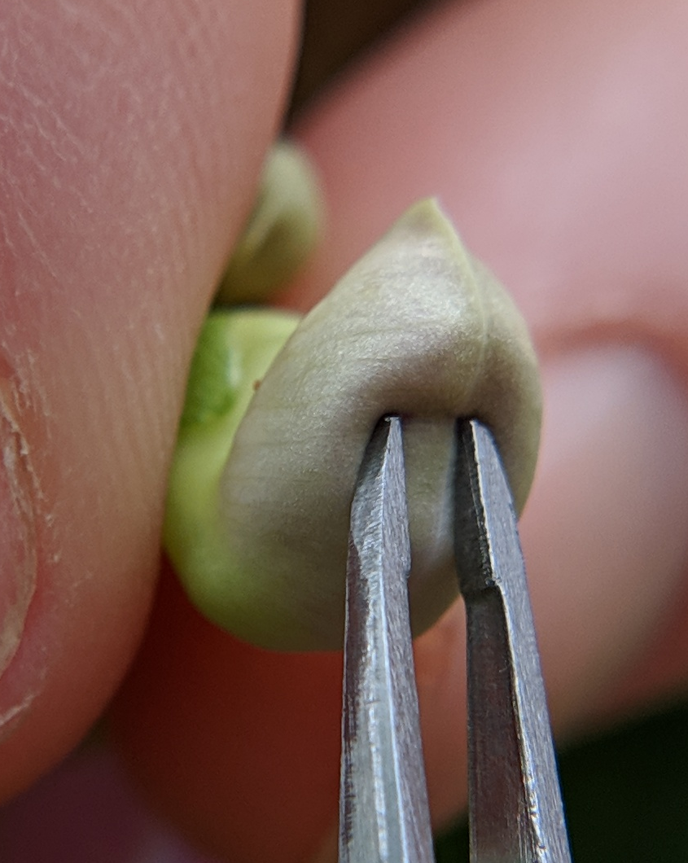
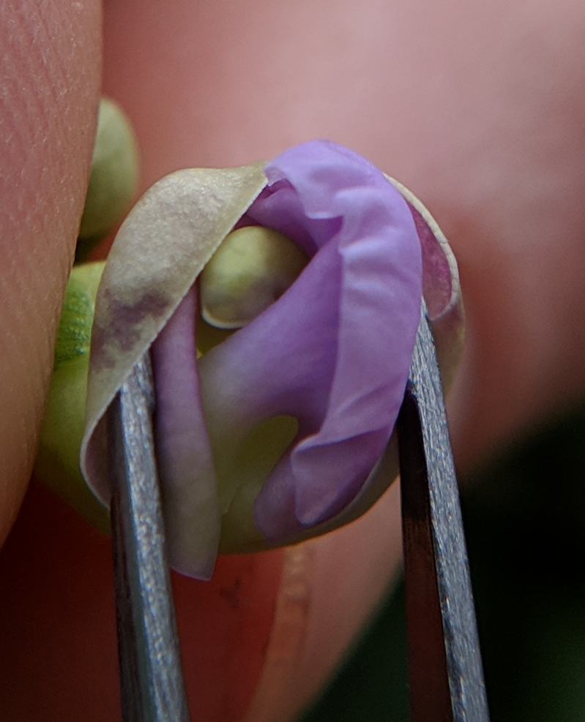
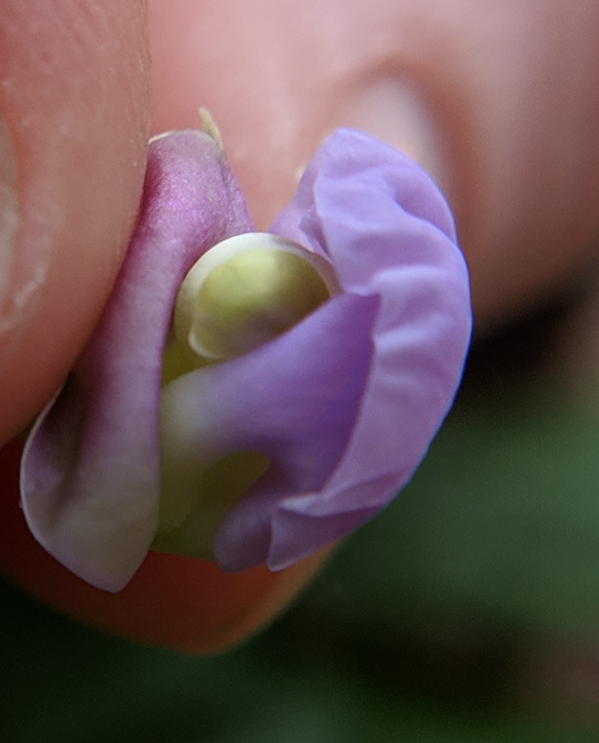
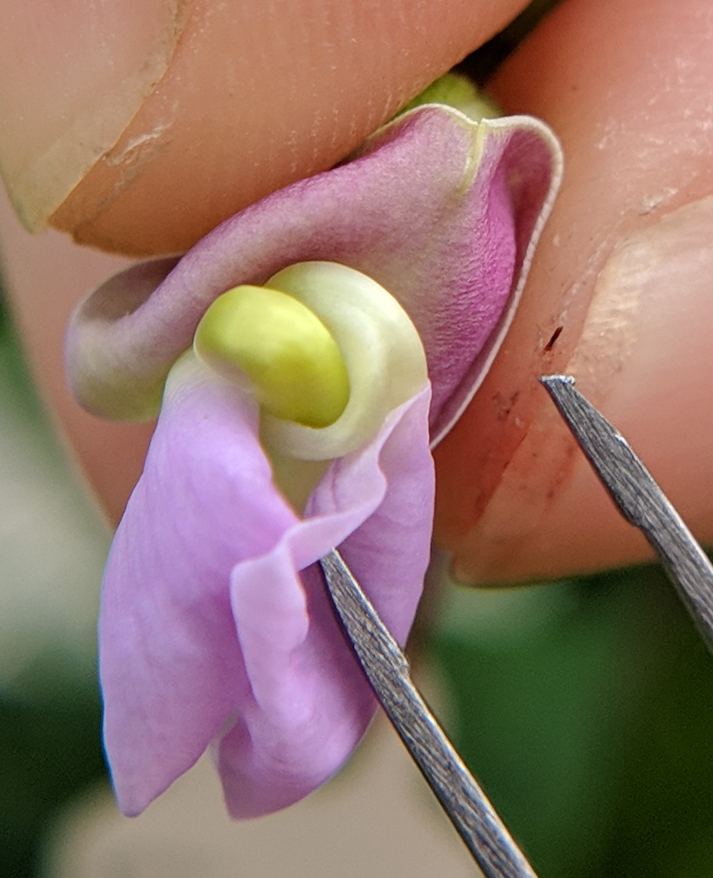
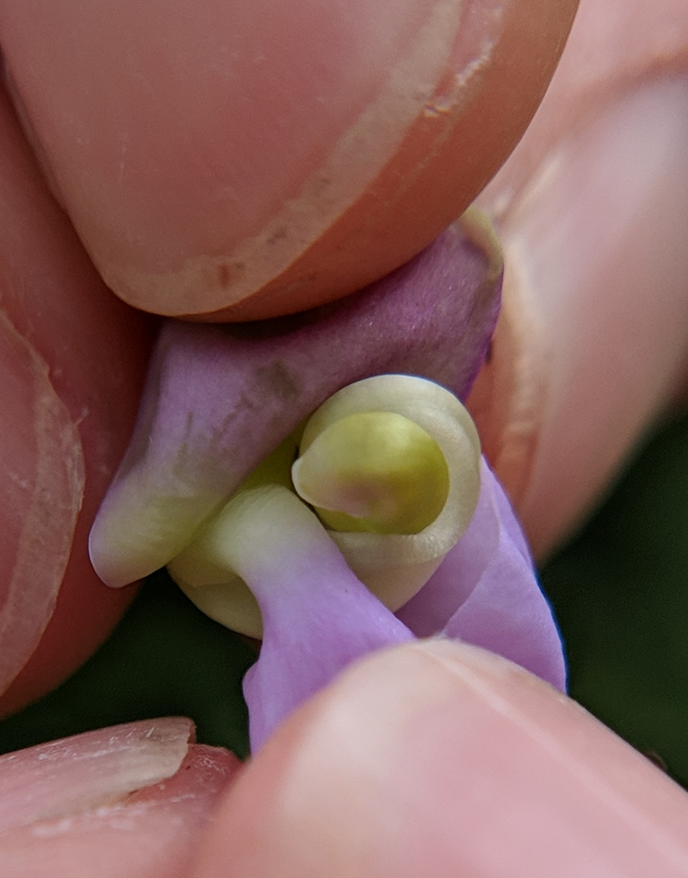
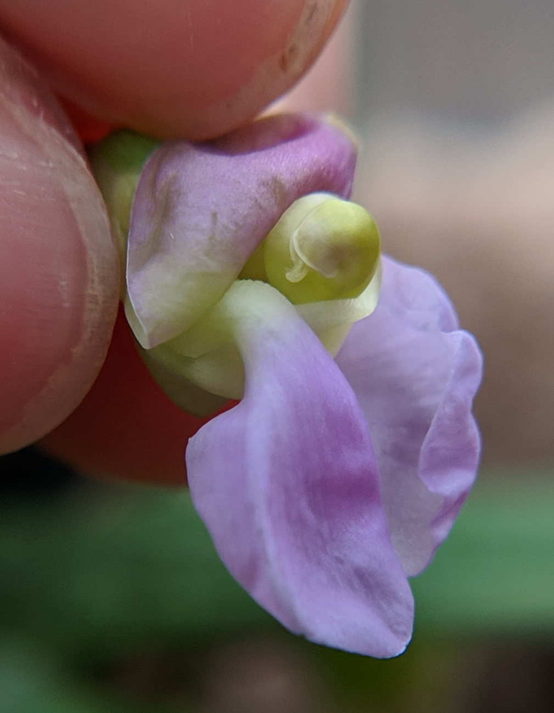
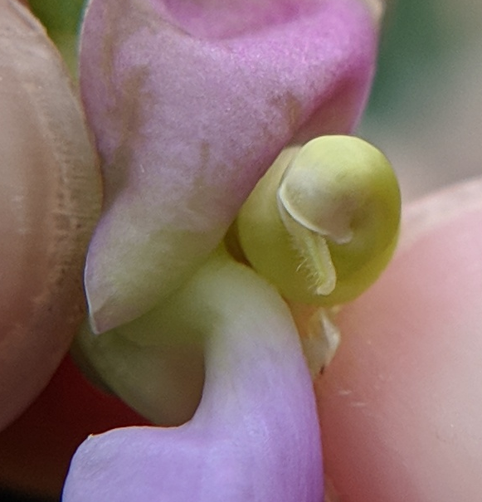
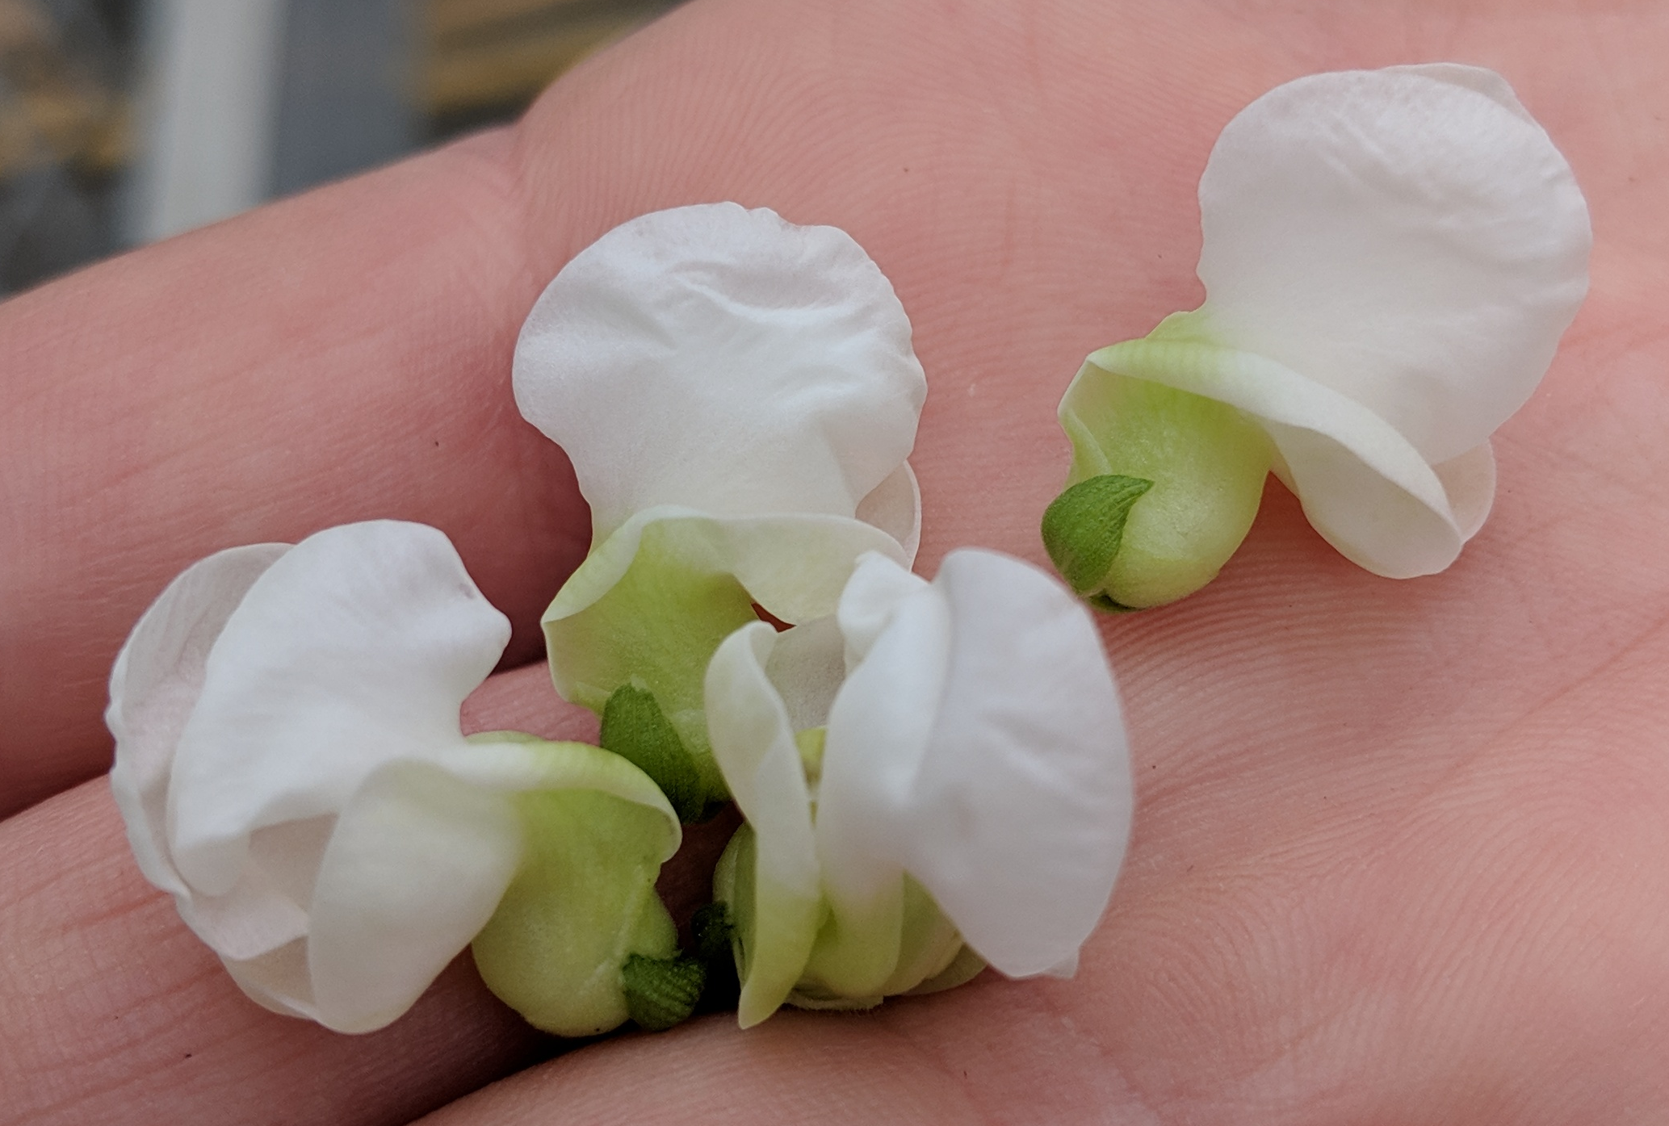
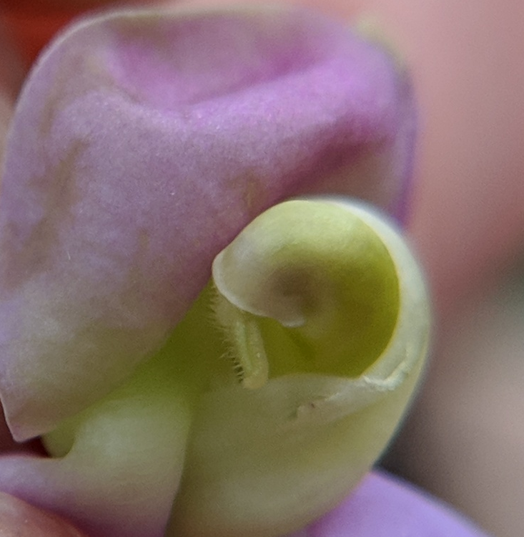
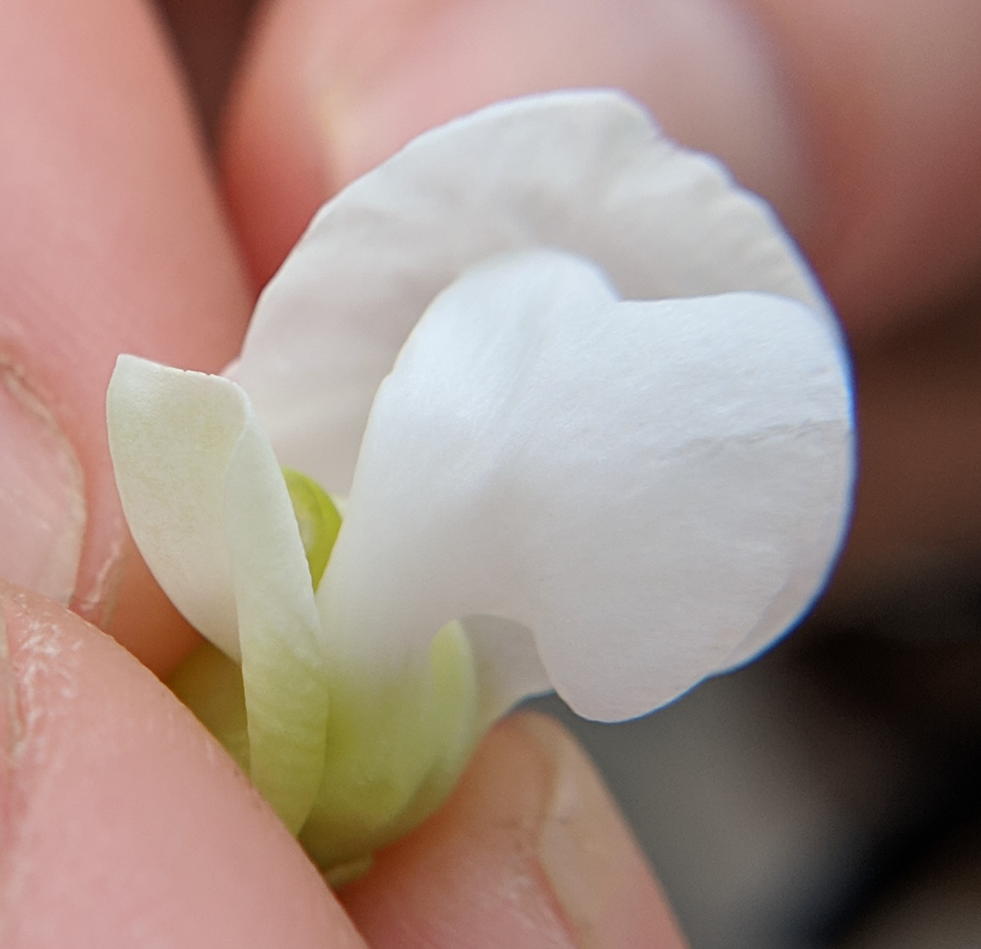
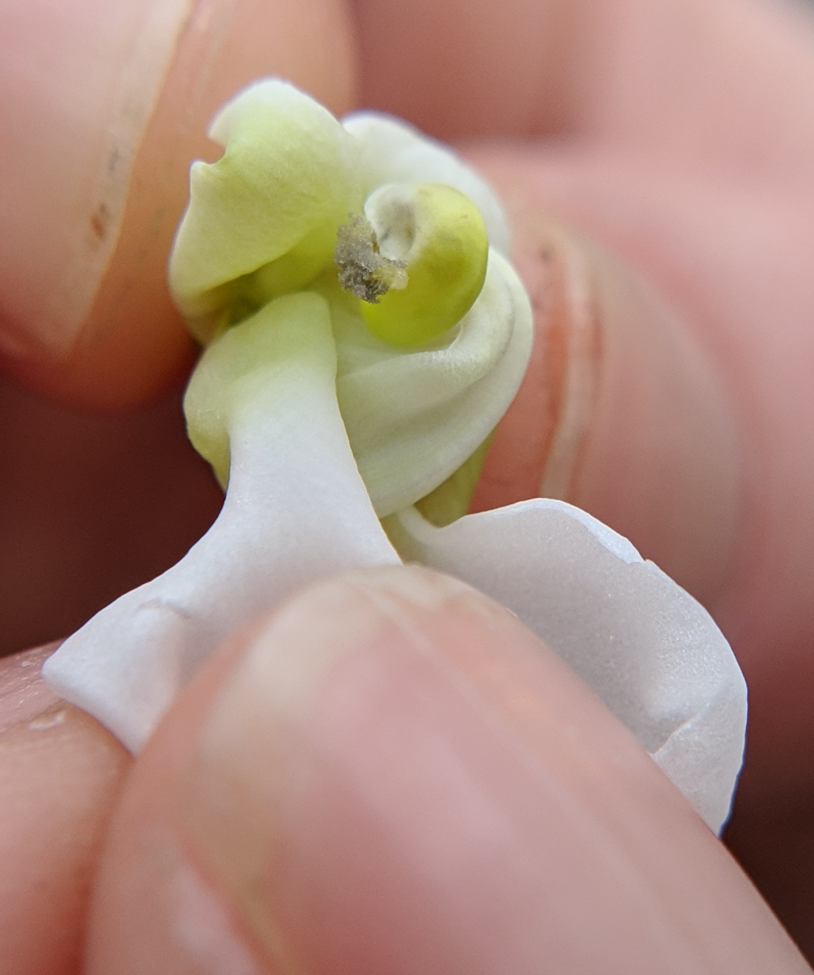
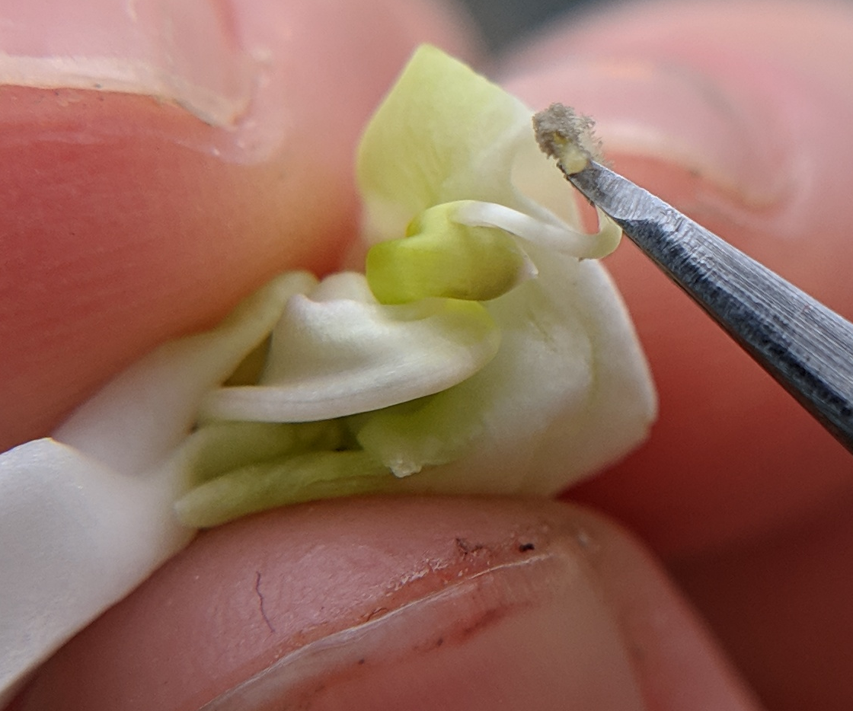
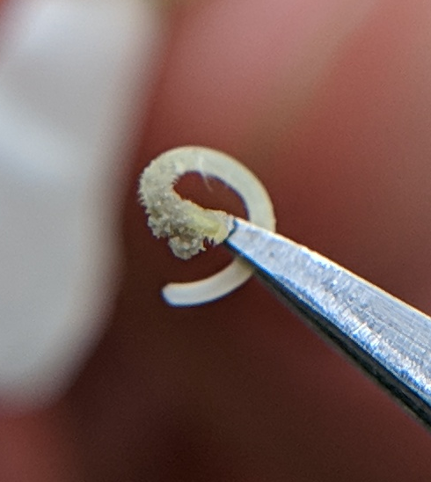
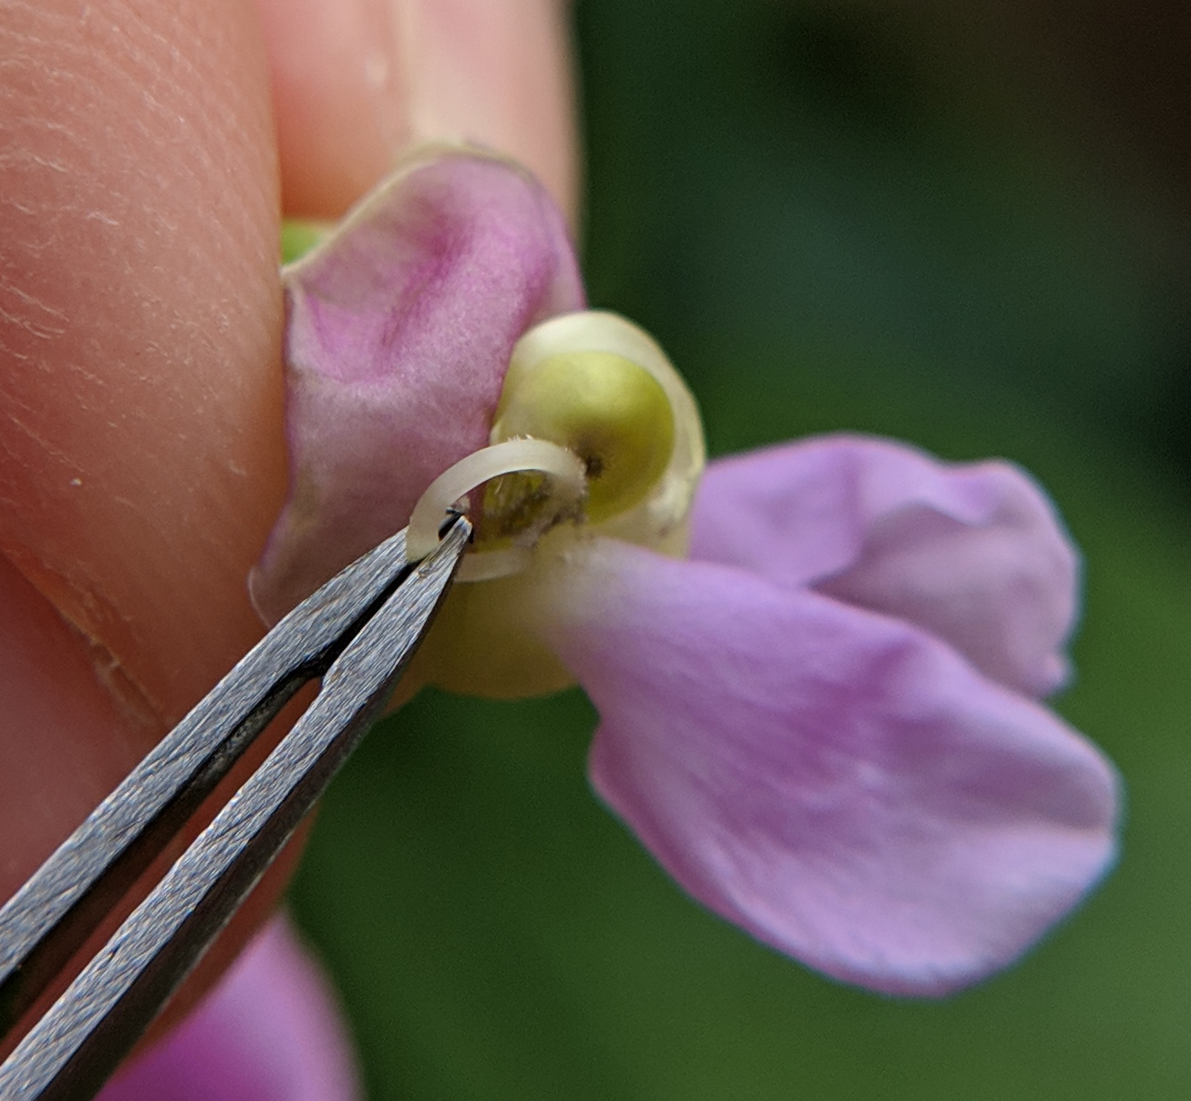
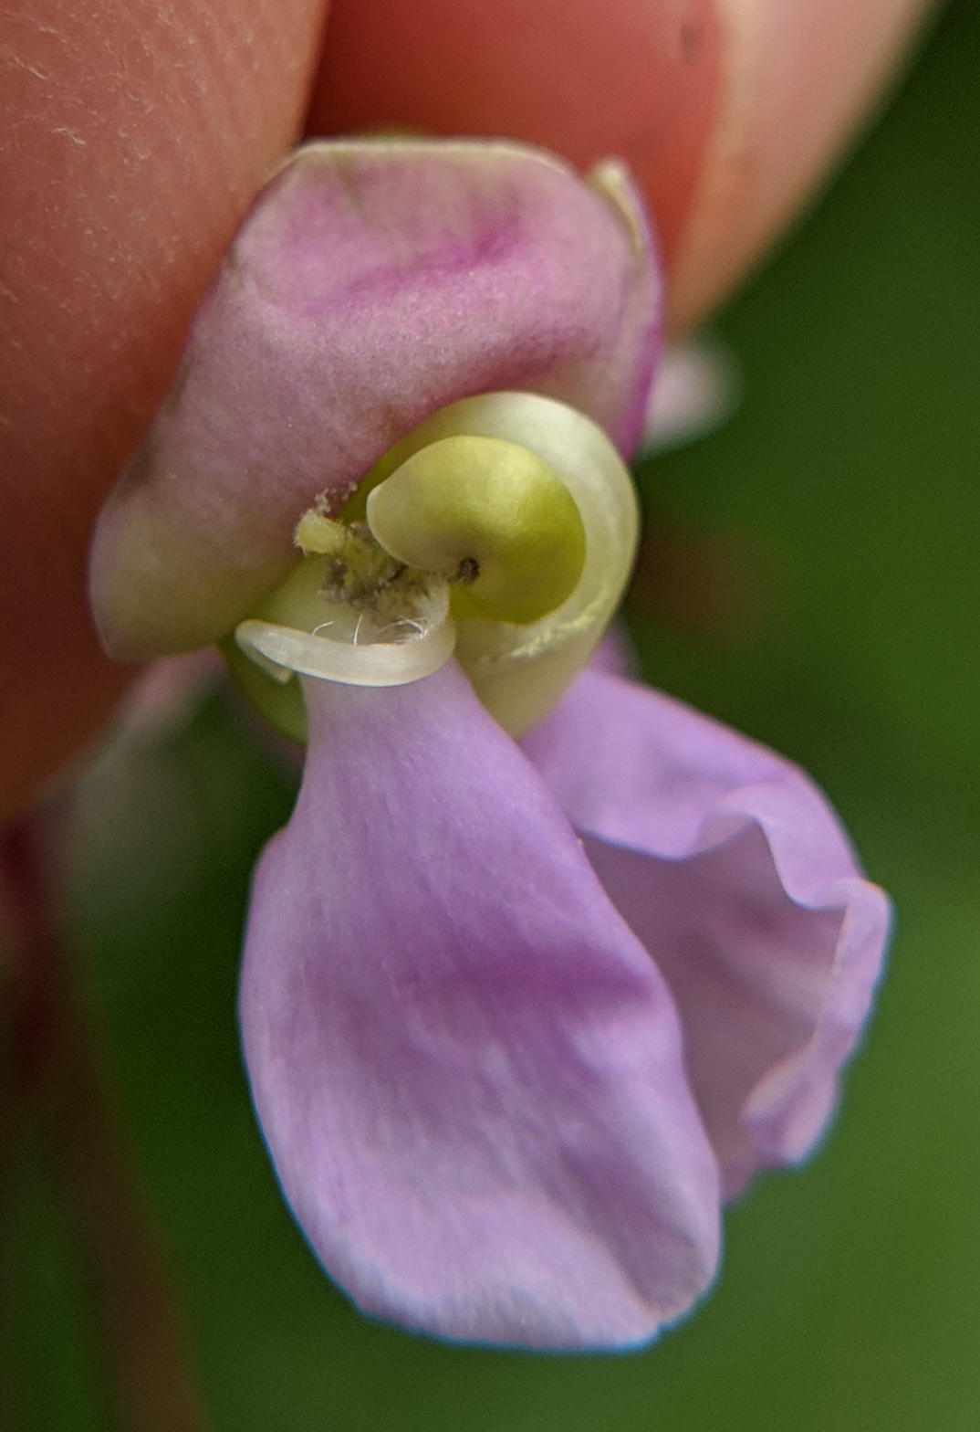
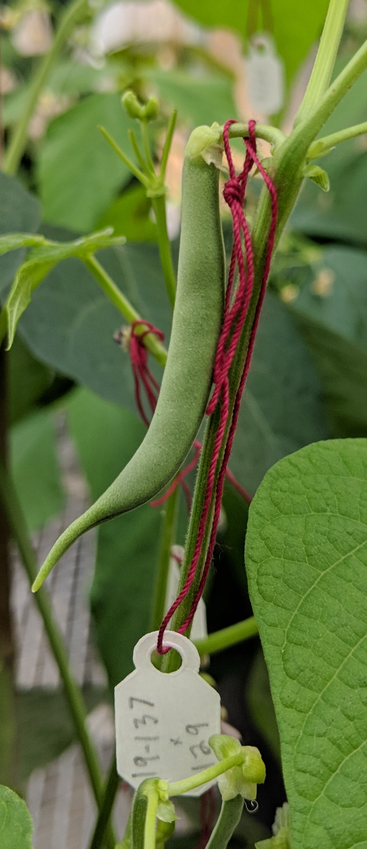
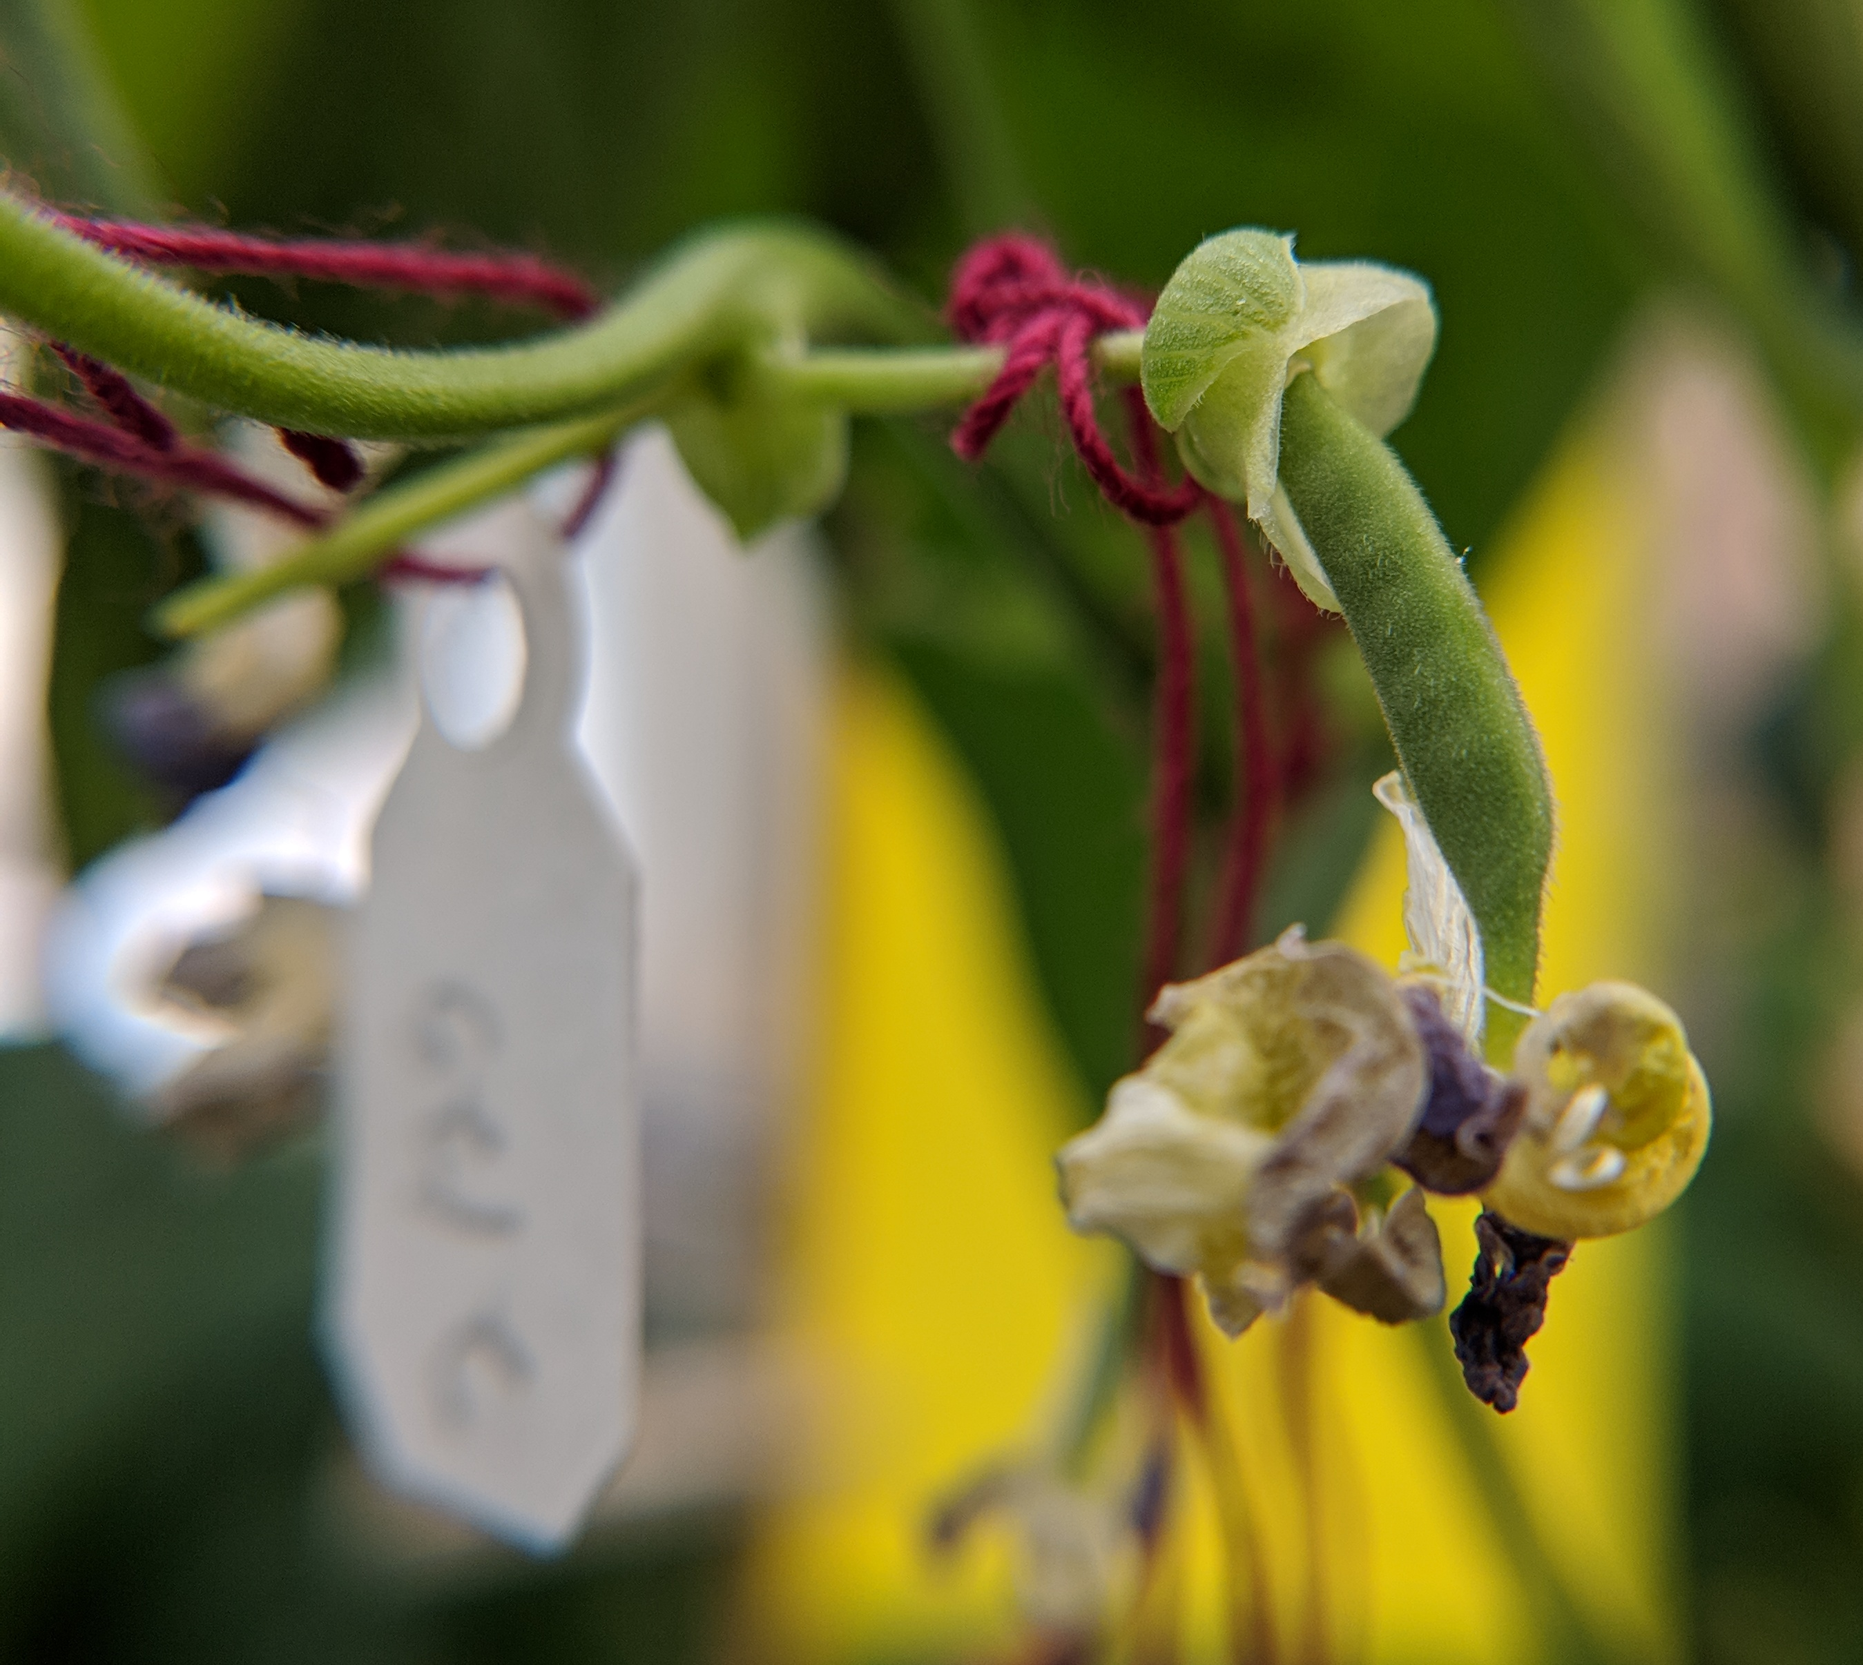

BEAN POLLINATION GUIDE
Phaseolus vulgaris
Common beans are highly self-pollinating with a specialized floral morphology that keeps the female stigma and male stamens in close proximity until pollination occurs.
STANDARD/
BANNER PETAL
WING PETALS
STIGMA
- and - STAMENS
KEEL PETALS
Step ONE: Identify immature female buds
Step TWO: “Trigger” the stigma using wing petals
Identify a flower bud with an unopened standard petal and minimal color. Using a sharp tweezers, push the margins of the standard apart to expose the keel and wing petals.
With the tweezers or your finger, grab the wing petals and pull in the opposite direction (downward) from the standard. The stigma should start to emerge from the keels.
Step THREE: Expose stigmatic surface
Step FOUR: Collect viable pollen
It may be necessary to repeat the downward motion with the wing petals or gently rub the keel petals to “trigger” the stigma. If stamens also emerge, be sure to carefully, remove these to avoid self pollination of this female bud. The stigmatic surface should protrude 1-2mm and its hairs should be free of pollen.
STIGMA
Collect male pollen from freshly opened flowers. Peel back the standard and wing petals to expose a pollen-covered stigma. With the tweezers, remove the stigma.
KEEL
Step FIVE: “Hook” pollen to receptive female
Step SIX: Label and monitor fruit development
Carefully brush the male stigma (with pollen) on the exposed female stigma (without pollen). Loop the male stigma around the female
Label a light threaded crossing-tag with female x male designators and the date of the cross. Carefully adhere to the single pedicel connected to the flower bud. Remove any additional pods and flowers that were not included in the cross.
Follow good seed stewardship practices, using clean harvesting and storage practices to obtain high quality, safe seed.
stigma. The male stigma should remain in this position until pod development. A second male stigma may also be used.
TIPS FROM THE PROS:
Selfed seed may occur – emasculation [see Hybridization of Crop Plants (1980)] is an alternative technique
A sharp, fine tweezers/forceps is key, and reading glasses or a jeweler’s headset can help magnify the technique
THIS PROJECT WAS SUPPORTED BY:
NORTHERN ORGANIC VEGETABLE IMPROVEMENT COOPERATIVE
Photos and design by: H. Swegarden
Demonstration by: K. Loria (Mazourek Lab)

