Slide 1
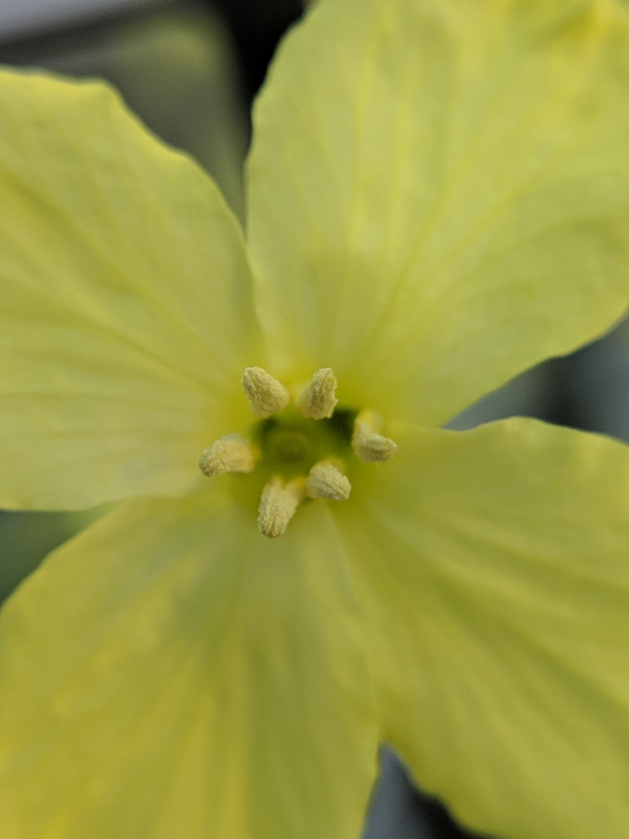
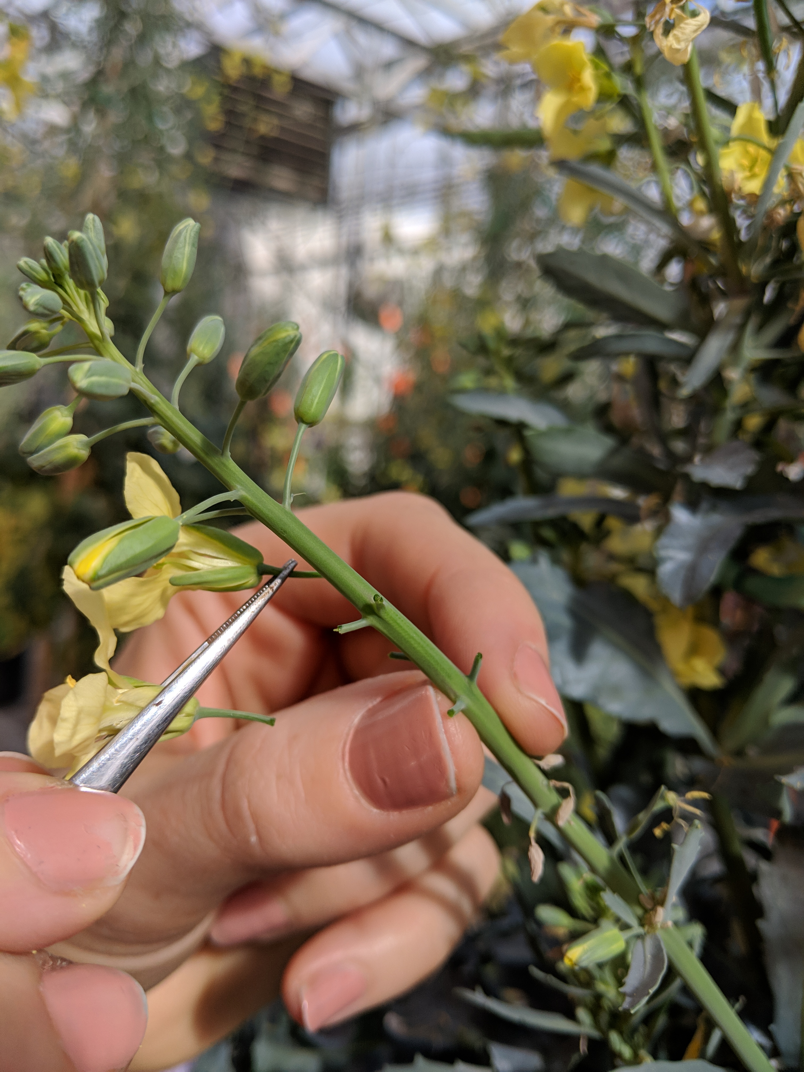
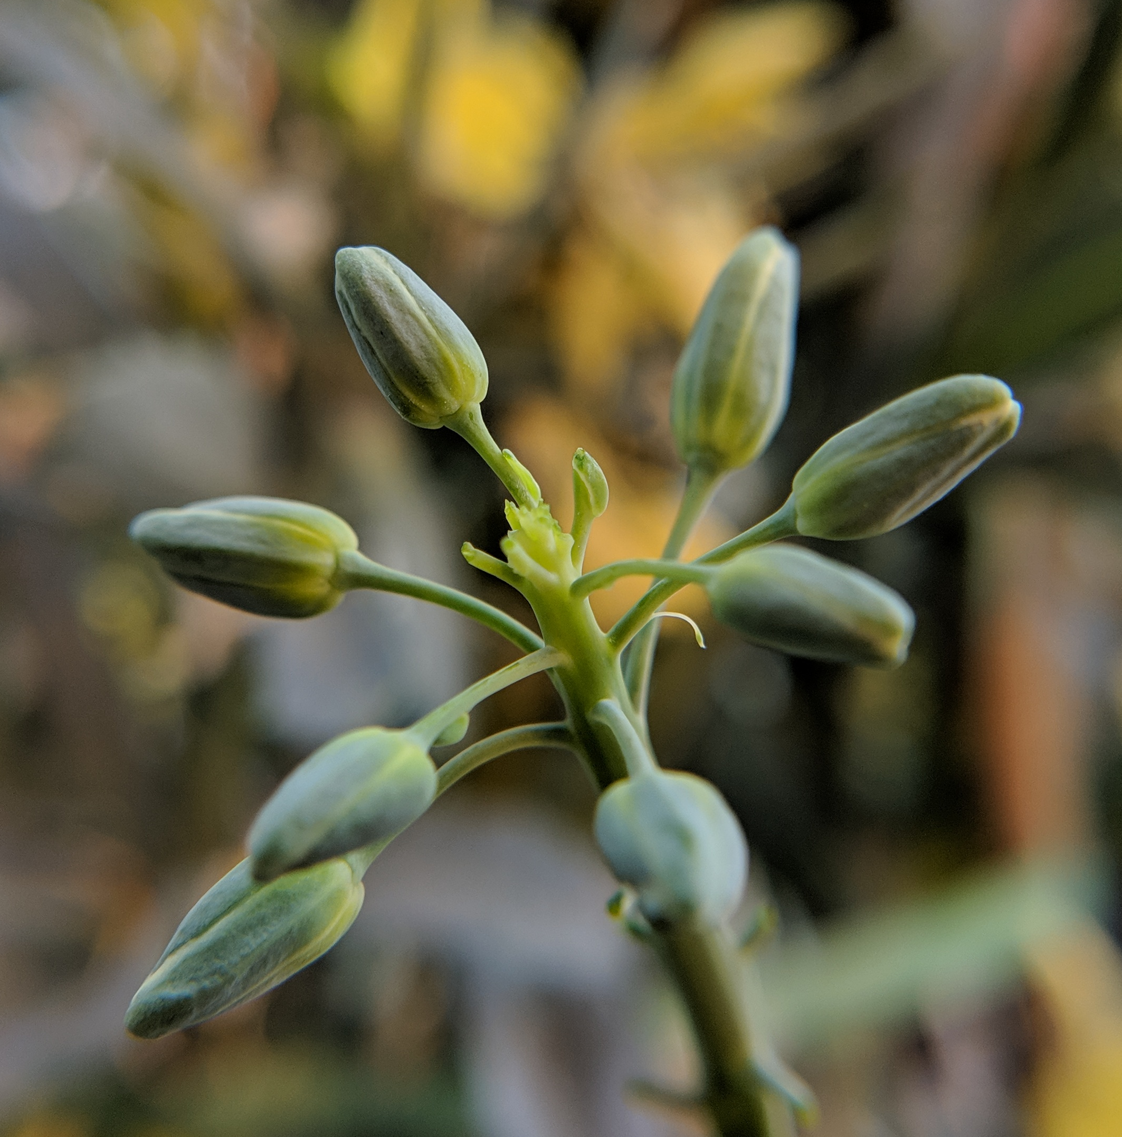
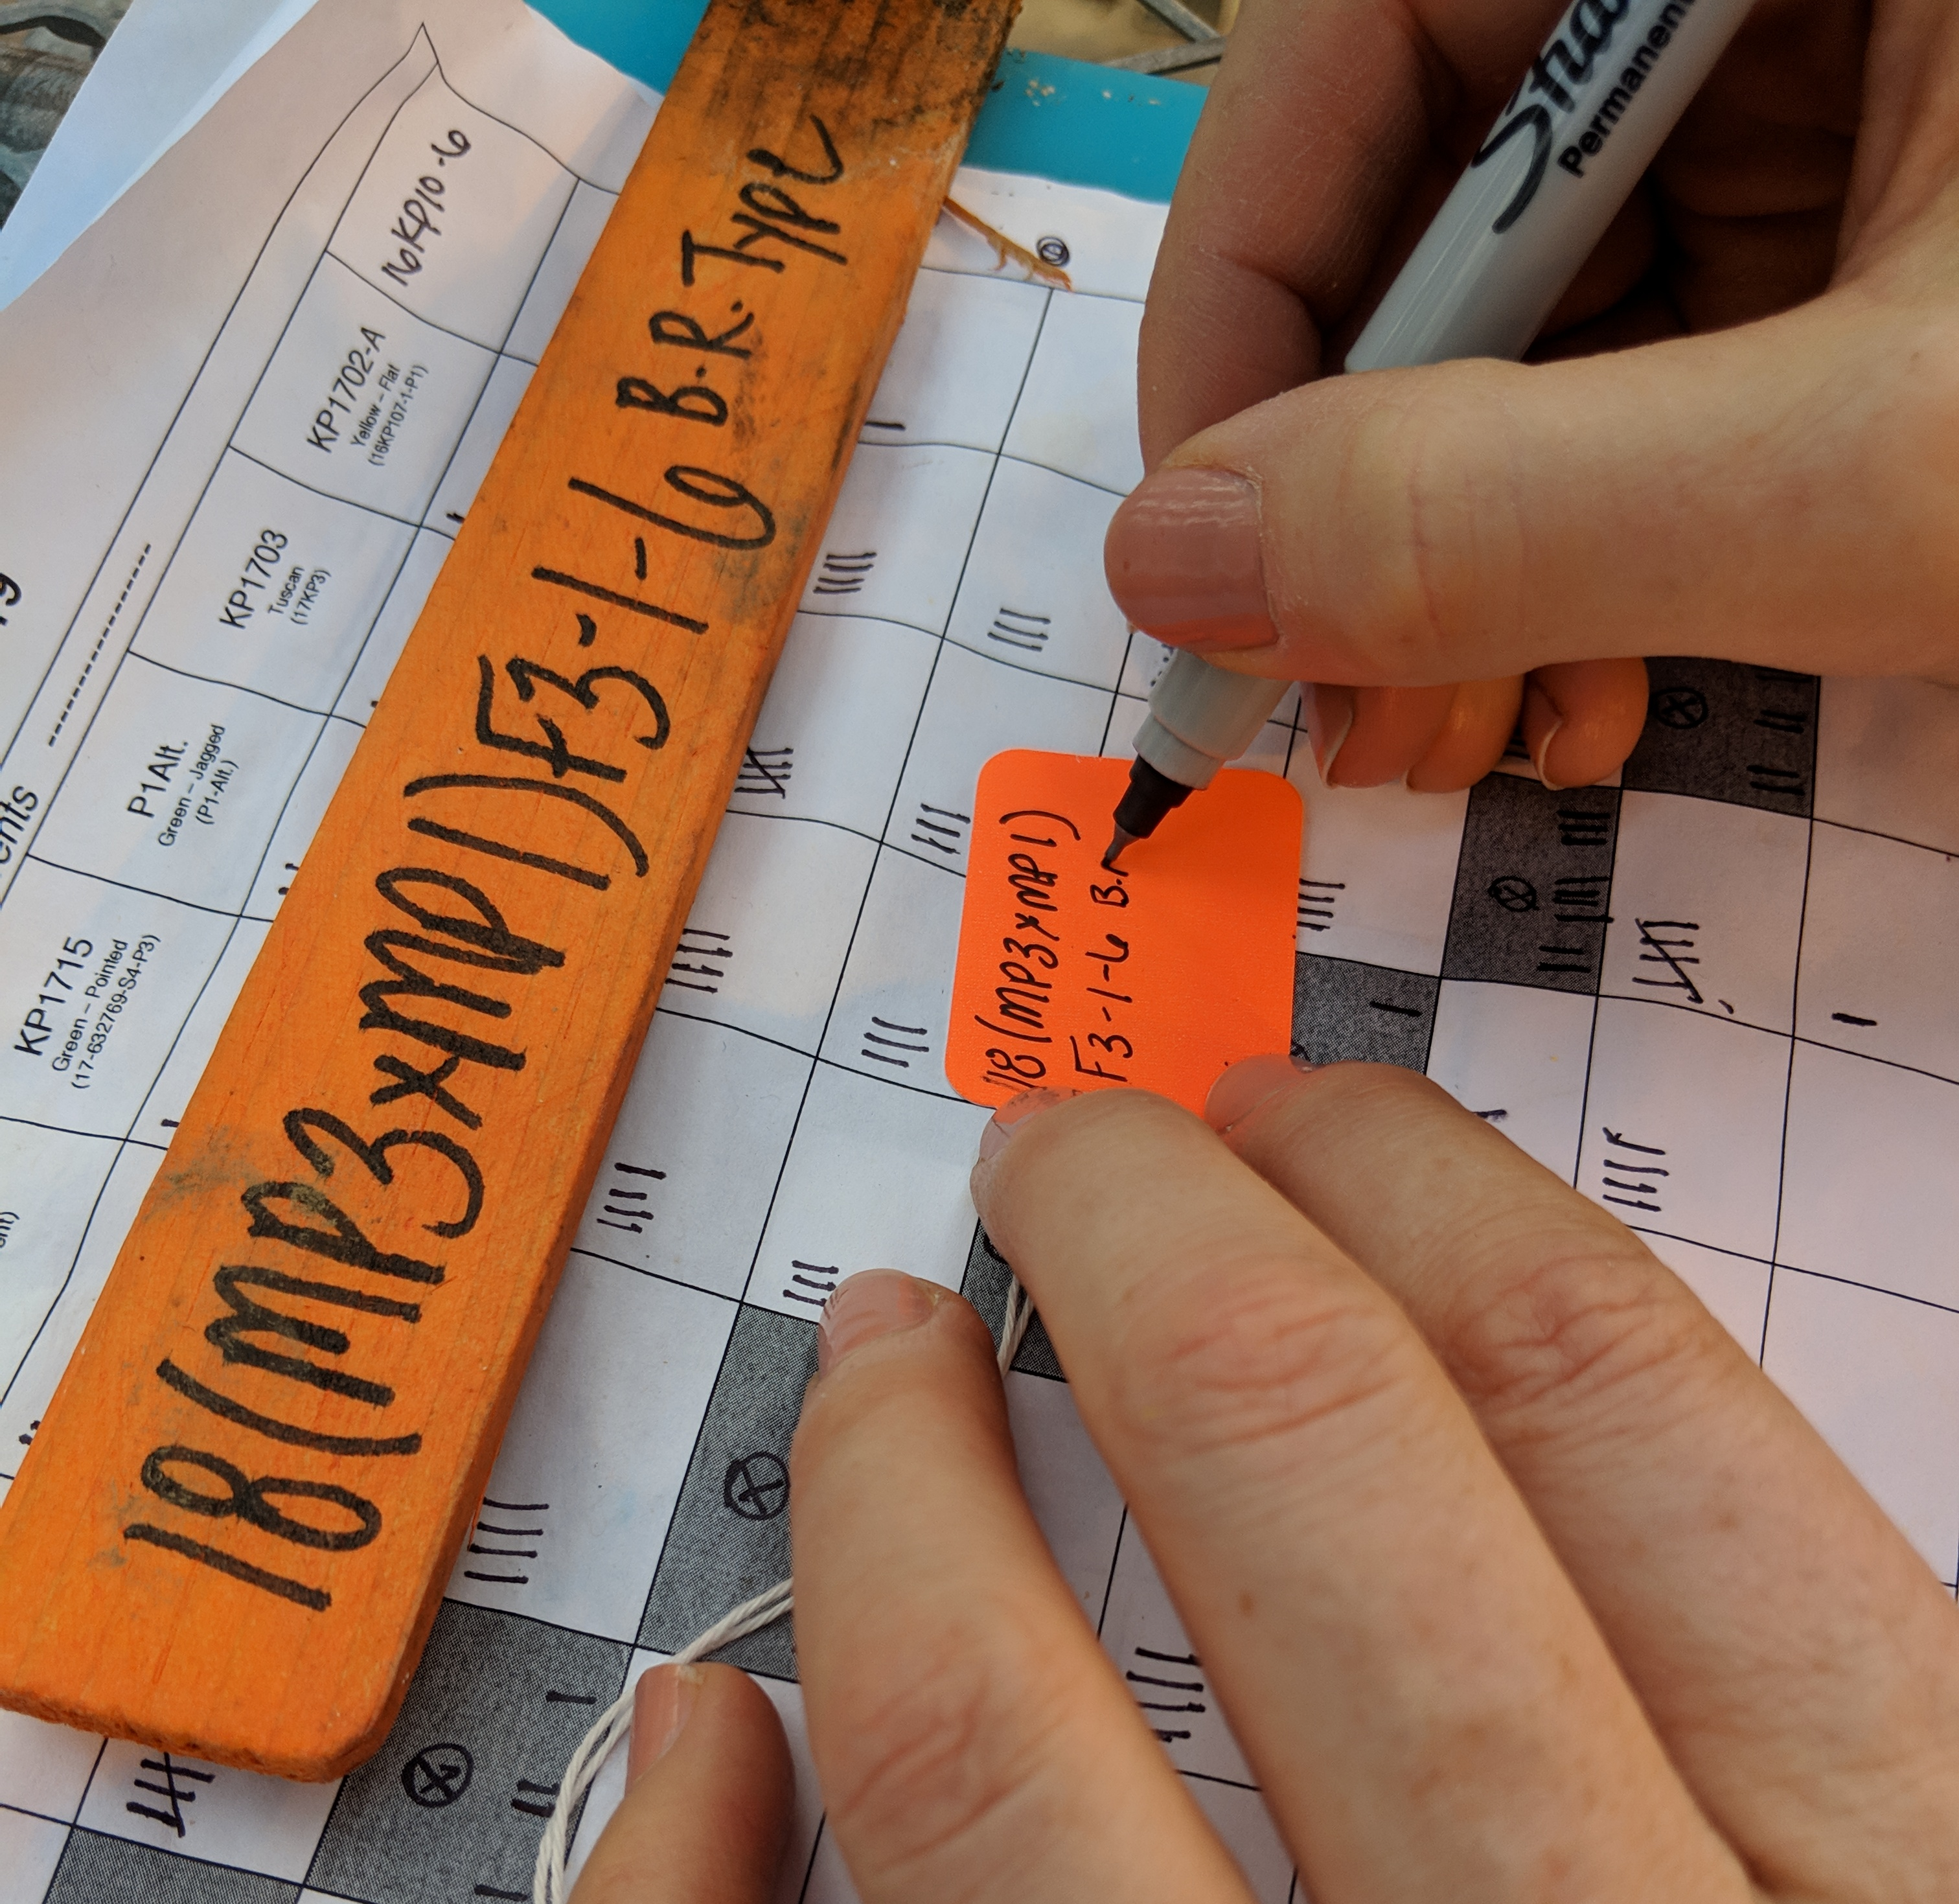
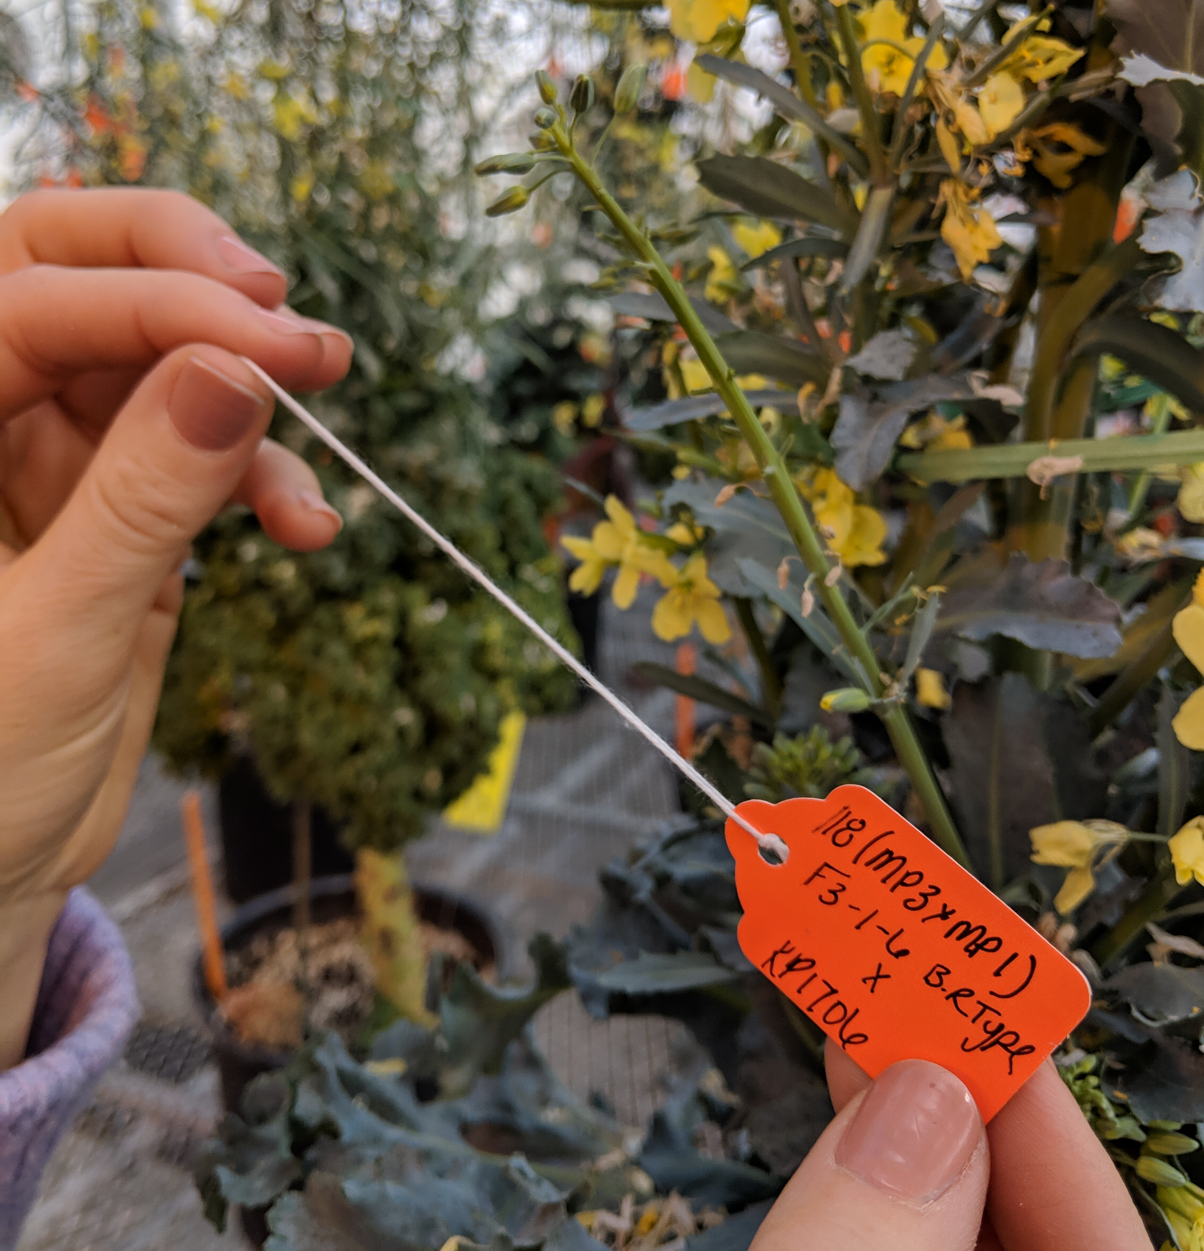
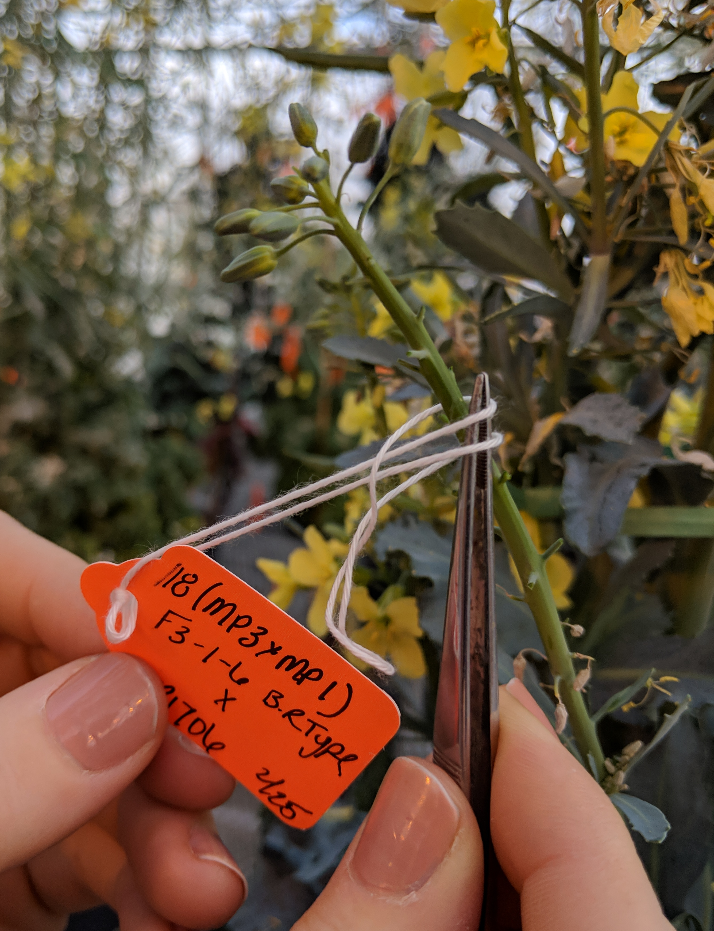
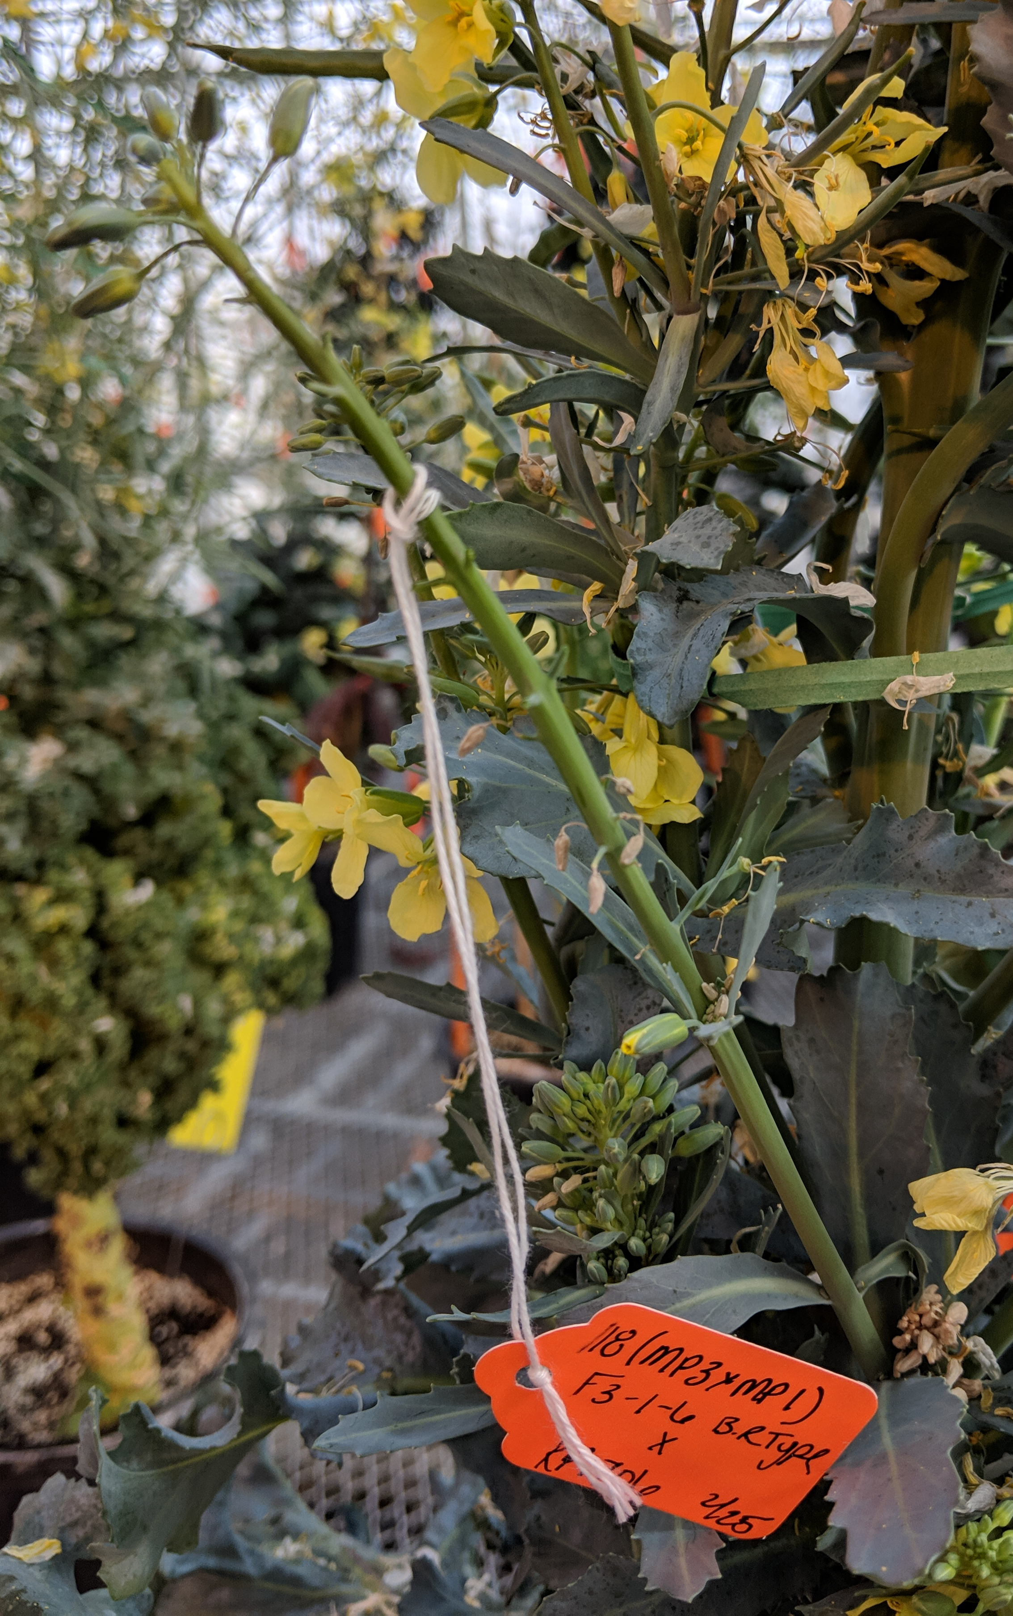
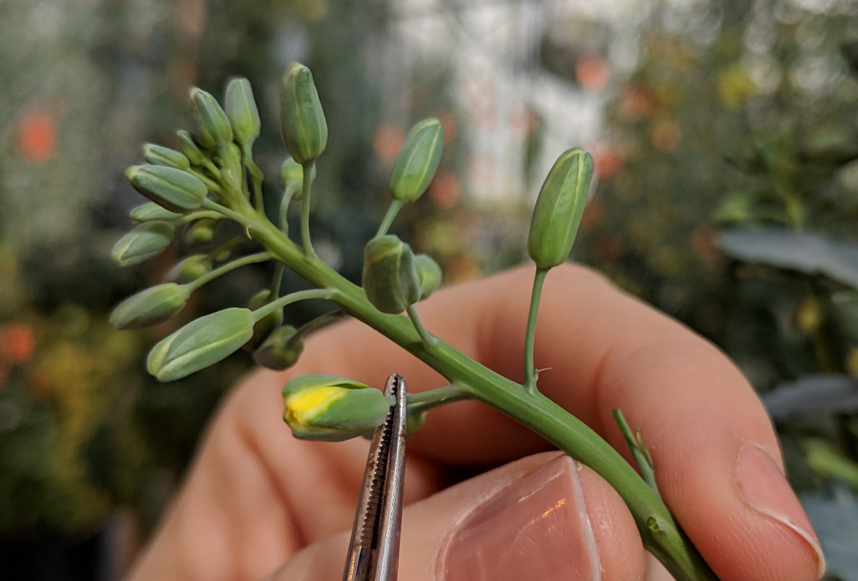
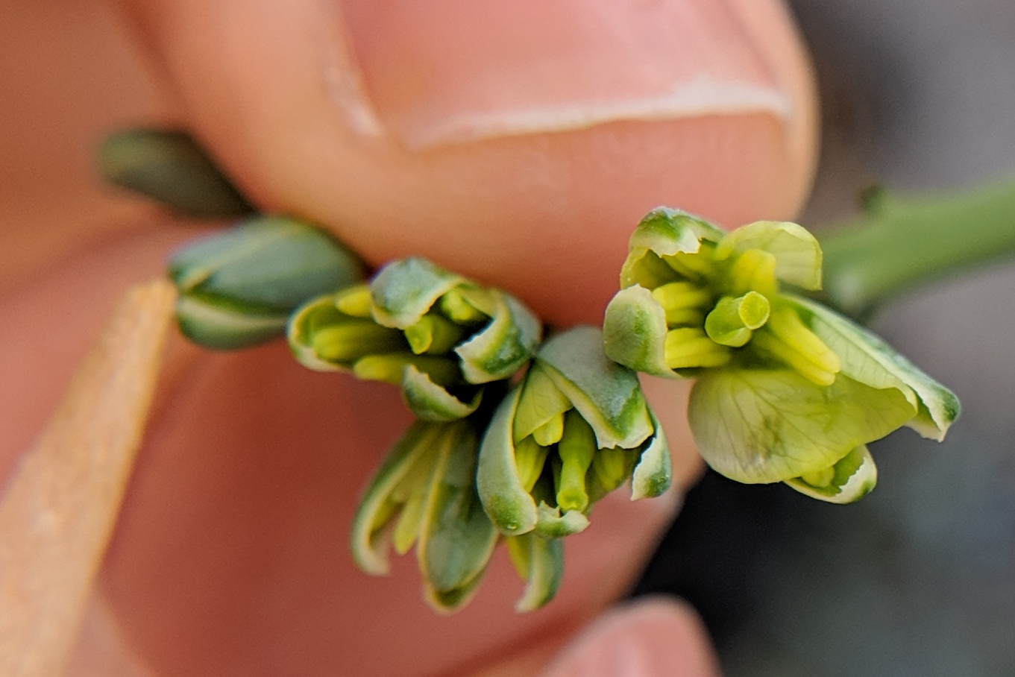
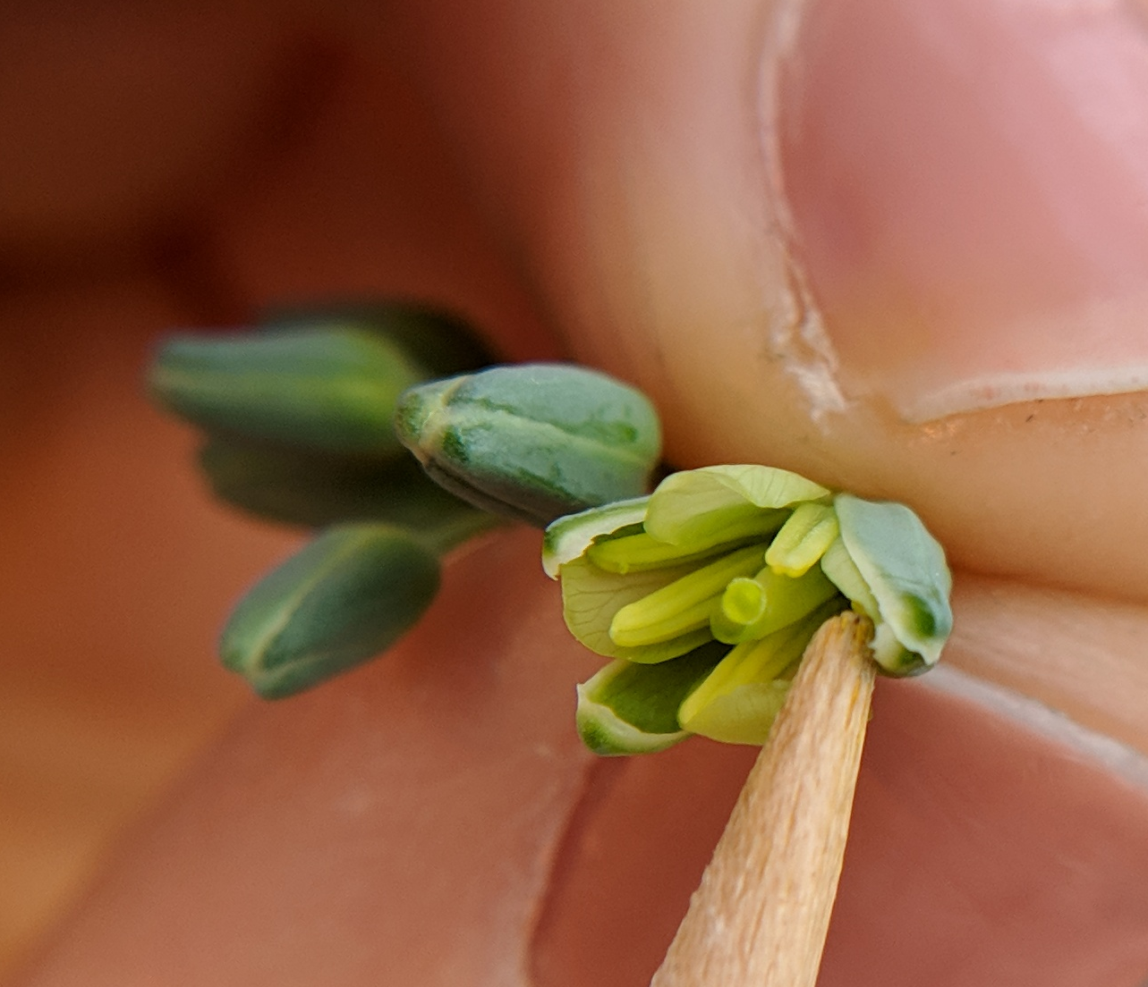
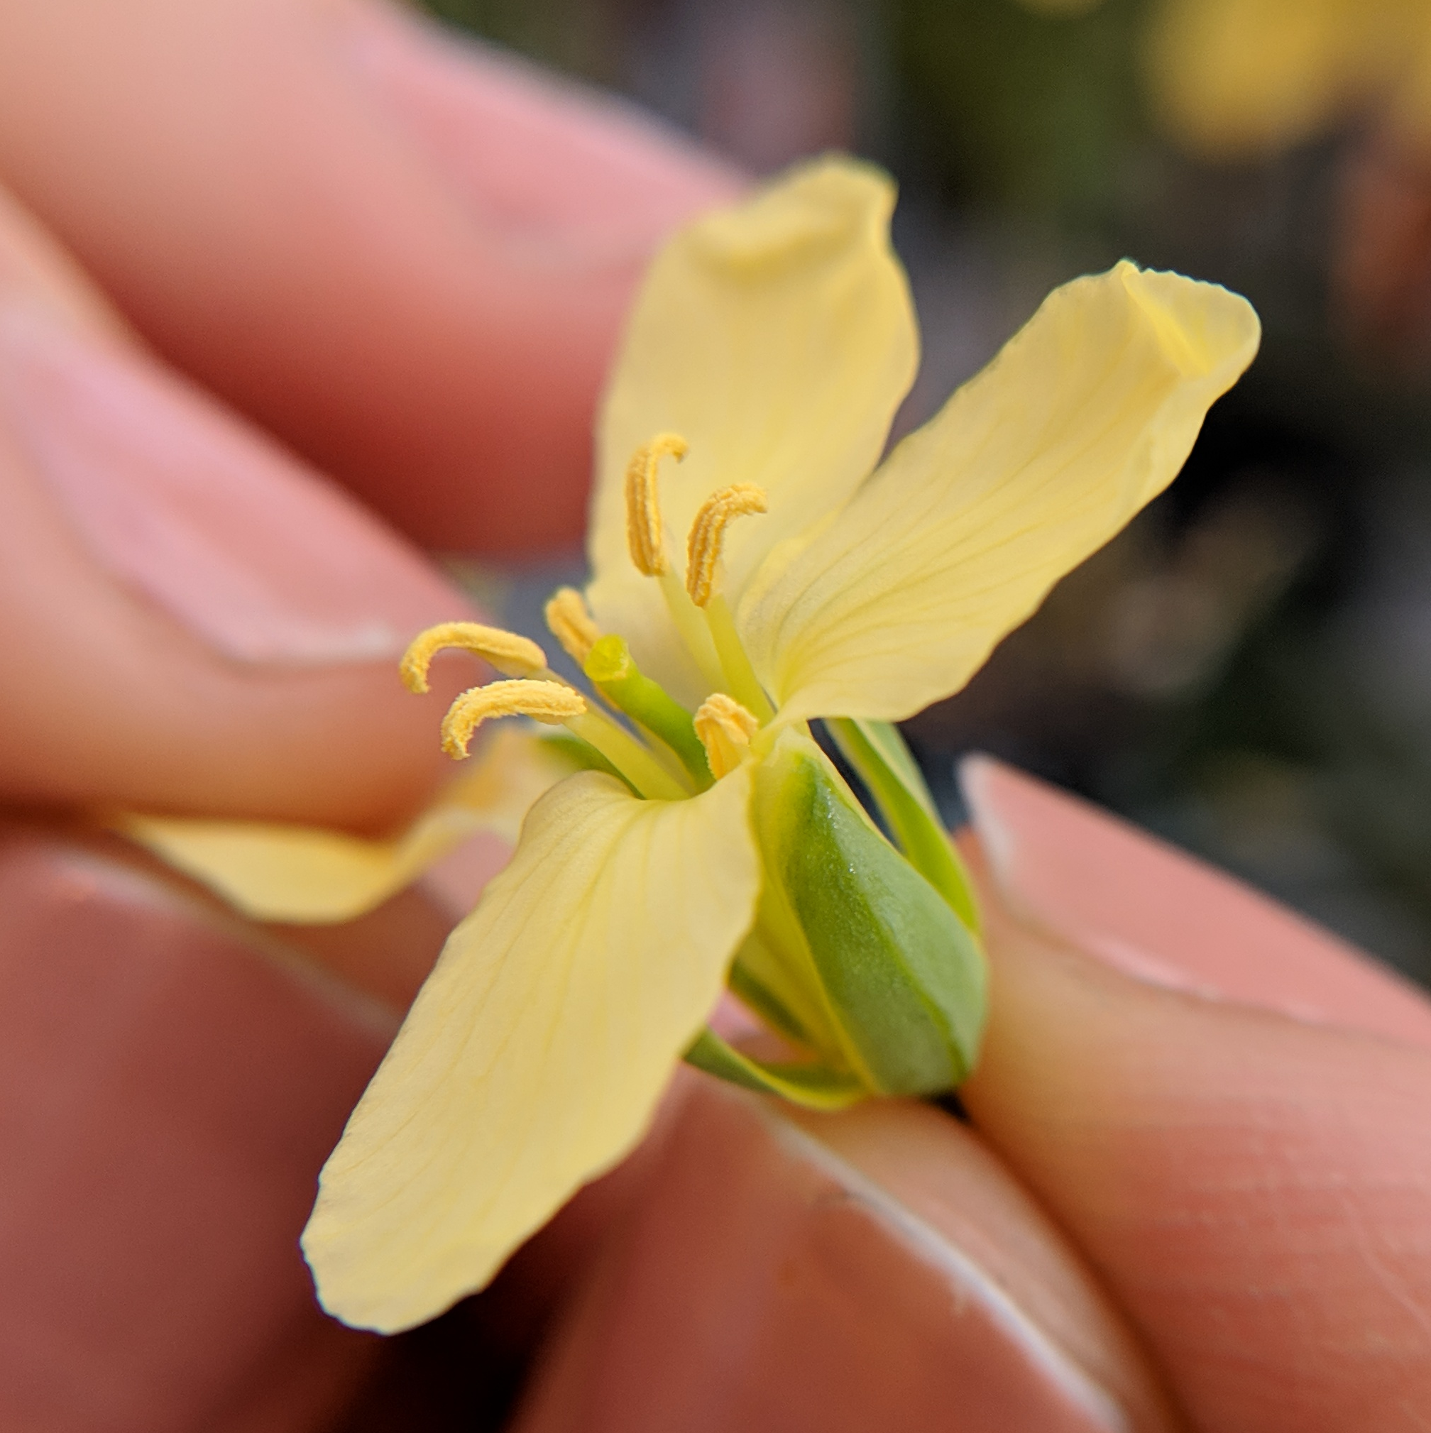
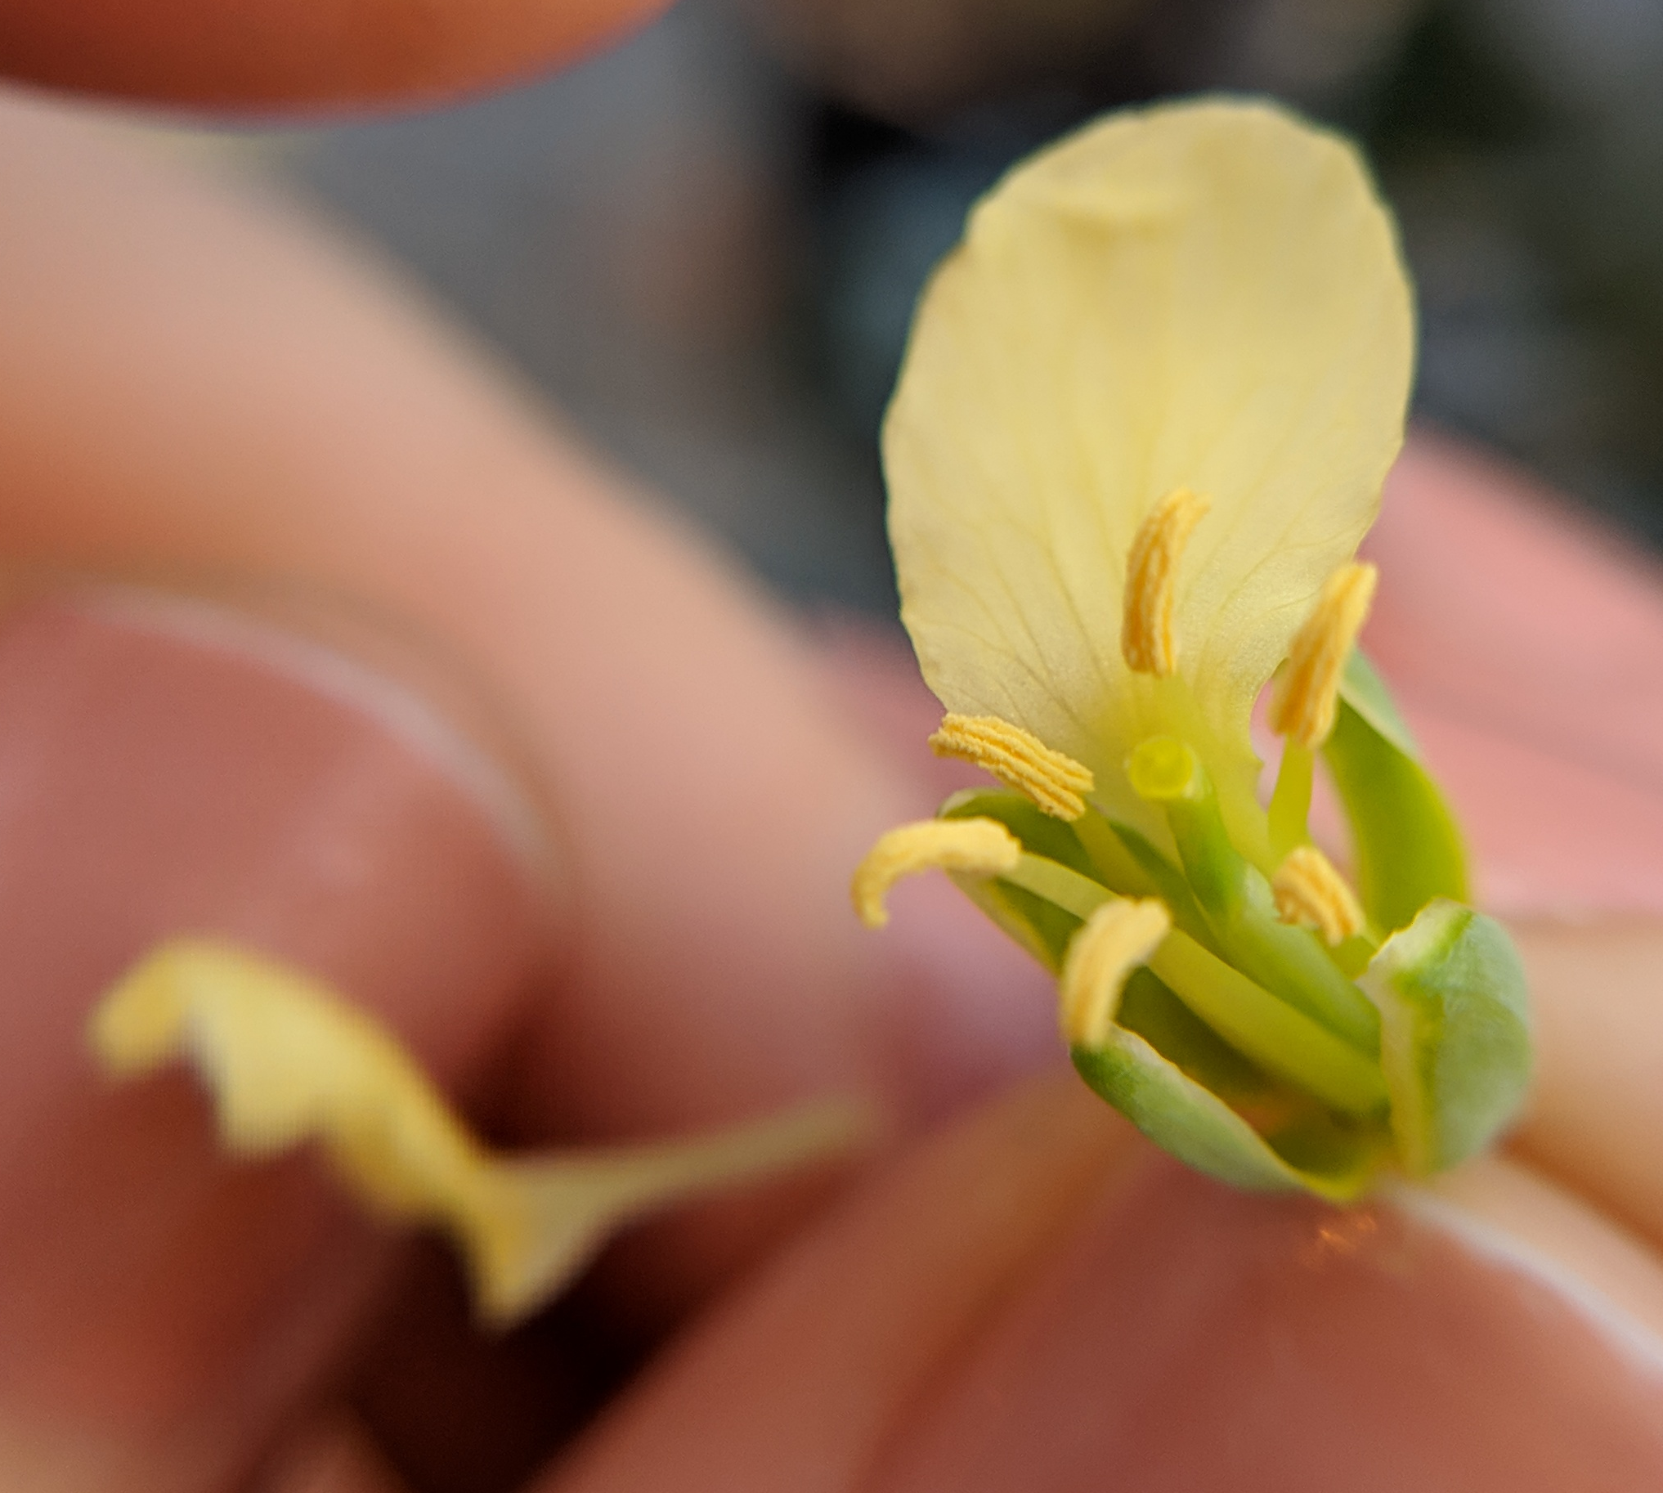
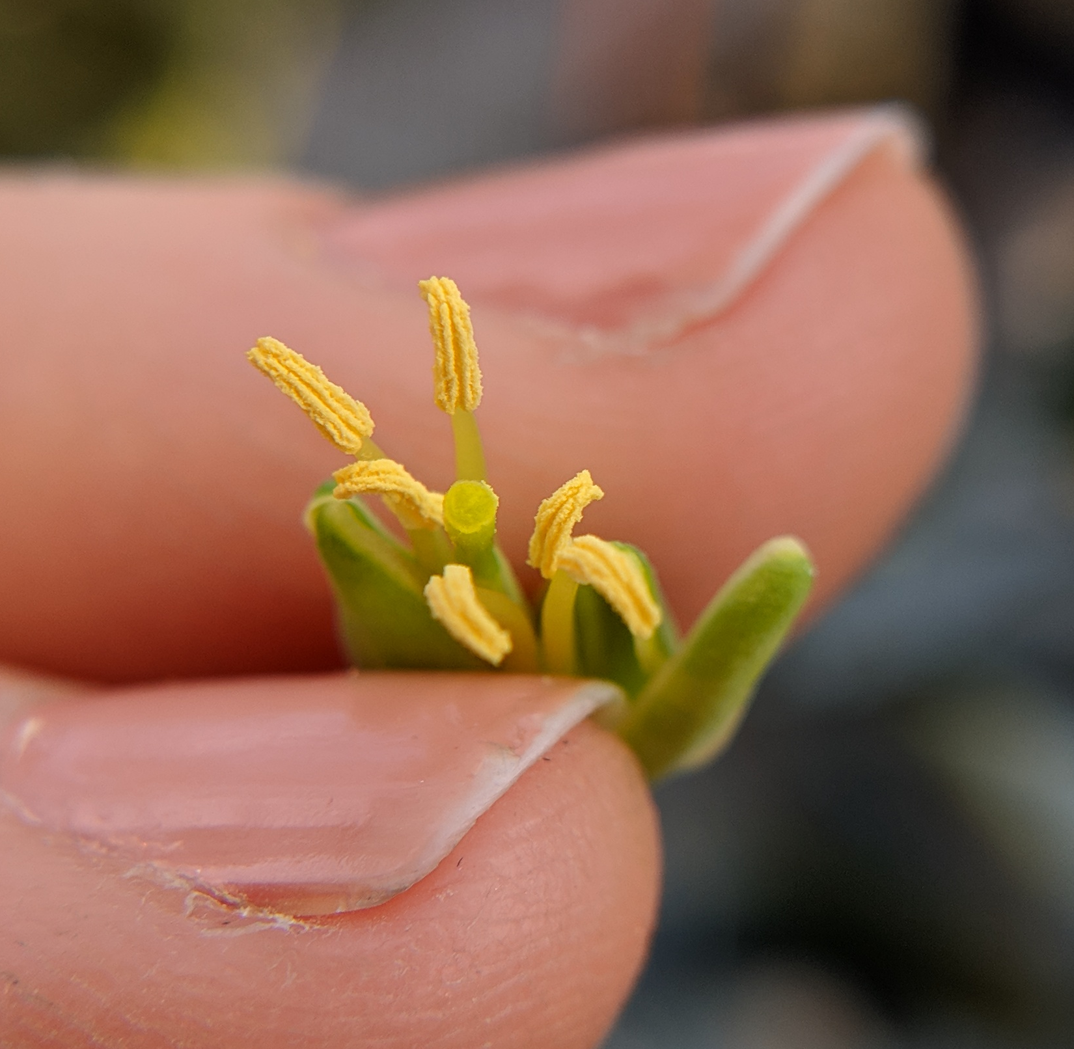
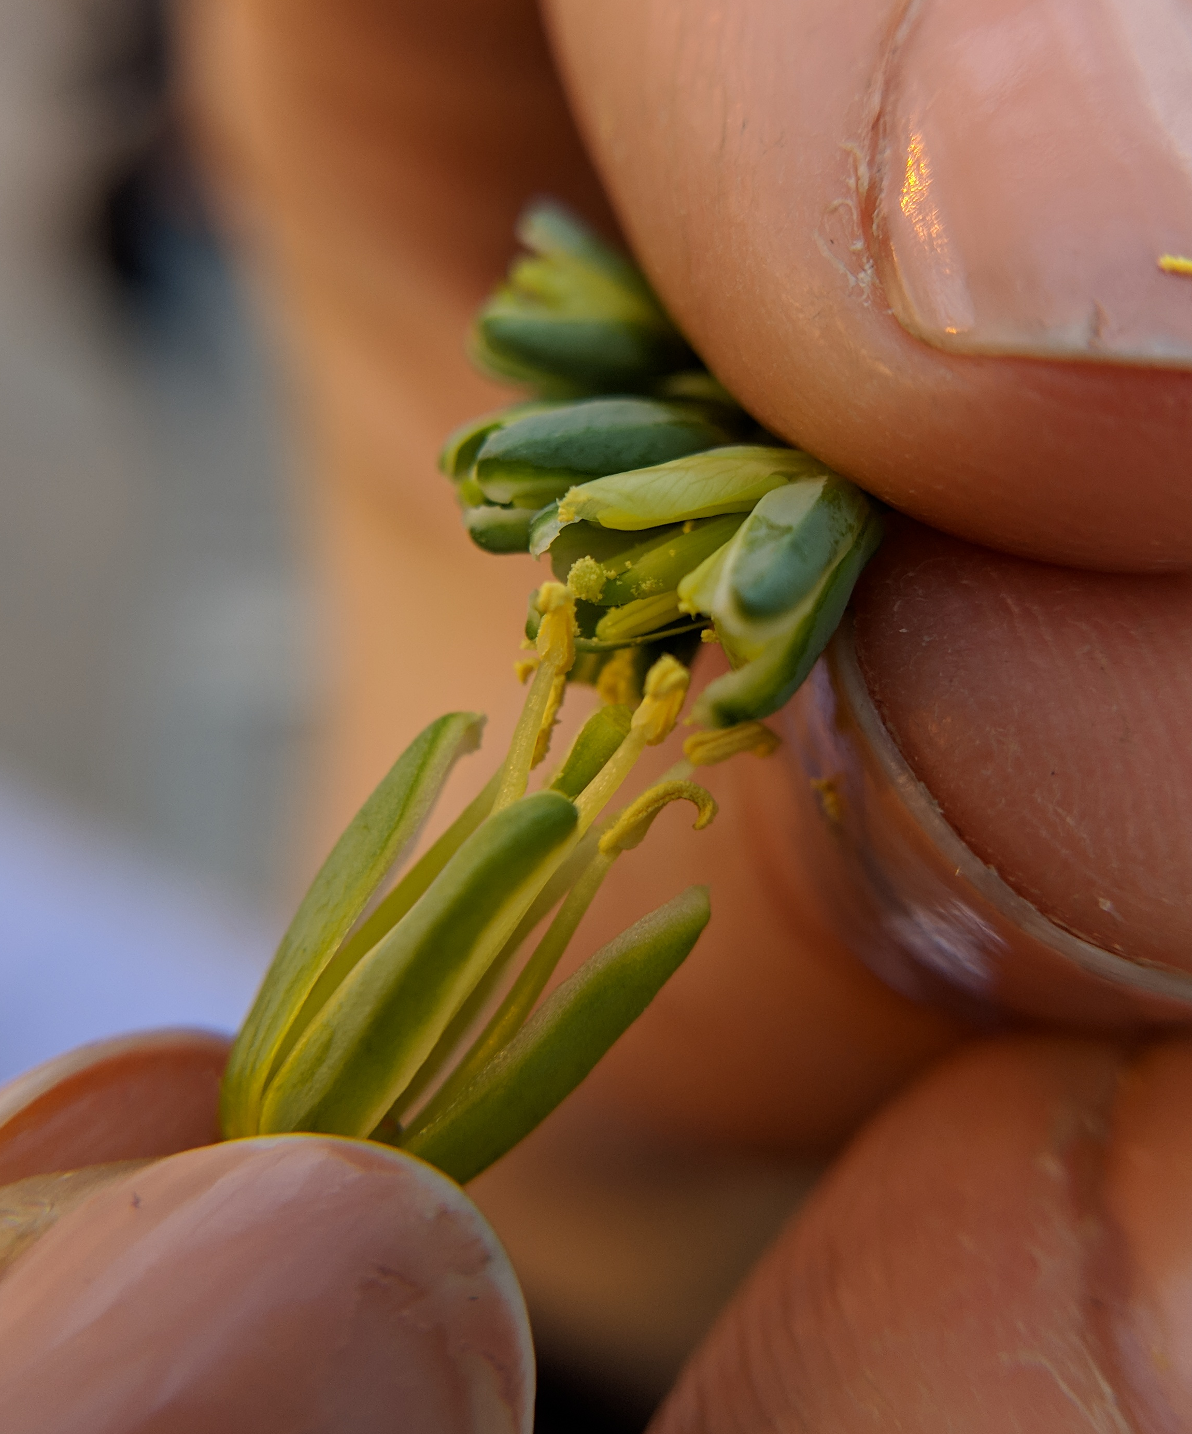
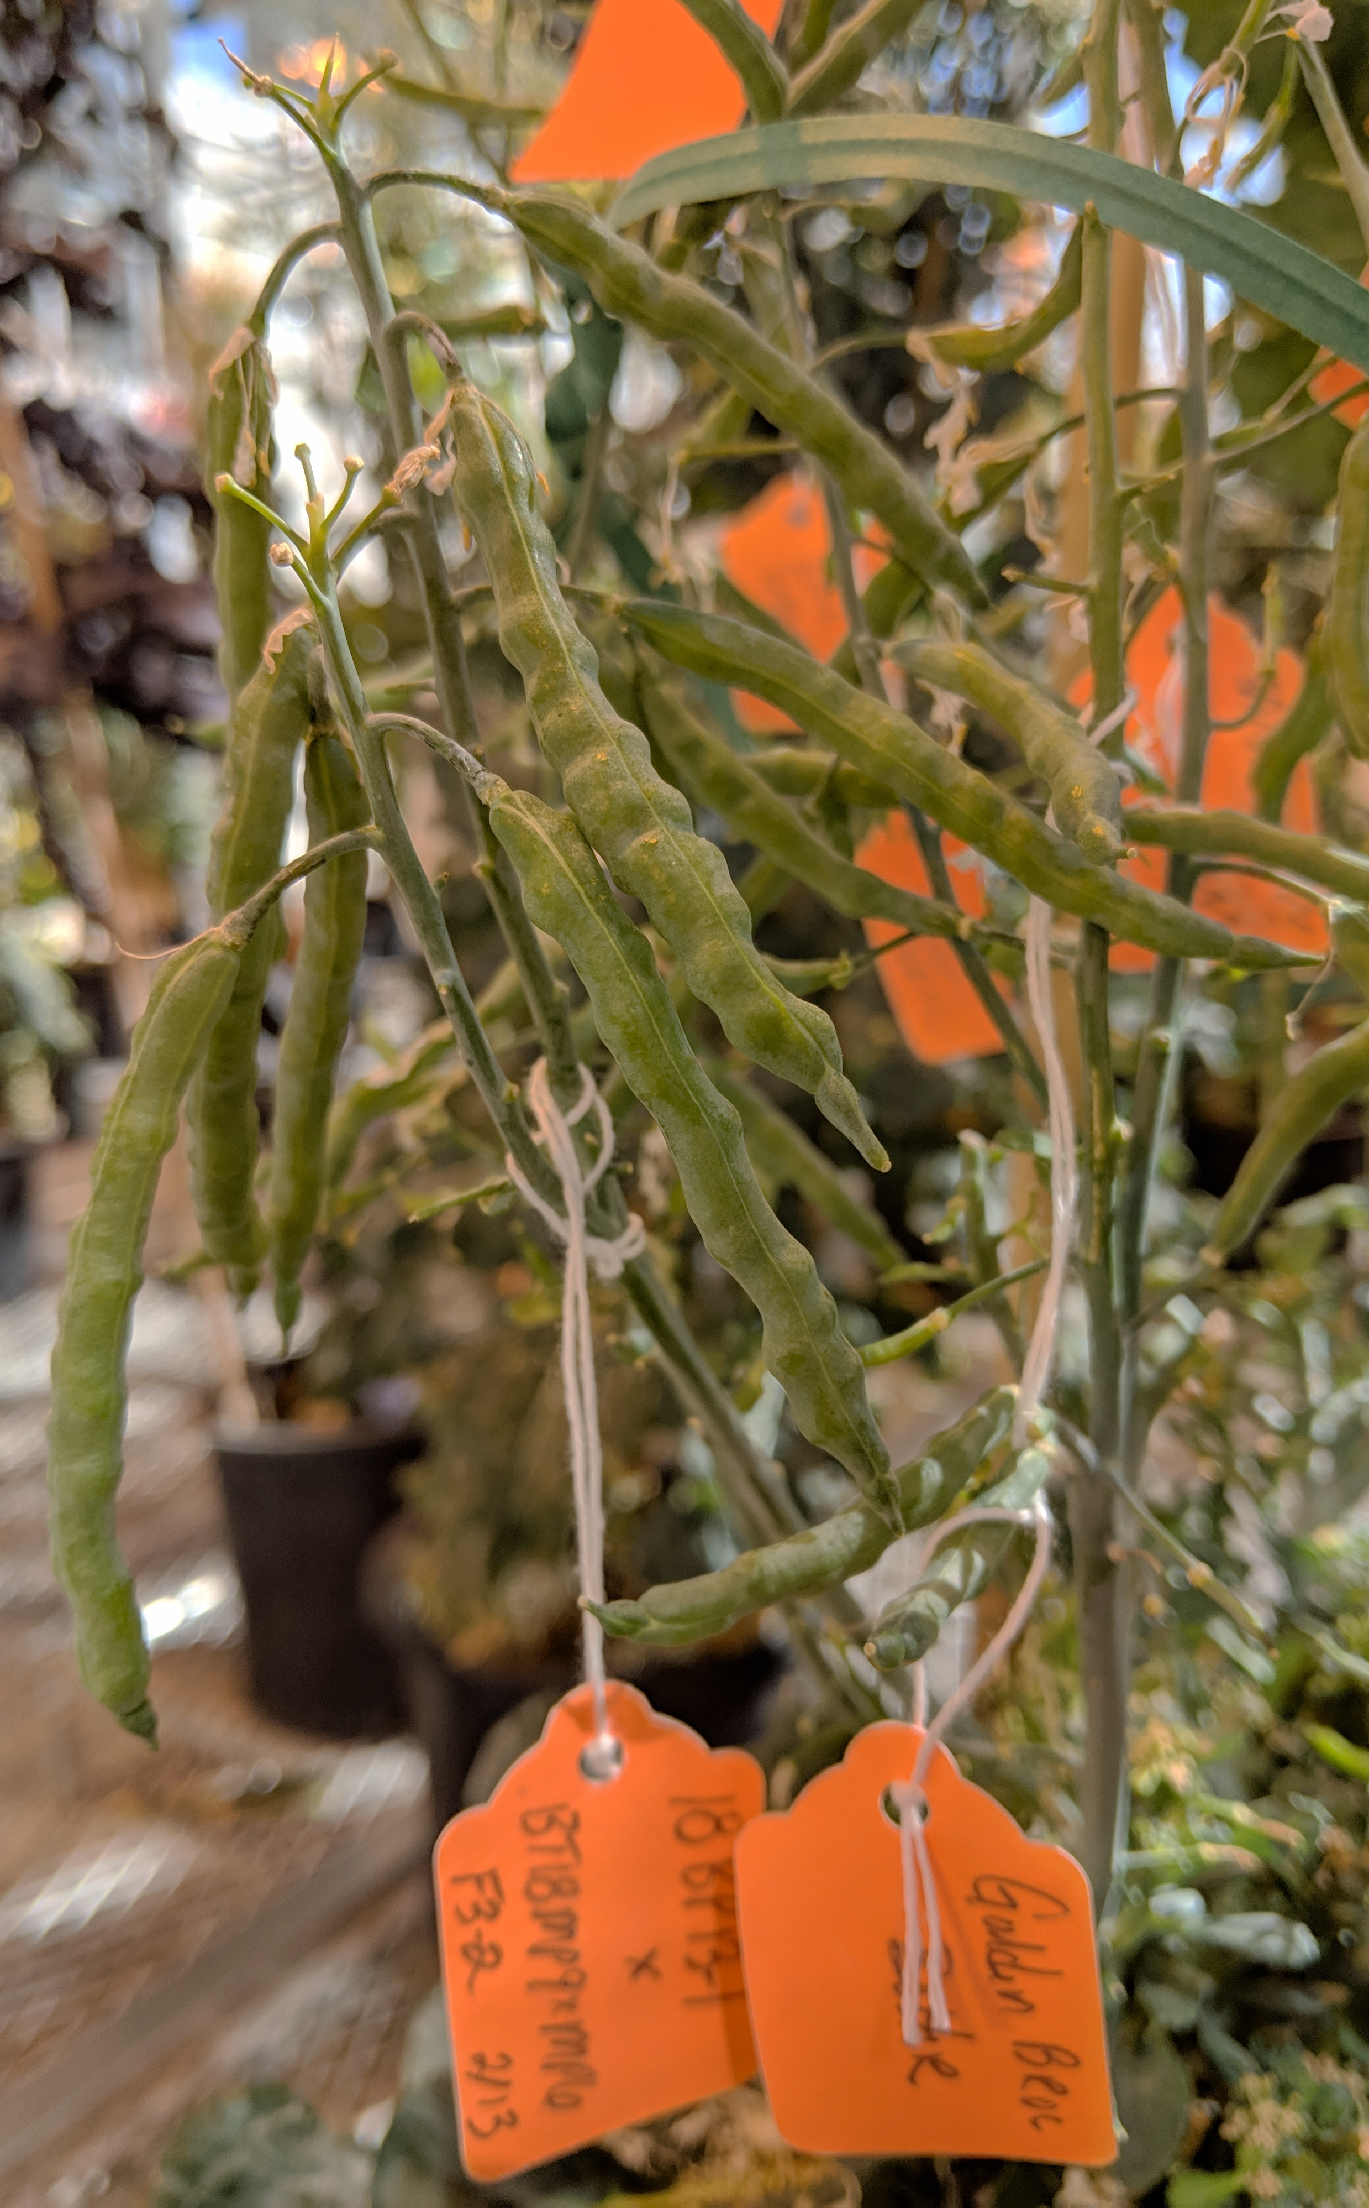
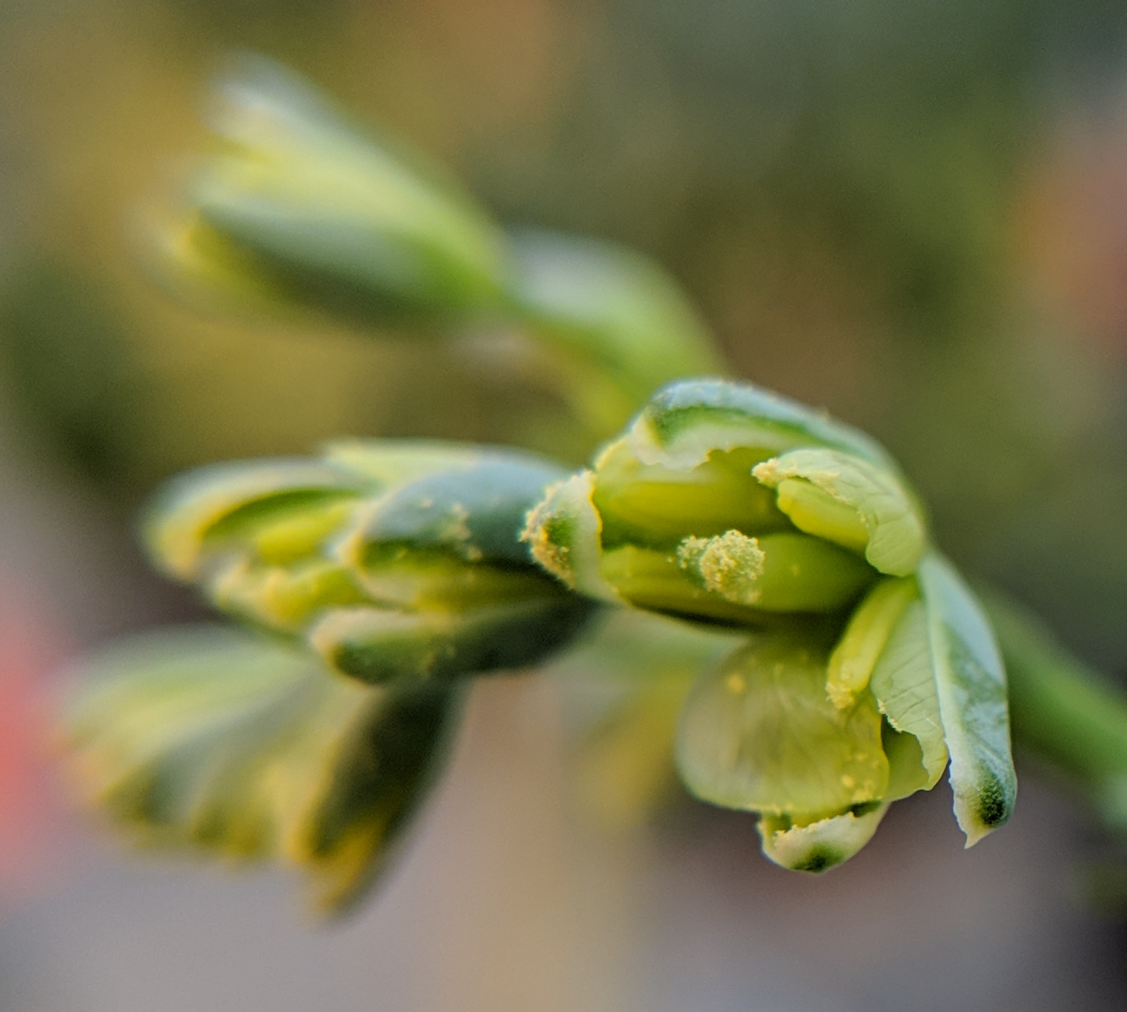
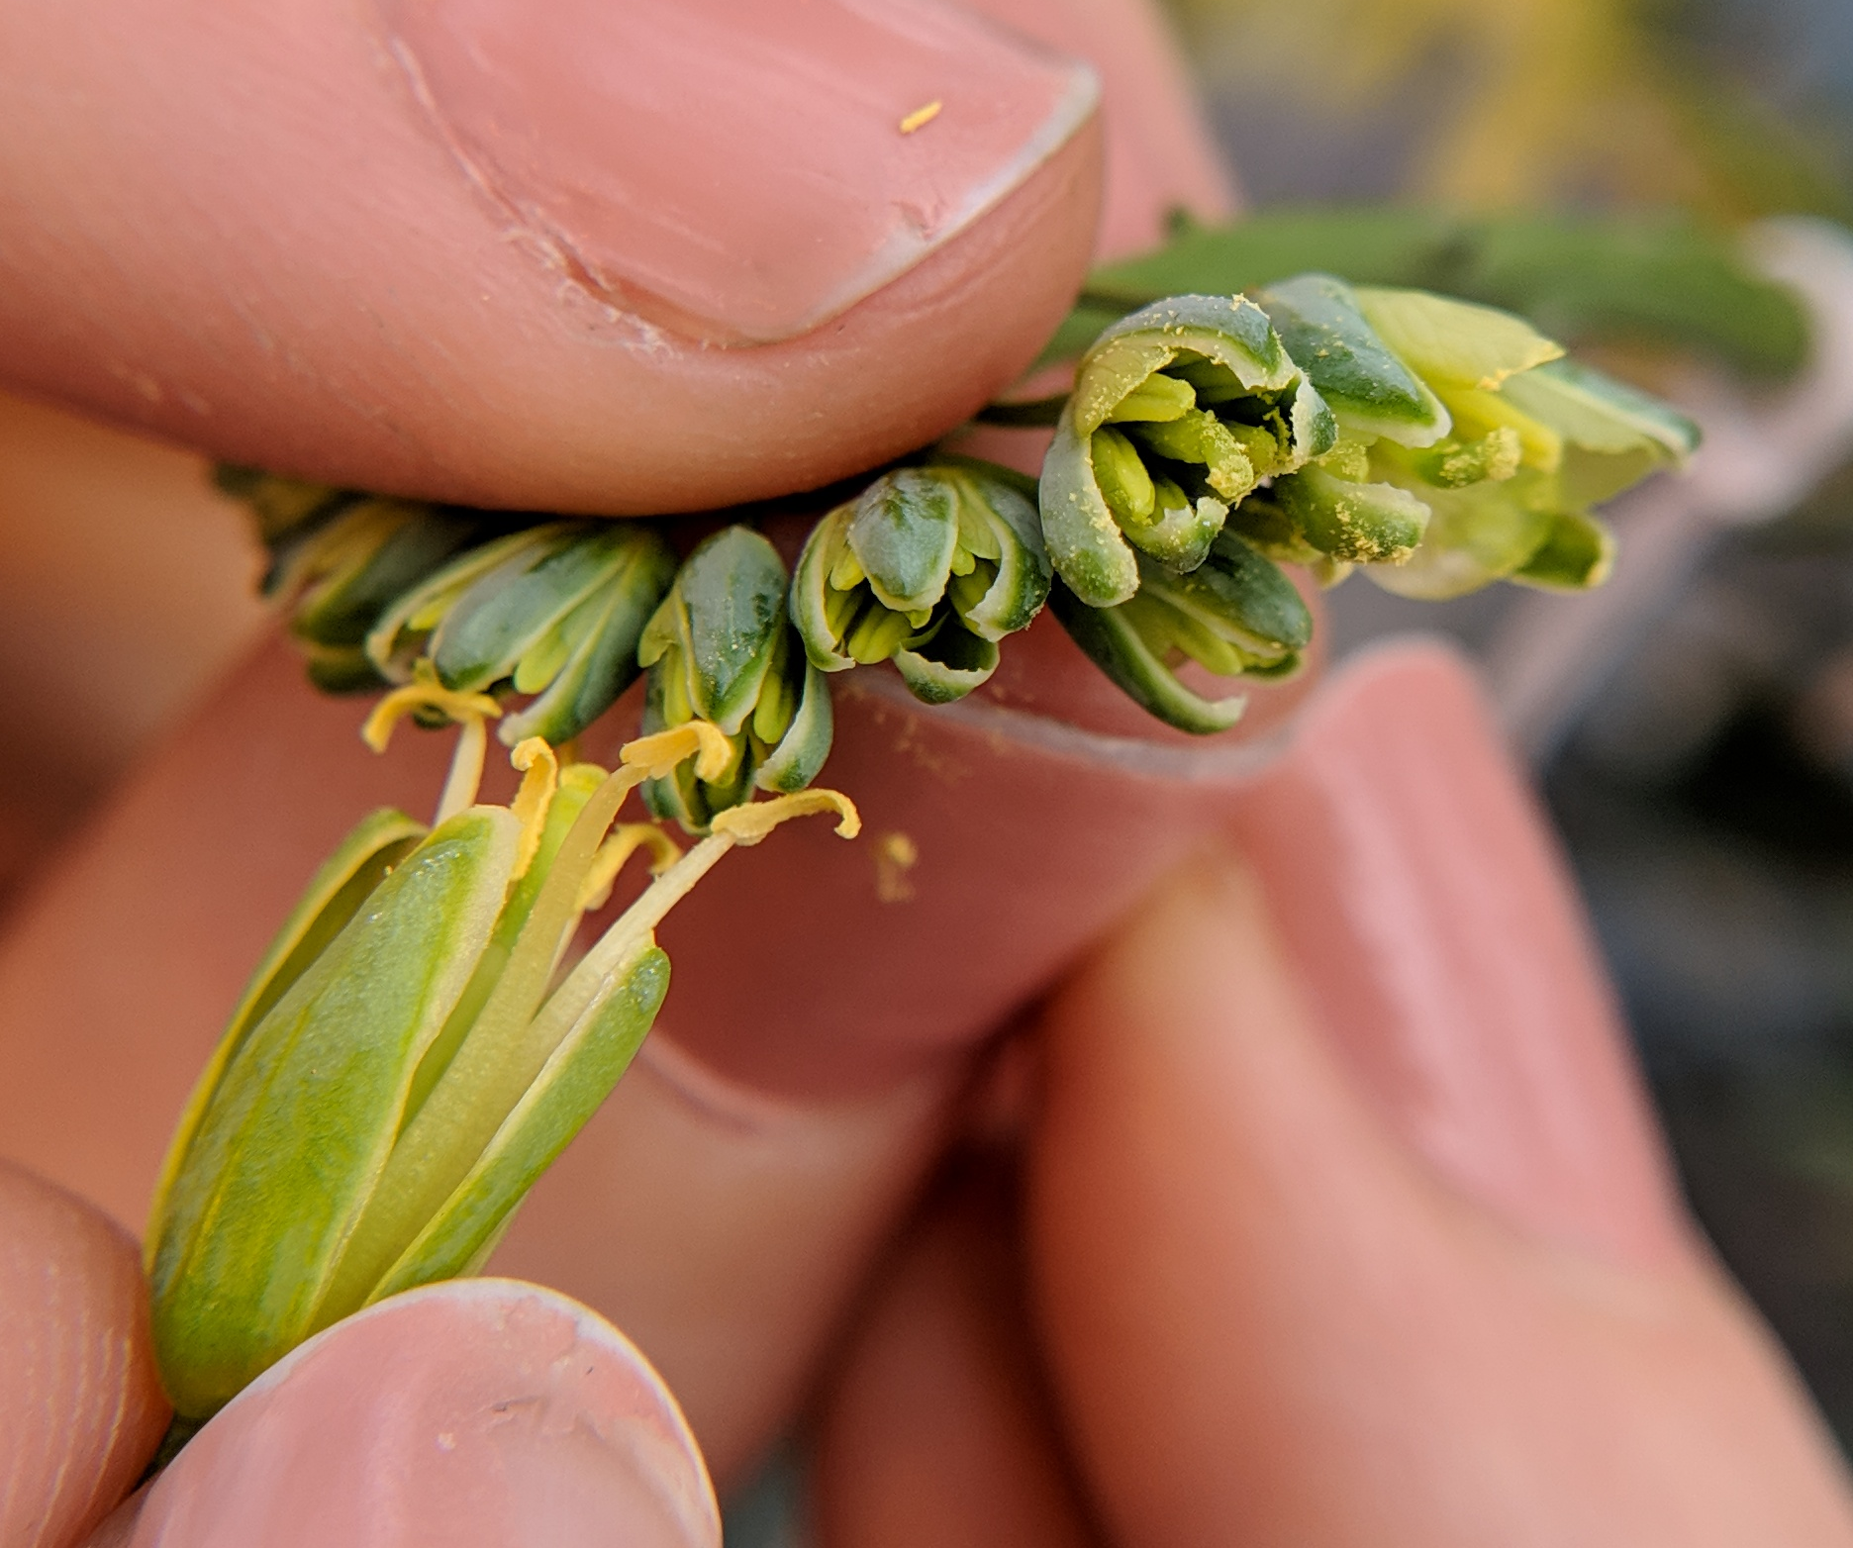

BRASSICA POLLINATION GUIDE
Brassica oleracea
Brassica oleracea consists of many important vegetable crops, including broccoli, kale, and cabbage. These plants have perfect flowers with both male and female parts, often relying on outcrossing for silique development.
PETAL
ANTHER
STIGMA
Step ONE: Remove old/young buds on raceme
Step TWO: Properly label raceme with cross
Identify a floral raceme with >10 unopened buds along it’s length. Remove growing point at the top of the raceme and any buds with visible petals. Viable buds are ~5-10mm long.
Label a small crossing-tag with female x male designators and the date of the cross. Carefully adhere to the single pedicel connecting the flower raceme to the main plant stem. Remove any buds on the pedicel below the tag.
Step THREE: Identify viable pollen source
Step FOUR: Expose stigmatic surface
Select fully opened flowers from a donor plant. Anthers should be actively shedding pollen, which appears bright yellow in color. Avoid dark, translucent pollen.
Use a tweezers or sharp wooden tool to tease open the sepals of each flower bud along the
length of the
raceme. Open flowers just enough to expose and isolate stigma from anthers. Avoid damage to the stigma. Male anthers should be smooth and void of pollen grains. Proceed to Step FIVE quickly to avoid drying of stigma.
Step FIVE: Transfer donor pollen to stigma
Step SIX: Monitor and harvest mature fruit
Carefully transfer viable pollen to the sigmatic surface, making sure to not break or damage the stigma. Pollen should be visibly sticking to the stigmatic surface.
Mature fruit will begin to develop and elongate within a week of pollination. Expect to see mature fruit (silique) 3-5 weeks after pollination. Dry siliques will appear yellow-to-tan within ~6-8 weeks after pollination. Siliques will shatter if left to dry too long. Follow good seed stewardship practices, using clean harvesting and storage practices to obtain clean, safe seed.
TIPS FROM THE PROS:
Brassica plants are often self-incompatible, requiring extra crosses or bud pollination to obtain selfed seed
Many B. oleracea plants are biennial – you may not see floral racemes without proper vernalization (cold period)
THIS PROJECT WAS SUPPORTED BY:
NORTHERN ORGANIC VEGETABLE IMPROVEMENT COOPERATIVE
Photos and design by: H. Swegarden
Demonstration by: S. Pena-Aragon (Griffiths Lab)

