Slide 1
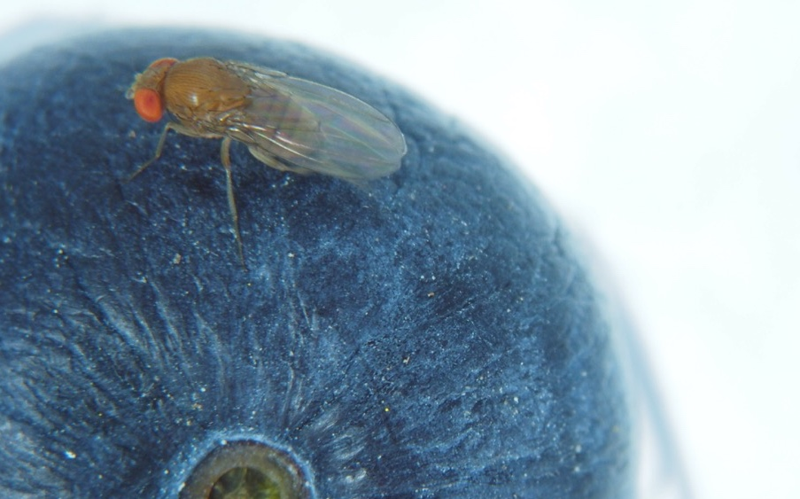












WELCOME TO:
Organic Management of Spotted-Wing Drosophila
A Webinar Presented by Organic SWD Management Project
Be patient……. the webinar will start at 2.00 pm eastern time
During the webinar: Your microphones will be muted to help ensure good audio quality
Ask questions using the Q&A box, and we will answer those at the end
After the webinar: There will be links to a survey about SWD challenges
The slides and link to the recording will be sent to all attendees

Slide 2
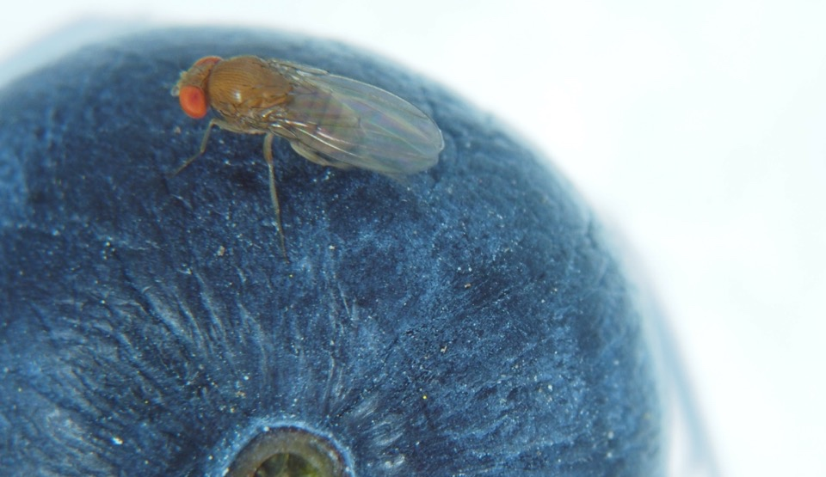
Organic Management of Spotted-Wing Drosophila
WEBINAR
Presented by Organic SWD Management Project
Organic Agriculture Research and Extension Initiative (OREI)
USDA National Institute of Food and Agriculture (NIFA)
Award No. 2018-51300-28434
March 9, 2021

Slide 3
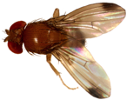
Spotted-Wing Drosophila (SWD)
August 2008
First detection in CA Santa Cruz County
 | Year of First Detection
 | 2008
 | 2009
 | 2010
 | 2011
 | 2012
 | 2013+
 | Not detected
1980
CABI Invasive Species Compendium
https://www.cabi.org/isc/datasheet/109283

Slide 4
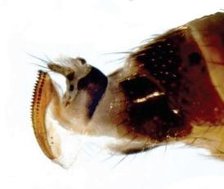

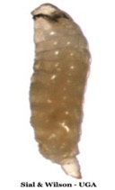
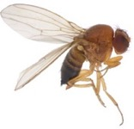


Pupae:
3-15 days
Saw-like ovipositor
Larvae:
3-13 days
One generation
8-10 days
(25°C)
Adults:
59 days
Annual Crop Losses
$718 million
Increased Management Costs
$129 million
Eggs:
12 hours - 3 days

Slide 5
Project Team
University of Georgia
Ash Sial
Kay Kelsey (Impact Evaluation)
Oregon State University
Vaughn Walton
Bernadine Strick (Horticulture)
Michigan State University
Matt Grieshop
Rufus Isaacs
University of Minnesota
Mary Rogers
University of Arkansas
Jennie Popp (Agri. Economics)
University of California, Davis
Frank Zalom
University of Florida
Oscar Liburd
North Carolina State University
Hannah Burrack
University of Maryland
Kelly Hamby
University of California, Berkeley
Kent Daane
USDA-ARS
Jana Lee
Rutgers University
Cesar Rodriguez-Saona

Slide 6
Project Team
Harvested Acres All Certified Organic Berries 2016
 | < 100
 | 100 - 500
 | 500 – 1000
 | > 1000
 | Not disclosed
USDA NASS Certified Organic Survey 2016
https://www.nass.usda.gov/Surveys/Guide_to_NASS_Surveys/Organic_Production/

Slide 7
Project Goal
To develop and implement systems-based organic SWD management programs that are compatible with the USDA National Organic Program (NOP) and true to the ethos of organic agriculture.
These programs will be based on a foundation of cultural, physical, behavioral, and biological control tactics, bolstered by NOP compliant insecticides

Slide 8
Objectives
Evaluate behavioral tactics for organic management of SWD
Improve effectiveness and feasibility of cultural strategies for organic management of SWD
Incorporate biological control in organic management of SWD
Integrate new OMRI-approved products into season-long IPM programs
Develop an integrated outreach approach to implement organic SWD management strategies and evaluate their economic impact

Slide 9
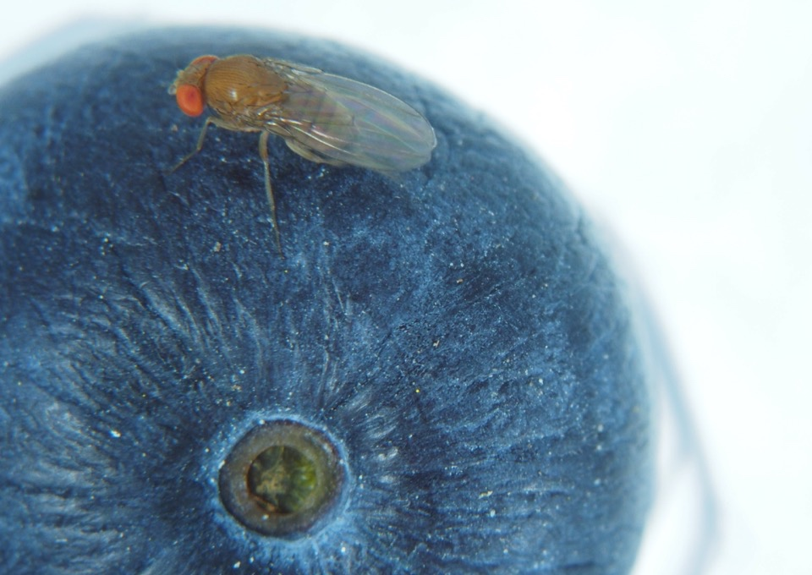
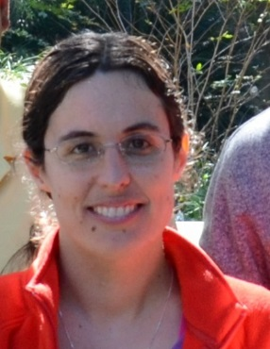
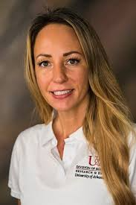
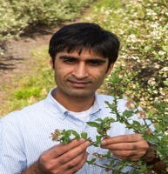
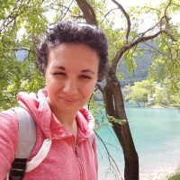
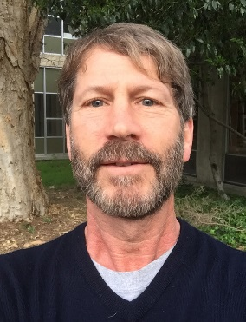
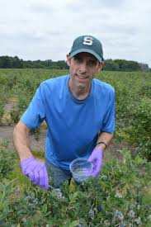
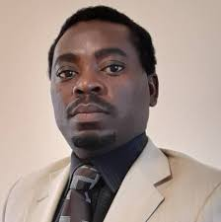
Today’s Presenters
Ash Sial
U Georgia
Elena Rhodes
U Florida
Kelly Hamby
U Maryland
Kent Daane
UC Berkeley
Steve VanTimmeren
Michigan State U
Leah English
U Arkansas
Mariano Kpanou
U Georgia

Slide 10
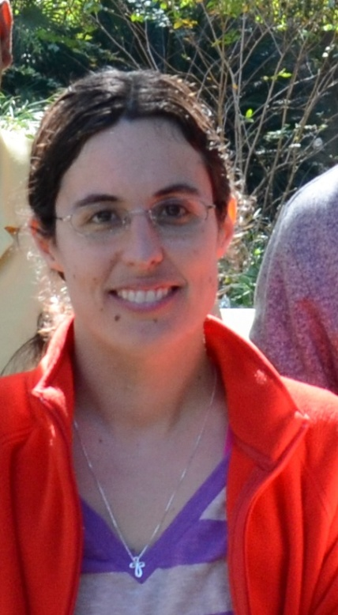






Behavioral Tactics for SWD Management
Oscar E. Liburd and Cesar Rodriguez-Saona (leads)
Elena Rhodes, Arun Babu, Pablo Urbaneja, Ash Sial, Vaughn Walton

Slide 11
HOOK and ACTTRA SWD

Slide 12
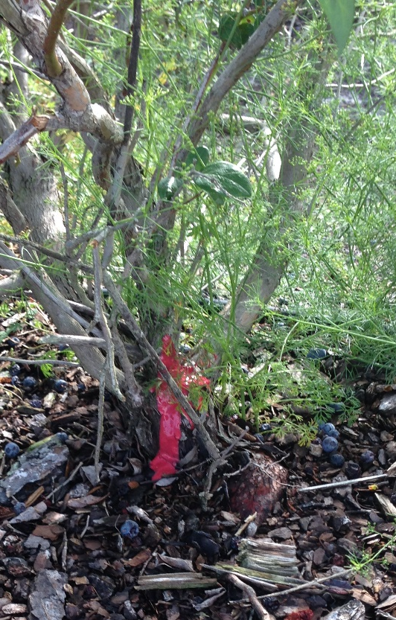
HOOK, ACTTRA, and ACTTRA Teun
HOOK SWD
  ATTRA SWD + red dye + spinosad
ACTTRA SWD
  8 or 9 component attractant blend
ACTTRA Teun SWD
  4 component attractant blend

Slide 13
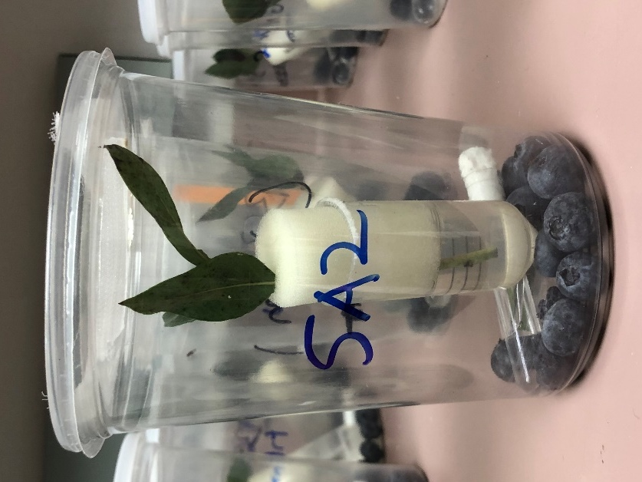
Laboratory studies: methods
Blueberry shoots
  3 – 4 leaves
  Trts applied 1-2 hr prior to SWD release
13-15 organic blueberries
  Distributed by Wish Farms (Plant City, FL) from Peru bought at Publix
Water source
10 SWD (5 fem and 5 male)

Slide 14
Methods: sampling
# dead flies were counted at 1, 3 ,and 6 d after release
On day 6-7, blueberries were removed and placed in an environmental chamber for emergence data
  # emerged flies counted after 10-14 days

Slide 15
Methods: experiment 1 treatments
5 reps of 10 or 11 trts
  Untreated control
  ACTTRA SWD
  ACTTRA SWD + dye
  ACTTRA Teun SWD
  ACTTRA Teun SWD + dye
  ACTTRA SWD + Entrust EC
  ACTTRA SWD + dye + Entrust EC
  ACTTRA Teun SWD + Entrust EC
  ACTTRA Teun SWD + dye + Entrust EC
  HOOK SWD
  Entrust SC foliar application (UGA)

Slide 16
Results: mortality UF

Slide 17
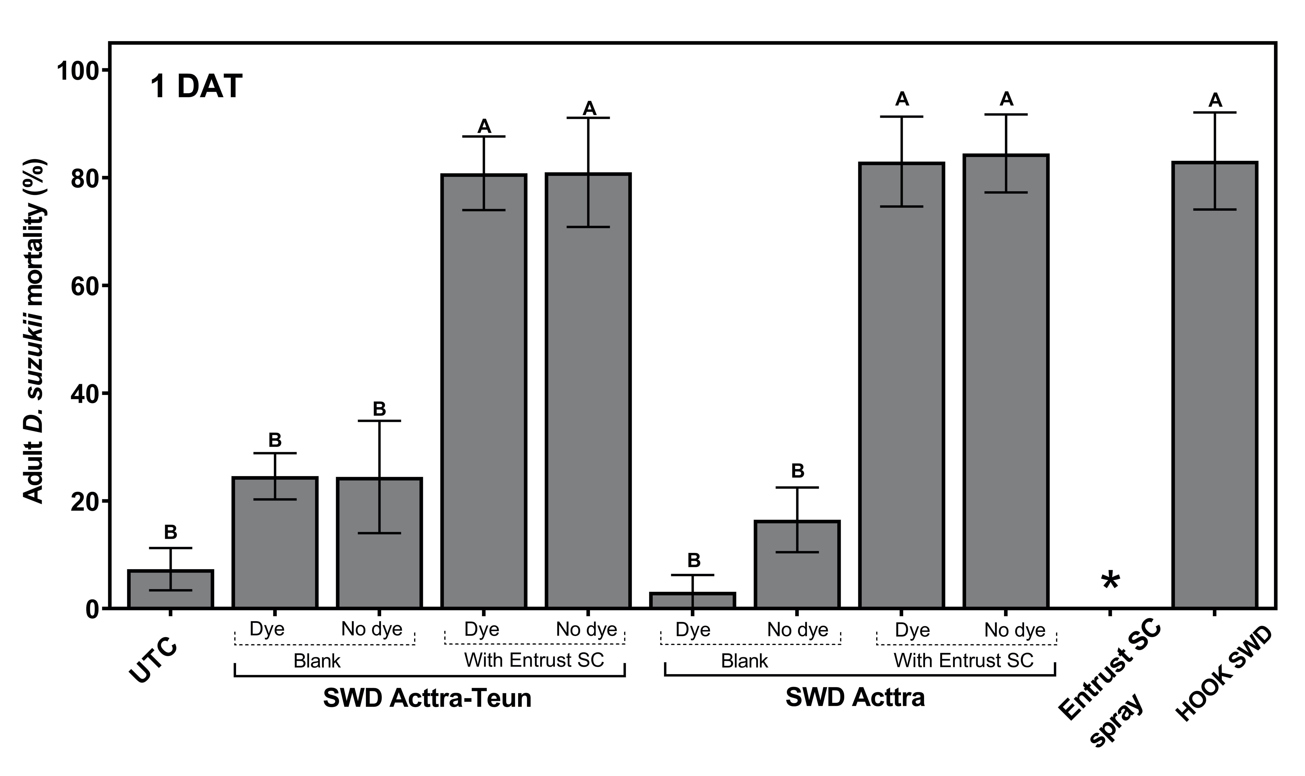
Results: mortality UGA

Slide 18
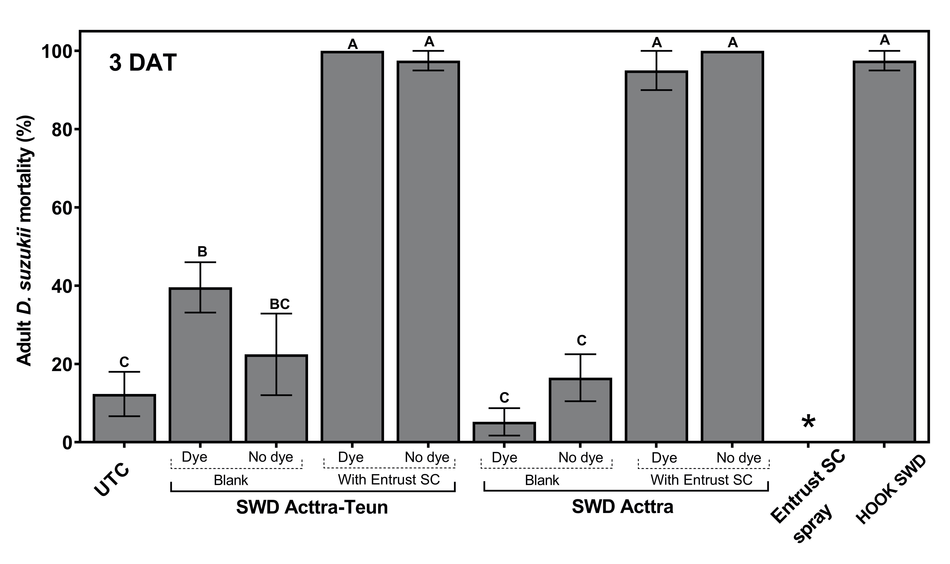
Results: mortality UGA

Slide 19
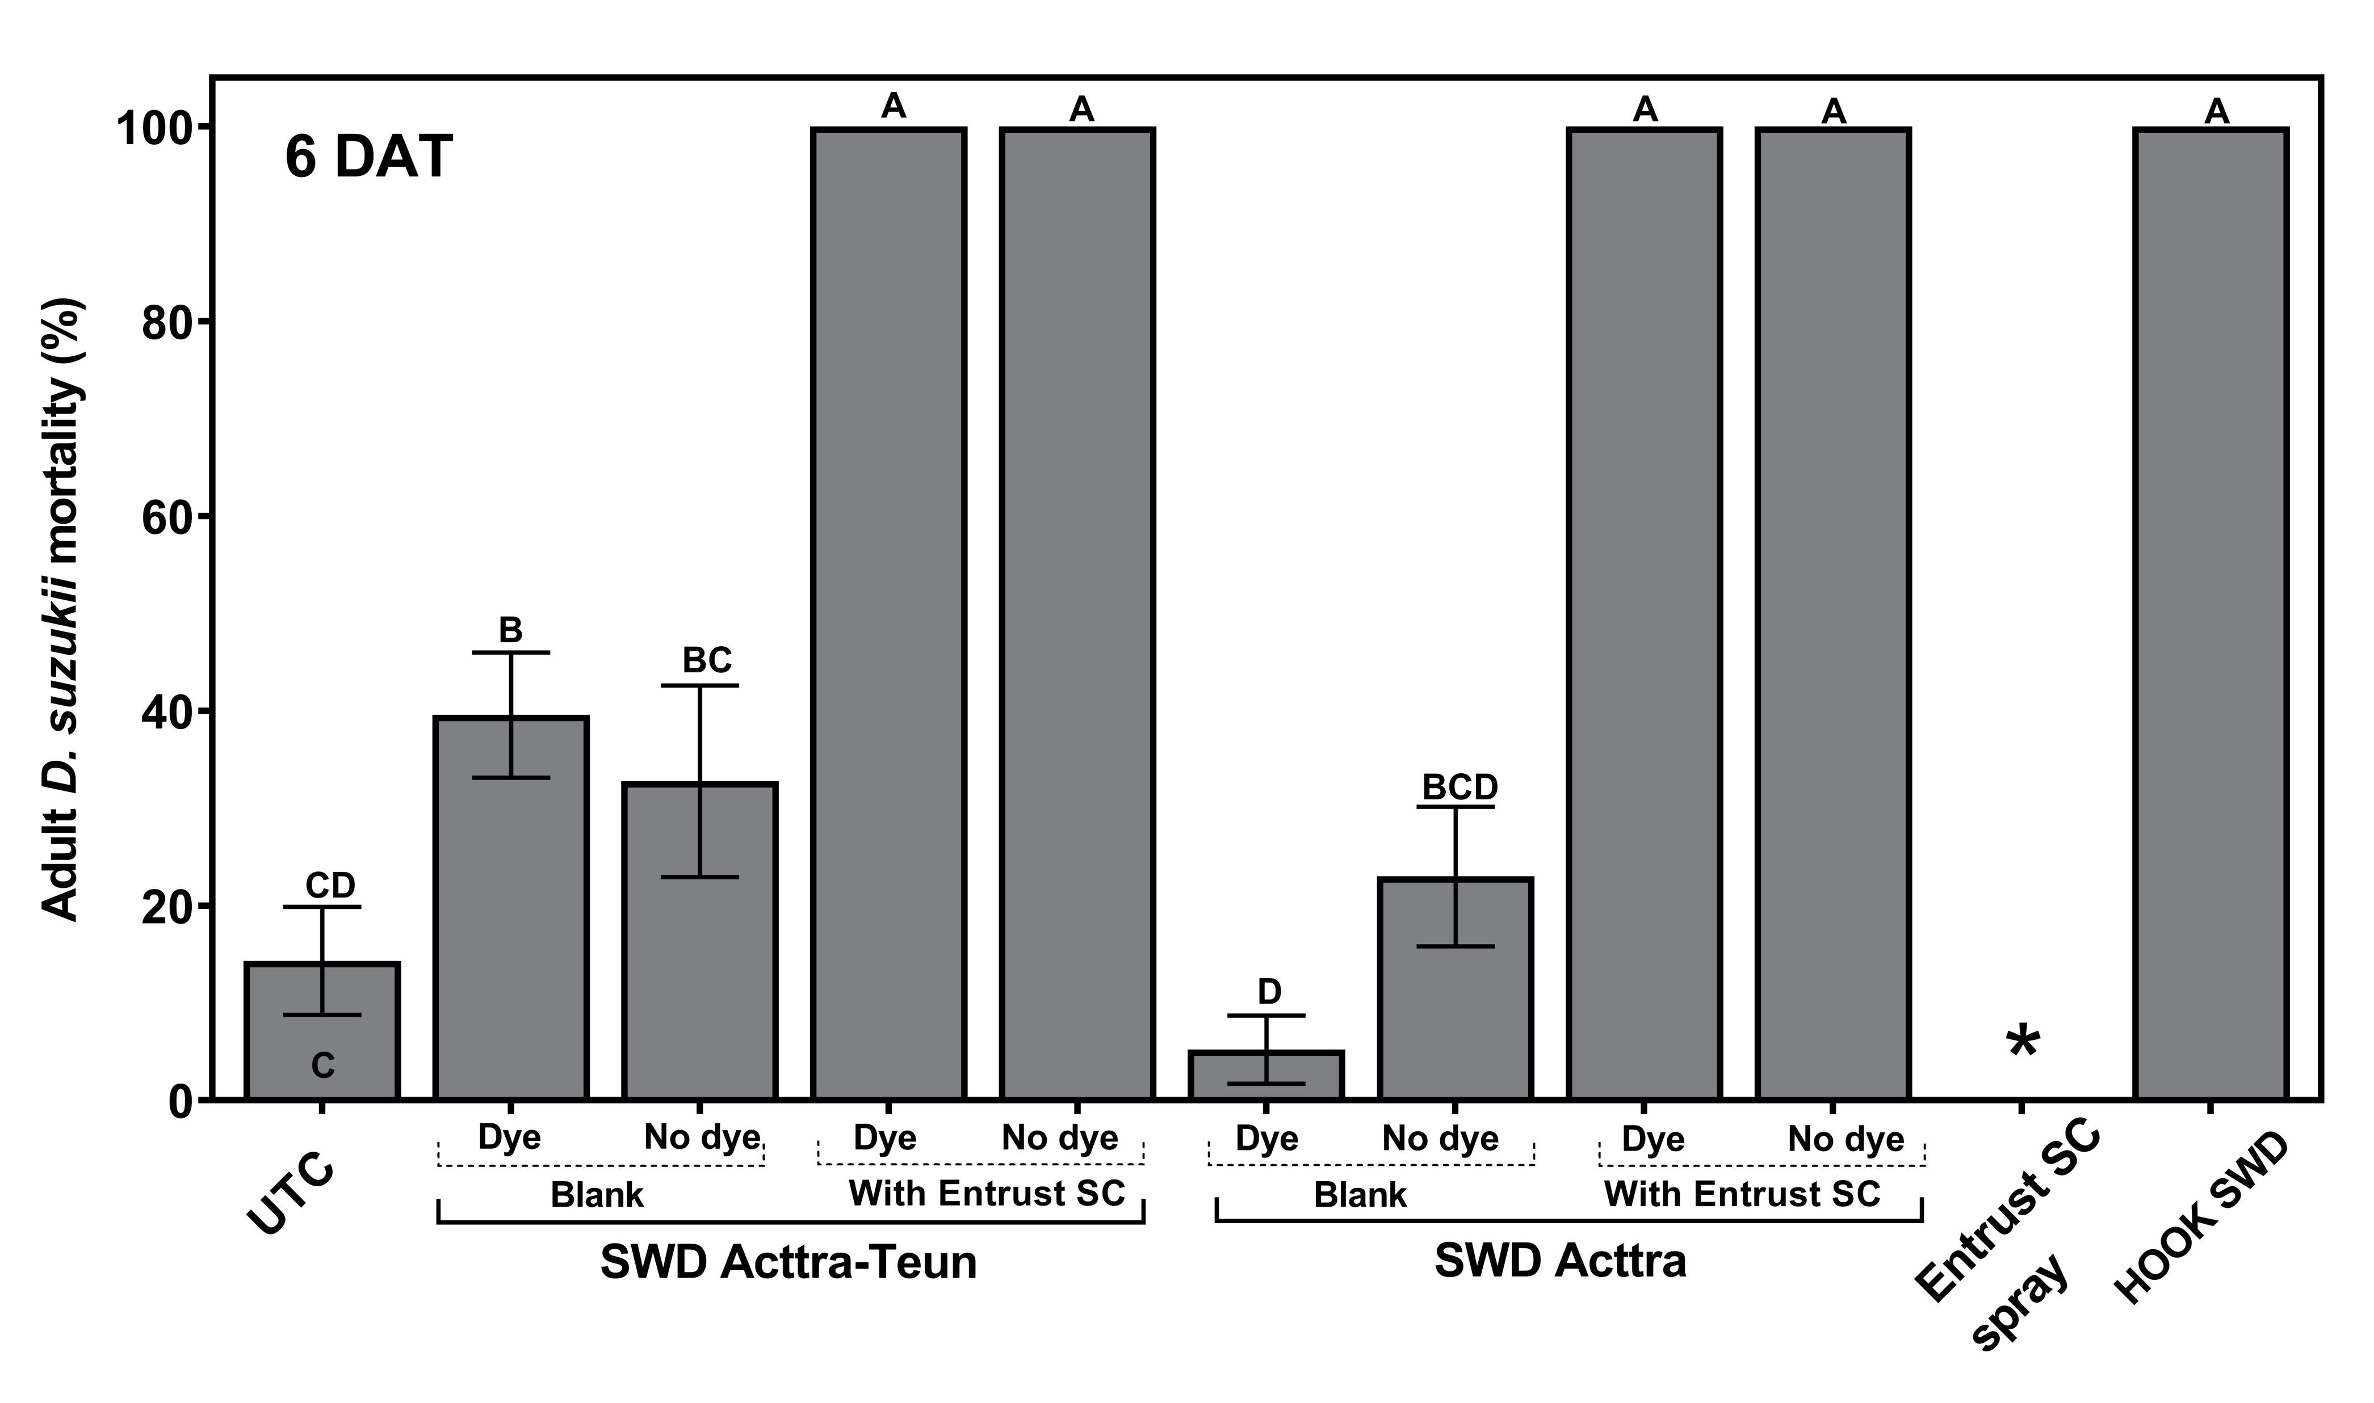
Results: mortality UGA

Slide 20
Results: Emergence UF

Slide 21
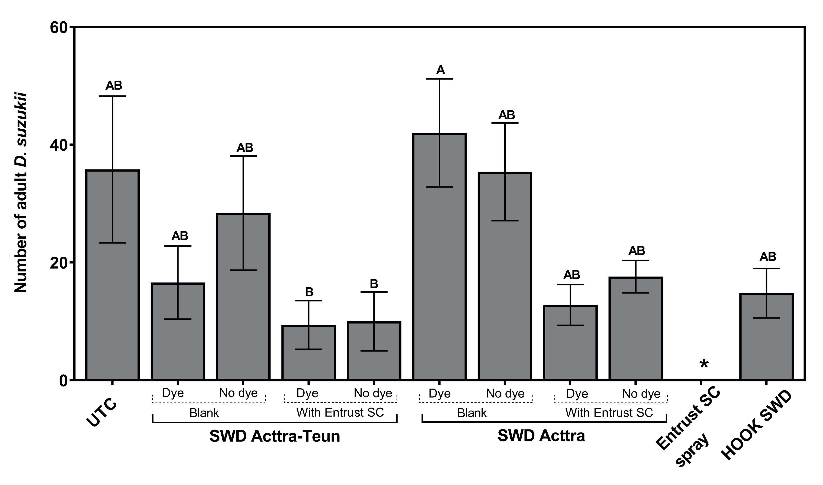
Results: Emergence UGA

Slide 22
Methods: experiment 2 treatments
5 reps of 9 – 12 trts
  Untreated control
  ACTTRA Teun + dye (ATd)
  HOOK SWD (R, UF) or Atd + Entrust SC (UGA)
  ATd + Grandevo WDG (UF, UGA)
  ATd + Grandevo SC (R, UF)
  ATd + Venerate XC (UF, UGA)
  ATd + Venerate EP (R, UF)
  ATd + Azera (R, UF, UGA)
  ATd + Pyganic 1.4 EC (UF)
  RU and UGA included some conventional products
  Foliar applications of products also included

Slide 23
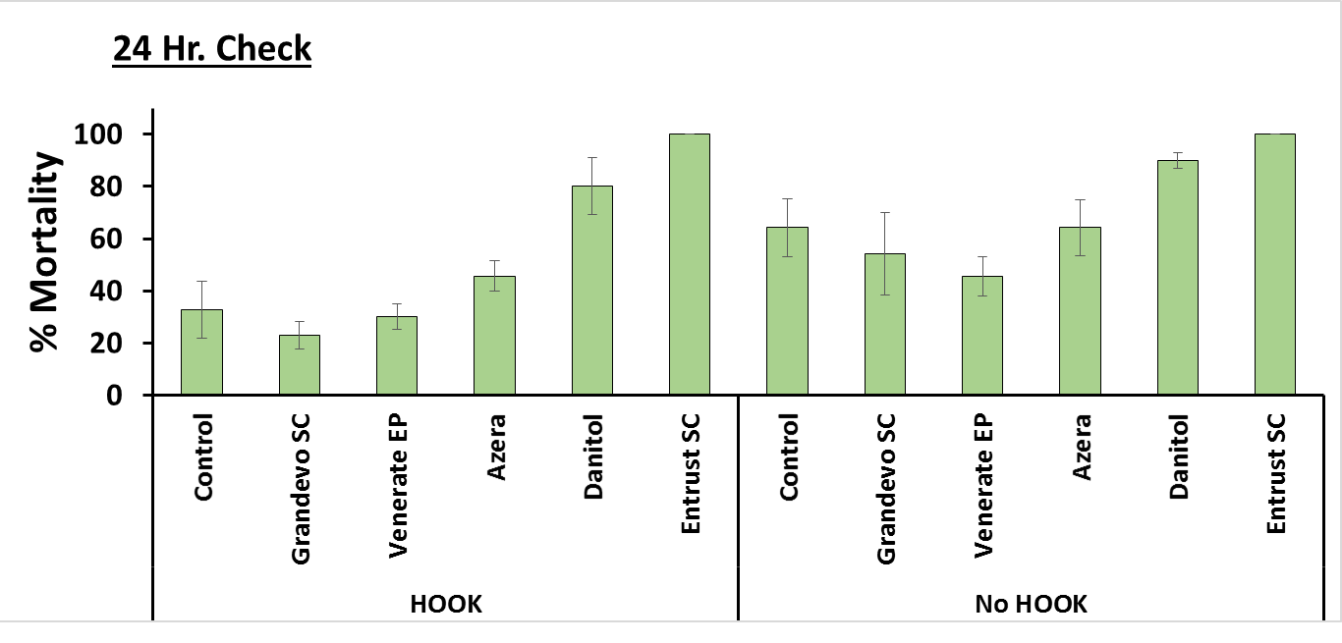
Results: mortality R
A
A
AB
AB
BC
BC
BC
C
BC
BC
C
C

Slide 24
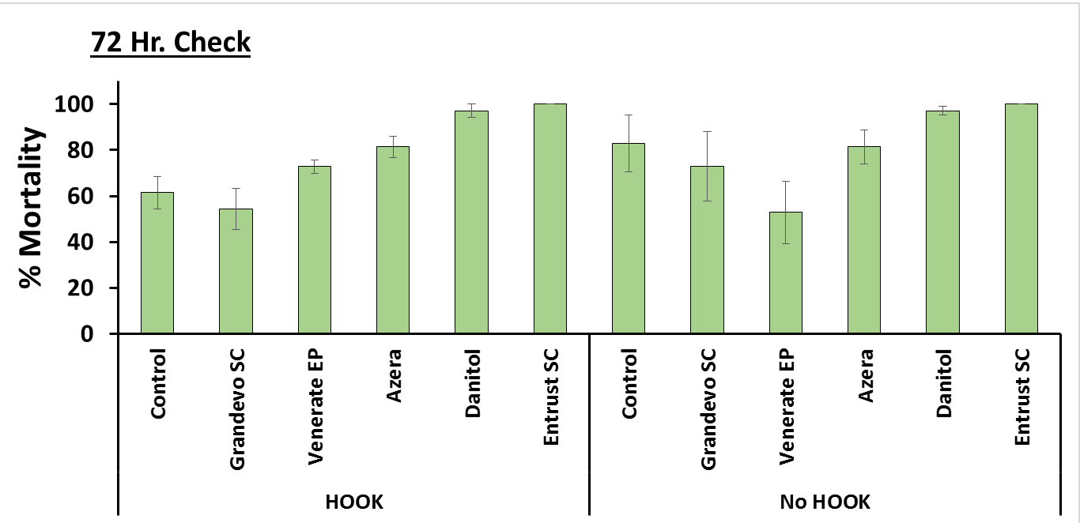
Results: mortality R
AB
A
ABC
AB
A
ABC
ABC
ABC
C
BC
C
C

Slide 25
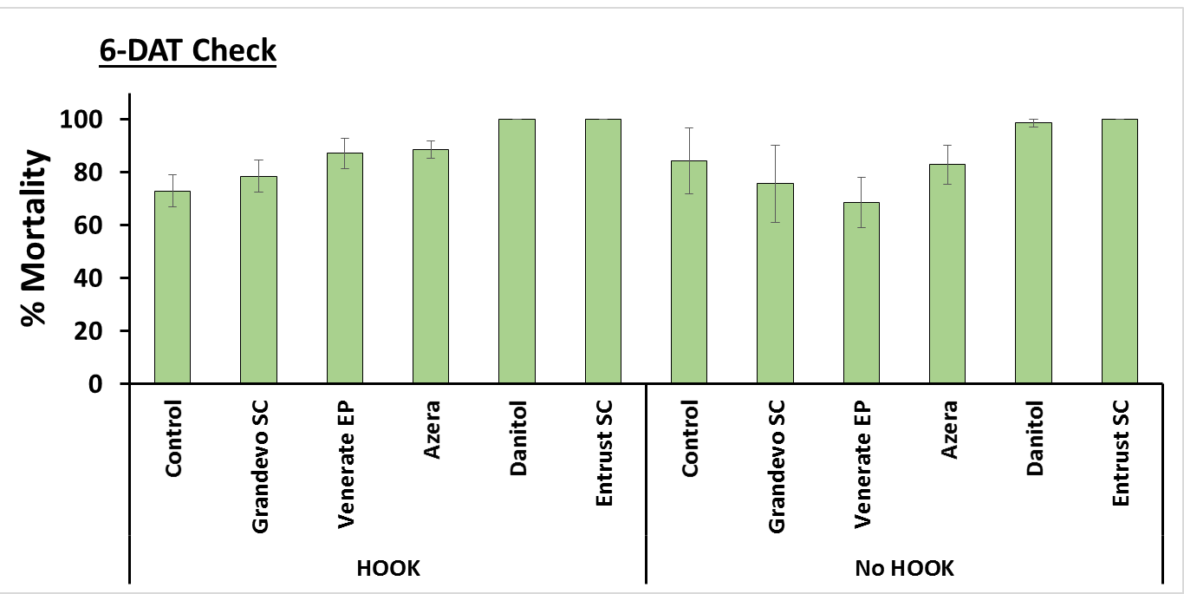
Results: mortality R
A
A
AB
AB
A
AB
AB
AB
AB
B
AB
B

Slide 26
Results: mortality UF
ACTTRA Teun + dye
Foliar applications

Slide 27
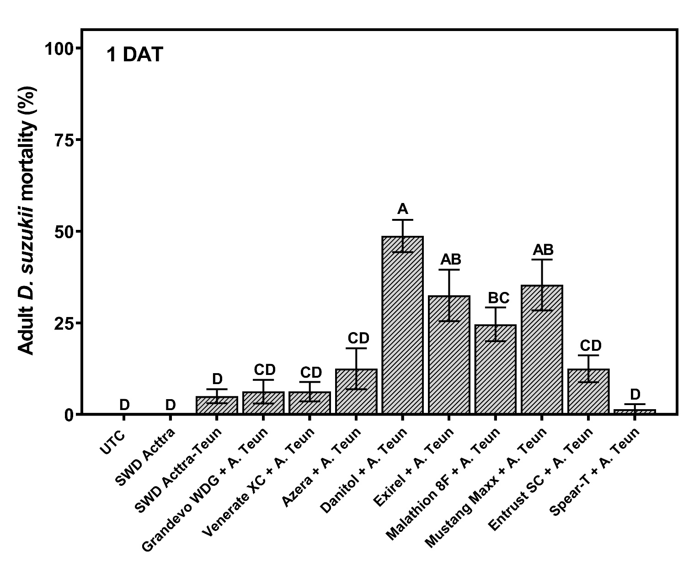
Results: mortality UGA

Slide 28
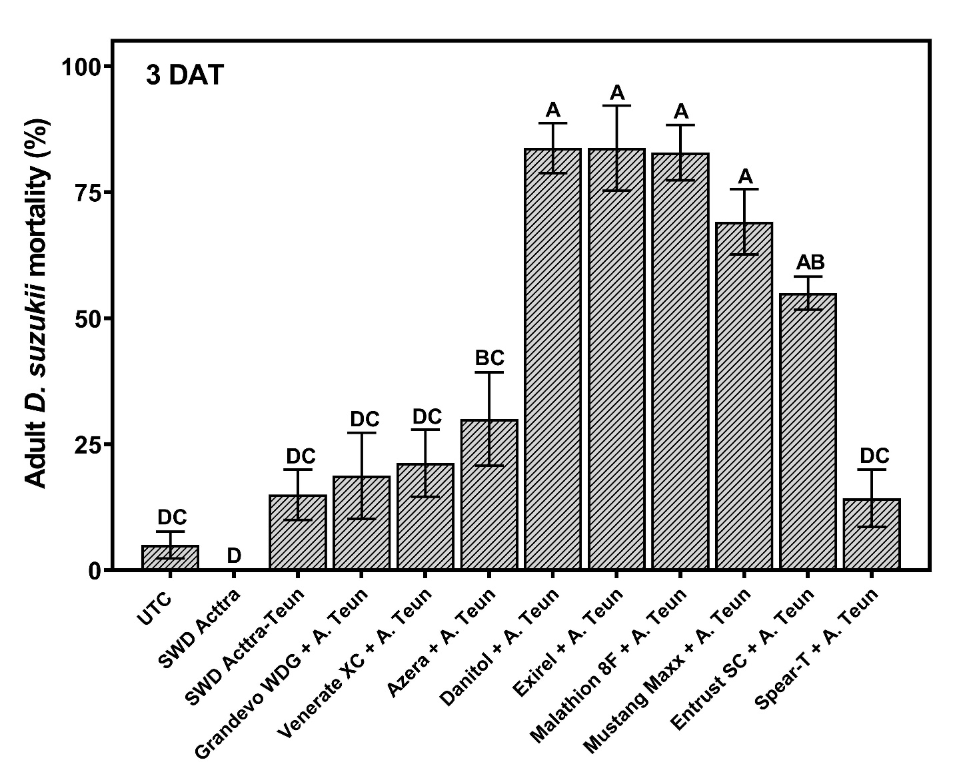
Results: mortality UGA

Slide 29
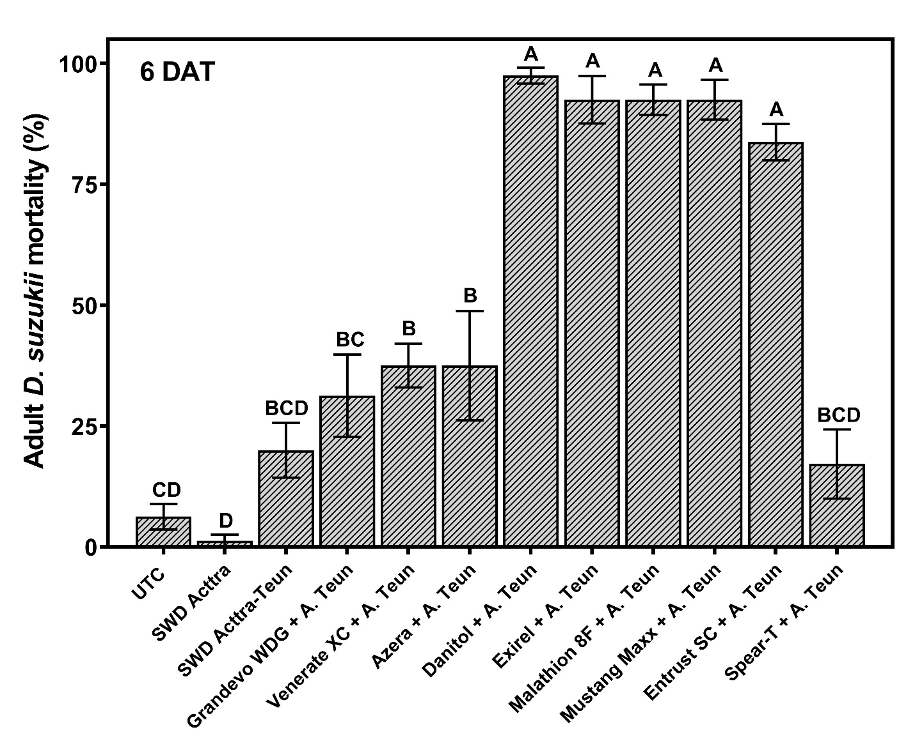
Results: mortality UGA

Slide 30
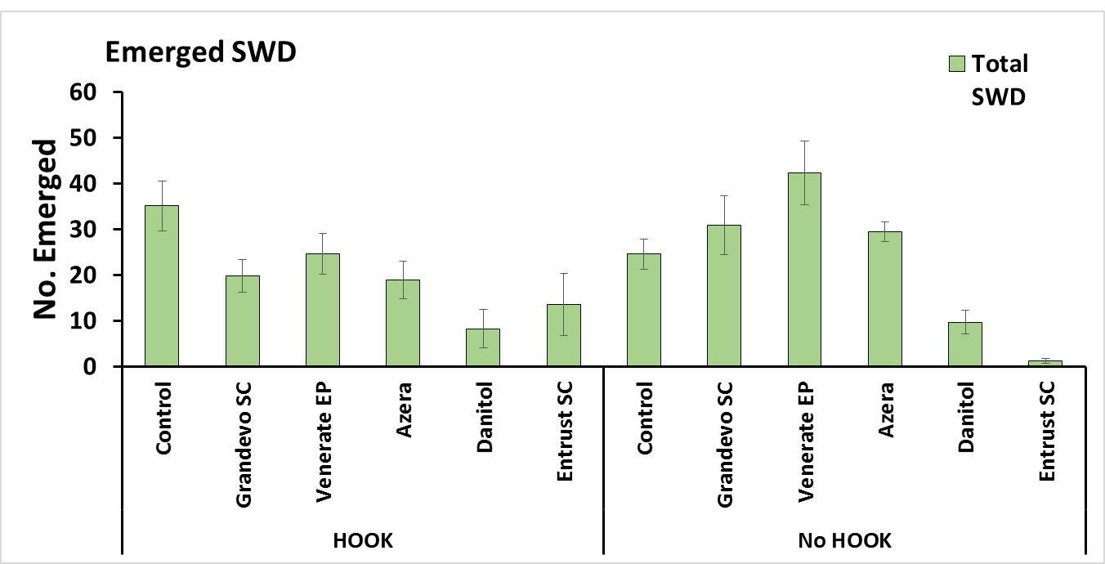
Results: emergence R
A
AB
ABCD
ABC
ABCD
D
ABCD
ABCD
ABCD
CD
BCD
E

Slide 31
Results: emergence UF
ACTTRA Teun + dye
Foliar applications

Slide 32
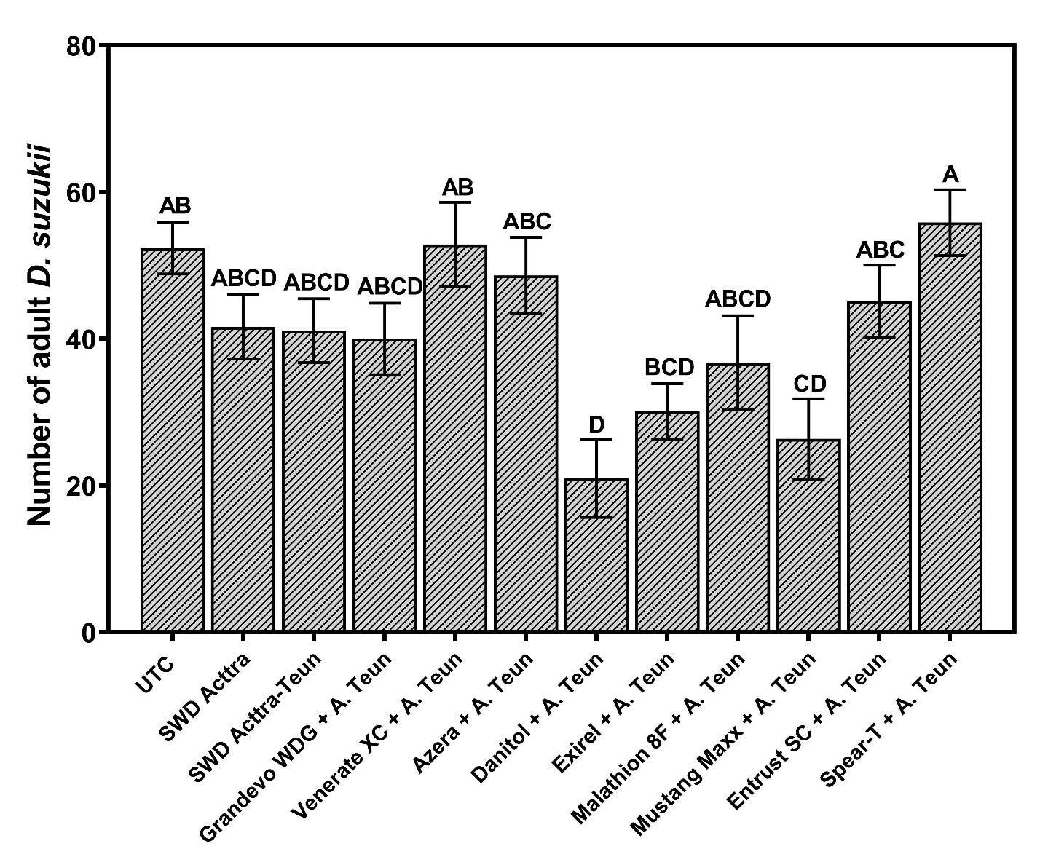
Results: emergence UGA

Slide 33
HOOK/ACTTRA summary
ACTTRA and ACTTRA Teun w/ and w/o dye + Entrust are as effective as HOOK SWD
ACTTRA Teun SWD at least as effective as ACTTRA SWD
Pyganic and Venerate EP mixed with ACTTRA Teun worth looking into further

Slide 34
Food-grade gum
Gabriella Tait¹, Christopher Adams², & Vaughn M. Walton¹
Oregon State University, Department of Horticulture, Corvallis, OR.
Mid Columbia Agricultural Research and Extension Center, Oregon State University, Hood River, OR.

Slide 35
Effective range (21-day period)
Eggs per 10 fruit
Distance away from point sources
0 ft
10 ft
20 ft
30 ft
40 ft
Arrestant point sources

Slide 36
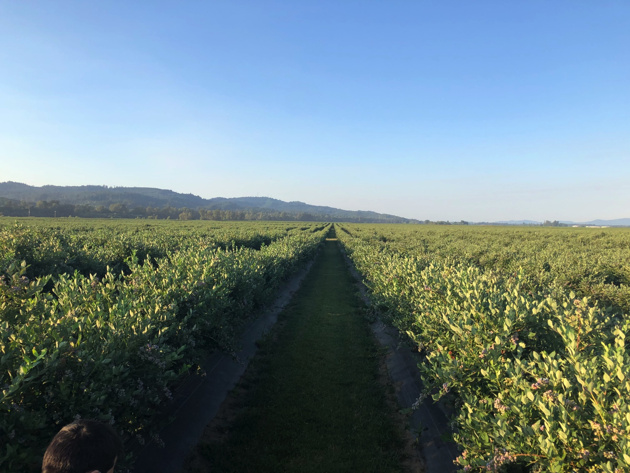

MCAREC, cherries, 2020
UTC
Untreated Control UTC). No treatment.
Untreated Control UTC). No treatment.
GUM treatments applied at day 0. No additional chemical treatments.
Buffer
GUM
Commercial blueberry field 21 plots, each ~1 acres in size each

Slide 37

Season 2020: Blueberry field efficacy trials, Willamette Valley
Gum application
Mean eggs/berry

Slide 38
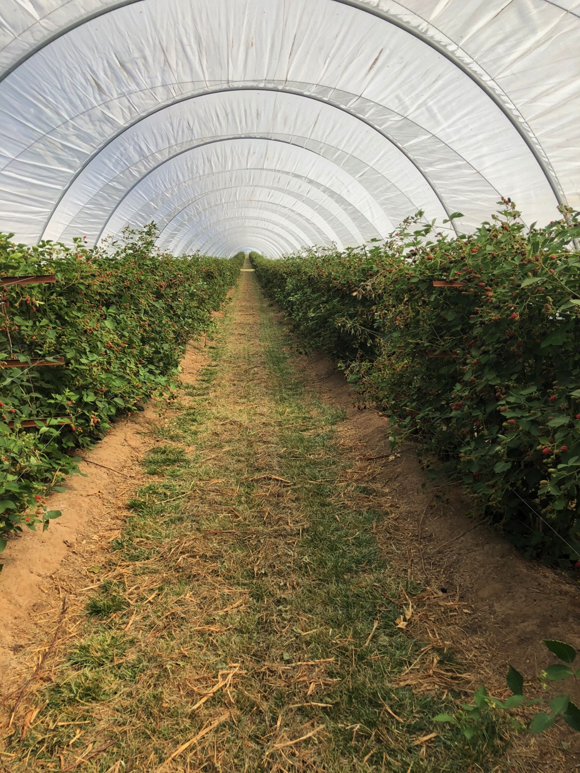
Season 2020: field efficacy trials, 3° party blackberry trials, California
Gum and Pesticide application
Notes:
Here the GS received weekly pesticide applications

Slide 39
Season 2020: Blueberry field efficacy trials, Northern Willamette Valley
Mean eggs/berry
*
*
*
Gum and Pesticide application, black arrow in Gum plot only
Cover pesticide applications in all plots any color arrow
Asterisks indicates Spinosad applications

Slide 40
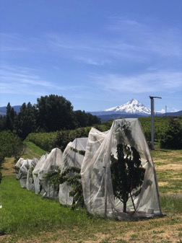

A novel gum technique to manage Spotted-Wing Drosophila
Summary:
Arrestant has ~21-day field longevity
Works at levels comparable to pesticide applications
Open-field trials at 50 dispensers/acre results in significant reduction in fruit damage
Under high-pressure situations less efficiency is seen
Pesticide reductions can be had (1/2000 when used with gum)
Will reduce production costs related to SWD control

Slide 41
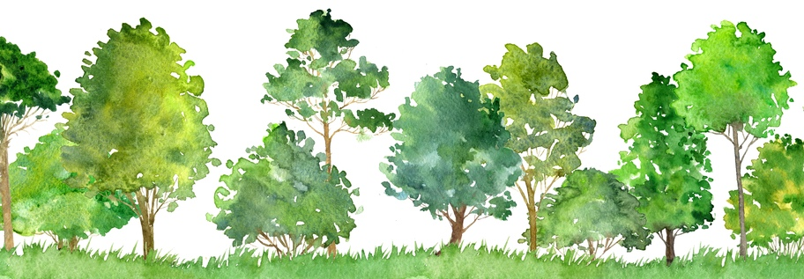
Objective 2: Cultural Control
How microclimates contribute to SWD distribution and abundance?
Vaughn Walton, Gabriella Tait, Ferdinand Pfab, Amanda Davis, Scott Orr, Bernadine Strik

Slide 42

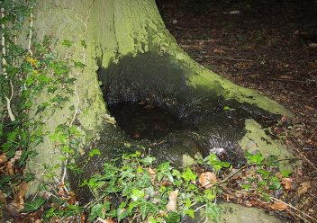
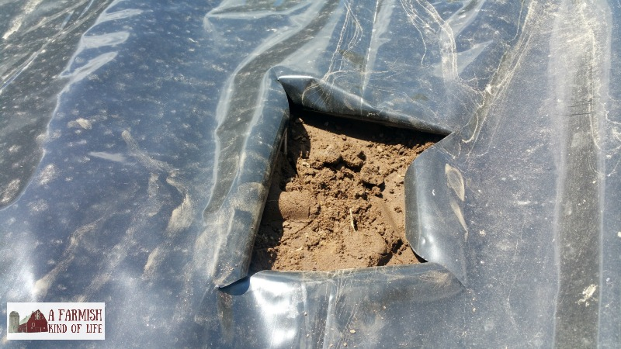
What do we mean with microclimate? Depends largely on the question being addressed
Microclimate is very much defined by the organism or community in question

Slide 43
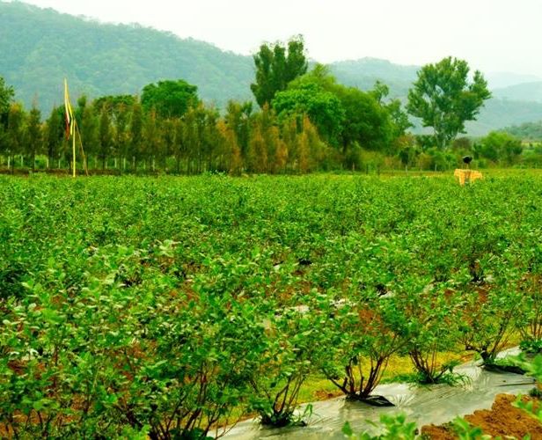
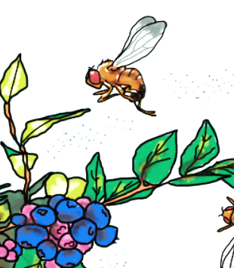
In agroecosystems, crop microclimate contributes to insect pest distribution and abundance
Temperature, humidity, light penetration, aeration, plant size, architecture of the crop, canopy distribution.
Picture created by Sabina Avosani (in prep)

Slide 44
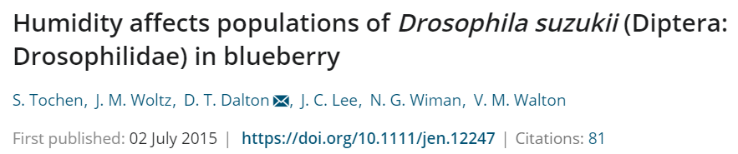
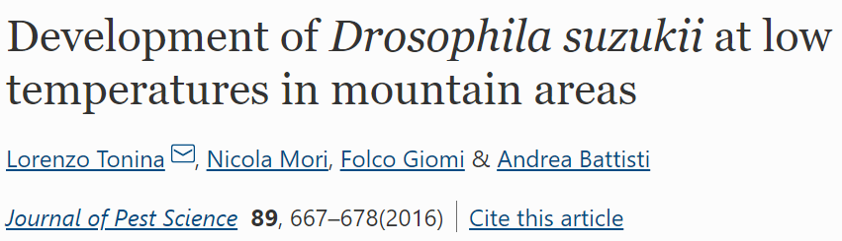
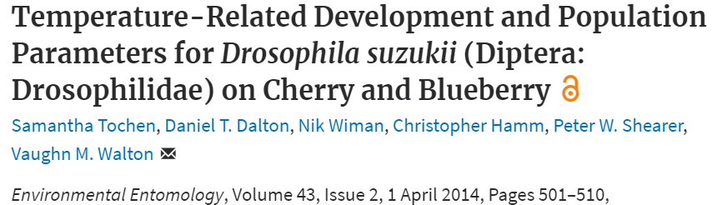
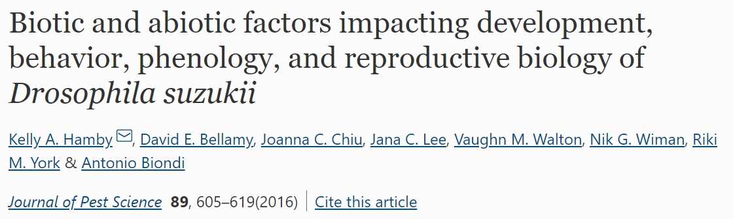
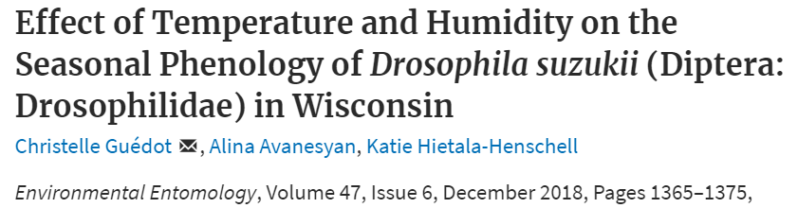
Temperature and Humidity

Slide 45
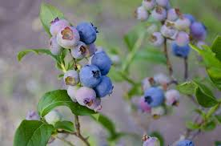
Horticulture management and pest insect are strictly connected
Increase plant performance
pest and disease control
Topics of the presentation:
1) Impact of Temperature and Humidity on D. suzukii distribution
2) Weed mat for horticulture management and related benefits
3) How we can use D. suzukii collection data and recorded temperature to model and predict the life cycle of D. suzukii

Slide 46

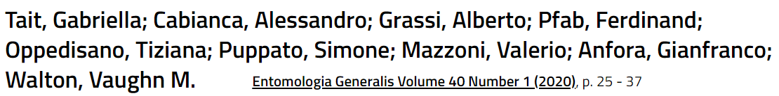
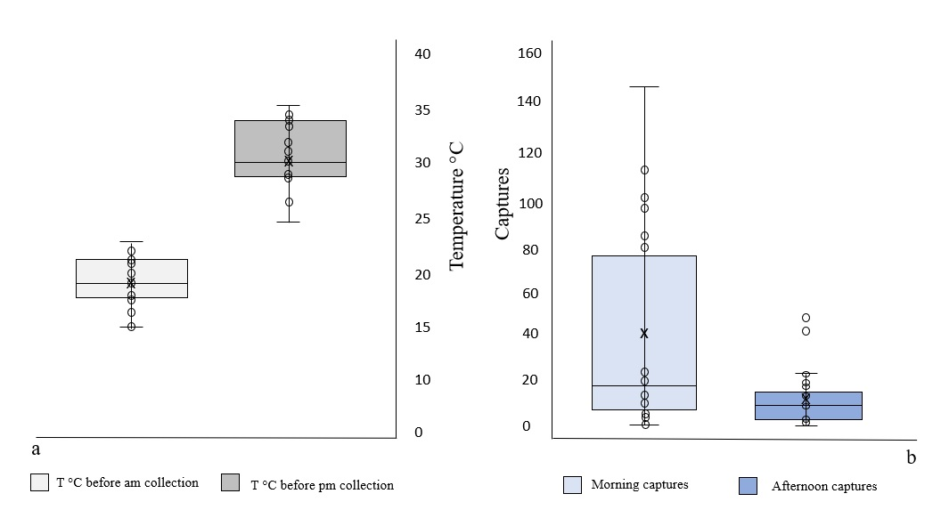
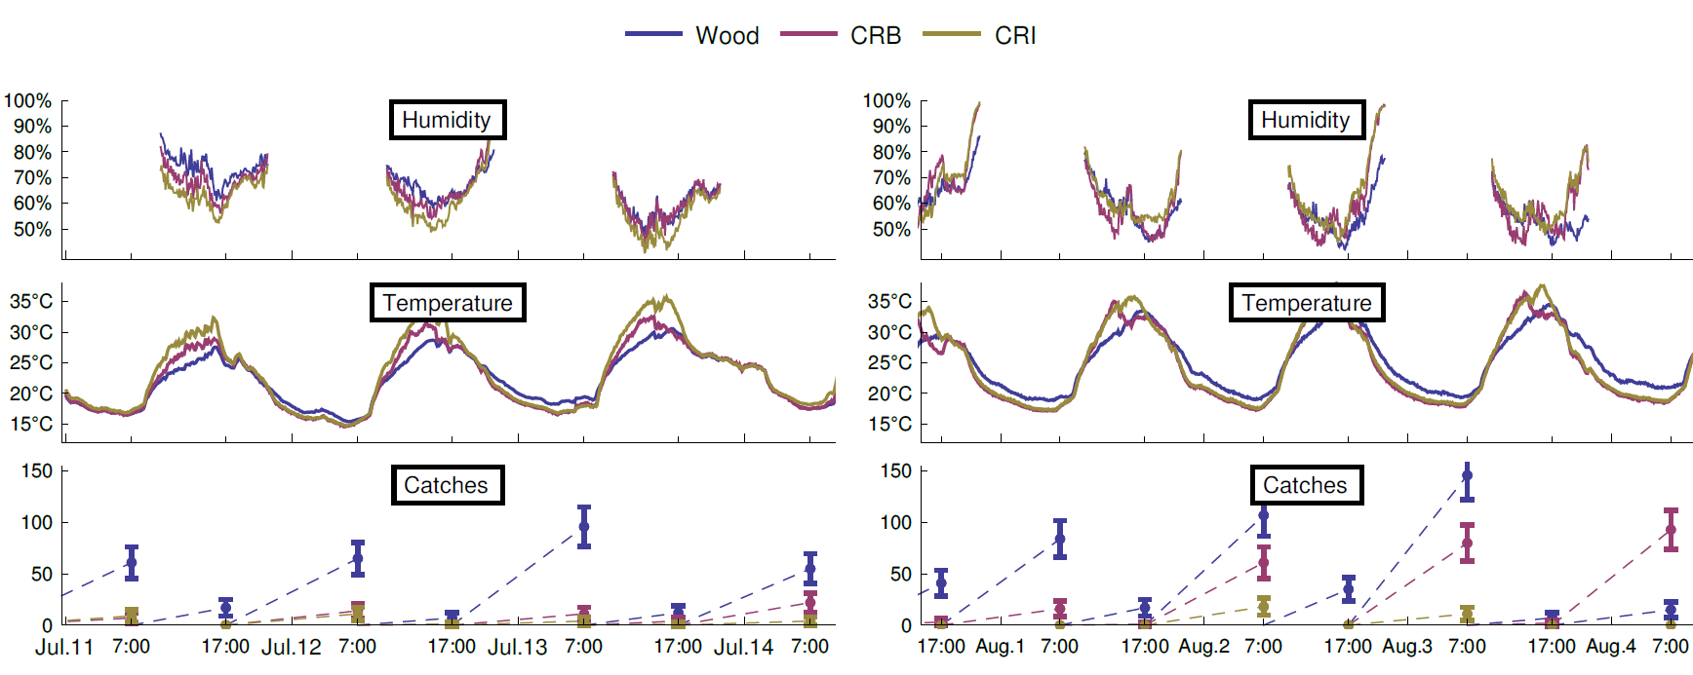
Drosophila suzukii daily dispersal between distinctly different habitats
Alberto Grassi

Slide 47
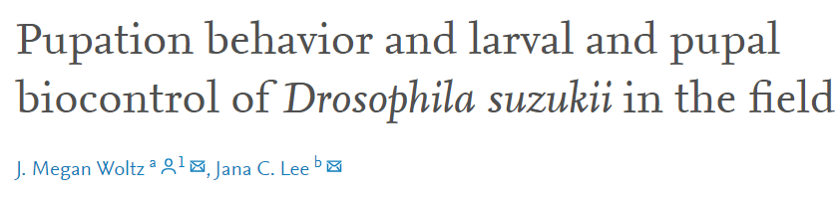
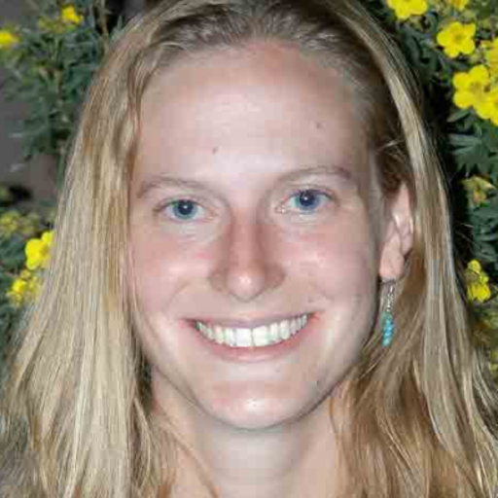
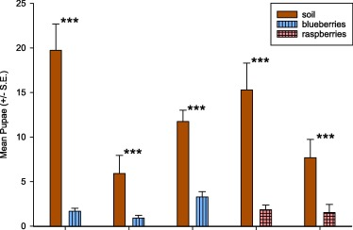
Dr. Megan Woltz
Mean (±S.E.) number of pupae from the pupation experiment found in soil or in fruits, by variety and year. The asterisks (*) indicate that the number of pupae found in soil and fruit were significantly different (***p < 0.01).

Slide 48
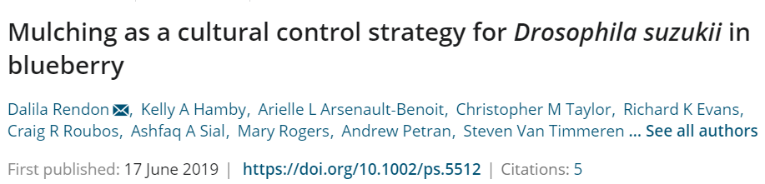


Dr. Dalila Rendon
Drosophila suzukii found on blueberries (mean ± SE) collected from branches or on top of the mulch (natural infestation) on different mulch types in Georgia, Michigan, and Oregon.

Slide 49


Sawdust + green
Sawdust
Dr. Bernadine Strik
Green weed mat
Black weed mat
‘Duke’
Fertigated
Year 1 (2017) through year 4 (2020)
Sawdust + black
Mulch trial – 2017 through 2020
After planting: Oct. 2016

Slide 50

Impacts of Mulch – overall, considering 3 years
High=H
Moderate=M
Low=L
No Difference=ND
*row “response varied by year”
Factor | Black weed mat + sawdust | Black weed mat alone | Sawdust alone
Plant vigor | H | M | L
Yield | ND | ND | ND
Fruiting season | ND | ND | ND
Brix (% TSS) | ND | ND | ND
Firmness | ND | ND | ND
Weed management | L | L | H
Vole presence | L | H | L
Cost to install & replenish as needed | M | L | H

Slide 51



Canopy and soil temperature
Year 2020
Scott Orr and canopy temperature sensor

Slide 52








Dr. Ferdinand Pfab
adult life length
maturation time
fecundity
maturation probability
days
days
eggs per day

Slide 53




Slide 54



Slide 55



Slide 56
Take home message
Drosophila suzukii is susceptible to high temperatures and low humidity (Tochen et al. 2014)
Weedmat color had no effect on yield or fruit quality (Strik et Davis 2021)
Fabric practices do not negatively impact SWD management, but it is helpful:
In‐row mulches may impede the development of D. suzukii immatures when larvae leave the fruit to pupate in the soil (Woltz et al. 2019)
Natural infestation by D. suzukii in blueberries is generally lower over weedmat compared to wood‐based mulches at one site (Rendon et al. 2019)

Slide 57
Objective 3:
Biological Control Tactics – 2019-2020 Progress
Mary Rogers & Leah Worth, Dept. Horticultural Science, Univ. Minnesota, St Paul, MN
Jana Lee, USDA ARS Horticultural Crops Research Unit, Corvallis, OR
Brian Hogg, USDA ARS, Invasive Species and Pollinator Health Research Unit, Albany, CA
Xingeng Wang, Kim Hoelmer & Keith Hopper, USDA ARS, BIIRU, Newark, DE
Matt Buffington, USDA ARS, Systematic Entomology Lab., Washington DC
Vaughn Walton, Betsey Millar, Jeff Millar, Dept Hort., Oregon State Univ., Corvallis, OR
Kent Daane, Dept Environ. Science, Policy & Management, Univ. California, Berkeley, CA

Slide 58



Parasitoids attacking SWD and other drosophilids
Pachycrepoideus vindemiae
Widespread geographic range
Large host range
0-10% parasitism
Can be mass-reared
Augmentation trials in USA
Not yet available in USA
Trichopria drosophilae
Not everywhere in the USA
Narrower T° tolerance
0-10% parasitism
Augmentation trials in
Europe & Mexico
Not yet available in USA
North America has no larval parasitoids – Classical Bio-Control
Ganaspis brasiliensis (Figitidae)
Leptopilina japonica (Figitidae)
Asobara japonica (Braconidae)

Slide 59


Insecticide Applications to Protect Crop
Fruit susceptibility
Harvest
SWD density (e.g., trap captures)
Economic Injury
late Fall
decline
Time from SWD presence to crop harvest

Slide 60
Augmentative Biological Control
Harvest
SWD density (e.g., trap captures)
late Fall
decline
Time from SWD presence to crop harvest

Slide 61

Augmentative releases of
P. vindemmiae in raspberries in exclusion tunnels
Mary Rogers and Leah Worth
University of Minnesota Results (2019 and 2020)

Slide 62


Materials and Methods
2019
Fall-bearing ‘Heritage’
8 mini-tunnels with 2 m rows
Tunnels artificially infested with 200 flies per week for 2 wks
Parasitoids released (500 Pv/week) at 50% infestation
30 sentinel pupae distributed weekly
2020
Summer-bearing ‘Nova’
12 mini-tunnels with 2 m rows
Tunnels artificially infested with 100 flies per week for 3 wks
Parasitoids released at 2 levels (500 Pv and 1000 Pv)/week
30 sentinel pupae distributed weekly

Slide 63



1-m² subsection of each plot harvested twice weekly
Random subsample of 10 marketable fruit per plot incubated for 7 days to determine % fruit infestation
Sentinel dishes collected at last harvest and evaluated for parasitism
Data Collection

Slide 64
Fruit Infestation
2019
5.7% parasitism
500 Pv released
2020
14.8% (500) & 20.4% (1000) parasitism
Arrows indicate release dates of Pv.
Data analyzed by PROC GLIMMIX; LSMeans separated at each harvest date at P≤0.05.
Notes:
Arrows indicate release dates of Pv.
Statistical analysis: PROC GLIMMIX, LSMeans separated at each harvest date at P≤0.05.

Slide 65



USDA-ARS (Oregon) - Jana Lee - 2019
Caneberry hoop houses
(4 release, 4 control)
Wild blackberry borders
(4 reps/trt, 100+ m apart)
Released 25-50 Pv per wk + Augmentorium box
(Rossi-Stacconi et al. 2018)
~0.14-0.27 wasps/m² per wk

Slide 66

USDA-ARS (Oregon) - Jana Lee – 2019
Releases of Pv & Muscidifurax
Pachycrepoideus rearing at home with lower production (Covid 19)
(25-50 Pv per wk + augmentorium box)
Muscidifurax raptorellus is pupal ectoparasitoid, used for livestock filth fly control
Reported 40% reduction in SWD in raspberry in cage exp (Bonneau et al. 2019)
$51 per 25,000 wasps
6,250 per release, 2 releases in Aug
~34.2/m² per release (~175 fold increase over Pv)
4 control and 4 release hoops, more distant
Entomology Today

Slide 67




Data Collection
Side row
9 m
SWD larvae in fruit
weighing out fruit samples
10 m
Sentinel SWD fruit
SWD adults in traps

Slide 68


2019 release of
Pachycrepoideus vindemiae (Pv)
2020 release of Pv & Muscidifurax raptorellus 2020
Photo by DaSilva
Sampling | Hoop House | Blackberry borders | 2020 Hoop House
Sentinel Parasitism | Higher (47 v 30%) | Ns (44 v 31%) | Ns (20 v 20%)
SWD larvae in fruit | ns | ns | ns
SWD adults in traps | ns | ns | ns
Parasitoid movement as all plots had parasitism, assuming low ambient parasitism.
Parasitism ranged from 2-52% per week, regardless of numbers of Pv or Muscidifurax released

Slide 69






Improve Mass-rearing of SWD pupal parasitoids (Pv and Td)

Slide 70




Improve Mass-rearing of SWD pupal parasitoids (Pv and Td)

Slide 71

Cold storage, freezing and shipment of parasitoids
Storing or freezing fly pupae:
Full factorial design: pupae age (1, 2, 3 d), T° (8, -20, -80C), Time (1d, 1w, 2w, 1m, 4m)
Controls: fly pupae (1, 2, 3 d) not stored.
Each replicate (10 pupae) exposed to Pv for 24 h, 30 replicates per combination.
Dependent variables: successful parasitism/offspring emergence, offspring sex ratio, probably F1 fecundity.

Slide 72
Cold storage, freezing and shipment of parasitoids
Storing parasitized pupae:
Full factorial design is planned.
The goal is to lower costs and deliver a viable NE in high numbers at the right timing for release.

Slide 73

USDA ARS (California) – Brian Hogg 2019-2020 releases of Td and Pv
`
2019 - ~60,000 Pv & Td released (1,500 - 16,000 per release)
2020 - ~200,000 Pv released (5-10K per site every 1-2 weeks from Aug to Oct

Slide 74



2019 releases (Watsonville, Driscoll’s & Nuturipe) with Pv & Td
0m
Release at edge of berry fields in semi-natural habitat, at 4 sites
Placed sentinel traps 10m, 40m, 70m away from release point in berry fields
Collect berries at each distance to sample SWD populations
Sampled at control plots at greater distances away (will be >1000m away)
2020 releases (Watsonville, Driscoll’s & Nuturipe) with Pv only
Host flies

Slide 75

2020 Results
Parasitism increased after release (~15-65%)
Shift from Td to Pv
Higher parasitism with higher release rates
No difference betw/ release & control
Suspect Pv got into riparian zone and multiplied on SWD (natural augmentorium)
80
control, R² = 0.36, P = 0.008
release, R² = 0.39, P = 0.006
60
40
Parasitism (%)
20
0
5000
7000
10000
No. parasitoids released per site

Slide 76

Classical BioControl – Introduction of Exotic Natural Enemy
SWD density (e.g., trap captures)
Economic Injury
Time from SWD presence to crop harvest

Slide 77



Classical Biological Control
Foreign explorations – 2013-2018
(average ~20% parasitism in Asia, up to 76% parasitism at some sites)
Quarantine studies – 2014-2018
(risk aversion & efficacy)
Taxonomic studies – 2014-present
USDA APHIS Petition – 2019-present
CABI
OSU
USDA
Italy
South
Korea
UCB
China
Ganaspis
brasiliensis
Leptopilina
japonica
Asobara
japonica

Slide 78
APHIS Environmental Compliance Process (2-4 yrs for insects)
(A) Petition to release a novel agent is a “federal action” that triggers the compliance with two Acts:
(1) The Endangered Species Act (ESA) (specifically “Section 7” consultation… addresses Risk!)
(2) National Environmental Policy Act (NEPA… addresses Risk!)
(B) Petition addressed seven required components (took three years to develop):
(1) Proposed Action (including statement of need), (2) Target Pest Information,
(3) Bio-Control Agent Information, (4) Host Specificity Testing, (5) Environ. & Economic Impacts
of Proposed Release (6) Pre–Release Clearance, and (7) Post Release Monitoring
(C) Steps in the “Environmental Compliance Process” after a Petition is developed:
(1) Petition was submitted to ad hoc review panel (full NAPPO representation)
(2) After NAPPO approval APHIS moved forward with the process (No Endangered Species Act concerns)
(3) APHIS conducted and is moving tje petition through a NEPA review:
(i) Tribal Consultation, (ii) Publication in Federal Register for Public Comment (could be 3-6 months)
(4) APHIS makes Environmental Finding
(5) Finding of No Significant Impact (FONSI)
(6) Publish Final Environmental Assessment and FONSI in Federal Register
(7) Permitting of release expected this spring, release from quarantine might start around August 2021
Based on a seven-slide review
courtesy: Dr. Robert Pfannenstiel

Slide 79



Develop regional insectaries for Gb release in different US regions.
Insectary Production of
Ganaspis brasiliensis
Insectary Production of
Ganaspis brasiliensis

Slide 80
Summary – Accomplishments BioControl Tactics
Pachycrepoideus vindemiae Trichopria drosophilae
Augmentation trials showed increased parasitism in some cases, but no economically important differences in SWD numbers, fruit infestation or percentage parasitism
Still in experimental phase, not yet commercially available in USA and undetermined costs or benefits for SWD control
Ganaspis brasiliensis (Figitidae)
Selected for classical biocontrol (based on safety and efficacy)
The USDA APHIS petition process in nearly complete and we hope to have permits in 2021 and begin releases in 2022

Slide 81

Three review articles

Slide 82
Objective 4. Integrate new OMRI-approved products into IPM programs.
4.1 Determine mechanisms and performance of sterilants for reducing infestation by SWD.
4.2 Determine how rotation programs of organic insecticides including sterilants affect SWD populations.
4.3 Demonstrate combined insecticide, biological and cultural control programs.
4.4 Monitor susceptibility of populations of SWD to spinosad using discriminating doses.

Slide 83




4.1 Determine mechanisms and performance of sterilants for reducing infestation by SWD.
Fruit sterilants: combination of peroxyacetic acid (PAA) and hydrogen peroxide (HP).
Most formulations are ~22-26% PAA and 2-15% HP.
Numerous products available, e.g.: Jet-Ag, Oxidate 2.0, Rendition, SporeQuell
Active against microbes; used in post-harvest sanitation.
SWD need yeast species to develop properly.
Laboratory and small-plot trials in blackberry and blueberry to test efficacy
of PAA-HP products against SWD.

Slide 84


Blackberry laboratory study (U. Maryland)
  Sterilize blackberries, dip in yeast suspension, then dipped in Jet-Ag or water.
  Fruit washed and yeasts on fruit were plated on agar.
  Fewer yeasts on blackberries treated with Jet-Ag.

Slide 85


Blackberry small-plot study
  Apply water or Jet-Ag to plots once a week for three weeks.
  Sampled fruit for SWD and yeast abundance once a week.
  No significant differences in SWD between treatments.

Slide 86

  No significant differences in yeast species between treatments.
  Primary yeast species detected:
  Curvibasidium pallidicorallium (85%)
  Hanseniaspora uvarum (75%)
  Aureobasidium pullulans (55%)
  Metschnikowia spp. (40%)

Slide 87


Blueberry small plot study (Michigan State U.)
  Apply one of four sterilant products to plots once a week when fruit are ripe.
  Sample fruit for SWD larvae each week.
  Significantly fewer SWD larvae in fruit from sterilant plots.
  Results consistent with previous year results.*
  * Van Timmeren, Fanning, Schöneberg, Hamby, Lee, Isaacs. 2019. Exploring the efficacy and mechanisms of a crop sterilant for reducing infestation by spotted-wing drosophila (Diptera: Drosophilidae). Journal of Economic Entomology.

Slide 88

Skin thickener trial: blueberry small plot study
  Several commercial products: OsmoPro, Profuze, Sil-Matrix, Sil-Cal.
  Profuze applied when fruit were ripe.
  Sample fruit for SWD larvae each week.
  Fewer SWD larvae in Profuze-treated plots.
  Similar results in other years and from a trial in Georgia.

Slide 89



RAPID test for detecting resistance
  Treat scintillation vials with diagnostic dose of spinosad (Entrust) (LC99x2 or LC90x8).
  Add 10 female SWD to treated vials.
  After 8 hours count number of surviving flies.

Slide 90

RAPID testing in California: caneberry (UC Davis)
  Tested SWD from four commercial sites and one susceptible site (Wolfskill).
  Tested three times during season.
  LC99x2 dose of spinosad used (927.94 ppm).
  Lower mortality at commercial sites.
  Trend towards lower mortality later in the season.
Mean proportion of dead

Slide 91
RAPID testing in California: strawberry (UC Davis)
  Tested SWD from four commercial sites.
  LC99x2 dose of spinosad used (927.94 ppm).
  Only ~50% survival of flies in diagnostic dose testing.
  Dose response: flies surviving at high doses of spinosad.
Log concentration

Slide 92

RAPID testing in other regions
  Tested SWD at several commercial farms.
  LC90x8 dose of spinosad used (847.77 ppm).
  Susceptible populations detected in Georgia, Michigan, Maine, decreased susceptibility reported in Oregon.

Slide 93
Summary
  Fruit sterilants effective against yeasts in laboratory.
  Reduced SWD in blueberry, not in blackberry.
  Lower SWD infestation using skin thickener product.
  Resistance to spinosad detected in CA.
  Reduced susceptibility in OR, no evidence of spinosad resistance in eastern US (ME, MI, GA).
  Ongoing analysis of pruning x insecticide trial.

Slide 94
Objective 5.
Economic Analysis of SWD Management Practices for Organic Berry Growers
Leah English, M.S. and Jennie Popp, PhD

Slide 95

Economic Analysis of SWD Control:
Collect experimental data from research teams
Identify economically viable control solutions
Incorporate viable options into budgeting tool for growers

Slide 96


Economic Analysis of SWD Control:
University of Maryland Trellis Studies:
How much is it going to cost?
  Cost of trellis construction:
    Materials
    Labor – installation time
  Operational costs:
    Labor
      Time spent fixing canes to trellis
      Picking time
    Maintenance
How will it affect revenues?
  Marketable Yield

Slide 97

Economic Analysis of SWD Control:
What is the net economic outcome for implementation of SWD control measures?
  Break-even Analysis
  Sensitivity Analysis
Provide a resource that allows growers to compare SWD control options based on their individual situation.

Slide 98



Budgeting Tool with SWD Control
Blueberry/Blackberry/Raspberry
  Region Specific
  Incorporate relevant practices for SWD control
Focus on usability and value for users.
  Is it easy to use/understand?
  How much value does this bring to growers?
    Planning
    Access to funding
Longevity of Use
  Easy to update

Slide 99
Impact Evaluation Unit (IEU):
Dr. Kay Kelsey (Professor and IEU Director)
Mariano Dossou Kpanou & Damilola Ajayi (Graduate Research Associates)
Objective 5
Evaluation of the SWD OREI Project

Slide 100

Why do we evaluate?
Strategically: 1) Project improvement, learning from our mistakes and celebrating our successes. 2) Accountability to the federal government for taxpayer funding.
Technically:
Our goal is to capture the overall impacts of the project
Social impact: How did participating in the SWD research foster the generation of berry and cherry grower networks?
Biological impact: what are berry and cherry growers’ experiences in applying the best management practices to control SWD?

Slide 101
What we did during Year 1 and Year 2
2019
2020
Preparation of the Evaluation
Formative Evaluation
Elaboration of Evaluation Plan
Construction of the evaluation instruments
  Observations protocols
  Interview guides
  Questionnaires
Monthly meetings and Conference Attendence
Elaboration of the evaluation report
Publication of a peer review article
https://doi.org/https://doi.org/10.37433/aad.v1i3.65

Slide 102
What we are doing for Year 3: Summative Evaluation
2019
2020
2021
Summative Evaluation (Ongoing)
We aim to report
  the differences you made through your efforts
  the changes that occured in knowledge, attitudes, and practices as result of the project
  to what extent has the project impacted lives

Slide 103
What we are doing for Year 3: Summative Evaluation
Satisfaction survey that includes
4 sections
Choice questions and 1 open question
In average the survey can be completed in 12 minutes
4 questions
6 questions
9 questions
1 question
Respondent Profile
Practices Regarding SWD Management
Impact and Effectivity of the SWD Management Practices
Stakeholders’ Overall Satisfaction and Suggestions
Notes:
According to our current record, the maximum times you need to fill the survey is 16 minutes

Slide 104
Current Work: Satisfaction Survey
Current status
So far, 50 records of which only 35 are valid.
  15 are empty records
  22 fully completed
  13 are partially completed
Link to access the survey
https://ugeorgia.ca1.qualtrics.com/jfe/form/SV_3NVhWTGnleU3bP7

Slide 105

Next Steps: Interviews
Please support us in conducting interviews to get In-depth qualitative insights.
A 30 minutes interviews with
  Growers
  Advisory Board Members
  Researchers/Research Associates/Research Assistant
Contacts:
bd82452@uga.edu 706-202-8206
kdk@uga.edu 706-247-2492
Are you a volunteer to participate in the interview and share your experience with us? Contact us
Notes:
We will contact you shortly asking you to participate in the interviews. But we will be grateful if you can volunteer to participate in the interview to share your experience working with the research team. Try to reach out using the contact on the last slide. We will promptly respond to you.

Slide 106

Please contact us if you have any further questions
Email:
kdk@uga.edu
bd82452@uga.edu
damilola.ajayi@uga.edu
Website:
https://ieu.uga.edu/

Slide 107
CONCLUSIONS
BEHAVIORAL STRATEGIES:
HOOK SWD, ACTTRA, and ACTTRA Teun when mixed with Entrust (spinosad) were effective as attract and kill system in lab. Studies will be conducted this year to determine effectiveness under field conditions. If effective, they can be used as attract and kill system to reduced SWD fruit infestation.
Food grade gum reduced SWD fruit infestation for up to 21 days. Field trials at 50 dispensers per acre significantly reduced fruit infestation.
These new technologies can be effective at lower SWD population densities which makes them especially useful early season tools.
CULTURAL STRATEGIES:
Using black weedmat reduces SWD survivorship and fruit infestation
Heavy pruning increases temperature and decreases humidity in the canopy leading to lower SWD fruit infestation
If installed appropriately, physical exclusion using mesh netting <1 mm can provide 100% control of SWD

Slide 108
CONCLUSIONS
BIOLOGICAL CONTROL:
Augmentation of native parasitoids showed increased parasitism but not effective in reducing SWD numbers or fruit infestation
Exotic parasitoids have shown promise in initial lab studies. Once USDA APHIS petition is approved, they will be evaluated and released in the field.
CHEMICAL CONTROL:
Entrust remains the most effective option of organic SWD control, and other materials including Grandevo, PyGanic, and Azera should be used in rotations
Resistance to Entrust has been documented in California, and while there is no evidence of resistance in other regions, they should continue to monitor
Sterilants such as Jet Ag and Oxidate were effective in reducing SWD fruit infestation in blueberries but not in blackberries
New skin thickener products reduced SWD infestation in blueberries

Slide 109
CONCLUSIONS
ECONOMIC ANALYSIS AND EVALUATION:
Region and crop specific interactive budgets are being develop to assist organic berry growers in making economic decisions regarding SWD management options
Summative impact evaluation surveys are underway. Please fill out the online surveys or contact evaluation team members to share your experiences of organic SWD management in a short virtual interview.

Slide 110


Online resources
Project website
http://eorganic.info/spottedwingorganic
SWD*IPM (western region)
spottedwing.org
NC IPM Center (factsheets)
ncipmc.org
NE IPM Center
SWD Working Group
Arkansas Interactive Budgets for Fruit Crops
http://cars.uark.edu/ourwork/Specialty-Crop-Production-and-Marketing/fruit_budget.aspx
Georgia
blog.caes.uga.edu/blueberry/
Michigan
www.ipm.msu.edu/SWD.htm
North Carolina
swd.ces.ncsu.edu
Minnesota
http://www.fruitedge.umn.edu
Florida
http://entomology.ifas.ufl.edu/liburd/fruitnvegipm/index.htm
https://bit.ly/2Lvzy14

Slide 111
Acknowledgements
USDA National Institute for Food and Agriculture (NIFA) Organic Agriculture Research and Extension Initiative (OREI) Award number 2018-51300-28434
  North Carolina Blueberry Council, Inc.
  Georgia Blueberry Growers Association
  Southern Region Small Fruit Consortium
  USDA-NIFA: IR-4 biopesticides program (grant 2015-34383-23710)
  Project GREEEN
  Michigan State Horticultural Society
  NC Agricultural Foundation, Inc.
  Michigan Blueberry Advisory Council
  Georgia Blueberry Commission
  Georgia Department of Agriculture
  Florida Department of Agriculture and Consumer Services (FDACS) Contract # 01219 (2014 -2017)
  Oregon Blueberry Commission
USDA NIFA award #2010-51181-21167, #2015-51181-24252, USDA OREI #2014-51300-22238, USDA CRIS 5358-22000-037-00D
USDA NWCSFR Oregon State Blueberry Commission
Washington State Blueberry Commission
Washington State Red Raspberry Commission Washington State Strawberry Commission
Washington State Commission on Pesticide Registration
California Cherry Board and USDA APHIS (Farm Bill, fund 14-8130-0463)
USDA NIFA RIPM Competitive Grants Program - North Central Region award number 2013-34103-21338 University of Minnesota Rapid Agricultural Response Fund, and Minnesota Agricultural Experiment Station.

Slide 112

Please complete a brief survey
https://ugeorgia.ca1.qualtrics.com/jfe/form/SV_3NVhWTGnleU3bP7
Slides from this webinar, and the recording, will be made available to all registered attendees and also posted on YouTube.

