Slide 1

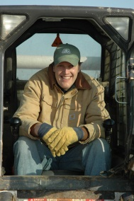
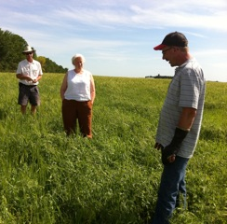
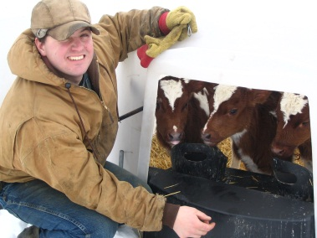
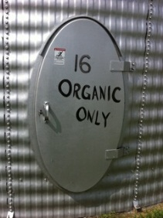
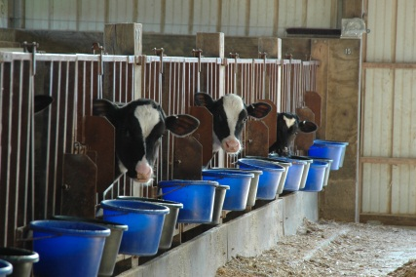
Research Findings: Who’s Transitioning and How in MN
Timothy A. Delbridge, Gigi DiGiacomo, and Robert P. King
Department of Applied Economics
University of Minnesota
delbr002@umn.edu, gigid@umn.edu, rking@umn.edu

Slide 2
Tools for Transition
The Tools for Transition Project (TFT) is a five-year research project on the economics of organic transition. It was funded in 2010 by USDA’s Organic Agriculture Research and Extension Initiative. Project objectives are:
To collect data on farm performance measures during the transition to organic production and develop resources such as an online database and benchmark reports for field crop and dairy enterprises and whole farm performance during and shortly after transition.
To develop web-based and print materials to address the informational needs of farmers transitioning to organic production and the education needs of agricultural professionals who advise them.

Slide 3






Project Partners
Dale Nordquist, Center for Farm Business Management: http://www.cffm.umn.edu
Farm Business Management Program: www.fbm.mnscu.edu
Meg Moynihan, Minnesota Department of Agriculture:
www.cffm.umn.edu
Robert King, Tim Delbridge and Gigi DiGiacomo, University of Minnesota:
www.apec.umn.edu
Helene Murray, Minnesota Institute for
Sustainable Agriculture:
www.misa.umn.edu
Jim Riddle, University of Minnesota, Organic Ecology:
http://swroc.cfans.umn.edu/ResearchandOutreach/OrganicEcology/index.htm

Slide 4
Significance
This project is generating data and knowledge about the transition process for use by:
  Farmers as they evaluate transition opportunities and plan for transition
  Lenders as they consider financing for transitioning farms
  Policymakers as they assess policies for organic agriculture
  The project led to discussion in Minnesota about the cost-share program for pre-certification meetings with certifiers.

Slide 5
Project Participants
Over the life of the project, we have recruited 46 transitioning and recently certified crop and dairy farms to participate in the Farm Business Management (FBM) program.
Participating farms have received scholarships up to 90% of program tuition. In return, they have responded to intake and annual surveys, shared data with project team and participated in project events.

Slide 6
Project Participants
At the start of participation, these 46 farms managed 18,151 acres with an average farm size of 395 acres:
  4,535 acres in transition (25%)
  1,761 acres recently certified (10%)
  8,193 acres certified more than 3 years (45%)
  3,662 acres managed conventionally (20%)
Participating farms had 2,350 dairy cows with an average herd size of 98 cows:
  692 cows in transition (30%)
  1,528 certified organic cows (65%)
  130 cows under conventional management (5%)

Slide 7
State and National Trends in Organic Field Crop Acreage
Notes:
In 2009 and 2010 the organic / conventional corn price ratio dropped to around 1.5 to 1.75. Today it is almost 3.0.

Slide 8
Who is Transitioning?
TFT farmers can be categorized into four groups:
  Conventional dairy farmers with relatively small herds
  Conventional crop farmers who were already using a diversified three- or four-year rotation prior to transition
  Certified organic crop farmers who are expanding by transitioning newly purchased or rented land or are transitioning additional land that they manage conventionally
  Farmers transitioning land that was previously fallow or enrolled in CRP

Slide 9
Who is Transitioning?
Common motivations for transition:
  environmental/conservation reasons
  price premiums
  health/safety reasons
  personal satisfaction
  philosophical/ethical reasons
Important challenges for transition:
  access to capital
  access to land
  time requirements
  cost and availability of inputs
  weed management

Slide 10
Data From TFT Farms
Data from TFT Farms
  We have data from 46 farms. Of these, 22 have significant livestock enterprises.
  These have been in FBM for an average of 5 years. Some as long as 18 years!
What information are we focusing on from TFT farms?
  Each farm conducts a year-end analysis with FBM and reports yields, expenses, price, etc. for each crop and livestock enterprise.
  We pay close attention to the “transition status” of each field
Notes:
One of the main reasons that we started this project is that there was previously no data on farmer’s experience during organic transition. Not in MN or any other state. There was nothing. We have been using the existing Farm Business management program to develop a database on outcomes during transition for MN crop and dairy farms. As Rob said, we have X farms. For some of these we have only 1 year of data, since they joined FBM only when they started the project, and for others we have much more.

Slide 11
Comparing Performance to Regional Averages
Regional production, expense, and profitability averages are pulled from FINBIN (www.finbin.umn.edu).
  Since it doesn’t make sense to compare yields from one year to the next, we compare TFT farm yields to the regional average from that year.
  This allows pooling data from different years.
Yield ratio = farm yield / regional average
  Ex: Organic yield of 120 bu/ac in a county with average conventional yield of 165 bu/ac. Ratio = 120/165 = 0.73
  If ratio > 1, the yields were higher than conventional neighbors. If ratio < 1, yields were lower.

Slide 12
Crop Enterprise Results
Crop | Status | Number of Obs. | Yield Ratio (median) | Total Expense Ratio (median) | Net Return (difference)
 | Conventional | 114 | 0.99 | 1.13 | -$32.86
Alfalfa Hay | In Transition | 33 | 0.79 | 0.59 | -$86.23
 | Certified Organic | 68 | 0.69 | 0.90 | -$147.19
 | Conventional | 132 | 0.94 | 0.94 | -$36.58
Corn | In Transition | 20 | 0.78 | 0.90 | -$66.07
 | Certified Organic | 110 | 0.72 | 0.85 | $356.50
 | Conventional | 103 | 1.02 | 1.01 | -$4.39
Soybeans | In Transition | 10 | 0.87 | 1.15 | -$68.49
 | Certified Organic | 37 | 0.67 | 1.00 | $195.27
Notes:
It makes sense that per-acre net returns (for corn and soybean anyway) are larger for farms once they achieve certification but this doesn’t tell us much about profitability. The data get a little tricky for whole-farm profitability measures (such as rate of return on assets) because most farms transition portions of their farm separately, so while it is obvious that a 500 acre farm with 400 acres in transition should be considered transitioning, how about a 500 acre farm with 50 in transition?
IN any case, we find that farms with significant acreage in transition are less profitable than average in their region, but are about 40% more profitable when a significant amount (more than 50%) is certified as organic.

Slide 13
Patterns in Crop Enterprise Data
  Yields drop during transition and often continue to decline.
  Expenses tend to drop or remain about the same during transition and after certification.
  Transition is costly but returns for corn and soybeans are much higher after certification.
  Organic alfalfa seems to be less profitable on these farms than when managed conventionally (but provides other benefits).

Slide 14
Dairy Results
Status | Number of Obs. | Production/ head | Production Ratio | Net Return/ head | Net Return Ratio | Feed Cost Ratio | ROA Ratio
Conventional | 59 | 16,391 lbs. | 0.83 | $381 | 0.74 | 0.90 | 0.87
In Transition | 16 | 13,335 lbs. | 0.65 | $254 | 0.88 | 0.79 | 0.56
Certified Organic | 34 | 14,491 lbs. | 0.68 | $926 | 1.61 | 0.87 | 1.01

Slide 15
Patterns in Dairy Enterprise Data
  Participating farms are smaller than average, with lower production per cow before beginning transition.
  Median feed costs do not increase through the transition.
  The transition is costly – profitability drops substantially during the transition year.
  These farms are more profitable after certification than they were before transition.

Slide 16
What Conclusions Can We Draw?
Transition costs seem to be recouped in a short time after certification.
  Some farms have more costly transitions than others.
  Timing cropland transitions correctly could make a big difference financially.
Yields, rather than expenses, seem to drive profitability changes during transition process.
Averages and medians hide differences across farms.
  We are particularly interested in the variability of yield decreases different farms.

Slide 17
What Are Other Barriers to Organic Adoption?
Why don’t more farms transition?
  Lack of information: technical, certification process, marketing.
  University trials have great results, but are these yields really achievable?
  Uncertainty surrounding organic prices and markets: Will price premiums diminish over time?
  Risk management difficulties: Crop insurance is a challenge, especially with new rules in 2014.
  Community and culture: For some organic is a controversial topic. How important is this?

Slide 18
Transition Tools
Tools and resources to assist with transition:
  Farmer profiles
  Financial data
  Organic price data
  Cost-share for transition assistance
  Business planning

Slide 19
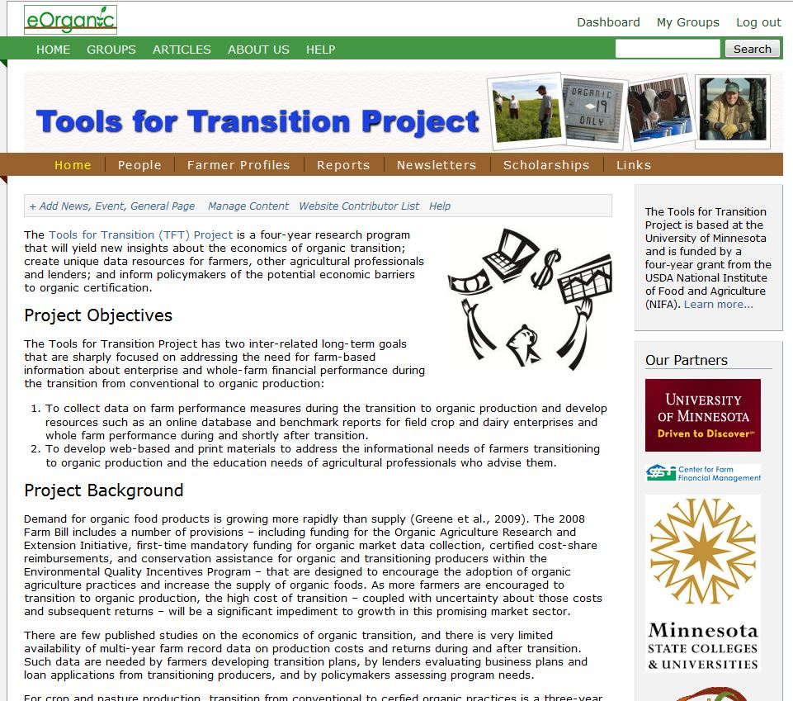
Transition Tools
Tools for Transition Project website
http://eorganic.info/toolsfortransition
  Farmer profiles
  Survey results
  Presentations
  Newsletters
  Resource links

Slide 20
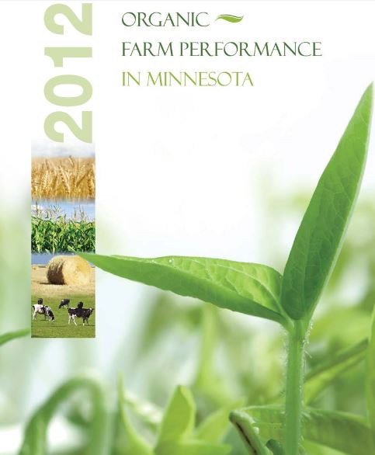
Transition Tools
Organic Farm Performance in Minnesota report
www.mda.state.mn.us
Compares organic and conventional:
  Input costs
  Net farm income
  Farm type and size
  Production trends
  * Data also available in FINBIN.

Slide 21
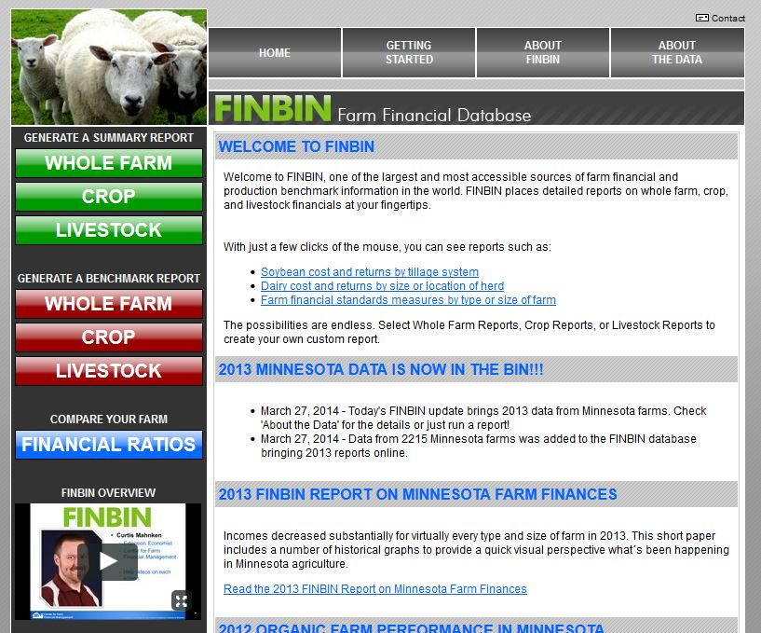
Transition Tools
FINBIN website
http://www.finbin.umn.edu/
Whole farm and enterprise reports for:
Conventional
Organic
Transitional (limited)

Slide 22
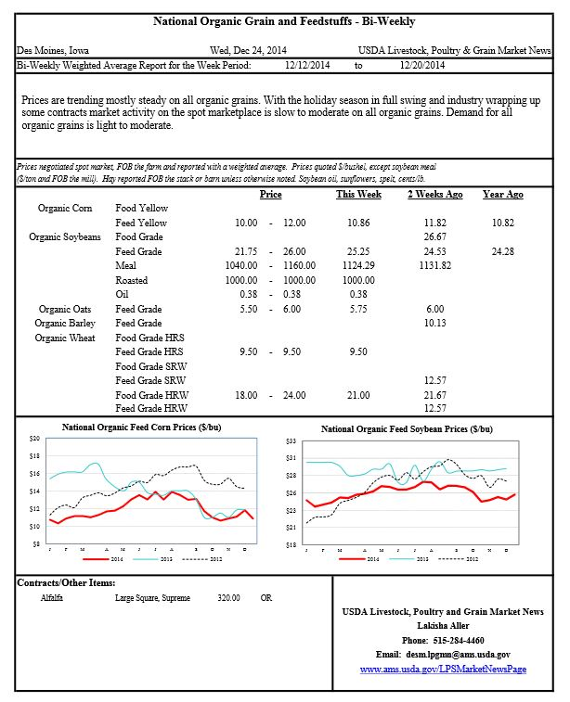
Transition Tools
National Organic Grain and Feedstuffs – Bi-Weekly report
http://www.ams.usda.gov/mnreports/lsbnof.pdf
Corn
Soybeans
Oats
Barley
Wheat
Hay

Slide 23
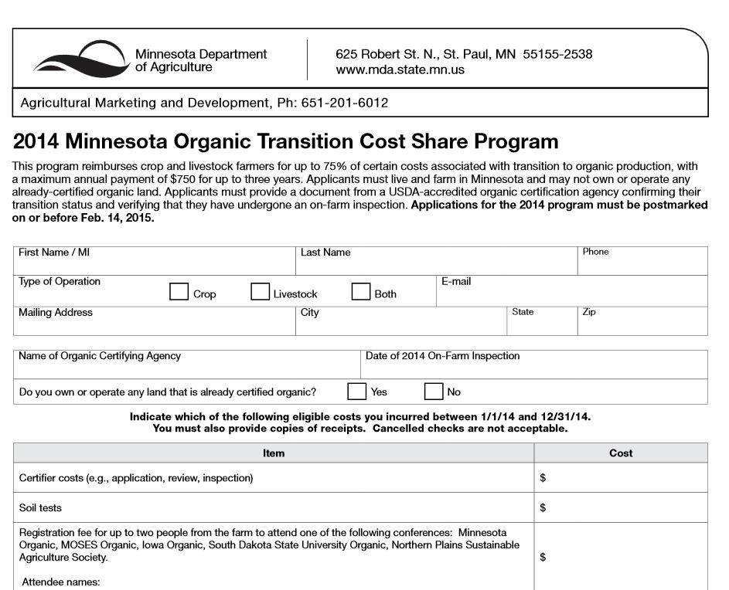
Transition Tools
Organic Transition Cost-Share Program
http://www.mda.state.mn.us/food/organic/transitioncostshare.aspx
75% of costs (up to $750/year/farm) for:
Certifier’s charges for on-farm visits
Soil tests
Organic conferences

Slide 24
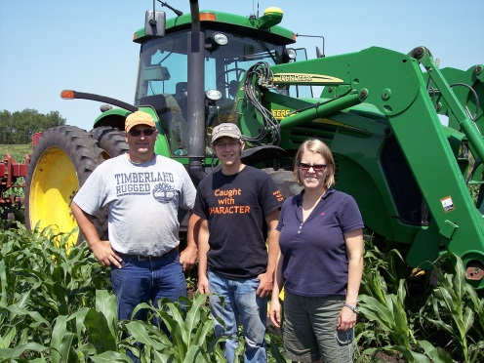
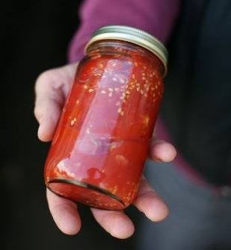
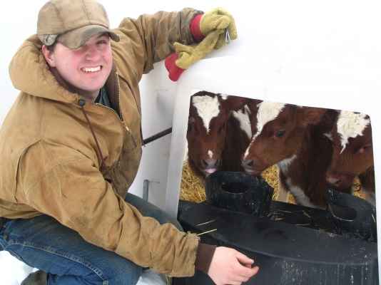
Transition Tools
Forthcoming 2015:
Organic Transition Business Planner
  Why transition?
  History and current situation
  Vision, mission, and goals
  Operations, marketing, human resource, and finance transition strategies
  Presentation, implementation, and monitoring
  * Linked to AgPlan software, https://www.agplan.umn.edu/

Slide 25
Questions … Comments?
Timothy A. Delbridge, Gigi DiGiacomo, and Robert P. King
Department of Applied Economics
University of Minnesota
delbr002@umn.edu, gigid@umn.edu, and rking@umn.edu

