Slide 1

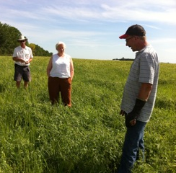
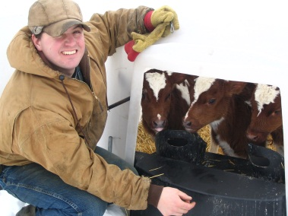
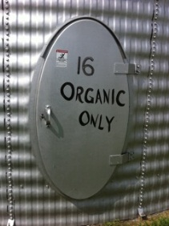
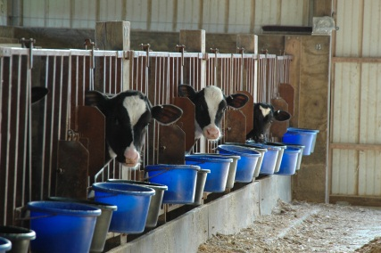
Challenges in Transitioning to Organic Production
Timothy A. Delbridge and Robert P. King
Department of Applied Economics
University of Minnesota
delbr002@umn.edu and rking@umn.edu

Slide 2
Profitability and Adoption
Profitability
  Organic crop production is consistently more profitable on a per-acre basis in experimental trials, but it is not clear that this extends to the whole-farm level.
  Farm-level data show that rate of return to organic management is often lower than to conventional management.
Uncertainty
  The cost and uncertainty related to the transition period is a significant barrier.

Slide 3
Profitability and Adoption
Whole-farm profitability research
  Delbridge et al. (2013) used long-term trial and weather data to maximize farm size for organic and conventional rotations while holding machinery and labor time fixed.
  Fewer management requirements allow the conventional system to be farmed on more acres, all else equal, but expected profits are still higher for the organic system.
  The whole-farm profitability advantage for the organic system was found to be greater for small farms.
  Results still suggest higher transition rates than we observe.

Slide 4
Profitability and Adoption
Modeling the transition decision
  Delbridge and King (in review) model the decision transition as a dynamic programming problem to find optimal organic transition strategy.
  Results show that transition is attractive when conventional returns are low. High conventional returns induce organic abandonment.
  Smaller farms face lower transition/opportunity costs and are more likely to transition.
  This is consistent with anecdotal evidence of recent organic abandonment.

Slide 5
Notes:
In 2009 and 2010 the organic / conventional corn price ratio dropped to around 1.5 to 1.75. Today it is almost 3.0.

Slide 6
Who is Transitioning?
Compared to conventional farm averages, the crop and dairy farms that are transitioning in MN tend to be:
  smaller
    Project dairy farms average herds of 98 cows versus state average of 158.
    Project crop farms average 640 crop acres compared to state average of 1,040.
  less productive per acre/cow
    Not only are organic yields lower than conventional averages, farms that transition also had lower than average conventional yields.
    Dairy production: 17,000 lbs/cow vs. 20,000 lbs/cow conventional average
    This points to a selection effect in organic transition.
  more likely to have managed diverse crop rotations
  slightly less profitable

Slide 7
Who is Transitioning?
Project farms cite as motivations for transition:
  environmental/conservation reasons
  price premiums
  health/safety reasons
  personal satisfaction
  philosophical/ethical reasons

Slide 8
Additional Challenges
Lack of Information
  Requirements for certification, fear of making a mistake … Minnesota’s transition cost share program
  How big is the “yield hit”?
  Input costs
Concerns about Thin Markets
  Lack of transparency and liquidity in organic markets is a common concern expressed by farmers.
  Demand is growing, but how price elastic is it?
  Price reporting by AMS and Mercaris.

Slide 9
Additional Challenges
Risk Management
  The Federal Crop Insurance Program is a key source of subsidies for farmers – expected indemnities are nearly $2.00 per $1.00 of premium (Glauber 2013).
  Participation has been low by organic producers, but steps have been taken to boost it
    Elimination of 5% premium surcharge
    Organic price elections are now offered for more crops
  These improvements may be offset by new procedures for determining T-yields that may pose problems for transitioning farmers who do not have historical yields under organic practices.

Slide 10
Additional Challenges
Risk Management
  Whole farm revenue products like AGR-Lite are an alternative to standard crop insurance, but AGR-Lite has low participation and is perceived to have high premiums. Also, proper documentation and rating is a problem when a significant change – like transition – is being made.
  Organic producers may also have less access to price risk management tools, but …
    Supply control by Organic Valley
    Production contracts
    Bargaining cooperatives

Slide 11
Additional Challenges
Knowledge
  Conventional farm yields often match experiment station yields, but organic farm yields generally lag behind experiment station yields.
    Selection bias
    Poorly developed public and private sector knowledge transfer systems
  Organic production systems can be more complex than conventional systems.
    More crops
    More field operations
    Fewer “recovery options”

Slide 12
Additional Challenges
Community
  Farmers often cite concerns about “what the neighbors will think” as a barrier to transition.
    Start transition with a single field away from the road
    Social media posts to explain flame weeding and tillage radishes
Culture
  GMOs have been the focus for “coexistence” debates, but there also are other areas of controversy that create the perception of a cultural divide between conventional and organic producers.
    Product quality – food safety and nutritional claims
    Efficiency – “feeding the world” and the “real cost” of food

Slide 13
Questions … Comments?
Timothy A. Delbridge and Robert P. King
Department of Applied Economics
University of Minnesota
delbr002@umn.edu and rking@umn.edu

Slide 14




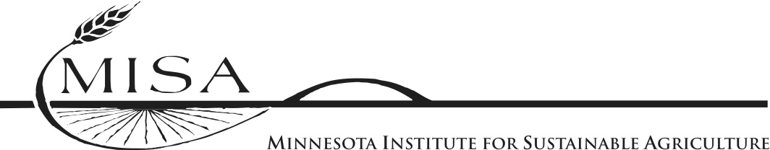

Project Partners
Dale Nordquist, Center for Farm Business Management: http://www.cffm.umn.edu
Farm Business Management Program: www.fbm.mnscu.edu
Meg Moynihan, Minnesota Department of Agriculture:
www.cffm.umn.edu
Robert King, Tim Delbridge and Gigi DiGiacomo, University of Minnesota:
www.apec.umn.edu
Helene Murray, Minnesota Institute for
Sustainable Agriculture:
www.misa.umn.edu
Jim Riddle, University of Minnesota, Organic Ecology:
http://swroc.cfans.umn.edu/ResearchandOutreach/OrganicEcology/index.htm

