Slide 1
Focus Crops for the Midwest
Present challenges for cultivar and market development

Slide 2
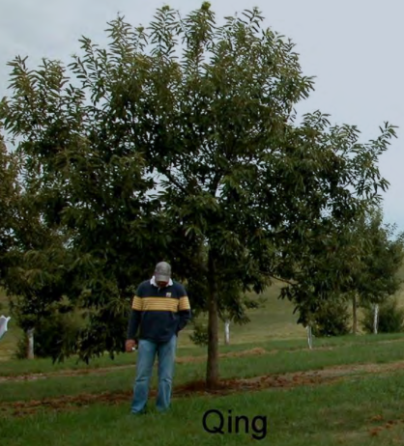
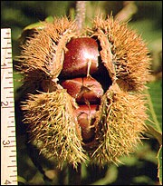
Chestnut
(Castanea sp.)
Much of the work on this crop can be found at the following links:
Michigan State University,
University of Missouri,
Penn State University,
North Carolina State University
and The American Chestnut Foundation.
Presently, viable cultivars and extension reports on BMPs are available but limited. Germplasm development work for disease resistances (blight and root rot) is still an ongoing focus.
nhm.ac.uk/nature-online/
agebb.missouri.edu/
extension.missouri.edu
extension.missouri.edu

Slide 3
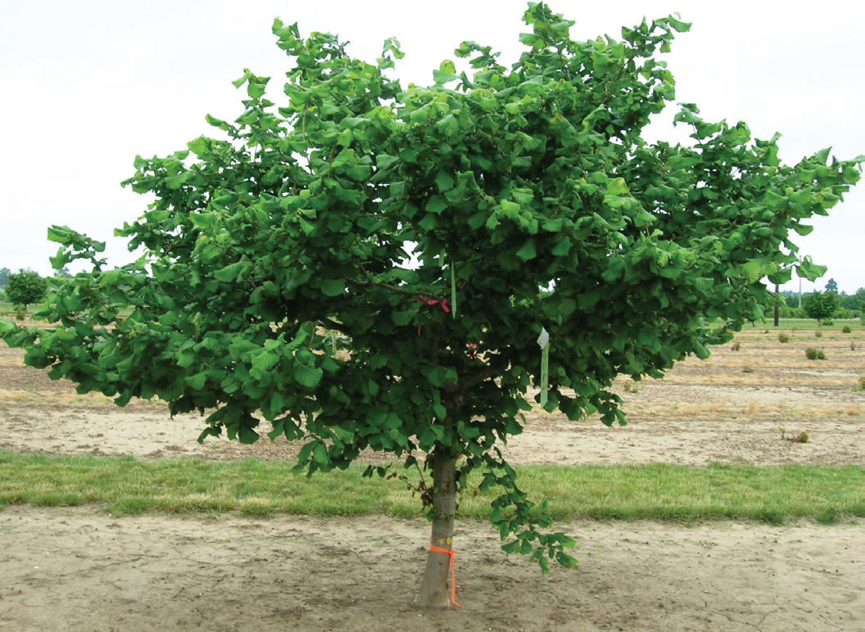
Hazelnut
(Corylus sp.)
Focal entities:
Oregon State University (GRIN),
Rutgers University,
UW-Extension (UMHDI),
and The Arbor Day Foundation
Presently, viable cultivars and extension reports on BMPs are available but limited. Germplasm development work for disease resistances (blight and root rot) is still an ongoing focus.
midwesthazelnuts.org
ir.library.oregonstate.edu

Slide 4
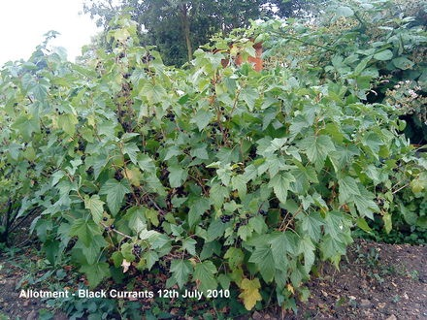
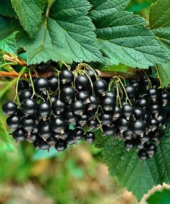
Currant
(Ribes sp.)
Focal entities:
Oregon State University (GRIN),
Guelph University,
Cornell University.
Plant material and management practices are abundantly available. The plant’s utility in polyculture settings is less known but may intercrop well shaded areas
growingfruitandveg.co.uk
currantc.com

Slide 5
Other potential supporting crops
American Persimmon
Shagbark Hickory
Pawpaw
American Plum
Pecan
Cornelian Cherry
Serviceberry
American Cranberry
Apple
Elderberry
wppresearch.org/
Chokeberry

Slide 6
Chestnuts in the U.S.
Cultivar Challenges and Work
Chestnut blight (Cryphonectria parasitica)
Source resistance and backcross
Root rot (Phytophthora cinnamomi)
Combined effort between TACF, Clemson, and NCS
Generate seedling pools containing root rot resistance
Add root rot resistance to blight resistance plants
Internal kernel breakdown (IKB)
forestpathology.org
acffarms.org/
missouribotanicgarden.org

Slide 7
Chestnuts in the U.S.
Cultivar Challenges and Work
Chestnut blight (Cryphonectria parasitica)
Source resistance and backcross
Root Rot (Phytophthora cinnamomi)
Combined effort between ACF, Clemson, and NCS
Generate seedling pools containing root rot resistance
Add root rot resistance to blight resistance plants
Internal kernel breakdown (IKB)
chestnuts.msu.edu/pest
chestnuts.msu.edu/pest
fitnessmotivation.us/tag/phytophthora

Slide 8
Chestnuts in the U.S.
Cultivar Challenges and Work
Chestnut Blight (Cryphonectria parasitica)
Source resistance and backcross
Root Rot (Phytophthora cinnamomi)
Combined effort between ACF, Clemson, and NCS
Generate seedling pools containing root rot resistance
Add root rot resistance to blight resistance plants
Internal kernel breakdown (IKB)
chestnuts.msu.edu

Slide 9
Chestnuts in the U.S.
Market Challenges and Work
Moving past infancy (journal articles).
“A majority of producers have been in business less than ten years and trees are just entering commercial productivity.”
“Around 1.5 million lbs. of production in the U.S.” (2011).
Two summares of the state of U.S. Chestnuts.
Warmund, M. R. Chinese Chestnut (Castanea mollissima) as a Niche Crop in the Central Region of the United States. (2011). HortScience, 46: 345-347.
Chestnut Marker Analysis: Producers Perspective
chestnuts.msu.edu

Slide 10
Chestnuts in the U.S.
Market Challenges and Work
Chestnut Growers, Inc.
Cooperative aggregator and processor
Enterprise budget tools & resources
Before getting started (MSU)
Cost of production tool (MSU)
chestnutgrowersinc.com/about.shtml

Slide 11
Hazelnuts in the U.S.
Cultivar Challenges and Work
oregonstate.edu
Eastern Filbert Blight (EFB) (Anisogramma anomala)
NW vs. MW vs. NE
Hybrid hazelnut consortium
Winter hardiness
Plant trait uniformity and propagation
agproducts.rutgers.edu
http://www.arborday.org/
http://www.arborday.org/
C. americana
C. cornuta

Slide 12
Hazelnuts in the U.S.
Cultivar Challenges and Work
Eastern Filbert Blight (EFB) (Anisogramma anomala)
Winter hardiness
Needed for NW and NE cultivars to transfer to the MW
Plant trait uniformity and propagation
http://www.arborday.org/
C. americana
C. cornuta
http://www.arborday.org/

Slide 13
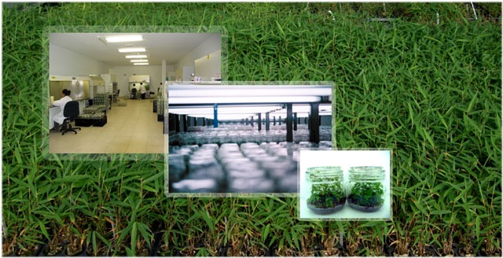
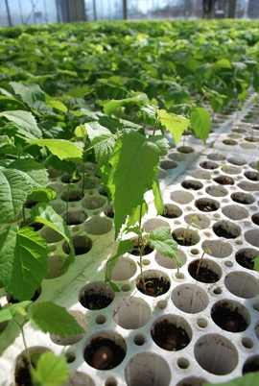
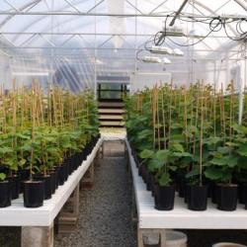
Hazelnuts in the U.S.
Cultivar Challenges and Work
naplants.com/
Eastern Filbert Blight (EFB) (Anisogramma anomala)
Winter hardiness
Plant trait uniformity and propagation
Tissue cultivar is available for a select group of viable NW cultivars developed at OSU.
Hybrids in the MW and most accessions in the NE do not yet have commercial viable asexual propagation.
Plants available for purchase in the MW and NE are typically grown from seed generate from narrowly selected parent plants.
arborday.org/
ruralnetwork.ca/
growinghazelnuts.com

Slide 14
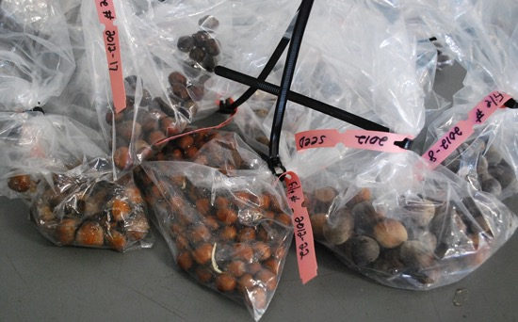
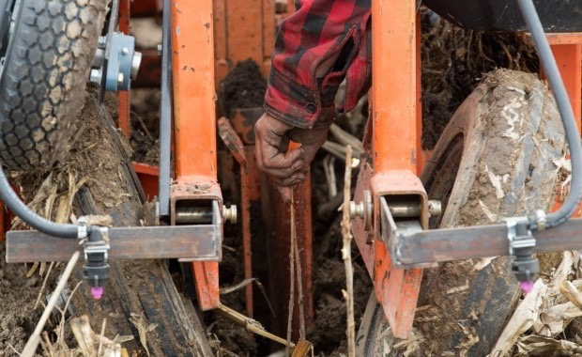
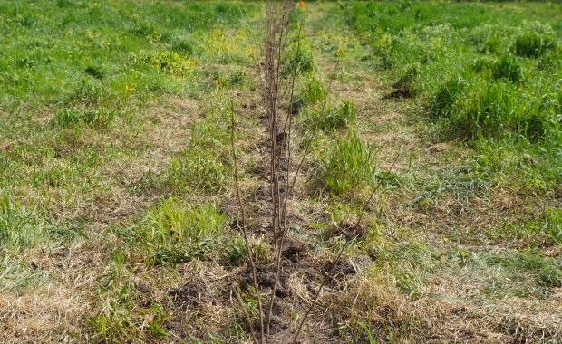
Hazelnuts in the U.S.
Cultivar Challenges and Work
Eastern Filbert Blight (EFB) (Anisogramma anomala)
Winter hardiness
Plant trait uniformity and propagation
Tissue cultivar is available for a select group of viable NW cultivars developed at OSU.
Hybrids in the MW and most accessions in the NE do not yet have commercial viable asexual propagation.
Plants available for purchase in the MW and NE are typically grown from seed generate from narrowly selected parent plants.
blog.liedlodge.org
http://midwest-ars.com/tree-planting/
http://midwest-ars.com/tree-planting/
http://midwest-ars.com/tree-planting/

Slide 15
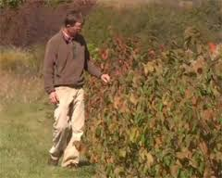
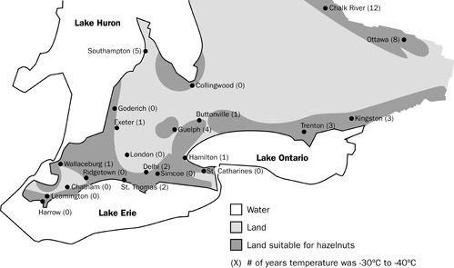
Hazelnuts in the U.S.
Market Challenges and Work
The chicken before the egg…
Upper Midwest Hazelnut Development Initiative
American Hazelnut Company
Ferreo in Ontario
900,000 sq. ft. industrial food facility that imports 12 million lbs. of hazelnuts annually.
Other business local to Ontario purchase $ 5 million in hazelnut annually.
University of Guelph & Dr. Adam Dale.
Ontario hazelnut association
American Hazelnut Company Now Recruiting Grower-Members
http://www.midwesthazelnuts.org/
Ontario Ministry of Ag, Food...

Slide 16
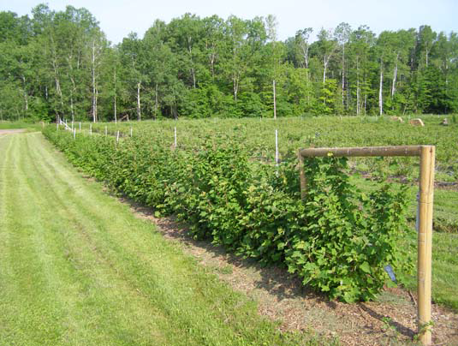
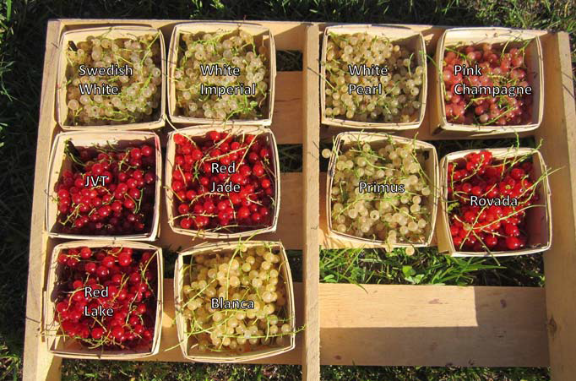
Currants in the U.S.
Cultivar Challenges and Work
Cultivars are readily available for NA
Major diseases have been addressed (WPBR & PWM). Bans still exist in 12 states
Some cultivars cater to specific markets (i.e. juice, culinary ingredient, whole fruit, wine etc.)
A broad spectrum of information is available at GRIN
European production is steady
1017 t in 2005
Ribes potential in American markets
Adam Dale (2000)
bmlindwpbr.blogspot.com
UW-extension @ Bayfield
ars-grin.gov/cor/ribes/
UW-extension @ Bayfield

Slide 17
Ron Revord
University of Illinois
M.S. Student in Plant Breeding and Genetics
Co-Founder, Vice-President of the Savanna Institute.
Agroecology and Sustainable Agriculture Program Scholar

