Slide 1
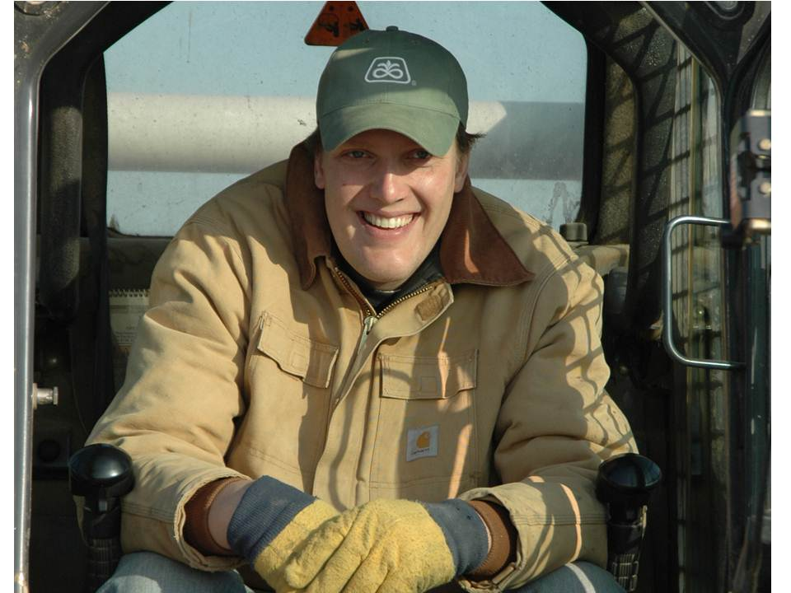
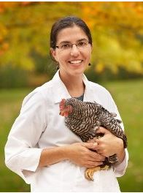
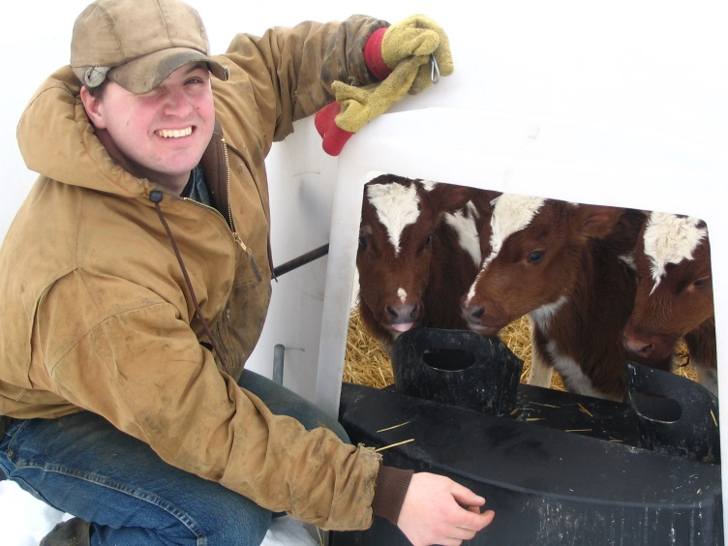
Planning for Organic Transition
Rory Beyer, Organic Dairy Farmer, Saint Charles MN
Gigi DiGiacomo, Department of Applied Economics, University of Minnesota
Nathan Walter, Organic Dairy Farmer, Villard MN
Minnesota Organic Conference, Friday, January 8, 1:15 – 2:15 pm

Slide 2
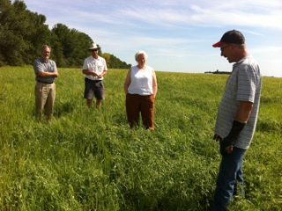
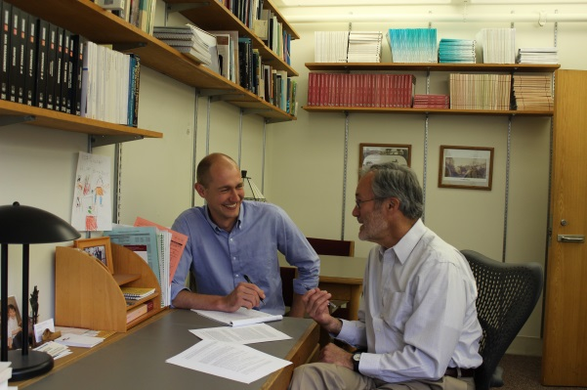
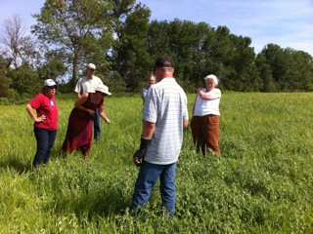
Session Overview
About the Tools for Transition Project
Transition Planning Tools
Business Planning Basics to Assist with Transition
Farmer Panel Discussion: Transition Challenges, Strategies

Slide 3
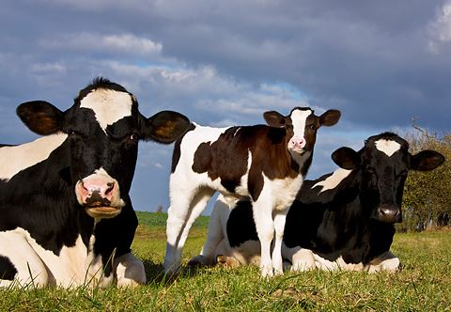
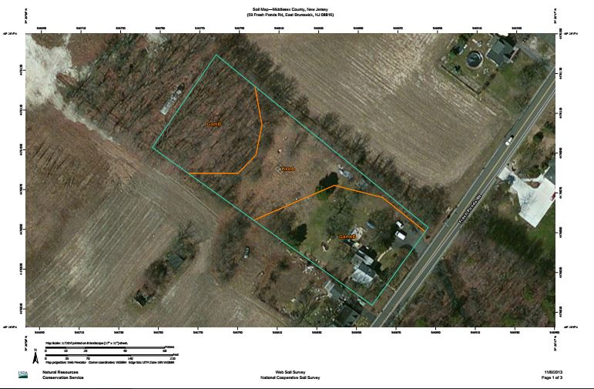
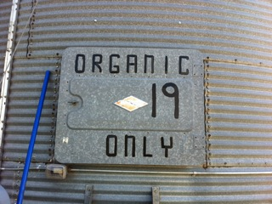
Tools for Transition Project
Project duration: September 2010 – August 2015
Objective: Learn about farm finances during transition; develop tools to assist with transition planning
47 row crop, dairy, cattle, processing farm businesses (36 transitioning)
4,700 acres in transition; 9,180 acres certified organic; 4,995 conventional acres
692 cows in transition; 1,525 cows certified organic; 255 conventional cows

Slide 4
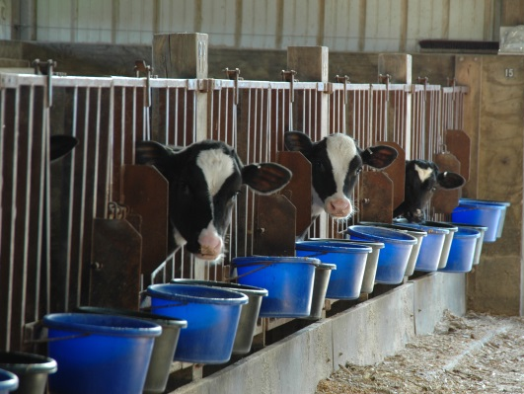
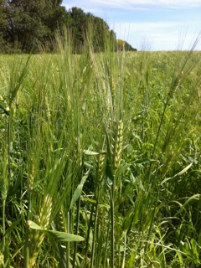
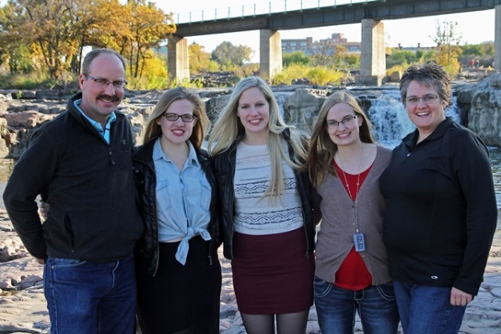
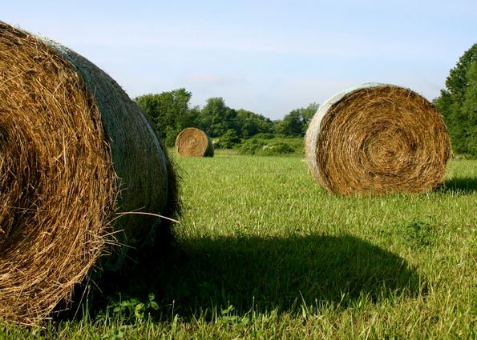
Tools for Transition Project
Research:
Annual financial analysis
Annual surveys
Intake surveys
Whole farm and enterprise studies
Notes:
Tools = FINBIN Data, Planner, AgPlan Software

Slide 5
Tools for Transition Project
Minnesota farmers reported many challenges during transition. Those ranked as a “big” or “medium” problem include:
1. Overall time requirements
2. Access to capital, financing
3. Risk management
4. Profitability
5. Cash flow
6. Recordkeeping requirements
7. Identifying buyers (esp. for small grains)
8. Organic price volatility
9. Proximity to markets

Slide 6
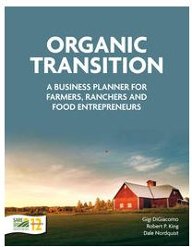
Business Planning Basics
Why transition? (p. 21)
What do you bring to transition? Describe your history and current situation. (pgs. 37-59)
What are your goals for transitioning? Outline future vision and what you need for transition to be “successful.” (p. 65)
How will you transition? Identify strategies for operations, marketing, human resources, and finances. (pgs. 106-140)
Notes:
Before developing a business plan – for transition or any other reason - you will need to identify strategies and test feasibility. .

Slide 7
Business Planning Strategies
Research suggests the following whole farm strategies used during transition:
Full: Transition all livestock and land at once.
Gradual: Transition land one field at a time with the intention of eventually certifying all livestock and land.
Immediate: Certify former conservation land or other land that has not been actively farmed for three years or less with little or no transition period.
Split: Manage some land conventionally and some land organically as a long-term strategy.
Notes:
Before developing a business plan – for transition or any other reason - you will need to identify strategies and test feasibility. .

Slide 8
Is Your Plan Feasible?
Test strategy for feasibility; successful outcomes.
If strategy is feasible, develop a written business plan.
If strategy is not feasible (or if you’re not sure), revisit plan, assumptions, strategies. You may decide, after planning, that organic transition is not the right decision for you at this time.

Slide 9
Transition Business Plan
Outline
Executive Summary
Business Description
Operations: current management and transition strategy
Marketing: current practices and transition strategy
Human Resources: current management and transition strategy
Finances: current performance, transition strategy, and capital request
Appendices: OSP, marketing contracts, tax returns, etc.
Notes:
What is a business plan? Dynamic document that guides business decisions, communicates plans to others. See how three farmers organized their plans in Planner.

Slide 10
AgPlan Software
Available for FREE from the Center for Farm Financial Management: http://cffm.umn.edu/
Business plan outlines for:
1. Conventional Farms
2. Transition-to-Organic Farms
3. Value Added Farms
Software provides:
1. Tips
2. Resources
3. Examples

Slide 11
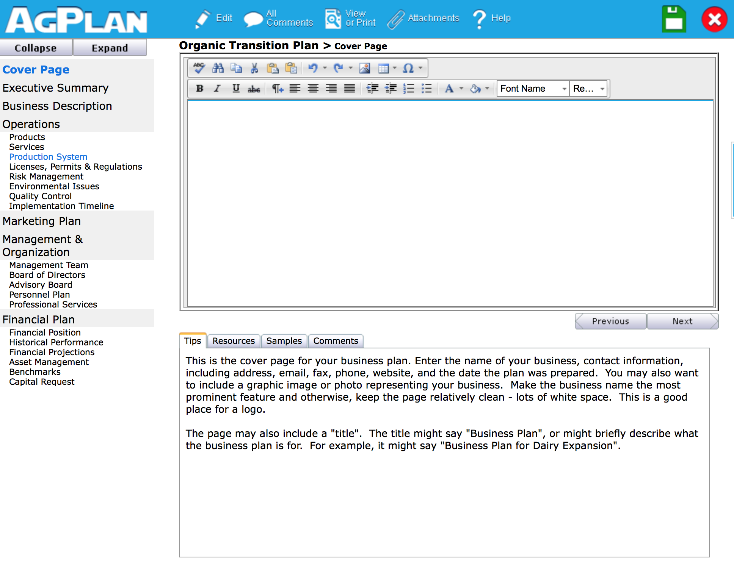
AgPlan Software

Slide 12
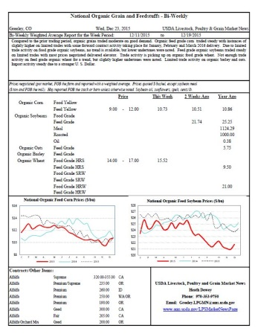
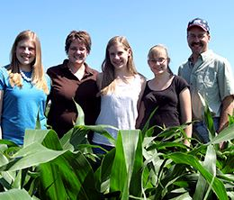
Other Transition Planning Tools
FINBIN database
National Organic Grain and Feedstuffs Price Report
Planner Spreadsheets
Planning Team!

Slide 13
Websites
Tools for Transition: http://eorganic.info/group/7820
Minnesota Institute for Sustainable Agriculture: http://www.misa.umn.edu/

Slide 14
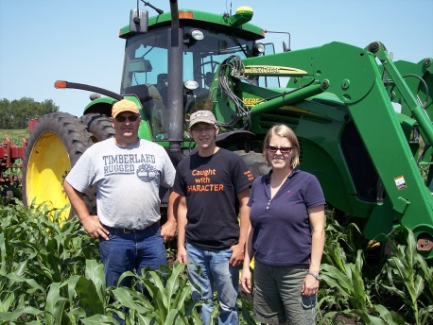
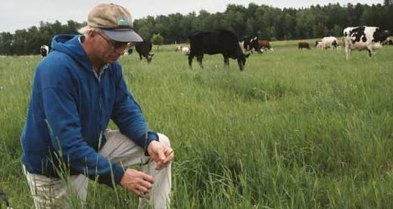
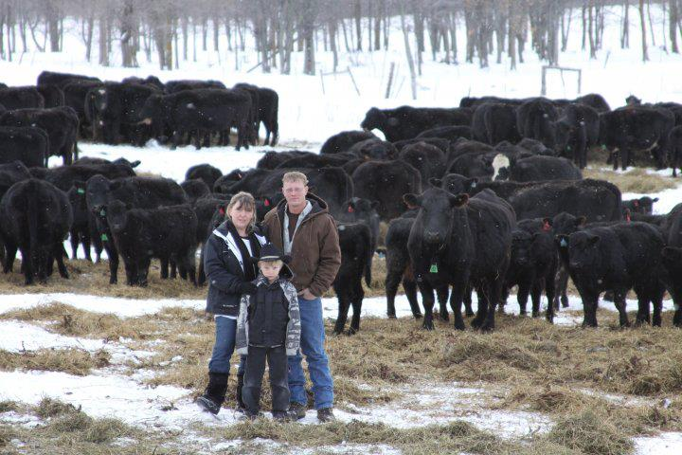
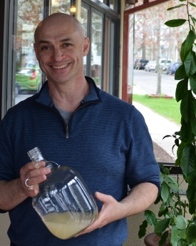
Farmer Panel Discussion
Farm Description and History
What Aspect of Transitioning Was the Most Challenging?
How Did You Plan for Transition?
Notes:
Wrap up discussion with idea that business planning can help you identify, anticipate, and plan for some of the challenges ahead of time.

Slide 15
More Info?
Contact Gigi DiGiacomo
gigid@umn.edu
612-624-7258

